Slide 1
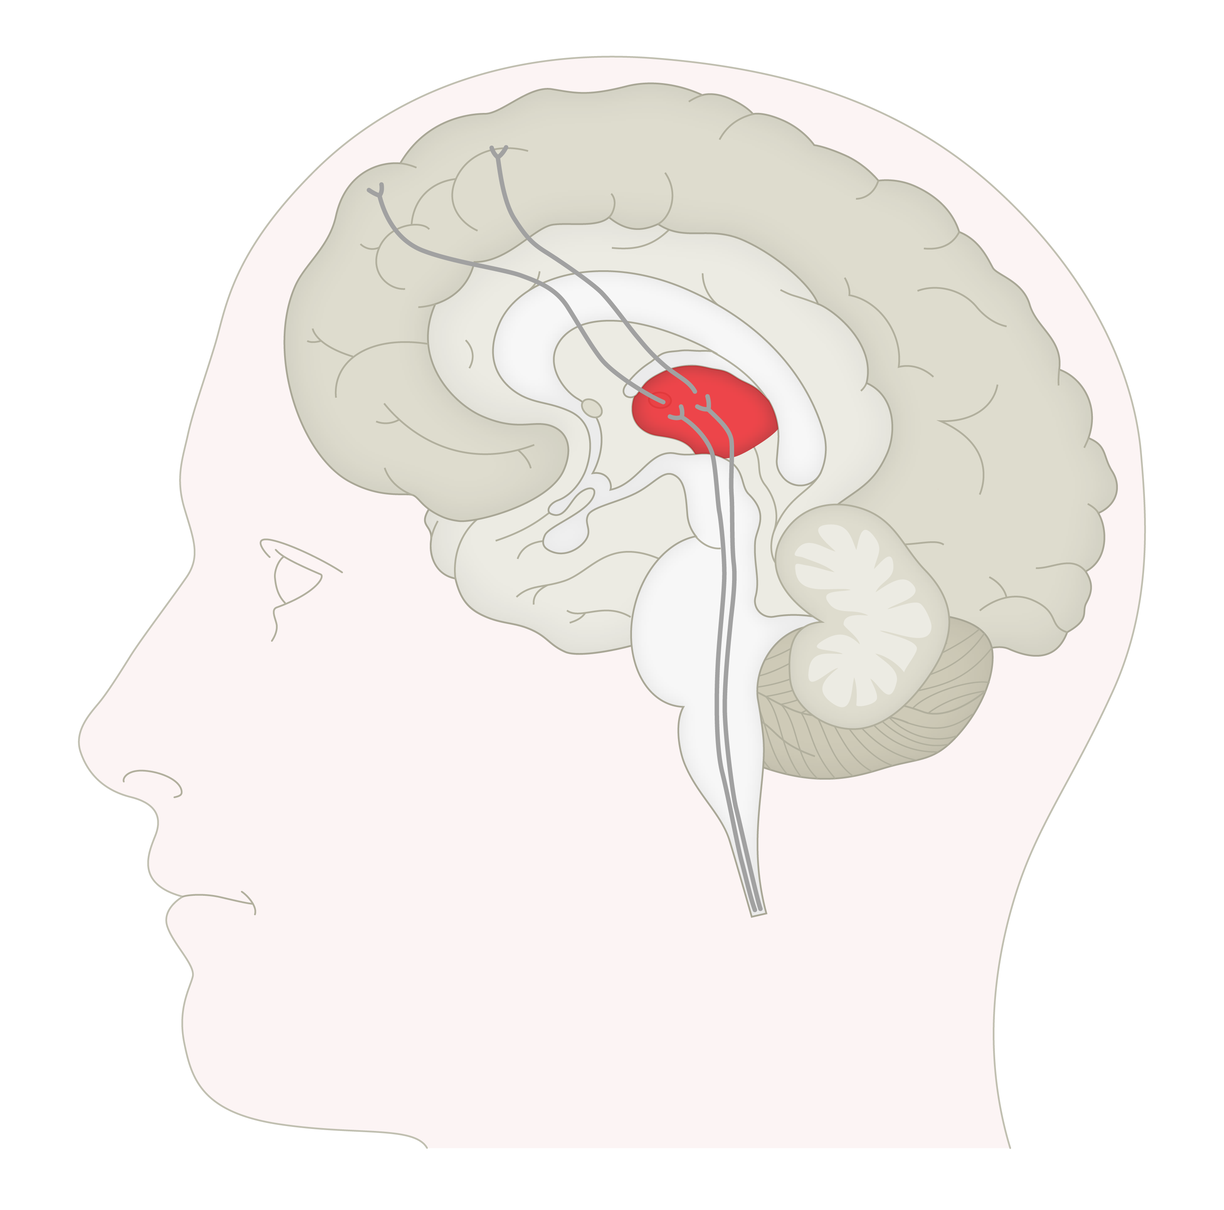
Migraine pathogenesis and the role of CGRP – thalamus
Migraine
Thalamus
Second-order neurons project from the TNC to third-order neurons in the thalamus^{1,2}
From the thalamus, ascending inputs are integrated and relayed to the cortex²
The thalamus appears to be critical for several processes underlying migraine:³
  Allodynia and central sensitisation – an increased neural response following normally non-painful stimulation
  Photophobia – experience of discomfort or pain on exposure to light
CGRP=calcitonin gene-related peptide; TNC=trigeminal nucleus caudalis
1. Purves et al. Neuroscience. 6th edition. 2018
2. Russo. Annu Rev Pharmacol Toxicol 2015;55:533–552
3. Younis et al. Cephalalgia 2019;39(13):1675–1682
Notes:
The thalamus is a structure in the brain that relays sensory information (including pain) from the body to the cerebral cortex.^{[Purves et al., 2018]} The thalamus is highly complex but organised, such that the incoming signals remain segregated, based on the type of somatosensory information that is conveyed.^{[Purves et al., 2018]}
Experiments have shown that the cortical trajectories of trigeminovascular neurons are defined by the thalamic nucleus of origin, suggesting separate roles for these pathways in discriminating elements of migraine such as location and intensity of pain, and in symptoms such as phonophobia and photophobia.^{[Noseda & Burstein, 2013]}
References:
Noseda R, Burstein R. Migraine pathophysiology: anatomy of the trigeminovascular pathway and associated neurological symptoms, CSD, sensitization and modulation of pain. Pain 2013; 154 (Suppl 1).
Purves D, Augustine GJ, Fitzpatrick D, et al. Neuroscience, 6th edition. New York, New York: Oxford University Press, 2018.
Other references used on slide:
Russo AF. Calcitonin gene-related peptide (CGRP): a new target for migraine. Annu Rev Pharmacol Toxicol 2015; 55: 533–552.
Younis S, Hougaard A, Noseda R, Ashina M. Current understanding of thalamic structure and function in migraine. Cephalalgia 2019; 39 (13): 1675–1682.

