Slide 1
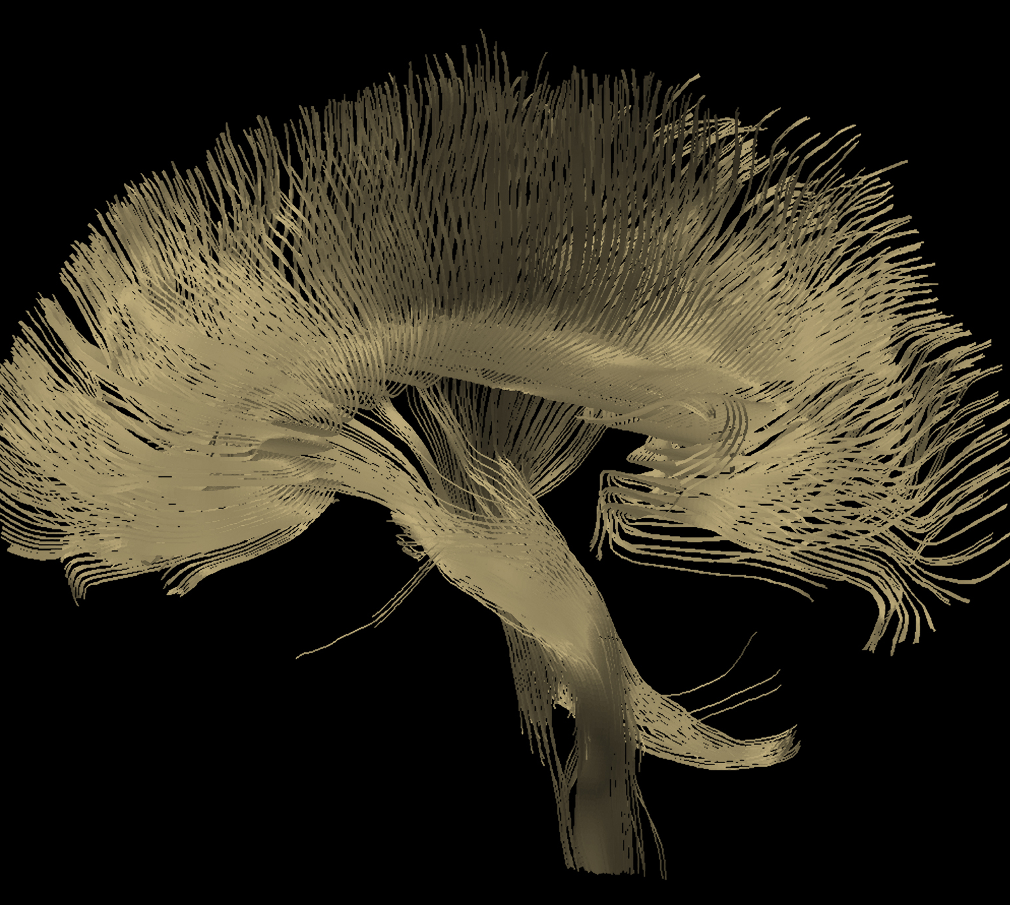
Migraine
Neurobiology and aetiology

Slide 2
Pain and nociception
Migraine

Slide 3
Pain
Migraine
The normal perception of pain is an important element of evolutionary survival – protecting from, and avoiding, tissue damage:¹
  Allowing rapid detection of a noxious stimulus
  Leading to removal of noxious stimuli where possible
  Commonly resulting in learning and memory of the stimuli or action
Acute pain is a warning sign, signalling that something is wrong, and that harm is occurring to the individual²
Acute pain would normally result in the individual stopping the activity that was causing pain²
Over time, if the pain persists and becomes chronic, it is a less useful signal because the likelihood of injury occurring with the activity has ceased²
1. Urch. Rev Pain 2007;1(1):2–6;
2. Steeds. Surgery 2016;34(2):55–59
Notes:
There have been many attempts to classify and define pain, and discussions about the nature of pain versus nociception.[Kumar & Elavarasi, 2016; Treede, 2018] In 1979, the International Association for the Study of Pain (IASP) defined pain as “an unpleasant sensory and emotional experience associated with actual or potential tissue damage, or described in terms of such damage”.^{[Merskey et al., 1979]} Subsequent attempts have been made to reach a more exacting definition, including by introducing elements of the individual’s perception and interpretation of the feeling of pain.[Kumar & Elavarasi, 2016; Cohen et al., 2018]
A distinction is sometimes drawn between pain and nociception: pain is a subjective experience,^{[Kumar & Elavarasi, 2016]} whereas nociception is the process within the nervous system that responds to the noxious stimuli.^{[Treede, 2018]} In this sense, pain is from the first-person perspective, whilst nociception is from the third-person perspective.^{[Treede, 2018]}
References:
Cohen M, Quintner J, van Rysewyk S. Reconsidering the International Association for the Study of Pain definition of pain. Pain Rep 2018; 3 (2): e634.
Kumar KH, Elavarasi P. Definition of pain and classification of pain disorders. J Adv Clin Res Insight 2016; 3 (3): 87–90.
Merskey H, Albe Fessard D, Bonica JJ, et al. Pain terms: a list with definitions and notes on usage. Recommended by the IASP subcommittee on taxonomy. PAIN 1979; 6: 249–252.
Treede RD. The International Association for the Study of Pain definition of pain: as valid in 2018 as in 1979, but in need of regularly updated footnotes. Pain Rep 2018; 3 (2): e643.
Other references used on slide:
Steeds CE. The anatomy and physiology of pain. Surgery 2016; 34 (2): 55–59.
Urch C. Normal pain transmission. Rev Pain 2007; 1 (1): 2–6.

Slide 4


Regulation of pain
Migraine
Regulation of pain¹⁻³
Ascending pathway³
The ascending pathway transmits pain signals to the brain, where the sensation is localised
Descending pathway³
The descending pathway regulates the signals of the ascending pathway, thereby downregulating and modulating pain signals
3rd order neuron
2nd order neurons
Brain
1st order neuron
Midbrain –
Locus coeruleus and periaqueductal grey matter
Spinal cord
Cross section of spinal cord
1. Purves et al. Neuroscience. 6th edition. 2018;
2. Urch. Rev Pain 2007;1(1):2–6;
3. Steeds. Surgery 2016;34(2):55–59
Notes:
Transmission of pain involves a complex series of interactions, described on the slide.^{[Steeds, 2016]} First-order, afferent neurons convey the signal from the site of injury, and synapse with second-order neurons in the dorsal horn of the spinal cord.^{[Steeds, 2016]} Tracts of neurons ascending the spinal cord convey the signal towards the brain, where it is processed in the thalamus, and sent onwards to the cortex.^{[Steeds, 2016]} The ascending pathway, which transmits sensations of pain to the brain, is regulated by neurons that descend from the brainstem – the descending pathway.^{[Steeds, 2016]} These noradrenergic and serotonergic neurons downregulate the activity of neurons of the dorsal horn, thereby modulating the feeling of pain.^{[Steeds, 2016]}
Reference:
Steeds CE. The anatomy and physiology of pain. Surgery 2016; 34 (2): 55–59.
Other references used on slide:
Purves D, Augustine GJ, Fitzpatrick D, et al. Neuroscience, 6th edition. New York, New York: Oxford University Press, 2018.
Urch C. Normal pain transmission. Rev Pain 2007; 1 (1): 2–6.

Slide 5
Regulation of pain – the ascending pathway
Migraine
Detection of an initial noxious stimulus is transmitted to the dorsal horn of the spinal cord via afferent, sensory neurons^{1,2}
The majority of afferent inputs to the dorsal horn synapse with interneurons in the spinal cord, allowing modulation of the signal²
Interneurons then synapse with the neurons of the spinothalamic tract, transmitting the signal to the brain via the spinal cord²
Within the brain, the signal is received in the thalamus; from here it is transmitted to the area of the cortex that corresponds to the location of the body from where the pain originated – in this way, the pain feels localised^{1,2}
The ascending pathway¹⁻³
3. Pain is localised in the cerebral cortex
3rd order neuron
2nd order neurons
Brain
1st order neuron
Spinal cord
Cross section of spinal cord
1. Sensory input received at the dorsal horn of the spinal cord
2. Message transmitted to the brain through the spinothalamic tract via interneurons
1. Purves et al. Neuroscience. 6th edition. 2018;
2. Urch. Rev Pain 2007;1(1):2–6;
3. Steeds. Surgery 2016;34(2):55–59
Notes:
Transmission of pain involves a complex series of interactions, described on the slide.^{[Steeds, 2016]} First-order, afferent neurons convey the signal from the site of injury, and synapse with second-order neurons in the dorsal horn of the spinal cord.^{[Steeds, 2016]} Tracts of neurons ascending the spinal cord convey the signal towards the brain, where it is processed in the thalamus, and sent onwards to the cortex.^{[Steeds, 2016]}
Reference:
Steeds CE. The anatomy and physiology of pain. Surgery 2016; 34 (2): 55–59.
Other references used on slide:
Purves D, Augustine GJ, Fitzpatrick D, et al. Neuroscience, 6th edition. New York, New York: Oxford University Press, 2018.
Urch C. Normal pain transmission. Rev Pain 2007; 1 (1): 2–6.

Slide 6
Regulation of pain – the descending pathway
Migraine
Pathways descending from the brainstem are important in regulating and modulating pain^{1,2}
Descending pathway neurons use noradrenaline and serotonin^{2,3}
Neurons in the descending pathway may control pain via:³
  Direct actions on dorsal horn cells
  Inhibition of excitatory dorsal horn neurons
  Excitation of inhibitory dorsal horn neurons
Additionally, interneurons in the spinal cord provide tonic inhibition by the release of endogenous opioids, enkephalins²
The ascending and descending pathways¹⁻³
3rd order neuron
2nd order neurons
Brain
1st order neuron
Midbrain –
Locus coeruleus and periaqueductal grey matter
Descending pathways downregulate signalling in the dorsal horn
Spinal cord
-
Cross section of spinal cord
-
Interneurons release endogenous opioids
1. Purves et al. Neuroscience. 6th edition. 2018;
2. Urch. Rev Pain 2007;1(1):2–6;
3. Steeds. Surgery 2016;34(2):55–59
Notes:
The ascending pathway, which transmits sensations of pain to the brain, is regulated by neurons that descend from the brainstem – the descending pathway.^{[Steeds, 2016]} These noradrenergic and serotonergic neurons downregulate the activity of neurons of the dorsal horn, thereby modulating the feeling of pain.^{[Steeds, 2016]}
Reference:
Steeds CE. The anatomy and physiology of pain. Surgery 2016; 34 (2): 55–59.
Other references used on slide:
Purves D, Augustine GJ, Fitzpatrick D, et al. Neuroscience, 6th edition. New York, New York: Oxford University Press, 2018.
Urch C. Normal pain transmission. Rev Pain 2007; 1 (1): 2–6.

Slide 7
The spinal cord
Migraine
First-order afferent neurons form synapses with second-order neurons in the dorsal horn of the spinal cord¹
This glutamatergic interaction is heavily regulated, with competing excitatory and inhibitory signals¹⁻³
Excitatory signals
Tachykinins activate G-protein coupled receptors enhancing excitation of second-order neurons in the spinal cord³
CGRP binds to its receptor and activates PKA, thereby enhancing pain signalling³
Certain excitatory signalling molecules of the spinal cord (such as some tachykinins, and CGRP) can also initiate inflammatory processes³
Inhibitory signals
The endogenous opioids enkephalin and dynorphin inhibit the release of excitatory neurotransmitters³
Neuropeptide Y is thought to be synthesised by neurons of the dorsal root ganglion and, when released, inhibit nociceptive signals⁴
Signals in the spinal cord¹⁻³
NA/5-HT
+
Higher centres
3rd order neuron
Control
neuron
-
R
P
U
S
C
A
L
L
O
S
U
Perception of pain
Sensory input
C
O
M
Brain
2nd order neurons
NA/5-HT
1st order neuron
Enkephalin
1st order
neuron
-
2nd order
neuron
Glutamate
Descending pathways downregulate signalling in the dorsal horn
+
Tachykinins
Spinal cord
-
Cross section of spinal cord
-
Interneurons release endogenous opioids
5-HT=5-hydroxytryptamine (serotonin); CGRP=calcitonin gene-related peptide; NA=noradrenaline; PKA=protein kinase A
1. Steeds. Surgery 2016;34(2):55–59; 2. Urch. Rev Pain 2007;1(1):2–6;
3. Yam et al. Int J Mol Sci 2018;19(8):E2164; 4. Diaz del Castillo et al. Neuroscience 2018;387:162–169
Notes:
Modulation of pain signals in the spinal cord is achieved by fine-tuning the various positive and negative signals that control the interaction of the first-order neuron with the second-order neuron.[Steeds, 2016; Urch, 2007; Purves et al., 2018] Within the dorsal horn of the spinal cord, there are some projections from the brainstem that directly interact with neurons of the pain pathway, whereas other modulatory projections interact indirectly, via enkephalin-releasing local circuit neurons.[Purves et al., 2018; Yam et al., 2018; Diaz del Castillo et al., 2018]
References:
Diaz del Castillo M, Woldbye DPD, Heegaard AM. Neuropeptide Y and its involvement in chronic pain. Neuroscience 2018; 387: 162–169.
Purves D, Augustine GJ, Fitzpatrick D, et al. Neuroscience, 6th edition. New York, New York: Oxford University Press, 2018.
Steeds CE. The anatomy and physiology of pain. Surgery 2016; 34 (2): 55–59.
Urch C. Normal pain transmission. Rev Pain 2007; 1 (1): 2–6.
Yam MF, Loh YC, Tan CS, et al. General pathways of pain sensation and the major neurotransmitters involved in pain regulation. Int J Mol Sci 2018; 19 (8): E2164.

Slide 8
Nociception
Migraine
Two types of receptors can be activated by noxious stimuli:¹
  High-threshold mechanoreceptors – which respond to mechanical deformation
  Polymodal nociceptors – which respond to a variety of tissue-damaging stimuli, e.g., cytokines, histamine, leukotrienes
There are two types of fibres that then carry nociceptive information:¹
  Aδ-fibres – myelinated, fast-conducting neurons that result in a localised, rapid, prickling feeling of pain
  C-fibres – non-myelinated, slow-conducting neurons that result in a poorly localised, dull, aching feeling of pain
Abnormal pain
Not all pain is nociceptive (i.e., pain arising from identifiable tissue damage)¹
Neuropathic pain can result from motor, sensory, or autonomic dysfunction¹
Neuropathic pain is often described as ‘burning’, ‘stabbing’, or a ‘numb’ sensation¹
Neuropathic pain can arise from damage to peripheral neurons, or from damage to the central nervous system¹
Some have suggested that migraine can be described as a form of neuropathic pain, whereby an otherwise intact nervous system responds abnormally to non-noxious stimuli²
1. Steeds. Surgery 2016;34(2):55–59; 2. Chakravarty & Sen. Med Hypotheses 2010;74(2):225–231
Notes:
In the last century, neurons have been classified according to conduction velocity, into groups A, B, and C.^{[Purves et al., 2018]} However, as more became known about neurons, different classifications arose within the groups, and entirely different groups arose for classification of motor neurons.^{[Purves et al., 2018]} The terms are still used for nociceptors; A-fibres are fast-conducting neurons that transmit sensory information about touch, pain, and temperature, whereas C-fibres are slow-conducting non-discriminating neurons that transmit sensory information about touch, pain, temperature, and itch sensations.^{[Purves et al., 2018]}
Reference:
Purves D, Augustine GJ, Fitzpatrick D, et al. Neuroscience, 6th edition. New York, New York: Oxford University Press, 2018.
Other references used on slide:
Chakravarty A, Sen A. Migraine, neuropathic pain and nociceptive pain: towards a unifying concept. Med Hypotheses 2010; 74 (2): 225–231.
Steeds CE. The anatomy and physiology of pain. Surgery 2016; 34 (2): 55–59.

Slide 9
The pathology of migraine
Migraine

Slide 10
The pathophysiology of migraine has emerged from a historical consideration of the “humors” through mid-20th century distraction of the now defunct vascular theory to a clear place as a neurological disorder
Goadsby et al. Physiol Rev 2017;97(2):553–622
Notes:
Reference used on slide:
Goadsby PJ, Holland PR, Martins-Oliveira M, et al. Pathophysiology of migraine: a disorder of sensory processing. Physiol Rev 2017; 97 (2): 553–622.

Slide 11
Timeline of migraine research
Migraine
CGRP first proposed to play a role in migraine
1985
1986
Discovery of the trigeminovascular reflex: a physiological role for CGRP
Vasodilation in migraine,
and ergot therapies
First measurement of CGRP released by trigeminal stimulation in humans
CGRP antibodies made to measure and localise CGRP in the trigeminal–cerebrovascular system, where CGRP was found to be a potent vasodilator
1988
1938
1984
Triptan shown to normalise CGRP levels during acute migraine attack
PET studies highlight the importance of the brainstem
Characterisation of the multicomponent CGRP receptor that consists of CALCRL, RAMP1 and RCP
Isolation and clinical testing of an ergot alkaloid
Lashley’s description of spreading scotoma
Discovery
of CGRP
1918
1941
Spreading oligaemia in migraine with aura
1981
1982
1993
1995
1998
1940
1959
Oligaemia in the wake of CSD in rats
1982
1984
1988
1994
1996
2002
Identification of
pain-sensitive structures in the brain
Serotonin – serum
(‘sero’) vasoconstrictor (‘tonin’) factor
Neurogenic inflammation theory of migraine
Discovery
of proto-
typical
triptan
Demonstration that CGRP release by trigeminal activation is inhibited by triptans
Gene for
familial hemiplegic
migraine identified
Infusion of CGRP shown to trigger migraine attack in people prone to migraine
Presence of CGRP confirmed in human cerebral vasculature
1987
1944
2000
Leão’s experiments into CSD
New headache classification from IHS
1988
Characterisation of the gepants
First demonstration in people with migraine that CGRP is released during an acute migraine attack
1996
1990
Meningeal sensitisation,
central sensitisation and allodynia
CALCRL=calcitonin receptor-like receptor; CGRP=calcitonin gene-related peptide;
CSD=cortical spreading depression (or depolarisation); IHS=International Headache Society;
PET=positron emission tomography; RAMP1=receptor activity-modifying protein 1; RCP=receptor coupling protein
Adapted from: Edvinsson et al. Nat Rev Neurol 2018;14(6):338–350; Tfelt-Hansen & Koehler. Headache 2011;51(5):752–778
Notes:
Over the last century, there has been much progress in understanding the pathology underlying migraine.^{[Tfelt-Hansen & Koehler, 2011]} Key scientific and clinical milestones are detailed on the slide, including some of the key events in the development of migraine therapies that target CGRP.[Tfelt-Hansen & Koehler, 2011; Edvinsson et al., 2018]
References:
Edvinsson L, Haanes KA, Warfvinge K, Krause DN. CGRP as the target of new migraine therapies - successful translation from bench to clinic. Nat Rev Neurol 2018; 14 (6): 338–350.
Tfelt-Hansen PC, Koehler PJ. One hundred years of migraine research: major clinical and scientific observations from 1910 to 2010. Headache 2011; 51 (5): 752–778.

Slide 12
Cortical spreading depression, aura and migraine
Migraine
Spreading depression describes a propagated slow wave of depolarisation of neurons and glia, followed by suppression of neural activity and eventual return to baseline¹
The phenomenon of CSD was first described by Leão, in the 1940s^{1,2}
At a similar time, Lashley published a description of spreading scotomas,ª which suggested a disruption in brain function and then a return to normal^{3,4}
Leão’s thorough experiments highlighted the similarity between CSD and the visual aura of migraine, leading to the hypothesis that CSD was the cause of migraine^{1,3}
CSD is likely to be the pathology underlying aura, based on the early experiments, and later MRI observations in humans⁵
However, key questions remain:^{1,6}
  What causes CSD in the first place?
  Does CSD occur in the brain during a migraine attack?
  What role does CSD play in migraine pathology?
More research is needed to fully explain the CSD phenomenon⁶
ªA scotoma is a small area of abnormally less sensitive or aberrant vision
CSD=cortical spreading depression (or depolarisation); MRI=magnetic resonance imaging
1. Charles & Brennan. Cephalalgia 2009;29(10):1115–1124; 2. Leão. J Neurophysiol 1944;7(6):359–390;
3. Close et al. Cephalalgia 2019;39(3):428–434; 4. Lashley. Arch NeurPsych 1941;46(2):331–339;
5. Tolner et al. Cephalalgia 2019;39(13):1683–1699; 6. McComas & Upton. Arq Neuropsiquiatr 2015;73(8):714–721
Notes:
Critics of CSD have long pointed out that, although observed in animal studies, CSD has not been consistently observed using electroencephalograms (EEG) in humans with migraine.^{[Charles & Brennan, 2010]} Furthermore, CSD would be expected to have quite profound effects on cognitive functioning – effects that are not universally observed in migraine.^{[Charles & Brennan, 2010]} Taken together, it is argued that migraine may involve cortical waves that are related to the CSD observed in animal models, but also that different types of cortical waves may propagate a signal through the cortex: so-called ‘astrocyte waves’.^{[Charles & Brennan, 2010]}
Reference:
Charles A, Brennan KC. The neurobiology of migraine. Handb Clin Neurol 2010; 97: 99–108.
Other references used on slide:
Charles A, Brennan KC. Cortical spreading depression – new insights and persistent questions. Cephalalgia 2009; 29 (10): 1115–1124.
Close LN, Eftekhari S, Wang M, et al. Cortical spreading depression as a site of origin for migraine: role of CGRP. Cephalalgia 2019; 39 (3): 428–434.
Lashley KS. Patterns of cerebral integration indicated by the scotomas of migraine. Arch NeurPsych 1941; 46 (2): 331–339.
Leão AAP. Spreading depression of activity in the cerebral cortex. J Neurophysiol 1944; 7 (6): 359–390.
McComas AJ, Upton ARM. Cortical spreading depression in migraine – time to reconsider? Arq Neuropsiquiatr 2015; 73 (8): 714–721.
Tolner EA, Chen SP, Eikermann-Haerter K. Current understanding of cortical structure and function in migraine. Cephalalgia 2019; 39 (13): 1683–1699.

Slide 13
Cortical spreading depression
Migraine
Simplified representation of cortical spreading depression (CSD)¹
1–2
2–3
3–4
Spreading depolarisation
Activity in ascending brainstem regionª
4–5
5–6
6–7
Time
Spreading depression describes a propagated slow wave of depolarisation of neurons and glia, followed by suppression of neural activity and eventual return to baseline²
ªRegions of the brainstem as defined by the authors
CSD=cortical spreading depression (or depolarisation)
1. Adapted from: Leão. J Neurophysiol 1944;7(6):359–390; 2. Charles & Brennan. Cephalalgia 2009;29(10):1115–1124
Notes:
The seminal publication of Aristides Leão in 1944 reported the experimental ability to temporarily suppress electrical activity in an area of the brain (specifically, a rabbit brain), and this suppression then slowly spread into neighbouring areas.^{[Leão, 1944]} This spreading could be blocked by physical incision in the cortex.[Leão, 1944; McComas & Upton, 2015] Later experiments explored the phenomenon more thoroughly, linking this CSD with vascular changes, and showing that CSD could occur in more superficial layers of the cortex.^{[McComas & Upton, 2015]}
References:
Leão AAP. Spreading depression of activity in the cerebral cortex. J Neurophysiol 1944; 7 (6): 359–390.
McComas AJ, Upton ARM. Cortical spreading depression in migraine – time to reconsider? Arq Neuropsiquiatr 2015; 73 (8): 714–721.
Other reference used on slide:
Charles A, Brennan K. Cortical spreading depression – new insights and persistent questions. Cephalalgia 2009; 29 (10): 1115–1124.

Slide 14
Evolving theories of migraine pathogenesis
Migraine
Vascular theories of migraine do not appear to provide a full explanation of the physiology of migraine:^{1,2}
  Vasodilation alone is not sufficient to trigger migraine symptoms
  Vasoconstriction alone is not sufficient to relieve migraine symptoms
The vascular theory of migraine has been described as “a great story wrecked by the facts”¹
Migraine is now considered to be a complex neurological disease with multiple processes whereby the brain loses control of its inputs^{3,4}
The many and varied symptoms experienced during migraine (e.g., cognitive, sensory [aura], autonomic, and affective), suggest that a migraine attack is a complex neurological disease involving multiple cortical, subcortical, and brainstem areas that regulate cognitive, sensory, autonomic, and affective functions³
1. Goadsby. Brain 2009;132(Pt 1):6–7; 2. Schytz et al. Brain 2009;132(Pt 1):16–25;
3. Burstein et al. J Neurosci 2015;35(17):6619–6629; 4. Goadsby et al. Physiol Rev 2017;97(2):553–622
Notes:
From the perspective of the patient, viewing migraine as a neural condition is potentially a good thing.^{[Goadsby, 2009]} The generation of vasoactive drugs that have been used in the treatment of migraine have the potential to cause vascular complications.^{[Goadsby, 2009]} Triptans, for example, carry prescribing precautions for individuals at risk of heart disease, who have cerebrovascular complications, or who have high blood pressure.^{[Imigran SPC, 2019]} Targeting the neurological processes underlying migraine, therefore, might lead to therapeutic options unhindered by vascular contraindications.^{[Goadsby, 2009]}
References:
Goadsby PJ. The vascular theory of migraine – a great story wrecked by the facts. Brain 2009; 132 (Pt 1): 6–7.
Imigran Radis 100 mg tablets. Summary of product characteristics. GlaxoSmithKline UK, October 2019.
Other references used on slide:
Burstein R, Noseda R, Borsook D. Migraine: multiple processes, complex pathophysiology. J Neurosci 2015; 35 (17): 6619–6629.
Goadsby PJ, Holland PR, Martins-Oliveira M, et al. Pathophysiology of migraine: a disorder of sensory processing. Physiol Rev 2017; 97 (2): 553–622.
Schytz HW, Birk S, Wienecke T, et al. PACAP38 induces migraine-like attacks in patients with migraine without aura. Brain 2009; 132 (Pt 1): 16–25.

Slide 15
The vascular theory of migraine
Migraine
The vascular theory of migraine proposes that pain results from vasodilation of cranial blood vessels – however, not all the data fit the hypothesis that vasodilation can cause migraine pain^{1,2}
The pain in migraine is typically a throbbing, pulsating pain.¹ This pulsating pain sensation has been linked to arterial pulsation in some studies, but not in others¹
A study of 63 people with migraine measured changes in cerebral blood flow and matched the timing of blood flow changes with aura and migraine symptoms:^{2,3}
  There was an increase in blood flow in people with migraine
  However, the onset of pain preceded this increase in cerebral blood flow, and the increased blood flow persisted after the migraine pain had abated
Moreover, studies of chemically induced migraine have failed to link the onset of increased blood flow with the onset of pain symptoms¹
More research is needed to fully understand the importance of vasodilation in migraine¹
1. Mason & Russo. Front Cell Neurosci 2018;12:233;
2. Charles & Brennan. Handb Clin Neurol 2010;97:99–108;
3. Olesen et al. Ann Neurol 1990;28(6):791–798
Notes:
One of the first therapies for migraine – an ergot alkaloid – works by vasoconstriction; this led to attempts to unravel the pathology of migraine by focussing on the vasculature.[Mason & Russo, 2018; Charles & Brennan, 2010] However, although vascular changes do occur during a migraine, it is not yet clear to what extent these changes cause, or are a result of, the migraine pathology and the resulting pain.^{[Mason & Russo, 2018]}
References:
Charles A, Brennan KC. The neurobiology of migraine. Handb Clin Neurol 2010; 97: 99–108.
Mason BN, Russo AF. Vascular contributions to migraine: time to revisit? Front Cell Neurosci 2018; 12: 233.
Other reference used on slide:
Olesen J, Friberg L, Olsen TS, et al. Timing and topography of cerebral blood flow, aura, and headache during migraine attacks. Ann Neurol 1990; 28 (6): 791–798.

Slide 16
The vasculature and migraine symptoms
Migraine
One hypothesis for the pathogenesis of migraine involves the interaction of immune cells and nociceptors in the dura mater – a highly vascularised and heavily innervated layer of the meninges¹
Direct evidence for this hypothesis is lacking, however a mechanism for vascular–neural cross-talk has been proposed:¹
  Distention of intracranial blood vessels, possibly from the dura mater, mechanically activates trigeminal perivascular afferent neurons that innervate portions of the face
  Activated neurons release molecules that cause mast cell activation and vasodilation of the nearby vessels in a feedback loop
  Mast cell activation increases vascular permeability and/or causes neuronal activation and neuropeptide release
  …which causes subsequent release of inflammatory mediators from the vessels that modulate sensory input
Model of vascular–neural coupling within the trigeminovascular microenvironment¹
Neurogenic inflammation
Inflammatory molecules from mast cells cause vasodilation, and
neuronal activation
Vasodilation
Neuronal activation
Leads to mechanical activation of neurons, vascular permeability, and neuron activation
Leads to increase in neurotransmitter/
neuropeptide release, and increase in vasodilation
1. Mason & Russo. Front Cell Neurosci 2018;12:233
Notes:
It has been argued that the therapeutic value of some vasoactive chemicals to treat migraine symptoms, and the fact that other vasoactive chemicals can cause migraine, means that vascular contributions to the pathology of migraine are more than peripheral.^{[Mason & Russo, 2018]} Indeed, whether or not the model outlined on the slide stands up against the new advances in migraine research, understanding the communication between blood vessels, neurons, and immune cells is important to fully comprehend migraine pathogenesis.^{[Mason & Russo, 2018]}
Reference:
Mason BN, Russo AF. Vascular contributions to migraine: time to revisit? Front Cell Neurosci 2018; 12: 233.

Slide 17
Inflammation and the role of the immune system
Migraine
Immune function may be important in migraine – a mutation known to cause familial hemiplegic migraineª affects a gene known to be expressed in astrocytes, which codes a Na⁺/K⁺ ATPase^{1,2}
Astrocytes are in close contact with neurons in the central nervous system, and are known to modulate both neural and vascular function:¹
  Astrocytes control vascular tone by releasing signalling molecules, resulting in either vasoconstriction or vasodilation
  Astrocytes also modulate neural function – astrocytes express several types of neurotransmitter receptor, and can release neurotransmitters
  Astrocytes are capable of propagating changes in calcium concentration from cell to cell
Some have argued that progression from episode to chronic migraine is driven in part by neurogenic neuroinflammation, involving proinflammatory cytokines and neuroinflammatory modulators, and the glial cells of the trigeminovascular system
(i.e., the system in which trigeminal neurons innervate cerebral blood vessels)^{3,4}
ªA rare subtype of migraine with aura
1. Charles & Brennan. Handb Clin Neurol 2010;97:99–108; 2. Vanmolkot et al. Eur J Hum Genet 2006;14(5):555–560;
3. Edvinsson et al. Nat Rev Neurol 2019;15(8):483–490; 4. Waeber & Moskowitz. Neurology 2005;64(10 Suppl 2):S9–S15
Notes:
Migraine has not classically been considered an inflammatory condition, perhaps because, other than pain, migraine is not obviously associated with signs of inflammation (redness, heat, and swelling).^{[Waeber & Moskowitz, 2005]} A question that immediately arises, then, is how to define neurogenic inflammation. Neurogenic inflammation is usually considered a phenomenon of vasodilation and of increased vascular permeability, caused by the interaction of neuropeptide mediators and proinflammatory chemicals.^{[Malhotra, 2016]} Examples of neuropeptides that can promote neuroinflammation are CGRP, and substance P.^{[Malhotra, 2016]}
References:
Malhotra R. Understanding migraine: potential role of neurogenic inflammation. Ann Indian Acad Neurol 2016; 19 (2): 175–182.
Waeber C, Moskowitz MA. Migraine as an inflammatory disorder. Neurology 2005; 64 (10 Suppl. 2): S9–S15.
Other references used on slide:
Charles A, Brennan KC. The neurobiology of migraine. Handb Clin Neurol 2010; 97: 99–108.
Edvinsson L, Haanes KA, Warfvinge K. Does inflammation have a role in migraine? Nat Rev Neurol 2019; 15 (8): 483–490.
Vanmolkot KRJ, Kors EE, Turk U, et al. Two de novo mutations in the Na, K-ATPase gene ATP1A2 associated with pure familial hemiplegic migraine. Eur J Hum Genet 2006; 14 (5): 555–560.

Slide 18
CGRP (calcitonin gene-related peptide)
Migraine
CALCI encodes several proteins by alternative splicing of the one transcript:¹
  The hormone calcitonin
  The hormone katacalcin
  Calcitonin-gene related peptide (αCGRP)
CGRP is a 37-amino acid peptide that functions in the body as a vasodilator^{2,3}
CGRP is found in neuronal and non-neuronal tissue, but its function in non-neuronal tissues is not clear³
In the nervous system, CGRP is mainly localised to C- and Aδ-fibres – nerves that carry information about pain³
A second isoform of CGRP (known as βCGRP) has been discovered, which is encoded by a different gene (CALCII), on the same chromosome as CALCI³
Because the two isoforms – αCGRP and βCGRP – share >90% homology, their biological functions are thought to be similar³
CGRP appears to effect its function by binding to the CLR/RAMP1 G-protein coupled receptor complex, also known as the CGRP receptor^{3,4}
Binding of CGRP to its receptor activates intracellular signalling cascades, resulting in modulation of cAMP and nitric oxide pathways⁴
cAMP=cyclic adenosine monophosphate; CGRP=calcitonin gene-related peptide; CLR=calcitonin receptor-like receptor; RAMP1=receptor activity modifying protein 1
1. GeneCards website. https://www.genecards.org. Accessed Jan 2020
2. CGRP Forum website. https://www.cgrpforum.org. Accessed Jan 2020;
3. Russell et al. Physiol Rev 2014;94(4):1099–1142; 4. Walker & Hay. Br J Pharmacol 2013;170(7):1293–1307
Notes:
The CALCI gene encodes several different proteins.^{[Russell et al., 2014]} This is achieved by alternative splicing, whereby certain portions of the code are removed from the RNA transcript that is used to produce a protein.^{[Russell et al., 2014]} In the case of CALCI, splicing differs between tissue types – in the thyroid, the fourth exon is included in the final transcript, whereas in the nervous system (the peripheral and central nervous system) the fifth and sixth exons are included but the fourth is not.^{[Russell et al., 2014]} In the thyroid, inclusion of the fourth exon leads to production of the calcitonin protein.^{[Russell et al., 2014]} In the nervous system, inclusion of the fifth and sixth exons leads to production of a 121-amino acid pre-product, that is then cleaved by post-translational processes to produce the mature, 37-amino acid CGRP protein.^{[Russell et al., 2014]} However, the mechanism that controls this alternative splicing process is not entirely clear.^{[Russell et al., 2014]}
Reference:
Russell FA, King R, Smillie SJ, et al. Calcitonin gene-related peptide: physiology and pathophysiology. Physiol Rev 2014; 94 (4): 1099–1142.
Other references used on slide:
CGRP Forum website. https://www.cgrpforum.org. Accessed Jan 2020.
GeneCards website. https://www.genecards.org. Accessed Jan 2020.
Walker CS, Hay DL. CGRP in the trigeminovascular system: a role for CGRP, adrenomedullin and amylin receptors? Br J Pharmacol 2013; 170 (7): 1293–1307.

Slide 19
The role of CGRP in migraine
Migraine
Several lines of evidence suggest that CGRP plays a crucial role in migraine:¹
  CGRP levels increase during a migraine attack²
  Elevated CGRP levels during a migraine attack are normalised with triptan therapy³
  IV infusion of CGRP can induce a migraine-like attack⁴
  Drugs that inhibit CGRP activity are effective in treating migraine⁵
Vasomotor responses to CGRP and substance P⁶
50
CGRP
Substance P
40
30
Mean (SE) vasodilation,
% change from baseline
20
10
0
Peptide concentration, nM
CGRP is a potent vasodilator
of cerebral blood vessels⁶
CGRP=calcitonin gene-related peptide; IV=intravenous; SE=standard error
1. CGRP Forum website. https://www.cgrpforum.org. Accessed Jan 2020; 2. Goadsby et al. Ann Neurol 1990;28(2):183–187;
3. Karsan & Goadsby. Curr Neurol Neurosci Rep 2015;15(5):25; 4. Guo et al. Cephalalgia 2017;37(2):114–124;
5. Holland & Goadsby. Neurotherapeutics 2018;15(2):304–312; 6. McCulloch et al. Proc Natl Acad Sci USA 1986;83(15):5731–5735
Notes:
A series of seminal experiments showed that CGRP was released into the blood during the headache phase of a migraine – in people with and without aura.[Goadsby et al., 1988; Goadsby et al., 1990] The levels of other peptides, e.g., substance P or neuropeptide Y, were unaltered.^{[Goadsby et al., 1990]} In other experiments, CGRP was shown to be a potent vasodilator, as shown on the slide.^{[McCulloch et al., 1986]}
Taken together, this evidence pointed to a central role for CGRP in the pathology of migraine, which led to interest in CGRP as a therapeutic target for migraine.
References:
Goadsby PJ, Edvinsson L, Ekman R. Vasoactive peptide release in the extracerebral circulation of humans during migraine headache. Ann Neurol 1990; 28 (2): 183–187.
Goadsby PJ, Edvinsson L, Ekman R. Release of vasoactive peptides in the extracerebral circulation of humans and the cat during activation of the trigeminovascular system. Ann Neurol 1988; 23 (2): 193–196.
McCulloch J, Uddman R, Kingman TA, Edvinsson L. Calcitonin gene-related peptide: functional role in cerebrovascular regulation. Proc Natl Acad Sci USA 1986; 83 (15): 5731–5735.
Other references used on slide:
CGRP Forum website. https://www.cgrpforum.org. Accessed Jan 2020.
Guo S, Christensen AF, Liu ML, et al. Calcitonin gene-related peptide induced migraine attacks in patients with and without familial aggregation of migraine. Cephalalgia 2017; 37 (2): 114–124.
Holland PR, Goadsby PJ. Targeted CGRP small molecule antagonists for acute migraine therapy. Neurotherapeutics 2018; 15 (2): 304–312.
Karsan N, Goadsby PJ. CGRP mechanism antagonists and migraine management. Curr Neurol Neurosci Rep 2015; 15 (5): 25.

Slide 20
The role of CGRP in migraine
Migraine
Several lines of evidence suggest that CGRP plays a crucial role in migraine:¹
  CGRP levels increase during a migraine attack²
  Elevated CGRP levels during a migraine attack are normalised with triptan therapy³
  IV infusion of CGRP can induce a migraine-like attack⁴
  Drugs that inhibit CGRP activity are effective in treating migraine⁵
Vasodilation in response to CGRP^{1-3,6}
Vasoconstriction in response to vasoconstricting factor
CGRP counters vasoconstriction, acting as a vasodilating factor
Vasoconstriction
CGRP concentration
Vasoconstricting factor
Time
CGRP is a potent vasodilator
of cerebral blood vessels⁶
CGRP=calcitonin gene-related peptide; IV=intravenous; SE=standard error
1. CGRP Forum website. https://www.cgrpforum.org. Accessed Jan 2020; 2. Goadsby et al. Ann Neurol 1990;28(2):183–187;
3. Karsan & Goadsby. Curr Neurol Neurosci Rep 2015;15(5):25; 4. Guo et al. Cephalalgia 2017;37(2):114–124;
5. Holland & Goadsby. Neurotherapeutics 2018;15(2):304–312; 6. McCulloch et al. Proc Natl Acad Sci USA 1986;83(15):5731–5735
Notes:
A series of seminal experiments showed that CGRP was released into the blood during the headache phase of a migraine – in people with and without aura.[Goadsby et al., 1988; Goadsby et al., 1990] The levels of other peptides, e.g., substance P or neuropeptide Y, were unaltered.^{[Goadsby et al., 1990]}
Taken together, this evidence pointed to a central role for CGRP in the pathology of migraine, which led to interest in CGRP as a therapeutic target for migraine.
References:
Goadsby PJ, Edvinsson L, Ekman R. Vasoactive peptide release in the extracerebral circulation of humans during migraine headache. Ann Neurol 1990; 28 (2): 183–187.
Goadsby PJ, Edvinsson L, Ekman R. Release of vasoactive peptides in the extracerebral circulation of humans and the cat during activation of the trigeminovascular system. Ann Neurol 1988; 23 (2): 193–196.
Other references used on slide:
CGRP Forum website. https://www.cgrpforum.org. Accessed Jan 2020.
Guo S, Christensen AF, Liu ML, et al. Calcitonin gene-related peptide induced migraine attacks in patients with and without familial aggregation of migraine. Cephalalgia 2017; 37 (2): 114–124.
Holland PR, Goadsby PJ. Targeted CGRP small molecule antagonists for acute migraine therapy. Neurotherapeutics 2018; 15 (2): 304–312.
Karsan N, Goadsby PJ. CGRP mechanism antagonists and migraine management. Curr Neurol Neurosci Rep 2015; 15 (5): 25.
McCulloch J, Uddman R, Kingman TA, Edvinsson L. Calcitonin gene-related peptide: functional role in cerebrovascular regulation. Proc Natl Acad Sci USA 1986; 83 (15): 5731–5735.

Slide 21
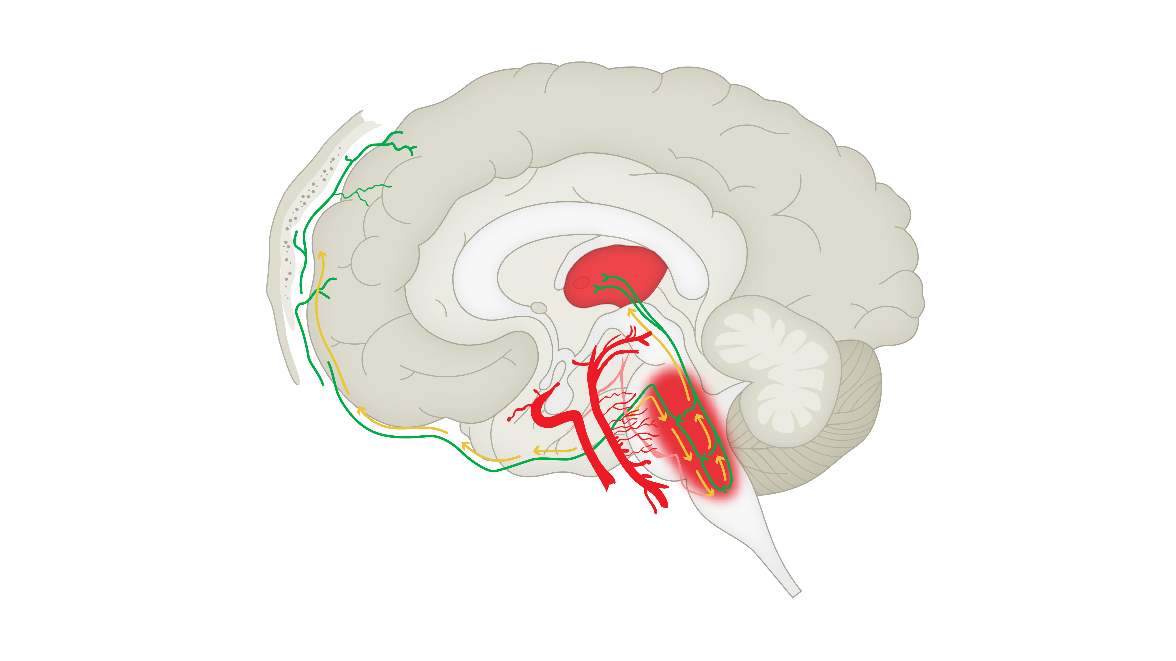
Pharmacological targets for CGRP inhibition
Migraine
Pain transmission
Trigeminal
Neuron
CGRP
receptor
2nd order neuron
Neurogenic inflammation
Inflammatory regulators
CGRP
Mast cell
Blood flow in cerebral blood vessels
Smooth muscle cells
Smooth muscle cells
Trigeminal
neuron
Trigeminal
neuron
Meningeal
blood
Vessel
Cerebral
artery
CGRP
CGRP
CGRP=calcitonin gene-related peptide
Adapted from: Levin et al. Headache 2018;58(10):1689–1696
Notes:
The CGRP peptide exerts its influence by binding to a CGRP receptor and activating intracellular signalling pathways, such as the cAMP (cyclic adenosine monophosphate) pathway.^{[Levin et al., 2018]} By interacting with second-order neurons passing on a nociceptive signal, interacting with smooth muscle cells lining the cerebral artery, and interacting with inflammatory mediators such as mast cells, there are several potential points of intervention where anti-CGRP therapies might arrest migraine pathology.[Levin et al., 2018; Durham, 2004]
References:
Durham PL. CGRP-receptor antagonists – a fresh approach to migraine therapy? N Engl J Med 2004; 350 (11): 1073–1175.
Levin M, Silberstein SD, Gilbert R, et al. Basic considerations for the use of monoclonal antibodies in migraine. Headache 2018; 58 (10): 1689–1696.

Slide 22
Structural changes from migraine attacks
Migraine
A meta-analysis of data from 19 studies found that migraine with aura was associated with three forms of brain abnormalities:¹
  White matter abnormalities
  Infarct-like lesions
  Volumetric changes
More recently, a diffusion MRI study compared white matter of people with episodic migraine, and chronic migraine, and white matter of control individuals²
  A total of 163 individuals were studied²
  The results showed global white matter changes in people with chronic migraine, compared with those with episodic migraine, and suggested damaged axon integrity in people with chronic migraine²
Research has suggested that Aδ- and C-fibres may interact structurally at nodes of Ranvier, via the action of CGRP³
Meta-analysis of white matter abnormalities associated with migraine¹
Migraine
with aura
OR: 1.68
95% CI: 1.07, 2.65
Migraine without aura
OR: 1.34
95% CI: 0.96, 1.87
Further research is needed into the relationship between migraine and structural brain changes, including longitudinal evaluation²
CGRP=calcitonin gene-related peptide; CI=confidence interval; MRI=magnetic resonance imaging; OR=odds ratio
1. Bashir et al. Neurology 2013;81(14):1260–1268;
2. Planchuelo-Gómez et al. J Headache Pain 2020;21(1):1;
3. Edvinsson et al. J Headache Pain 2019;20(1):105
Notes:
It has been much debated over the years whether or not the recurrent attacks that typify chronic migraine result in damage to the brain.[Bashir et al., 2013; Planchuelo-Gómez et al., 2020] However, with mounting evidence that people with migraine are at an increased risk of clinically silent brain lesions, a meta-analysis attempted to answer this question with specific reference to three types of brain changes: white matter abnormalities, infarct-like lesions, and volumetric changes.^{[Bashir et al., 2013]} The results of the meta-analysis are shown on the slide. From a total of 19 studies, the meta-analysis suggested that people with migraine were at a greater risk of structural brain changes and lesions compared with control individuals.^{[Bashir et al., 2013]} The implications of these results are not clear; whilst more research is needed, one practical application of the result is to consider that people with infarct-like lesions should be evaluated for stroke risk factors.^{[Bashir et al., 2013]}
References:
Bashir A, Lipton RB, Ashina S, Ashina M. Migraine and structural changes in the brain: a systematic review and meta-analysis. Neurology 2013; 81 (14): 1260–1268.
Planchuelo-Gómez Á, García-Azorín D, Guerrero ÁL, et al. White matter changes in chronic and episodic migraine: a diffusion tensor imaging study. J Headache Pain 2020; 21 (1): 1.
Other reference used on slide:
Edvinsson JCA, Warfvinge K, Krause DN, et al. C-fibers may modulate adjacent Aδ-fibers through axon-axon CGRP signaling at nodes of Ranvier in the trigeminal system. J Headache Pain 2019; 20 (1): 105.

Slide 23
Brain regions involved in migraine
Migraine

Slide 24
A model of migraine pathophysiology
Migraine
Headache pain
CSD wavefront
Vascular effects
C
O
R
P
U
S
C
A
L
L
O
S
U
M
Thalamus
Trigeminal ganglion
Trigeminal complex
CSD=cortical spreading depression (or depolarisation)
Tolner et al. Cephalalgia 2019;39(13):1683–1699
Notes:
The slide shows a schematic of how cortical spreading depression might interact with the trigeminovascular system in one proposed model of migraine pathology.^{[Tolner et al., 2019]} Of course, although the importance of the cortex in migraine is uncontroversial, there are many conflicting observations and experimental results in the field of migraine study that have yet to be satisfactorily integrated.^{[Tolner et al., 2019]} This uncertainty highlights the importance of hypothesis-driven study designs in future experiments investigating migraine pathology.^{[Tolner et al., 2019]}
Reference:
Tolner EA, Chen SP, Eikermann-Haerter K. Current understanding of cortical structure and function in migraine. Cephalalgia 2019; 39 (13): 1683–1699.

Slide 25
Proposed phases of a migraine attack
Migraine
Premonitory
Aura
Headache
Postdrome
A few hours
to days
5–60
minutes
4–72 hrs
<12–24 hrs
Fatigue
Cognitive difficulties
Mood changes
Food cravings
Neck pain
Yawning
Visual aura (scotoma, fortification spectrum)
Sensory disturbance
Speech disturbance
Motor symptoms
Feeling tired
or weary
Difficulty with concentration
Neck stiffness
Headache
Nausea with or without vomiting
Photophobia
Phonophobia
Osmophobia
Headache
Symptoms in bold denote criteria in the ICHD-3 classification
ICHD-3=International Classification of Headache Disorders, 3rd edition
Adapted from: Dodick. Lancet 2018;391(10127):1315–1330; Cady et al. Headache 2002;42(3):204–216; Goadsby et al. Physiol Rev 2017;97(2):553–622;
Headache Classification Committee of the International Headache Society (IHS). Cephalalgia 2018;38(1):1–211;
The American Migraine Foundation. https://americanmigrainefoundation.org/resource-library/timeline-migraine-attack/. Accessed May 2020;
Migraine Buddy website. Available at: https://migrainebuddy.com/migraine/2018/11/22/the-stages-of-a-migraine-postdrome-phase. Accessed May 2020
Notes:
Migraine attacks can be broken down into four phases: premonitory, aura, headache, and postdrome, as shown on the slide.^{[Dodick, 2018; IHS, 2018]} The exact timing of each phase is highly variable; the headache phase of a migraine can range from 4–72 hours in adults, and 2–48 hours in children.^{[Dodick, 2018]} However, in most people, the median time to peak intensity of the headache pain is 1 hour, and the median duration of the pain is 24 hours.^{[Dodick, 2018]}
Follow this link for a one-minute video, showing what an aura may be like for people with migraine: https://www.youtube.com/watch?v=qVFIcF9lyk8.
References:
Dodick DW. Migraine. Lancet 2018; 391 (10127): 1315–1330.
Headache Classification Committee of the International Headache Society (IHS). The International Classification of Headache Disorders, 3rd edition. Cephalalgia 2018; 38 (1): 1–211.
Other references used on slide:
Cady R, Schreiber C, Farmer K, Sheftell F. Primary headaches: a convergence hypothesis. Headache 2002; 42 (3): 204–216.
Goadsby PJ, Holland PR, Martins-Oliveira M. Pathophysiology of migraine: a disorder of sensory processing. Physiol Rev 2017; 97 (2): 553–622.
Migraine Buddy website. https://migrainebuddy.com/migraine/2018/11/22/the-stages-of-a-migraine-postdrome-phase. Accessed May 2020.
The American Migraine Foundation website. https://americanmigrainefoundation.org/resource-library/timeline-migraine-attack/. Accessed May 2020.

Slide 26
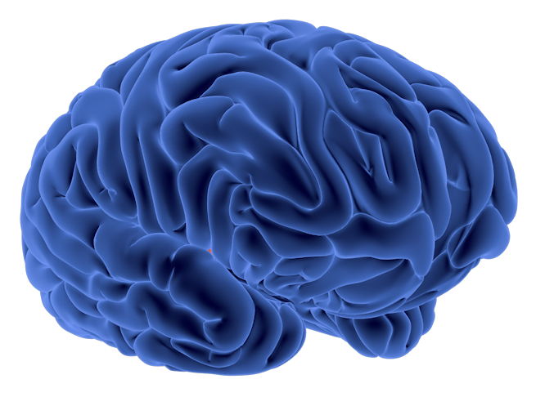
Migraine symptoms are complex and have specific neurologic origins
Migraine
Premonitory
Headache
Fatigue
Cognitive difficulty
Mood changes
Food cravings
Yawning
Headache
Nausea and vomiting
Photophobia
Phonophobia
Osmophobia
Postdrome
Fatigue
Cognitive difficulty
Mood changes
Food cravings
Aura
Scotoma
Fortification spectrum
Adapted from: Cady et al. Headache 2002;42(3):204–216; Goadsby et al. Physiol Rev 2017;97(2):553–622
Notes:
A convergence hypothesis has been proposed that links the clinical features of a migraine attack with pathophysiological models, and suggests that successive symptoms reflect an escalating pathophysiological process, beginning with the premonitory period, progressing to a tension-type headache and – if uninterrupted – into a migraine.^{[Cady et al., 2002]} The symptoms experienced at each stage reflect this progressive pathology.[Cady et al., 2002; Goadsby et al., 2017]
References:
Cady R, Schreiber C, Farmer K, Sheftell F. Primary headaches: a convergence hypothesis. Headache 2002; 42 (3): 204–216.
Goadsby PJ, Holland PR, Martins-Oliveira M, et al. Pathophysiology of migraine: a disorder of sensory processing. Physiol Rev 2017; 97 (2): 553–622.

Slide 27
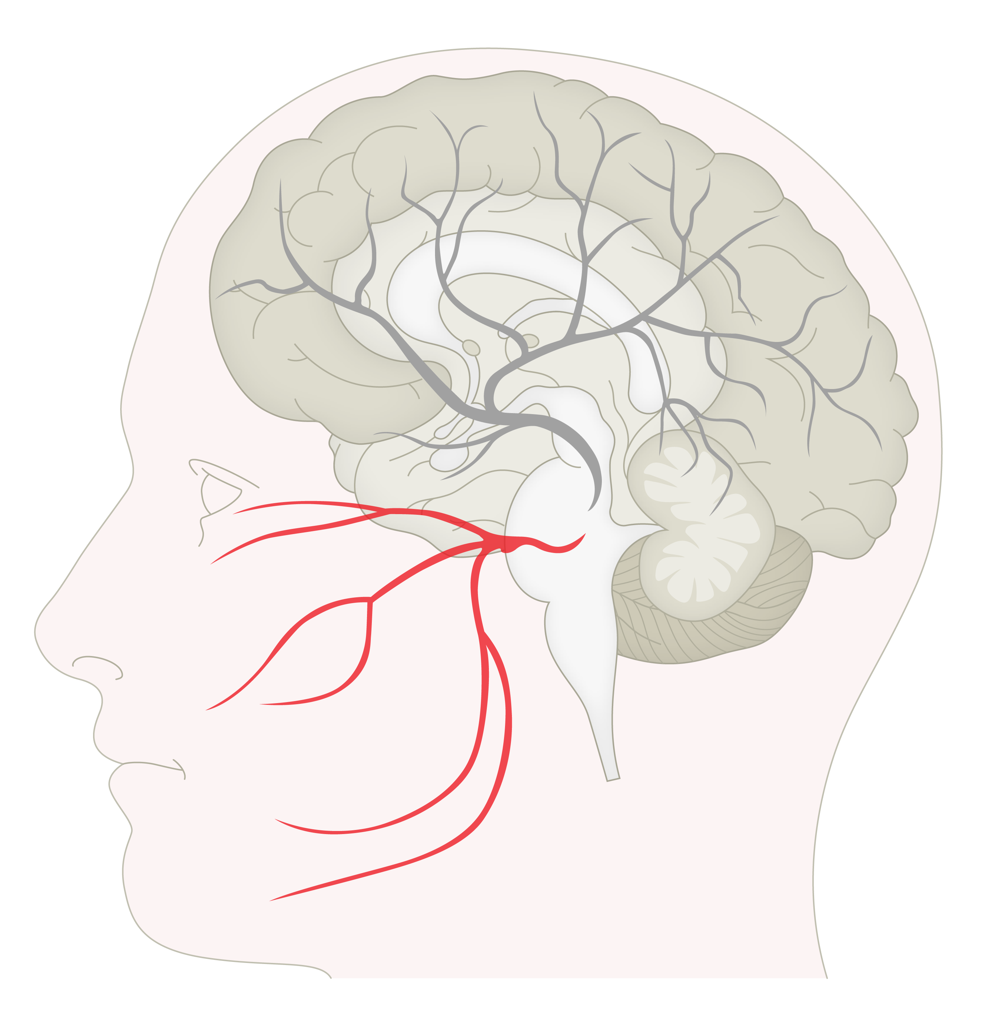
Migraine pathogenesis and the role of CGRP – trigeminal ganglion
Migraine
Trigeminal ganglion (TG)
Trigeminal nerves innervate portions of the face, and transmit information about pain¹
Trigeminal nerves interact with cerebral blood vessels as part of the trigeminovascular system, and with the trigeminal nucleus caudalis (TNC) of the brainstem²
Within the trigeminal ganglion, an abundant neuropeptide is CGRP, which is expressed in approximately 50% of neurons³
When released, CGRP causes vasodilation, neurogenic inflammation, and potentially a cascade of biochemical events leading to sensitisation⁴
CGRP=calcitonin gene-related peptide; TG=trigeminal ganglion; TNC=trigeminal nucleus caudalis
Purves et al. Neuroscience. 6th edition. 2018;
2. Russo. Annu Rev Pharmacol Toxicol 2015;55:533–552
3. Eftekhari et al. Neuroscience 2010;169(2):683–696; 4. Levin et al. Headache 2018;58(10):1689–1696
Notes:
The trigeminal nerve (the fifth cranial nerve), forms three peripheral processes (ophthalmic, maxillary, and mandibular branches, as shown on slide) each of which innervates a portion of the face.^{[Purves et al., 2018]} The central processes of the trigeminal nerve enter the brainstem, and form the ‘trigeminal brainstem complex’.[Purves et al., 2018; Noseda & Burstein, 2013]
Several lines of evidence point to the importance of the trigeminal system in migraine, reviewed in Andreou & Edvinsson, 2019:^{[Andreou & Edvinsson, 2019]}
The patterns of pain in migraine are similar to patterns of referred pain observed in certain surgeries after stimulation of meningeal and cerebral arteries. These arteries are innervated by trigeminal nerve fibres.
Experiments suggest that the elevated CGRP found during migraine attacks originates from the trigeminal nerves.
Agents that cannot cross the blood–brain barrier are capable of causing a migraine attack, and certain effective treatments for migraine cannot cross the blood–brain barrier. Peripheral trigeminal fibres and the trigeminal ganglion are not regions of the brain with a blood–brain barrier.
References:
Andreou AP, Edvinsson L. Mechanisms of migraine as a chronic evolutive condition. J Headache Pain 2019; 20 (1): 117.
Noseda R, Burstein R. Migraine pathophysiology: anatomy of the trigeminovascular pathway and associated neurological symptoms, CSD, sensitization and modulation of pain. Pain 2013; 154 (Suppl 1).
Purves D, Augustine GJ, Fitzpatrick D, et al. Neuroscience, 6th edition. New York, New York: Oxford University Press, 2018.
Other references used on slide:
Eftekhari S, Salvatore CA, Calamari A, et al. Differential distribution of calcitonin gene-related peptide and its receptor components in the human trigeminal ganglion. Neuroscience 2010; 169 (2): 683–696.
Levin M, Silberstein SD, Gilbert R, et al. Basic considerations for the use of monoclonal antibodies in migraine. Headache 2018; 58 (10): 1689–1696.
Russo AF. Calcitonin gene-related peptide (CGRP): a new target for migraine. Annu Rev Pharmacol Toxicol 2015; 55: 533–552.

Slide 28
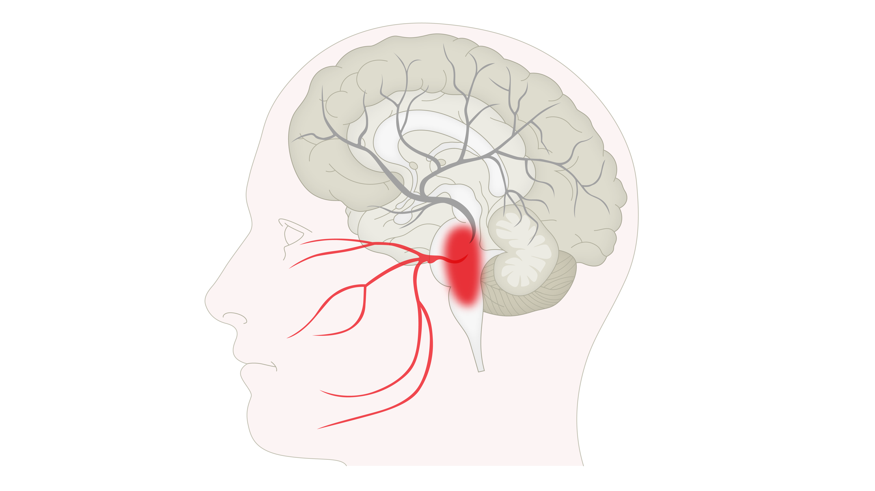
Migraine pathogenesis and the role of CGRP – trigeminal nucleus caudalis
Migraine
Trigeminal nucleus caudalis (TNC)
Nerves from the trigeminal ganglion carry nociceptive information to the TNC¹
Nerves from the TNC project to the thalamus¹
Some experiments have shown that cells of the TNC can release CGRP in response to stimulation by PACAP-38 – a known inducer of migraines in individuals with migraine^{2,3}
CGRP=calcitonin gene-related peptide; PACAP-38=pituitary adenylate cyclase activating peptide-38; TNC=trigeminal nucleus caudalis
1. Russo. Annu Rev Pharmacol Toxicol 2015;55:533–552
2. Jansen-Olesen et al. Neuropeptides 2014;48(2):53–64
3. Schytz et al. Brain 2009;132(Pt 1):16–25
Notes:
Neurons of the trigeminal ganglion (TG) project to the trigeminal nucleus caudalis (TNC) of the brainstem.^{[Iyengar et al., 2019]} With connections to the meninges, the trigeminovascular system, more broadly, is thought to mediate nociception in the dura mater of the meninges.^{[Iyengar et al., 2019]}
Reference:
Iyengar S, Johnson KW, Ossipov MH, Aurora SK. CGRP and the trigeminal system in migraine. Headache 2019; 59 (5): 659–681.
Other references used on slide:
Jansen-Olesen I, Baun M, Amrutkar DV, et al. PACAP-38 but not VIP induces release of CGRP from trigeminal nucleus caudalis via a receptor distinct from the PAC1 receptor. Neuropeptides 2014; 48 (2): 53–64.
Russo AF. Calcitonin gene-related peptide (CGRP): a new target for migraine. Annu Rev Pharmacol Toxicol 2015; 55: 533–552.
Schytz HW, Birk S, Wienecke T, et al. PACAP38 induces migraine-like attacks in patients with migraine without aura. Brain 2009; 132 (Pt 1): 16–25.

Slide 29
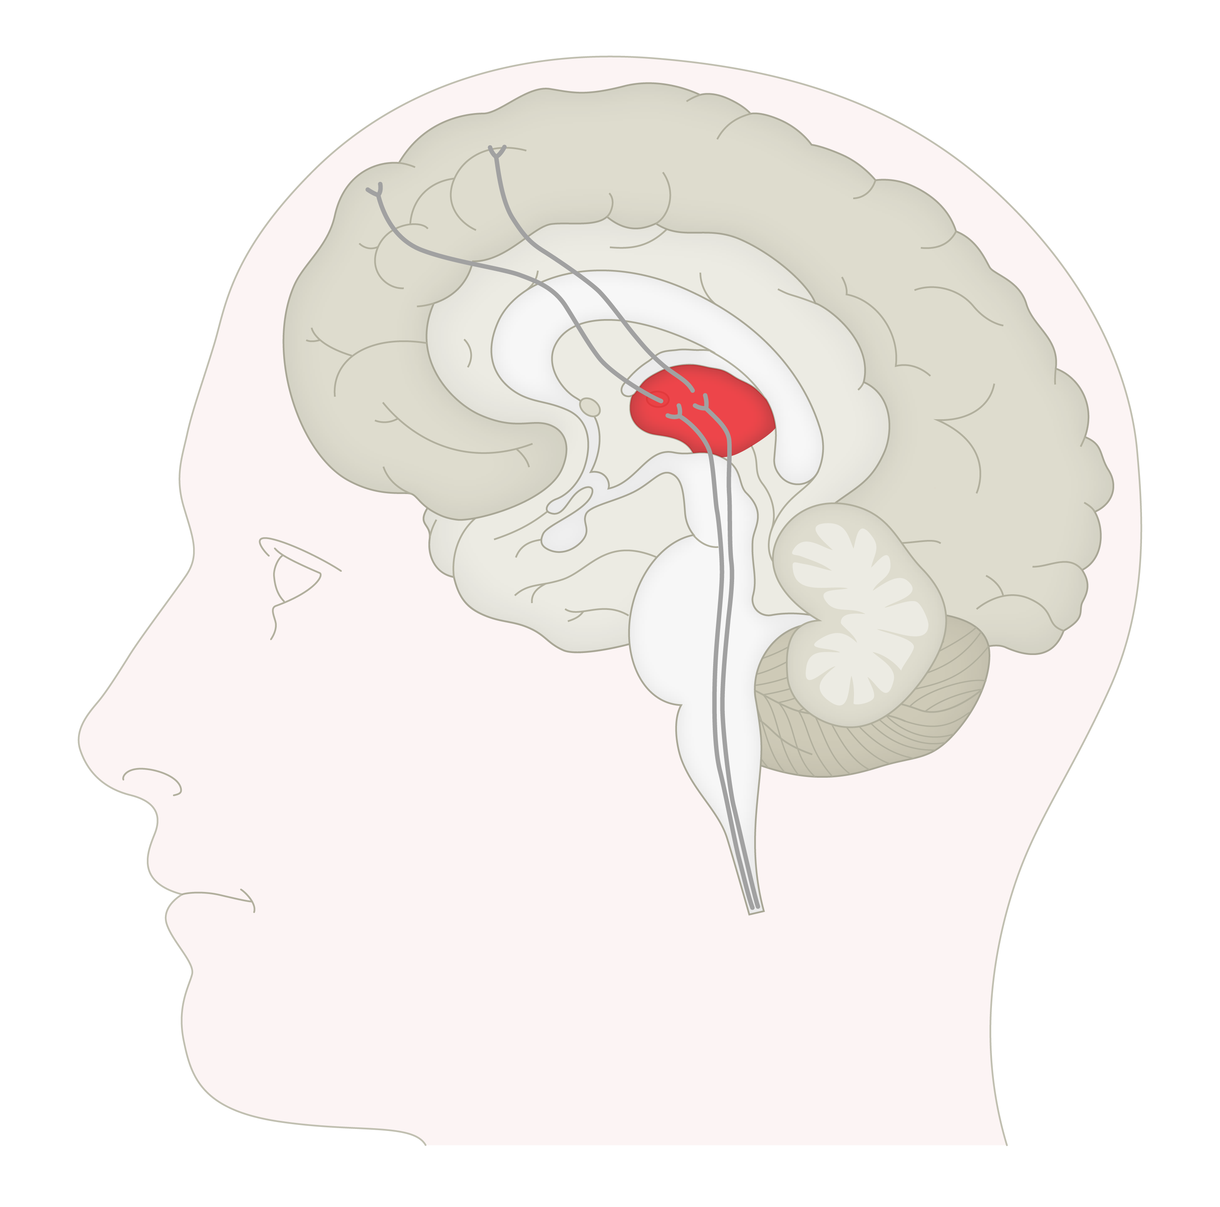
Migraine pathogenesis and the role of CGRP – thalamus
Migraine
Thalamus
Second-order neurons project from the TNC to third-order neurons in the thalamus^{1,2}
From the thalamus, ascending inputs are integrated and relayed to the cortex²
The thalamus appears to be critical for several processes underlying migraine:³
  Allodynia and central sensitisation – an increased neural response following normally non-painful stimulation
  Photophobia – experience of discomfort or pain on exposure to light
CGRP=calcitonin gene-related peptide; TNC=trigeminal nucleus caudalis
1. Purves et al. Neuroscience. 6th edition. 2018
2. Russo. Annu Rev Pharmacol Toxicol 2015;55:533–552
3. Younis et al. Cephalalgia 2019;39(13):1675–1682
Notes:
The thalamus is a structure in the brain that relays sensory information (including pain) from the body to the cerebral cortex.^{[Purves et al., 2018]} The thalamus is highly complex but organised, such that the incoming signals remain segregated, based on the type of somatosensory information that is conveyed.^{[Purves et al., 2018]}
Experiments have shown that the cortical trajectories of trigeminovascular neurons are defined by the thalamic nucleus of origin, suggesting separate roles for these pathways in discriminating elements of migraine such as location and intensity of pain, and in symptoms such as phonophobia and photophobia.^{[Noseda & Burstein, 2013]}
References:
Noseda R, Burstein R. Migraine pathophysiology: anatomy of the trigeminovascular pathway and associated neurological symptoms, CSD, sensitization and modulation of pain. Pain 2013; 154 (Suppl 1).
Purves D, Augustine GJ, Fitzpatrick D, et al. Neuroscience, 6th edition. New York, New York: Oxford University Press, 2018.
Other references used on slide:
Russo AF. Calcitonin gene-related peptide (CGRP): a new target for migraine. Annu Rev Pharmacol Toxicol 2015; 55: 533–552.
Younis S, Hougaard A, Noseda R, Ashina M. Current understanding of thalamic structure and function in migraine. Cephalalgia 2019; 39 (13): 1675–1682.

Slide 30
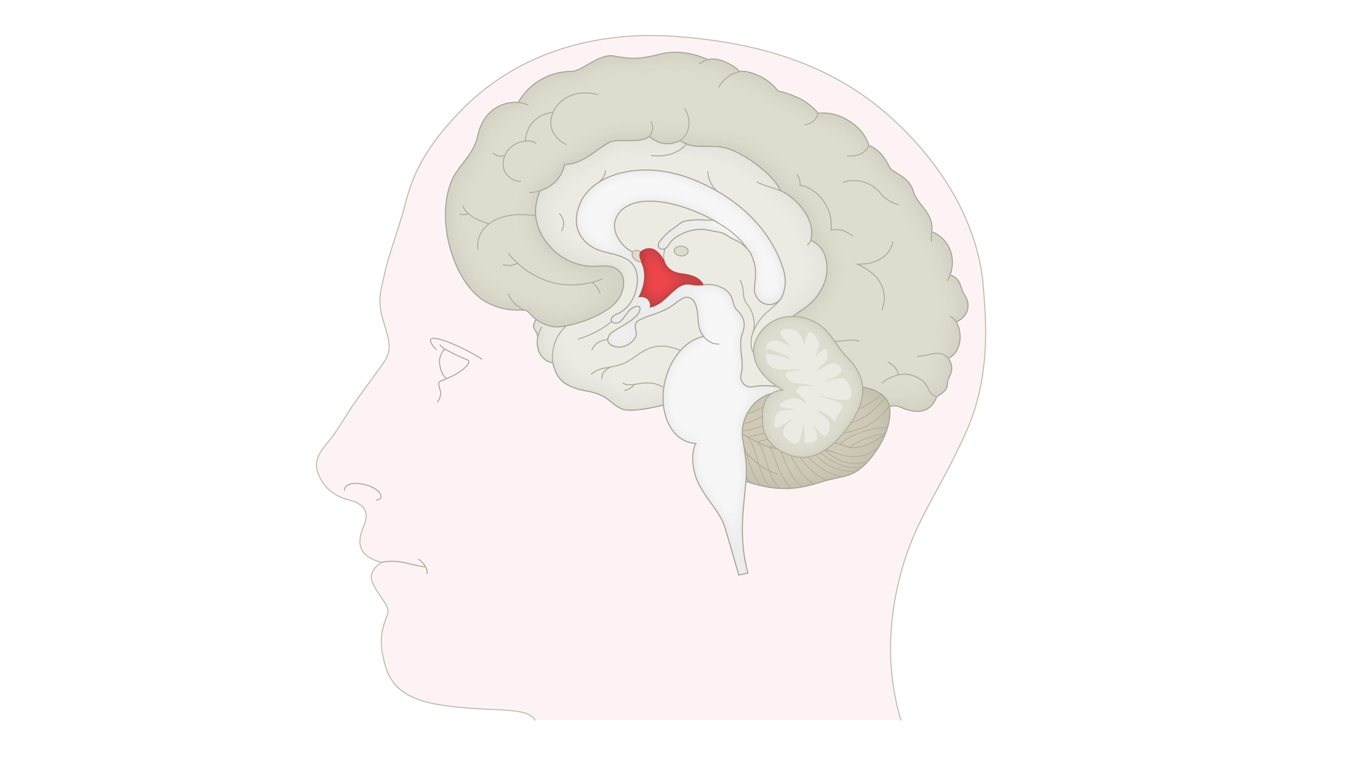
Migraine pathogenesis and the role of CGRP – hypothalamus
Migraine
Hypothalamus
The role of the hypothalamus in the pathology of migraine is not yet clear¹
Changes in hypothalamic function precede migraine attacks and may generate some premonitory symptoms, e.g., polyuria, mood changes, and change in appetite¹⁻³
Some evidence suggests that changes to hypothalamic volume may serve as a biomarker for chronic migraine³
One study found that individuals with migraine had decreased hypothalamic volume, and that the change in volume was associated with headache frequency³
CGRP=calcitonin gene-related peptide
1. Charles. Lancet Neurol 2018;17(2):174–182
2. Maniyar et al. Brain 2014;137(Pt 1):232–241
3. Chen et al. Front Neurol 2019;10:606
Notes:
The hypothalamus is a small structure, located at the base of the forebrain, comprising several distinct nuclei.^{[Purves et al., 2018]} It has multiple functions related to maintaining homeostasis, including controlling blood flow, regulating energy metabolism, and coordinating responses to threatening conditions via regulation of stress hormone release.^{[Purves et al., 2018]} Although the role of the hypothalamus in migraine is unclear, some aspects of the premonitory phase suggest involvement of the hypothalamus.[Chen et al., 2019; Charles, 2018; Maniyar et al., 2014]
References:
Charles A. The pathophysiology of migraine: implications for clinical management. Lancet Neurol 2018; 17 (2): 174–182.
Chen Z, Chen X, Liu M, et al. Volume of hypothalamus as a diagnostic biomarker of chronic migraine. Front Neurol 2019; 10: 606.
Maniyar FH, Sprenger T, Monteith T, et al. Brain activations in the premonitory phase of nitroglycerin-triggered migraine attacks. Brain 2014; 137 (Pt 1): 232–241.
Purves D, Augustine GJ, Fitzpatrick D, et al. Neuroscience, 6th edition. New York, New York: Oxford University Press, 2018.

Slide 31
Various brain regions are activated during a migraine attack
Migraine
Visual cortex²
Hypothalamus¹
Brainstem³
Migraine symptoms
Premonitory
Aura
Headache
Postdrome
1. Maniyar et al. Brain 2014;137(Pt 1):232–241;
2. Hadjikhani et al. Proc Natl Acad Sci USA 2001;98(8):4687–4692;
3. Weiller et al. Nat Med 1995;1(7):658–660
Notes:
Several lines of evidence suggest activation of different regions of the brain at different stages of a migraine attack.
During the premonitory phase, positron emission tomography (PET) studies have shown activation of the hypothalamus in individuals with nitroglycerin-triggered migraine attacks.^{[Maniyar et al., 2014]}
During aura, magnetic resonance imaging (MRI) studies have shown activation of the visual cortex in individuals who experience migraine attacks during the aura stage.^{[Hadjikhani et al., 2001]} Furthermore, the slow and contiguously progressive nature of blood oxygenation level-dependent (BOLD) signal activation has been linked to the cortical spreading depression phenomenon.^{[Hadjikhani et al., 2001]}
During the headache phase of the migraine attack, PET studies have shown increased blood flow in some cerebral regions of the brain as well as in the brainstem.^{[Weiller et al., 1995]}
References:
Hadjikhani N, Sanchez Del Rio M, Wu O, et al. Mechanisms of migraine aura revealed by functional MRI in human visual cortex. Proc Natl Acad Sci USA 2001; 98 (8): 4687–4692.
Maniyar FH, Sprenger T, Monteith T, et al. Brain activations in the premonitory phase of nitroglycerin-triggered migraine attacks. Brain 2014; 137 (Pt 1): 232–241.
Weiller C, May A, Limmroth V, et al. Brain stem activation in spontaneous human migraine attacks. Nat Med 1995; 1 (7): 658–660.

Slide 32
Cortical and brainstem activation alone or in combination?
Migraine
Is there an anatomic sequence to migraine?
Cortical activation precedes brainstem activation
Both the cortex and brainstem are activated simultaneously
Supported by the typical occurrence of aura before headache, and experiments showing that CSD can activate neurons of the TNC
Brainstem activation precedes cortex activation
Supported by clinical observations in some people who experience migraine symptoms without any clear sequence
Supported by experiments showing that brainstem activation can alter cortical blood flow
CSD=cortical spreading depression (or depolarisation); TNC=trigeminal nucleus caudalis
Adapted from: Charles & Brennan. Handb Clin Neurol 2010;97:99–108
Notes:
Putting aside the arguments about which brain region is activated first, summarised on the slide, both cortical and brainstem signalling present appealing targets for migraine therapy.^{[Charles & Brennan, 2010]}
Reference:
Charles A, Brennan KC. The neurobiology of migraine. Handb Clin Neurol 2010; 97: 99–108.

Slide 33
The genetics of migraine
Migraine

Slide 34
The heritability of headaches and migraine
Migraine
Data from family and twin studies have demonstrated that an individual’s susceptibility to headaches and migraine has a heritable, genetic, component^{1,2}
There are autosomal dominant forms of migraine, including familial hemiplegic migraine – a rare subtype of migraine with aura – which is known to be a directly inheritable form of migraine^{1,2}
Common migraine is thought to be a polygenic condition, meaning that many different genes are believed to interact with the environment in the disease process²
The heritability of common migraine is estimated to be 30–60%²
Identifying the genes involved in migraine susceptibility has been aided by the advent of high-throughput technologies such as GWAS²
More research is needed to fully understand the genetic component of headaches and migraine, and to translate this deeper understanding of the genes and molecular pathways involved in migraine pathology into treatments for patients²
GWAS=genome-wide association studies
1. Pelzer et al. Curr Treat Options Neurol 2013;15(1):13–27
2. Sutherland et al. J Headache Pain 2019;20(1):72
Notes:
Migraine is known to have a genetic component, be it as an autosomal dominant familial trait or as so-called common migraine, as outlined on the slide.[Pelzer et al., 2013; Sutherland et al., 2019] Research focusing on known familial cases of inherited forms of migraine, using techniques such as DNA sequencing and linkage mapping, have been complimented more recently by larger-scale, hypothesis-generating techniques such as genome-wide association studies (GWAS).^{[Sutherland et al., 2019]} As technologies become more commonly used, and sample sizes increase, more gene loci linked to migraine will be unearthed.^{[Sutherland et al., 2019]} However, translating this progress in the genetics of migraine into understanding the pathology of, and ultimately treating, migraine will be the focus of much research.^{[Sutherland et al., 2019]}
References:
Pelzer N, Stam AH, Haan J, et al. Familial and sporadic hemiplegic migraine: diagnosis and treatment. Curr Treat Options Neurol 2013; 15 (1): 13–27.
Sutherland HG, Albury CL, Griffiths LR. Advances in genetics of migraine. J Headache Pain 2019; 20 (1): 72.

Slide 35
The genetics of migraine
Migraine
The genetic basis of migraine is complex, however, there are some known monogenetic causes of certain types of migraine¹
Three genes have been associated with hemiplegicª migraine:¹⁻³
  CACNA1A (Ca²⁺ voltage-gated channel subunit alpha 1A)
  ATP1A2 (ATPase Na⁺/K⁺ transporting subunit alpha 2)
  SCN1A (Na⁺ voltage-gated channel alpha subunit 1)
Additionally, the gene KCNK18, encoding a K⁺ channel, has been linked to another inheritable form of migraine¹
Some specific clinical features of migraine appear to be determined by genetic factors, e.g., a greater family history of migraine is associated with:²
  Lower age at symptom onset
  Higher frequency of migraine
  Number of medication days
  Migraine with aura subtype
Migraine shares some genetic risks with psychiatric diseases, including depression²
Migraine is clearly a multifaceted disease, one in which genetics plays an important role in the susceptibility of an individual and in the symptomatology that they experience¹
ªA rare subtype of migraine with aura
1. Sutherland et al. J Headache Pain 2019;20(1):72
2. de Boer et al. Curr Opin Neurol 2019;32(3):413–421
3. GeneCards website. https://www.genecards.org. Accessed Jan 2020
Notes:
Hemiplegic migraine is a rare subtype of migraine with aura, characterised by episodes of severe migraine, along with motor weakness or numbness usually affecting one side of the body (hemiparesis).^{[Pelzer et al., 2013]} Visual, sensory, or speech disturbances may also be present.^{[Pelzer et al., 2013]} Although three genes are known to cause hemiplegic migraine, listed on slide, many other genes may be involved.^{[Pelzer et al., 2013]}
There have been many attempts to explore the genetics of migraine using GWAS, whereby the genetic makeup of many individuals with migraine is compared with that of many control individuals, looking for differences between the two groups.^{[Sutherland et al., 2019]} GWAS have so far identified, amongst others, genes involved in synapse and neural function, as well as genes involved in vascular function, which appear to be associated with migraine.^{[Sutherland et al., 2019]}
References:
Pelzer N, Stam AH, Haan J, et al. Familial and sporadic hemiplegic migraine: diagnosis and treatment. Curr Treat Options Neurol 2013; 15 (1): 13–27.
Sutherland HG, Albury CL, Griffiths LR. Advances in genetics of migraine. J Headache Pain 2019; 20 (1): 72.
Other references used on slide:
de Boer I, van den Maagdenberg AMJM, Terwindt GM. Advance in genetics of migraine. Curr Opin Neurol 2019; 32 (3): 413–421.
GeneCards website. https://www.genecards.org. Accessed Jan 2020.

Slide 36
Migraine polygenic risk score
Migraine
A Danish study established a polygenic risk score (PRS) by analysing the genomes of 2,219 individuals with migraine, alongside clinical assessment¹
This genetic information was then compared with Danish controls¹
A two-fold increase in PRS was associated with a positive response to migraine-specific therapy:¹
  OR: 1.25 (95% CI: 1.05, 1.49)
…but not a positive response to non-migraine-specific analgesics¹
Association of PRS with response to acute treatment¹
This suggests that there is possibly a genetic component to migraine – and that the PRS can identify patients with a higher-than-average chance of responding to triptans¹
Any migraine-specific therapy
Triptans
Ergot
Non-migraine-specific analgesics
CI=confidence interval; OR=odds ratio; PRS=polygenic risk score
1. Kogelman et al. Neurol Genet 2019;5(6):e364
Notes:
Polygenic risk scores (PRS) attempt to bring together risk contributions from a large number of genes and variations in genetics into a single number that quantifies an individual’s risk for a disease or state.^{[Vilhjálmsson & Privé, 2019]} A Danish study established a PRS for migraine, which was shown to be associated with treatment response (as shown on slide).^{[Kogelman et al., 2019]} Whilst useful, the result has been criticised for several reasons:[Vilhjálmsson & Privé, 2019; Kogelman et al., 2019]
the treatment effect was quite small (an odds ratio of 1.25)
although an attempt was made to do so, confounding sources are hard to rule out completely
the sample was not a random sample.
Furthermore, even if the treatment response is in doubt, some have argued that an individual might as well try a drug and see if it works.^{[Vilhjálmsson & Privé, 2019]} It is important that the scientific value of studies, such as the GWAS outlined on slide, are balanced against the clinical relevance of any findings – genetic screening comes at a cost that might easily outweigh any benefits.^{[Vilhjálmsson & Privé, 2019]}
References:
Kogelman LJA, Esserlind AL, Francke Christensen A, et al. Migraine polygenic risk score associates with efficacy of migraine-specific drugs. Neurol Genet 2019; 5 (6): e364.
Vilhjálmsson BJ, Privé F. Headaches and polygenic scores. Neurol Genet 2019; 5 (6): e368.

Slide 37
Migraine GWAS
Migraine
Several GWAS of migraine have compared the genomes of hundreds of thousands of individuals with migraine with those of controls^{1,2}
SNPs identified from these GWAS have highlighted some possible common themes:¹
  Vascular function
  Metal ion homeostasis
  Ion channel activity
Other identified genes have neural functions, further fuelling the vascular versus neurological debate¹
GWAS have identified several potential genes and systems involved in migraine – the task that remains is to verify these findings^{1,2}
Migraine-associated SNPs putatively associated with similar biological functions¹
Metal ion homeostasis
rs10218452; rs6791480; rs7684253; rs2506142; rs11172113; rs4081947; rs17857135; rs111404218
Vascular function
rs10218452; rs6693567; rs1925950; rs6791480; rs13078967; rs7684253; rs9349379; rs67338227; rs28455731; rs1268083; rs2506142; rs10786156; rs2223089; rs10895275; rs1024905; rs11172113; rs4081947; rs111404218; rs144017103
Ion channel activity
rs10166942; rs7684253; rs10456100; rs4814864
GWAS=genome-wide association studies; SNP=single nucleotide polymorphism
1. van den Maagdenberg et al. J Headache Pain 2019;20(1):5;
2. Nyholt & van den Maagdenberg. Curr Opin Neurol 2016;29(3):302–308
Notes:
Initially, migraine genome-wide association studies (GWAS) had sample sizes of up to a few thousand patients, and compared migraine with aura and without aura against controls.[van den Maagdenberg et al., 2019] GWAS conducted more recently have used increased samples sizes, with hundreds of thousands of individuals with migraine and relevant control groups.[van den Maagdenberg et al., 2019] The combined efforts of these studies have identified several locations in the genome, SNPs (single nucleotide polymorphisms), that appear to be robustly associated with migraine.[van den Maagdenberg et al., 2019] Importantly, all associated SNPs identified to date have small effect sizes – emphasising the fact that no single genetic factor seems to cause migraine.[van den Maagdenberg et al., 2019]
Reference:
van den Maagdenberg AMJM, Nyholt DR, Anttila V. Novel hypotheses emerging from GWAS in migraine? J Headache Pain 2019; 20 (1): 5.
Other reference used on slide:
Nyholt DR, van den Maagdenberg AMJM. Genome-wide association studies in migraine: current state and route to follow. Curr Opin Neurol 2016; 29 (3): 302–308.

