Slide 1
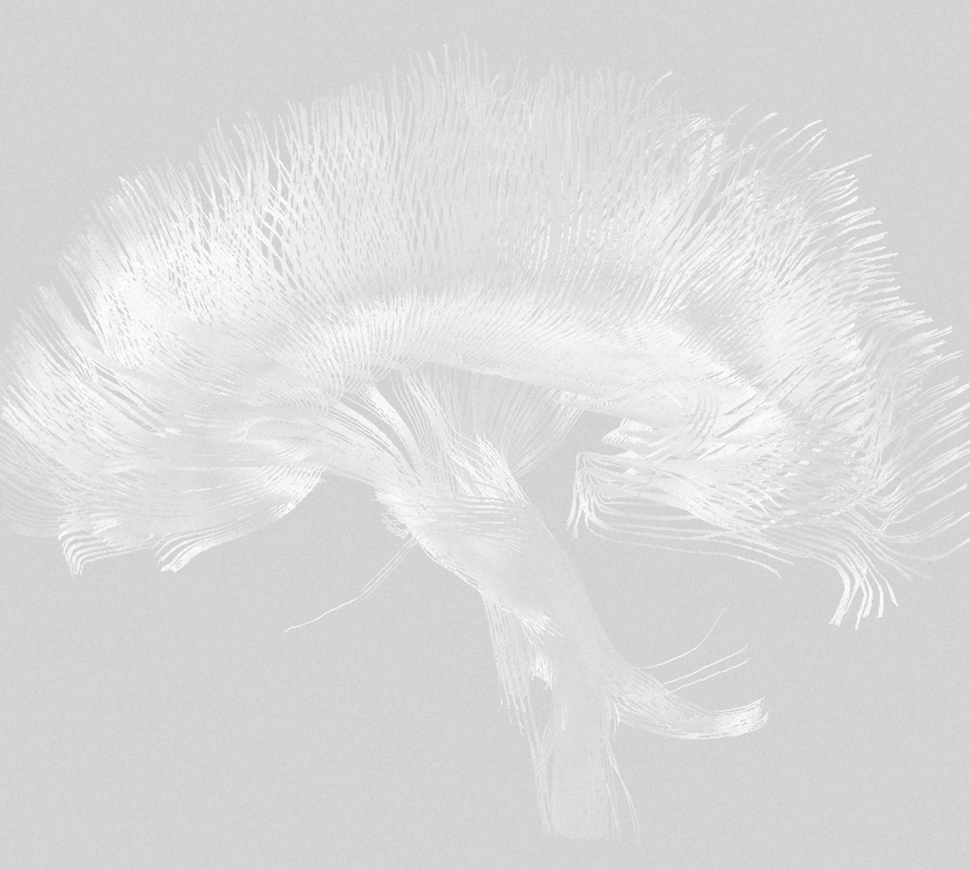
Alzheimer’s disease (AD)
Comorbidities

