Slide 1
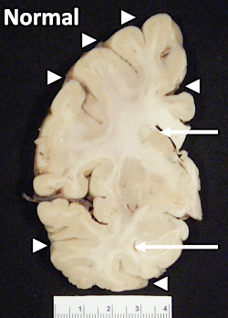
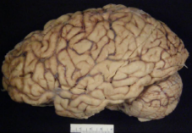



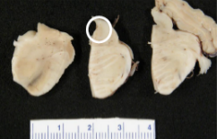
Alzheimer’s disease is not a part of normal aging
Alzheimer´s disease (AD) – Course, natural history and prognosis
Normal
AD is a progressive neurodegenerative disease
that causes cognitive impairment, neuropsychiatric symptoms, and loss of independence throughout
its course^{1,2}
Clinical symptoms of AD exist on a continuum, progressing from no cognitive impairment to dementia²
AD patients often struggle with memory, language, and executive function²
The exact degree of clinical deficits, accompanying neuropsychiatric symptoms, and the progression of the disease may vary individually²
AD
Widening of sulcal spaces and narrowing of gyri
Enlargement of the frontal and temporal horns of the lateral ventricles
Loss of pigmented neurons in the locus coeruleus
1. Atri. Med Clin North Am 2019;103(2):263–293; 2. Knopman et al. Nat Rev Dis Primers 2021;7(1):33; 3. Figure adapted from: DeTure and Dickson. Mol Neurodegener 2019;14(1):32
Notes:
References:
Atri A. The Alzheimer's disease clinical spectrum: diagnosis and management. Med Clin North Am 2019; 103 (2): 263–293.
Knopman DS, Amieva H, Petersen RC, et al. Alzheimer disease. Nat Rev Dis Primers 2021; 7 (1): 33.
DeTure MA, Dickson DW. The neuropathological diagnosis of Alzheimer's disease. Mol Neurodegener 2019; 14 (1): 32.

