Slide 1

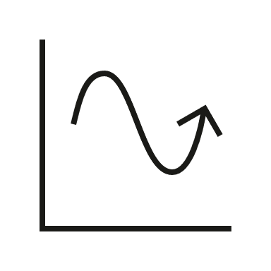
Clinical staging of dementia
Alzheimer´s disease (AD) – Course, natural history and prognosis
The Global Deterioration Scale, developed in 1982, was widely used in categorizing cognitive and functional severity into seven stages, from no cognitive decline to severe cognitive decline¹
Today, clinical staging of dementia can be done using staging scales that measure cognitive and functional impairment in persons with dementia^{2,} as an unbiased staging of the disease is important for personalized clinical management³
Commonly used clinical staging scales include²
  Clinical Dementia Rating (CDR) Scale was designed for MCI and mild dementia⁴
  Global Deterioration Scale (GDS) has seven stages and is suitable for the full range of MCI and dementia¹
  Functional Assessment Staging (FAST) has seven stages, focuses on function in activities of daily living⁵
The progression and severity of functional decline are the basis of clinical staging⁶
The rate of progression through clinical stages is variable and may depend on comorbid medical conditions⁷
CDR=Clinical Dementia Rating; FAST=Functional Assessment Staging; GDS=Global Deterioration Scale; MCI=mild cognitive impairment
1. Reisberg et al. Am J Psychiatry 1982;139(9):1136–1139; 2. Olde Rikkert et al. Am J Alzheimers Dis Other Demen 2011;26(5):357–365;
3. Therriault et al. Trends Mol Med 2022;28(9):726–741; 4. Morris JC. Int Psychogeriatr 1997;9(Suppl 1):173–178;
5. Sclan & Reisberg. Int Psychogeriatr 1992;4(Suppl 1):55–69; 6. Gélinas. In: Gauthier et al. World Alzheimer Report 2022; 7. Knopman et al. Nat Rev Dis Primers 2021;7(1):33
Notes:
References:
Reisberg B, Ferris SH, de Leon MJ, Crook T. The Global Deterioration Scale for assessment of primary degenerative dementia. Am J Psychiatry 1982; 139 (9): 1136–1139.
Olde Rikkert MG, Tona KD, Janssen L, et al. Validity, reliability, and feasibility of clinical staging scales in dementia: a systematic review. Am J Alzheimers Dis Other Demen 2011; 26 (5): 357–365.
Therriault J, Zimmer ER, Benedet AL, et al. Staging of Alzheimer's disease: past, present, and future perspectives. Trends Mol Med 2022; 28 (9): 726–741.
Morris JC. Clinical dementia rating: a reliable and valid diagnostic and staging measure for dementia of the Alzheimer type. Int Psychogeriatr 1997; 9 (Suppl 1): 173–178.
Sclan SG, Reisberg B. Functional assessment staging (FAST) in Alzheimer's disease: reliability, validity, and ordinality. Int Psychogeriatr 1992; 4 (Suppl 1): 55–69.
Gélinas. A functional perspective on staging dementia. In: Gauthier S, Webster C, Servaes S, et al. World Alzheimer Report 2022: Life after diagnosis: navigating treatment, care and support. Available at: https://www.alzint.org/u/World-Alzheimer-Report-2022.pdf. Accessed August 2023.
Knopman DS, Amieva H, Petersen RC, et al. Alzheimer disease. Nat Rev Dis Primers 2021; 7 (1): 33.

