Slide 1
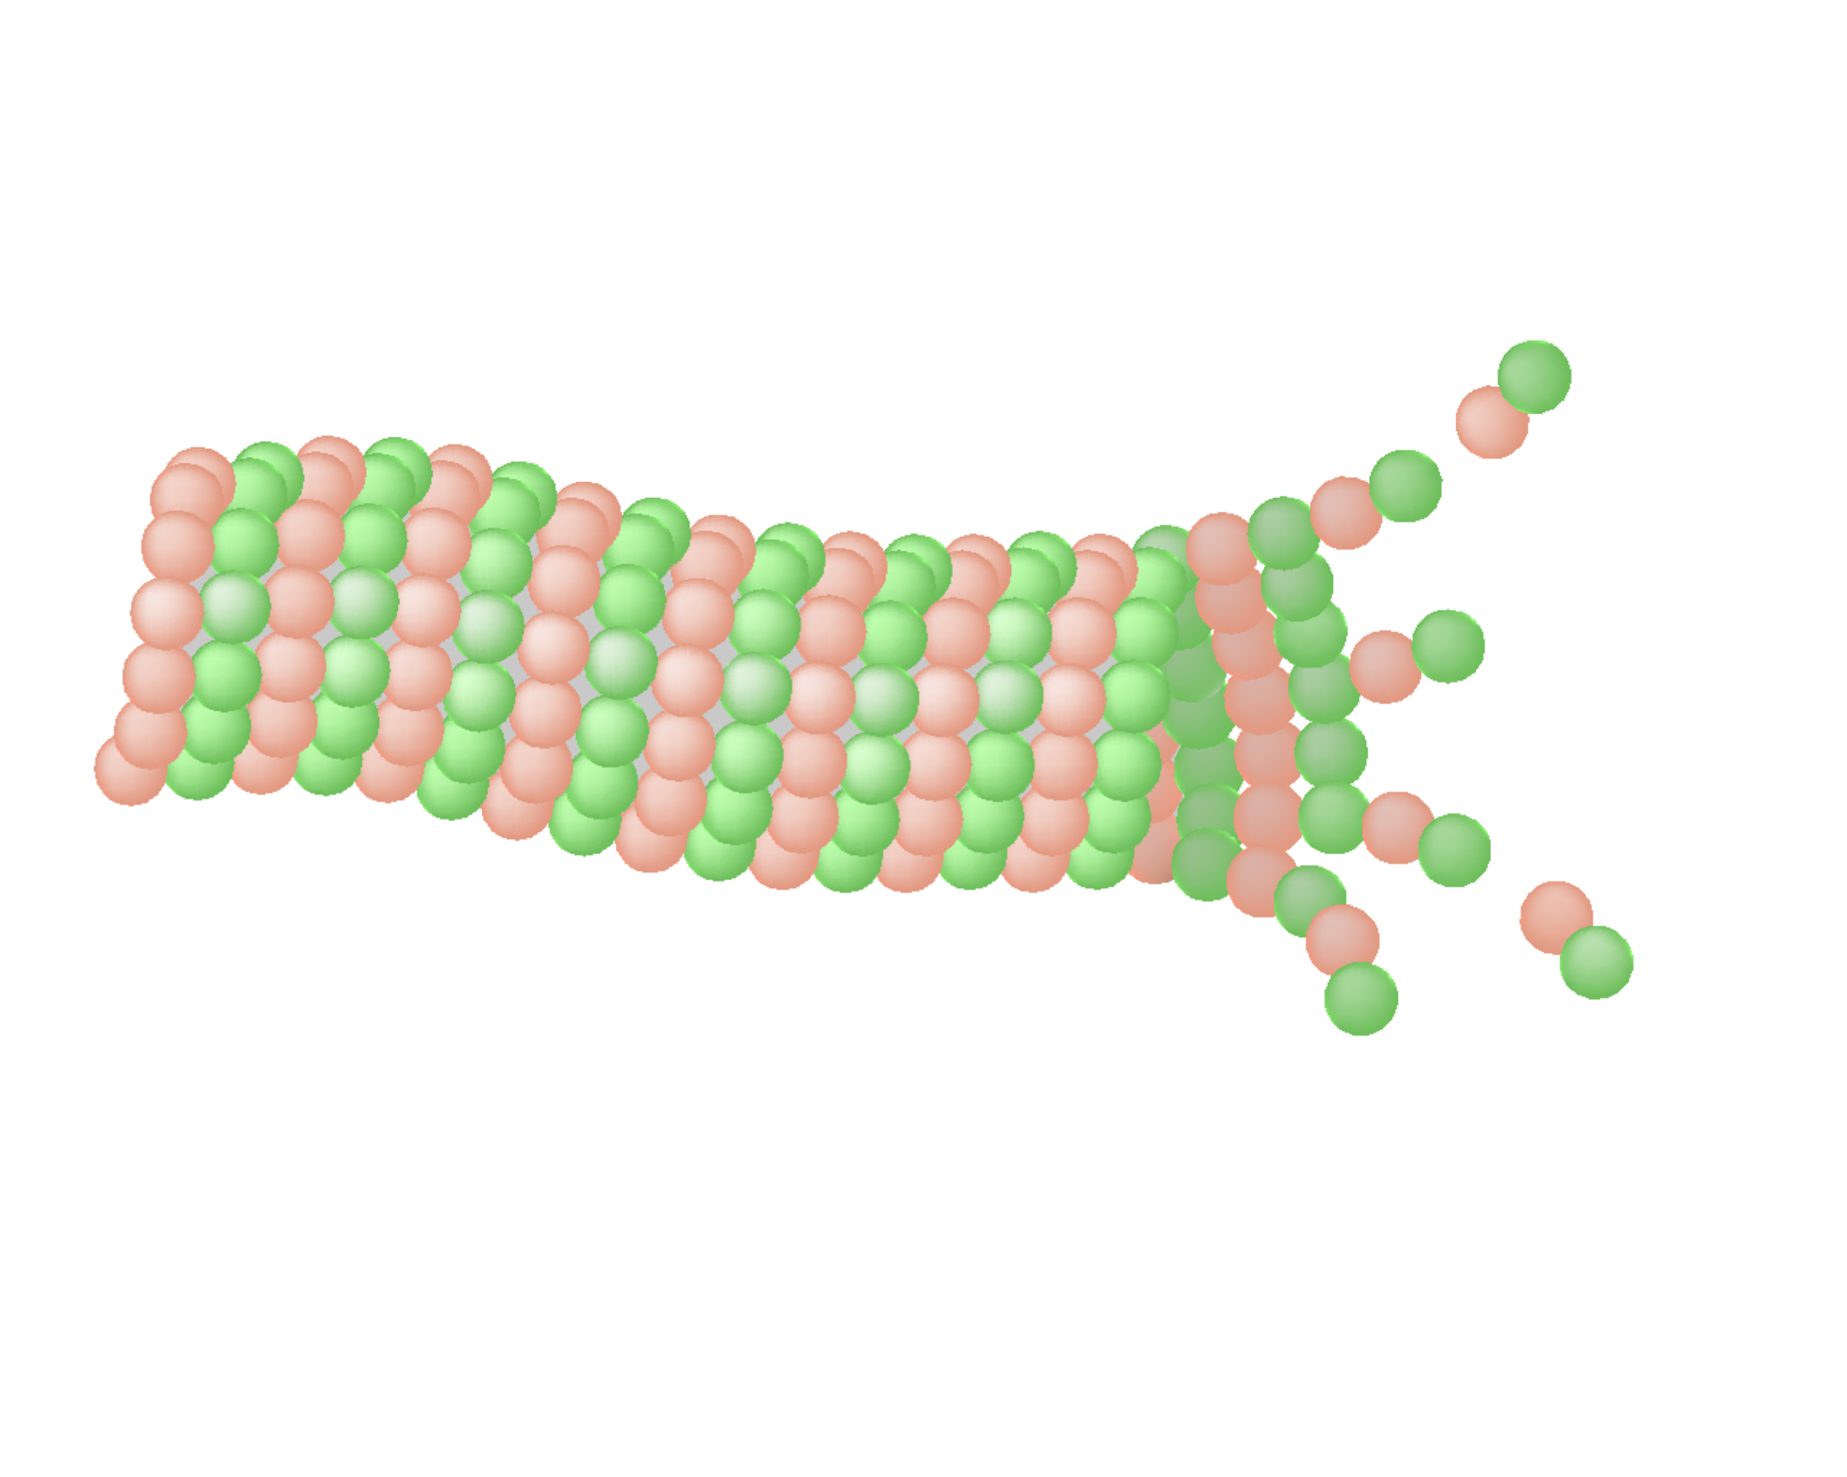
Tau hypothesis
Alzheimer’s disease (AD) – Neurobiology and aetiology
Molecular pathway of the tau hypothesis¹
Tau is a microtubule-associated protein involved in stabilizing microtubules in the axon of a neuron²
In AD, tau becomes abnormally hyperphosphorylated, resulting in misfolding and aggregation into NFTs²
Hyperphosphorylated and misfolded tau form NFTs in specific parts of the brain, which is a core part of AD and correlates with clinical symptoms of the disease²⁻⁵
While some hypotheses suggest tau as an initiating event in AD,⁴ most animal and human studies suggest that tau pathology aggregation and spreading happens following Aβ aggregation⁶⁻⁷
Aβ
Protein kinases
Tau
Misfolded tau monomer
Soluble tau oligomer
Paired helical fragments
Phosphatases
p-tau
Microtubule destabilization
Aβ
p-tau neurotoxicity
Tau NFTs
Disrupted axonal transport
This work is adapted from ‘Linking the amyloid, tau, and mitochondrial hypotheses of Alzheimer’s disease and identifying promising drug targets’ by Fišar et al., used under CC-BY. This work is licensed under Creative Commons license CC-BY-SA by The Lundbeck Foundation.
Aβ=amyloid-β; NFT=neurofibrillary tangle; p-tau=phosphorylated tau
1. Fišar. Biomolecules 2022;12(11):1676; 2. Serrano-Pozo et al. Cold Spring Harb Perspect Med 2011;1(1):a006189;
3. Braak et al. Acta Neuropathol 2006;112(4):389–404; 4. Arnsten et al. Alzheimers Dement 2021;17(1):115–124;
5. Goedert. Alzheimers Dement 2016;12(10):1040–1050; 6. Jagust. Nat Rev Neurosci 2018;19(11):687–700; 7. Karran & De Strooper. Nat Rev Drug Discov 2022;21(4):306–318
Notes:
The tau hypothesis is based on evidence that tau NFTs consist of p-tau.¹ According to the tau hypothesis, tau NFTs precede the development of Aβ, and the initiation of neurodegeneration is caused by the destabilization of microtubules and neurotoxic effects of p-tau and its aggregates.^{1,4} Therapeutic strategies related to the tau hypothesis include microtubule stabilization, inhibition of intracellular transfer and uptake of tau, inhibition of protein kinase and activation of phosphatase, modulation of tau glycosylation, inhibition of p-tau aggregation, and targeting p-tau degradation.¹
References:
Fišar Z. Linking the amyloid, tau, and mitochondrial hypotheses of Alzheimer's Disease and identifying promising drug targets. Biomolecules 2022; 12 (11): 1676.
Serrano-Pozo A, Frosch MP, Masliah E, Hyman BT. Neuropathological alterations in Alzheimer disease. Cold Spring Harb Perspect Med 2011; 1 (1): a006189.
Braak H, Alafuzoff I, Arzberger T, et al. Staging of Alzheimer disease-associated neurofibrillary pathology using paraffin sections and immunocytochemistry. Acta Neuropathol 2006; 112 (4): 389–404.
Arnsten AFT, Datta D, Del Tredici K, Braak H. Hypothesis: tau pathology is an initiating factor in sporadic Alzheimer's disease. Alzheimers Dement 2021; 17 (1): 115–124.
Goedert M. The ordered assembly of tau is the gain-of-toxic function that causes human tauopathies. Alzheimers Dement 2016; 12 (10): 1040–1050.
Jagust W. Imaging the evolution and pathophysiology of Alzheimer disease. Nat Rev Neurosci 2018; 19 (11): 687–700.
Karran E, De Strooper B. The amyloid hypothesis in Alzheimer disease: new insights from new therapeutics. Nat Rev Drug Discov 2022; 21 (4): 306–318.

