Slide 1
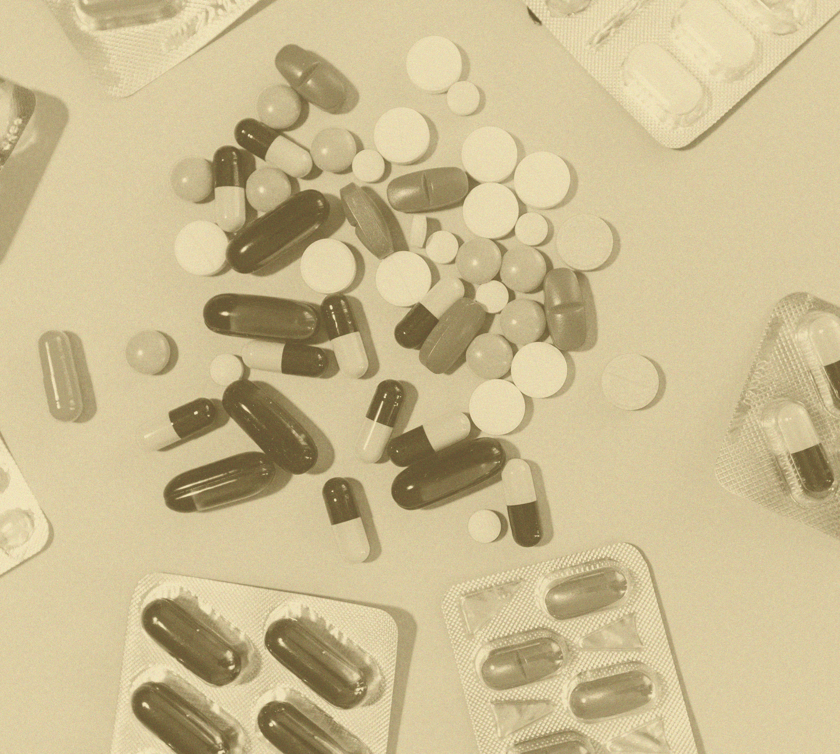
Substance use disorders and other addictions
Neurobiology and aetiology

