Slide 1
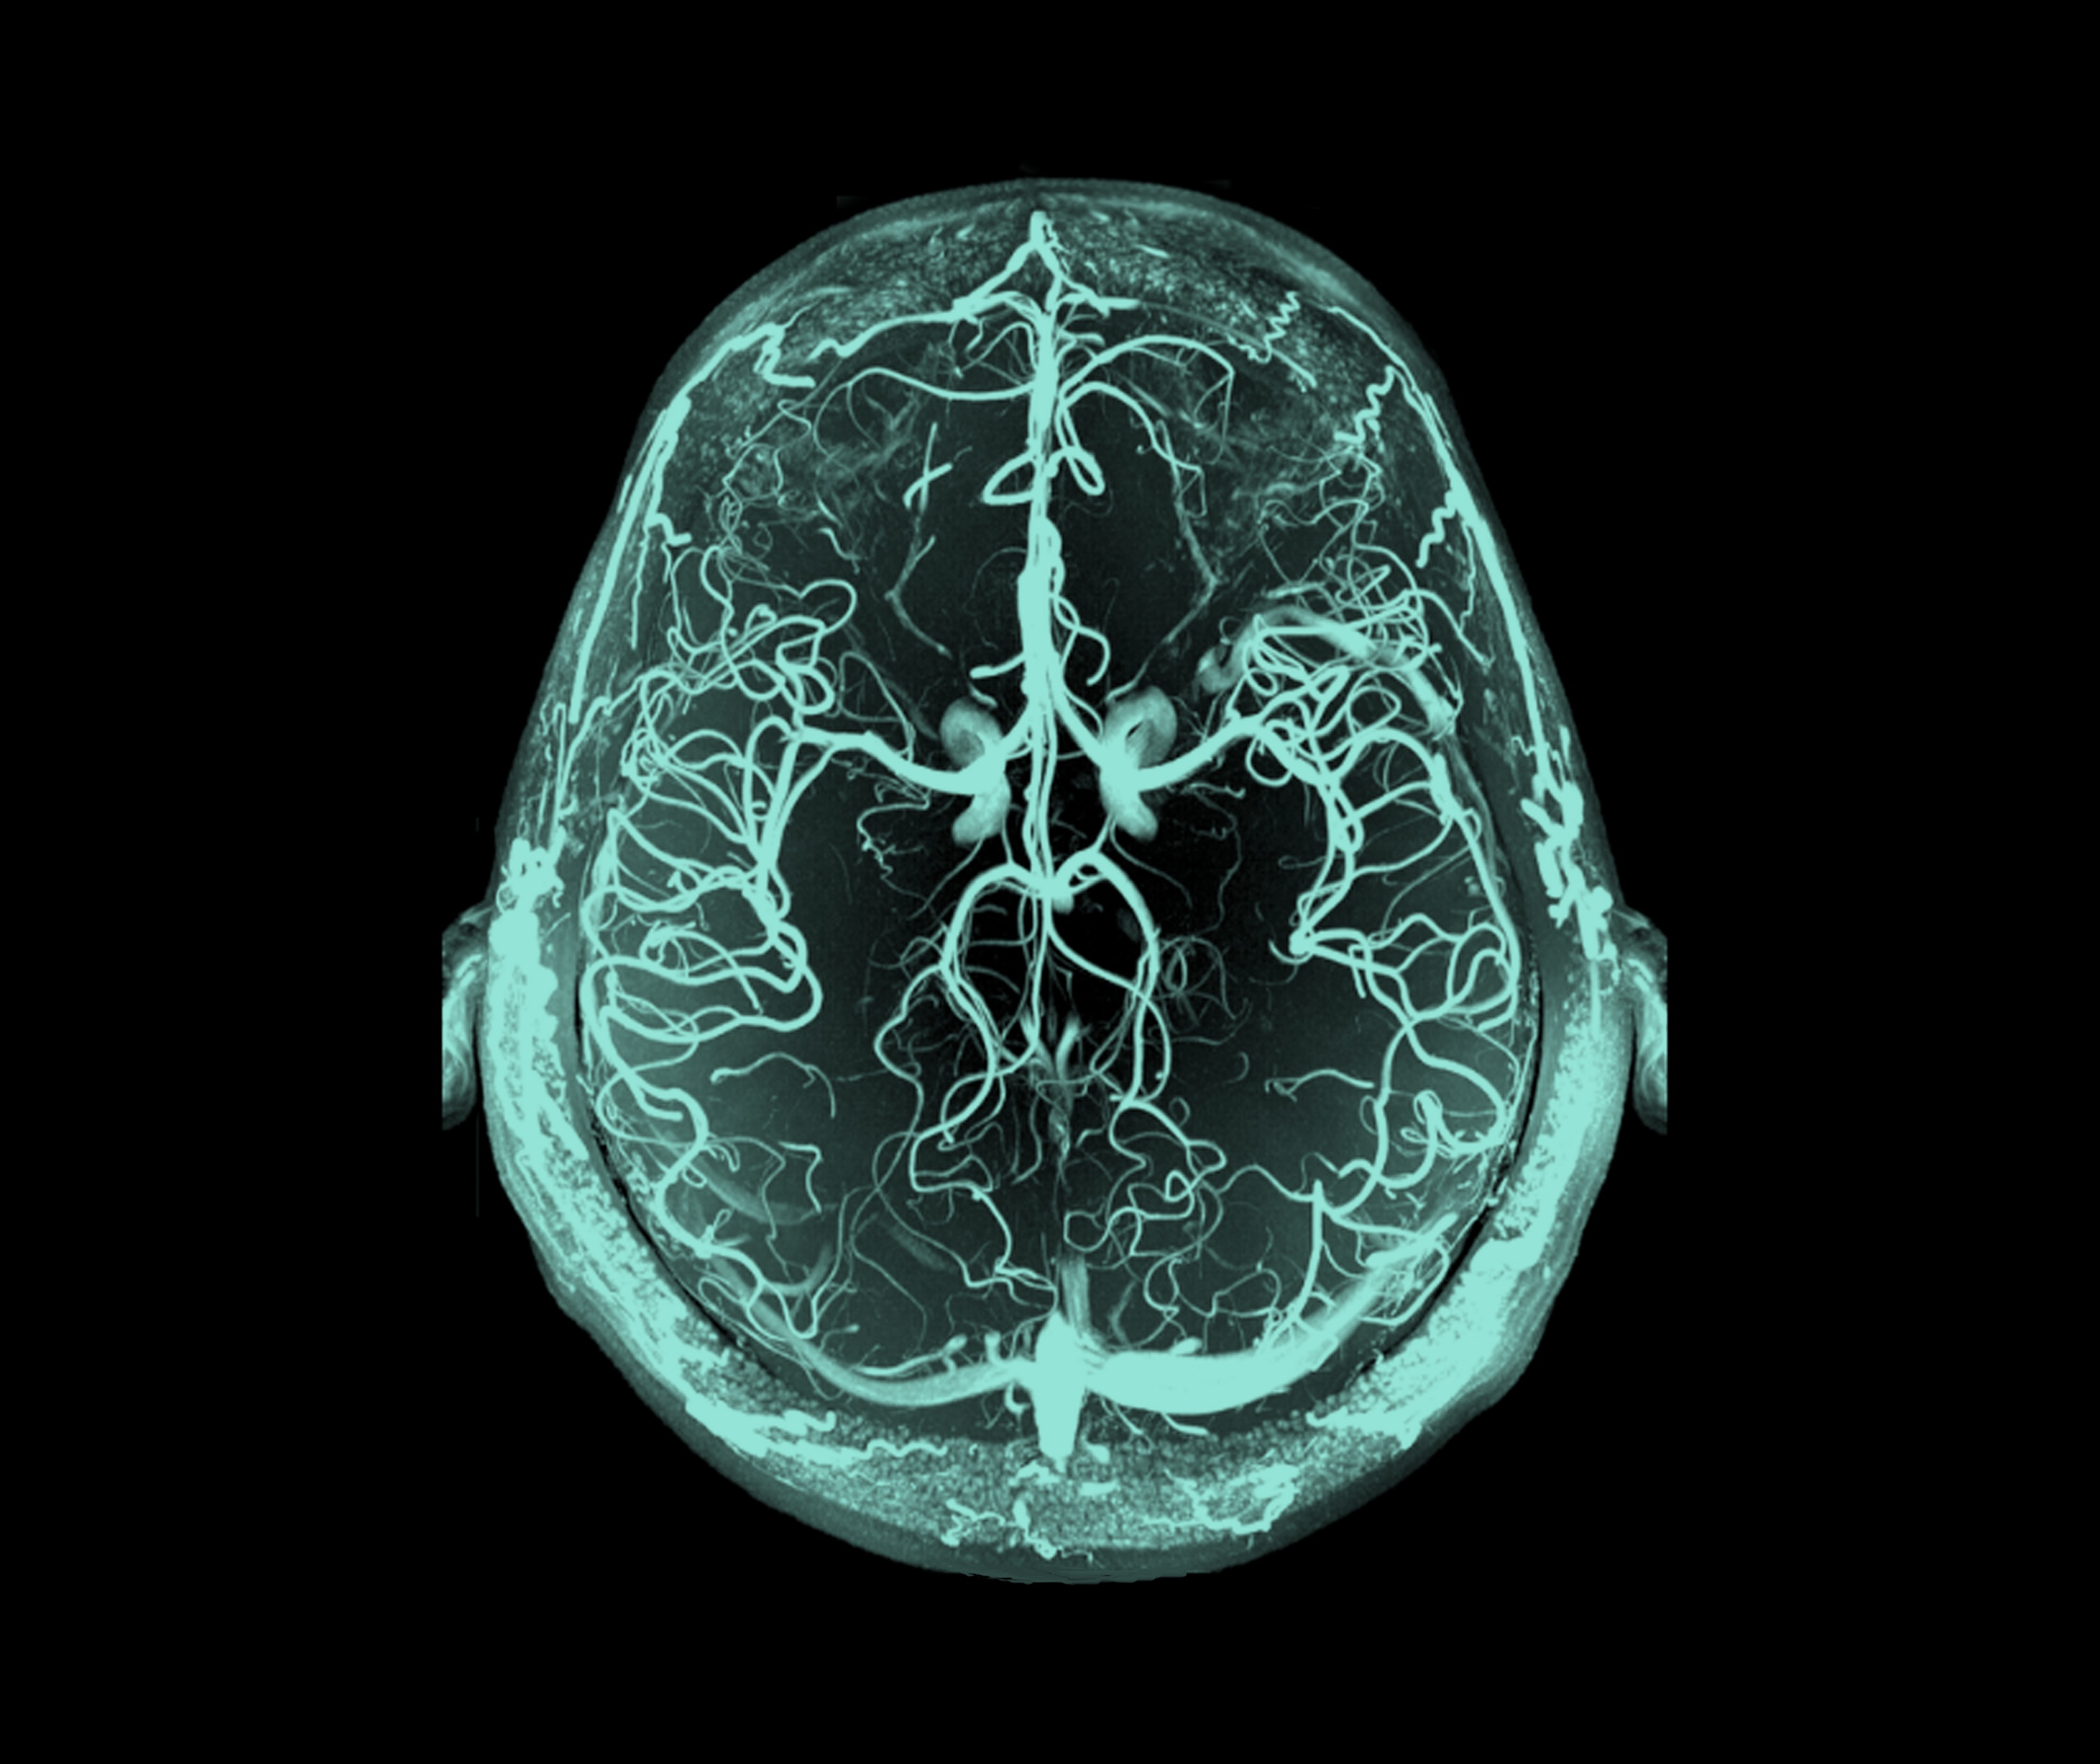
Bipolar disorder
Acute treatment

