Slide 1
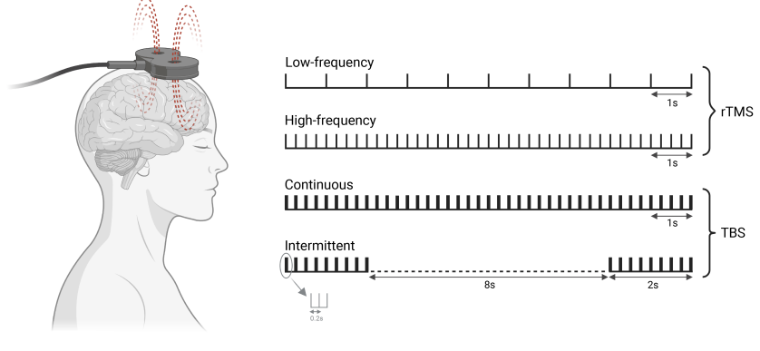
Transcranial magnetic stimulation (TMS)
Bipolar disorder – Acute treatment
TMS is a non-invasive brain stimulation technique, whereby an electromagnetic coil is placed over a patient’s scalp and certain regions of the brain are targeted with magnetic pulses that depolarize neurons¹
A meta-analysis found that TMS was an effective treatment for depressive symptoms in BD versus sham therapy:²
  Improvement in depressive symptoms, SMD: 0.302 (p<0.05)
  Improvement in remission rate, risk difference: 0.104 (p<0.05)
Another meta-analysis concluded that repeated TMS was more effective in treating bipolar depression than sham therapy when response rates were compared:³
  OR: 2.72 (95% CI: 1.44, 5.14)
More high-quality studies are needed to recommend TMS in the treatment of BD^{2,3}
Different forms of TMS protocols in treatment of BD⁴
This figure is from ‘Brain stimulation treatment for bipolar disorder’ by Mutz, used under CC-BY 4.0.
This work is licensed under Creative Commons license CC-BY-SA by The Lundbeck Foundation.
BD=bipolar disorder; CI=confidence interval; OR=odds ratio; SMD=standardized mean difference; TBS=theta burst stimulation; TMS=transcranial magnetic stimulation
1. Hett & Marwaha. Ther Adv Psychopharmacol 2020;10:2045125320973790; 2. Tee & Au. Psychiatr Q 2020;91(4):1225–1247;
3. Nguyen et al. J Affect Disord 2021279:250–255; 4. Mutz. Bipolar Disord 2023;25(1):9–24
Notes:
As outlined on the slide, there is some evidence suggesting that repetitive transcranial magnetic stimulation (TMS) is useful in the treatment of depression associated with bipolar disorder.^{2,3} However, there are fewer studies of TMS in bipolar mania.¹ One systematic review identified several studies of TMS in bipolar disorder, including two studies comparing TMS with sham therapy in bipolar mania and some open-label studies (as well as some less conclusive data), which taken together suggest a possible treatment effect in favour of TMS.¹ However, more studies are needed to fully understand how TMS can best help people with bipolar disorder.¹
References:
Hett D, Marwaha S. Repetitive transcranial magnetic stimulation in the treatment of bipolar disorder. Ther Adv Psychopharmacol 2020; 10: 2045125320973790.
Tee MMK, Au CH. A systematic review and meta-analysis of randomized sham-controlled trials of repetitive transcranial magnetic stimulation for bipolar disorder. Psychiatr Q 2020; 91 (4): 1225–1247.
Nguyen TD, Hieronymus F, Lorentzen R, et al. The efficacy of repetitive transcranial magnetic stimulation (rTMS) for bipolar depression: a systematic review and meta-analysis. J Affect Disord 2021; 279: 250–255.
Mutz J. Brain stimulation treatment for bipolar disorder. Bipolar Disord 2023; 25 (1): 9–24.

