Slide 1
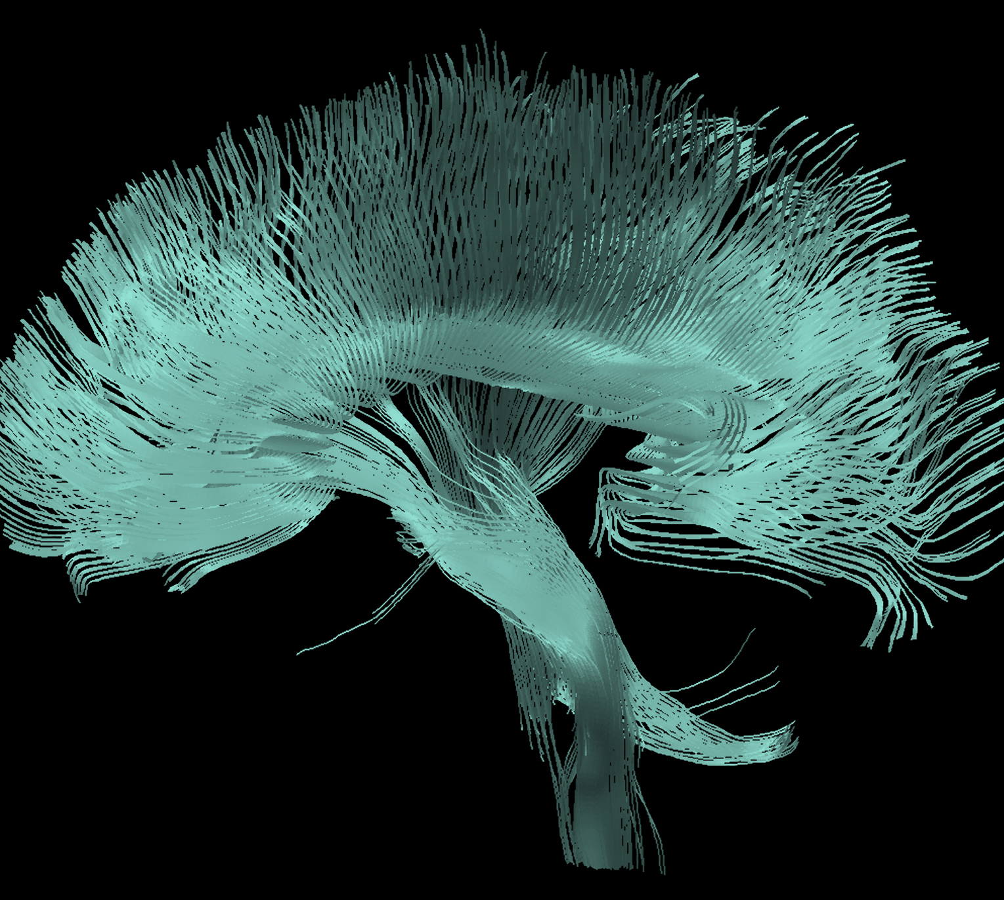
Bipolar disorder
Comorbidities

