Slide 1
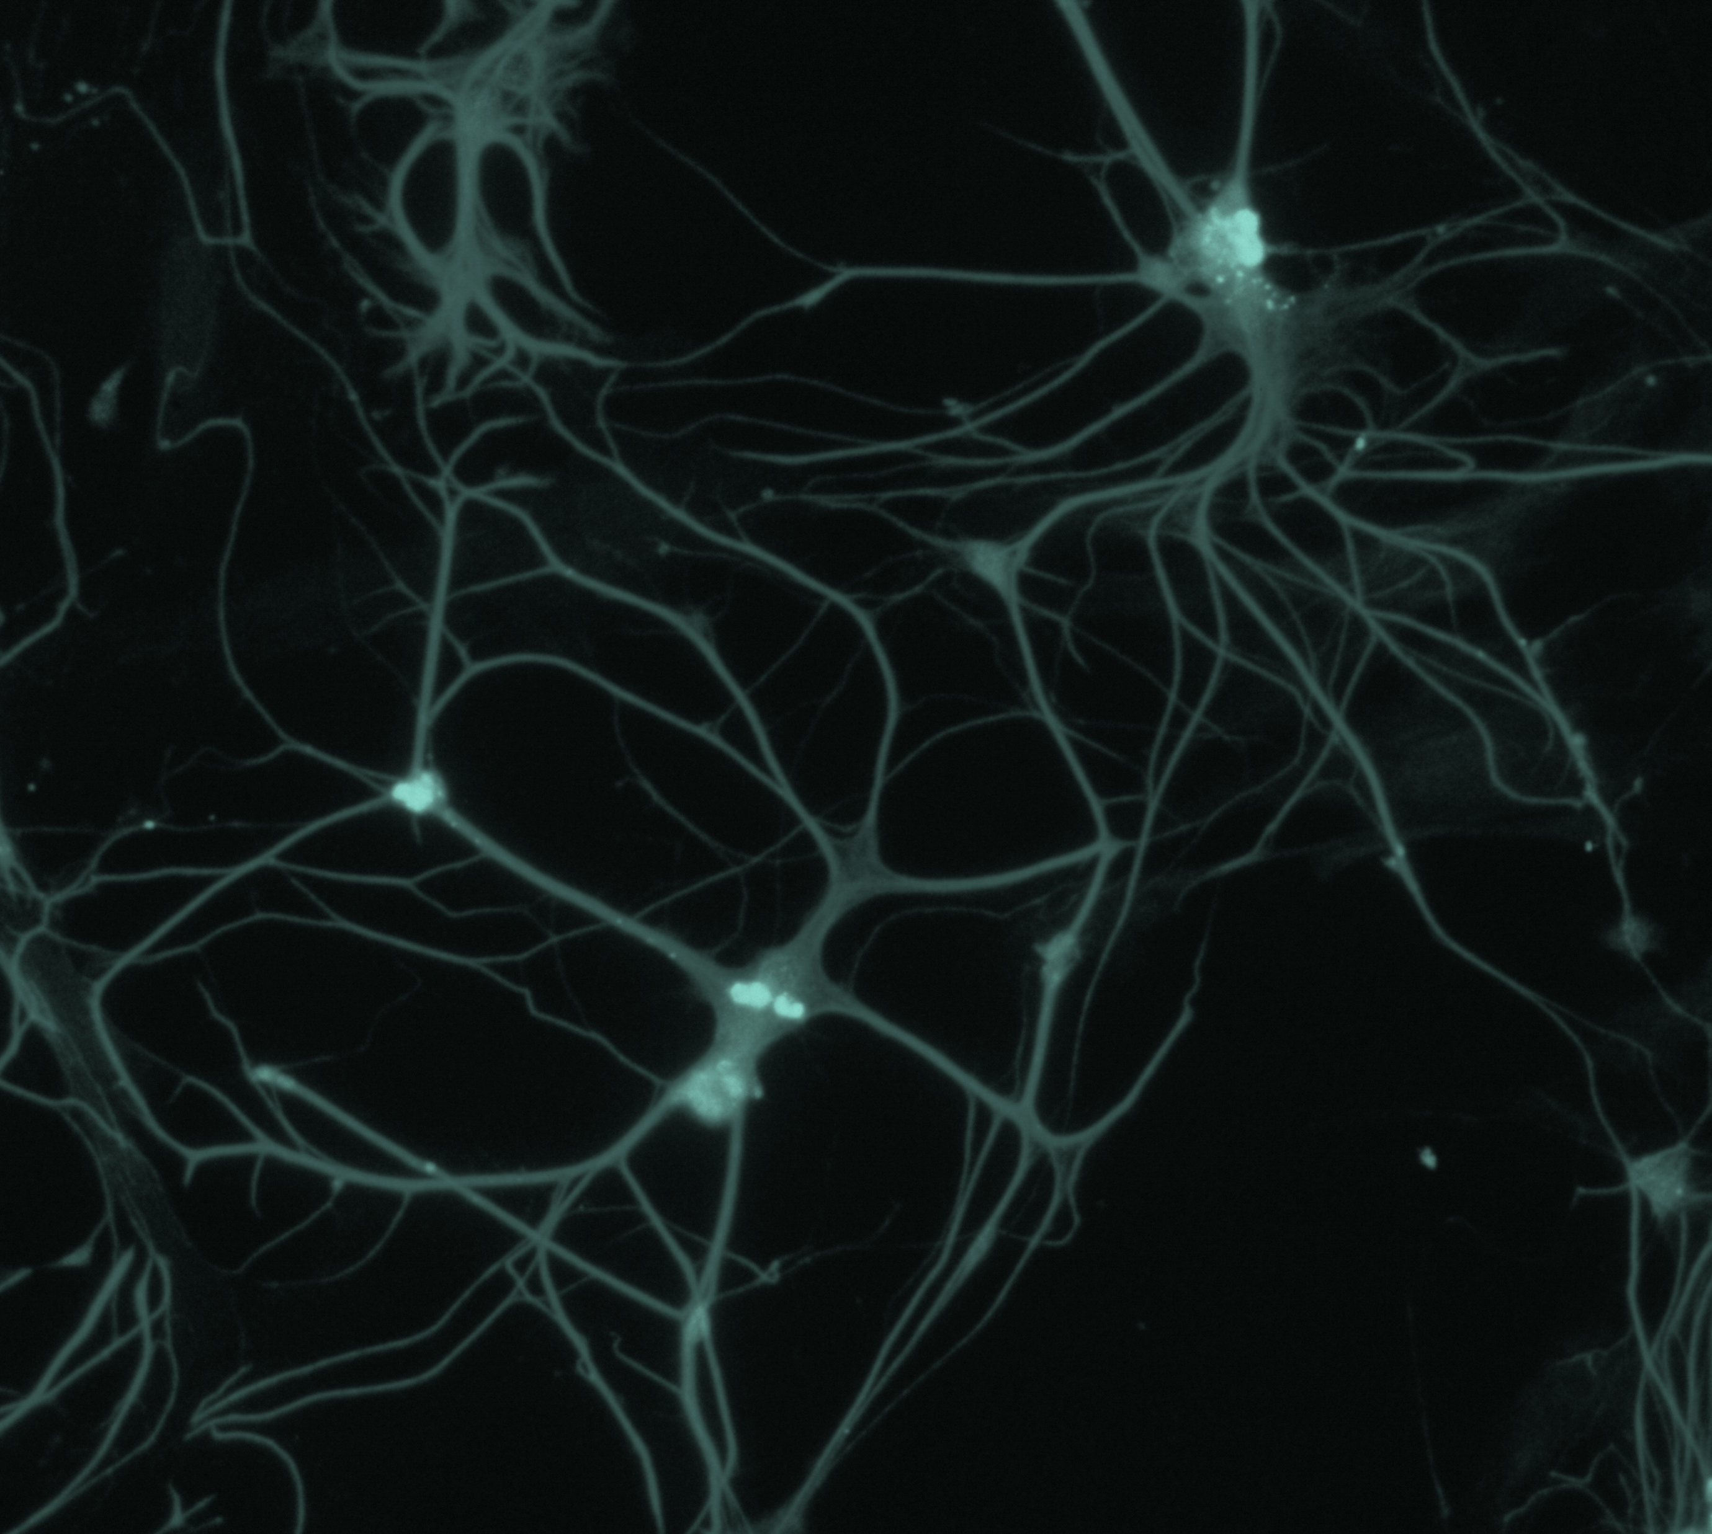
Bipolar disorder
Course, natural history, and prognosis

