Slide 1
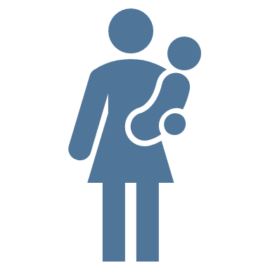
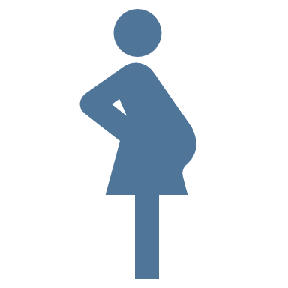





Perinatal and juvenile risk factors for bipolar disorder
Bipolar disorder – Course, natural history, and prognosis
Various maternal stressors or early adverse life events appear to increase the risk of BD, including exposure to war, smoking, and infection
Smoking during pregnancy has been shown to double the risk of BD
Maternal stress, e.g., exposure to war stress, can more than double the risk of their child developing BD, whilst parental loss can up to quadruple the risk of BD
Premature birth, or a low birth weight can increase the risk of BD by as much as 7 times
Early exposure to illicit drugs, including cannabis, cocaine, and opiates, appears to predict BD and mania, increasing the risk by as much as 11 times
BD=bipolar disorder
Faedda et al. Bipolar Disord 2019;21(8):720–740
Notes:
Many different perinatal and juvenile factors have been shown to increase the risk of developing bipolar disorder, as outlined on the slide.¹ However, disentangling the risk of bipolar disorder from that of other mood disorders can be challenging, because many of these factors also increase the risk of depression, or psychotic disorders.¹
Reference:
Faedda GL, Baldessarini RJ, Marangoni C, et al. An International Society of Bipolar Disorders task force report: precursors and prodromes of bipolar disorder. Bipolar Disord 2019; 21 (8): 720–740.

