Slide 1
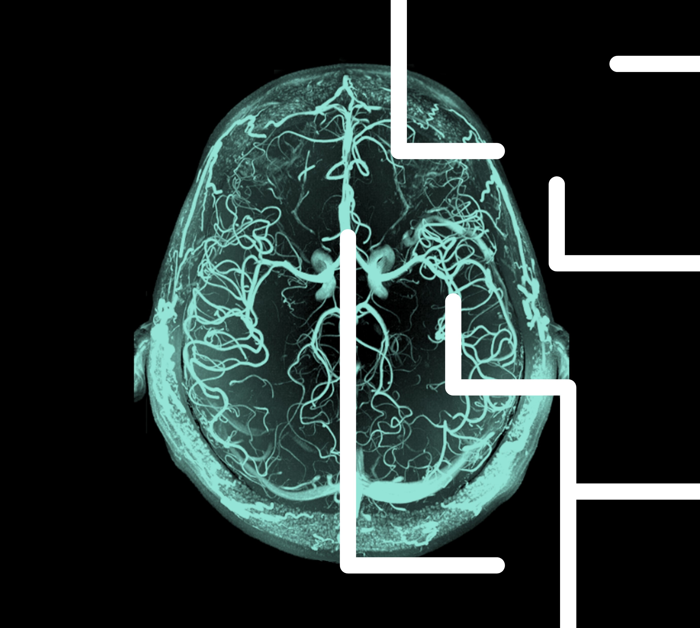
Bipolar disorder
History, definitions, diagnosis, epidemiology, and burden

