Slide 1
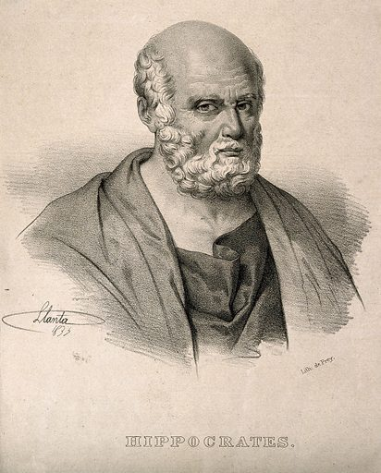
The history of bipolar disorder
Bipolar disorder – History, definitions, diagnosis, epidemiology, and burden
DSM-III-R clarified the description from ‘physical restlessness’ to ‘psychomotor agitation’ as a component of the goal-directed activity criteria for a manic episode⁸
DSM-IV introduced ‘mixed episode’ as its own type of episode with diagnostic criteria⁹
Emil Kraepelin characterized all dysfunction of mood into what he termed ‘dementia praecox’ and ‘manic–depressive insanity’^{1,3}
Hippocrates was among the first to document two extreme moods¹
Jean-Pierre Falret described
a new disorder encompassing depression and mania, known as ‘folie circulaire’^{1,3}
DSM-II renamed disorder subtypes, and characterized schizophrenia as a separate disorder^{4,6}
460–370 BC
1851
Late 1800s
1968
1987
1994
2013
900
1863
1952
1980
Physician Ishaq Ibn Imran published the concept of melancholia which includes the modern-day ‘manic-depressive illness’ or ‘bipolar disorder’²
Karl Kahlbaum distinguished two groups of mental disorders based on symptoms and outcomes – ‘vecordia’ and ‘vesania’^{3,4}
The DSM-I was developed, separating what was previously known as ‘manic–depressive insanity’ into three types: manic, depressed, and other⁵
DSM-III identified BD for the first time, and introduced the term ‘hypomania’^{4,7}
DSM-5 edited the criteria for ‘manic episode’, converted ‘mixed episode’ from a separate diagnostic category to the ‘with mixed features’ specifier, and classified goal-directed activity/energy as a key feature
of manic episodes¹⁰
BD=bipolar disorder; DSM=Diagnostic and Statistical Manual of Mental Disorders; R=revised
1. Angst et al. J Affect Disord 2001;67(1–3):3–19; 2. Omrani et al. J Affect Disord 2012;141(2–3):116–119; 3. Angst. Schizophr Res 2002;57(1):5–13;
4. Mason et al. Behav Sci (Basel) 2016;6(3):14; 5. APA DSM-I 1952; 6. APA DSM-II 1968; 7. APA DSM-III 1980; 8. APA DSM-III-R 1987; 9. APA DSM-IV 1994; 10. APA DSM-5 2013
Notes:
The two extreme moods of melancholia and mania have been documented as early as the time of Hippocrates.¹ In 900, Ishaq Ibn Imran wrote the monograph on melancholia, which today, is the oldest surviving manuscript dedicated to this topic.² Up until the 19th century, melancholia and mania were believed to be two completely different disorders, characterized by a variety of psychiatric symptoms.⁴ Jean-Pierre Falret termed a new disorder ‘folie circulaire’, which was characterized by a continuous cycle of depression, mania, and free intervals of varying length in between.^{1,3} His contemporary Jules Baillarger described ‘folie à double forme’ in which mania and melancholia change into one another, however there was no requirement for a free interval between the two.⁴ In 1863, Karl Kahlbaum suggested two large groups of mental disorders distinguished on the basis of symptoms and outcome – ‘vecordia’, which denoted limited disturbance of the mind, and ‘vesania’, which denoted a complete disturbance of the mind.⁴ Emil Kraeplin developed the work of Kahlbaum and Falret, and attempted to combine mania, depression, and all psychotic states into what he termed ‘dementia praecox’ and ‘manic–depressive insanity’,^{1,3,4} now referred to as schizophrenia and bipolar disorder, respectively.⁴
The DSM-I (1952) provided the first attempt to categorize and standardize mental illness.⁴ It classified manic-depression as a psychotic disorder, “characterized by a varying degree of personality integration and a failure to test and evaluate correctly external reality in various spheres”.⁵ Three types were described: manic, which is most similar to the modern day description of mania; depressed, which is most similar to what we know as major depressive disorder, and other, which included mixed states or cycling as a feature.^{4,5} Since then, the classification has undergone a variety of changes, to bipolar disorder encompassing three subtypes – bipolar I disorder, bipolar II disorder, and cyclothymia.⁶⁻¹¹
References:
Angst J, Marneros A. Bipolarity from ancient to modern times: conception, birth and rebirth. J Affect Disord 2001; 67 (1–3): 3–19.
Omrani A, Holtzman NS, Akiskal HS, Ghaemi SN. Ibn Imran's 10th century treatise on melancholy. J Affect Disord 2012; 141 (2–3): 116–119.
Angst J. Historical aspects of the dichotomy between manic–depressive disorders and schizophrenia. Schizophr Res 2002; 57 (1): 5–13.
Mason BL, Brown ES, Croarkin PE. Historical underpinnings of bipolar disorder diagnostic criteria. Behav Sci (Basel) 2016; 6 (3): 14.
American Psychiatric Association (APA). Diagnostic and Statistical Manual of Mental Disorders. First edition. Washington DC: APA; 1952.
American Psychiatric Association (APA). Diagnostic and Statistical Manual of Mental Disorders. Second edition. Washington DC: APA; 1968.
American Psychiatric Association (APA). Diagnostic and Statistical Manual of Mental Disorders. Third edition. Washington DC: APA; 1980.
American Psychiatric Association (APA). Diagnostic and Statistical Manual of Mental Disorders. Third edition, revision. Washington DC: APA; 1987.
American Psychiatric Association (APA). Diagnostic and Statistical Manual of Mental Disorders. Fourth edition. Washington DC: APA; 1994.
American Psychiatric Association (APA). Diagnostic and Statistical Manual of Mental Disorders. Fifth edition. Arlington VA: APA; 2013.
American Psychiatric Association (APA). Diagnostic and Statistical Manual of Mental Disorders. Fifth edition, text revision. Washington DC: APA; 2022.

