Slide 1
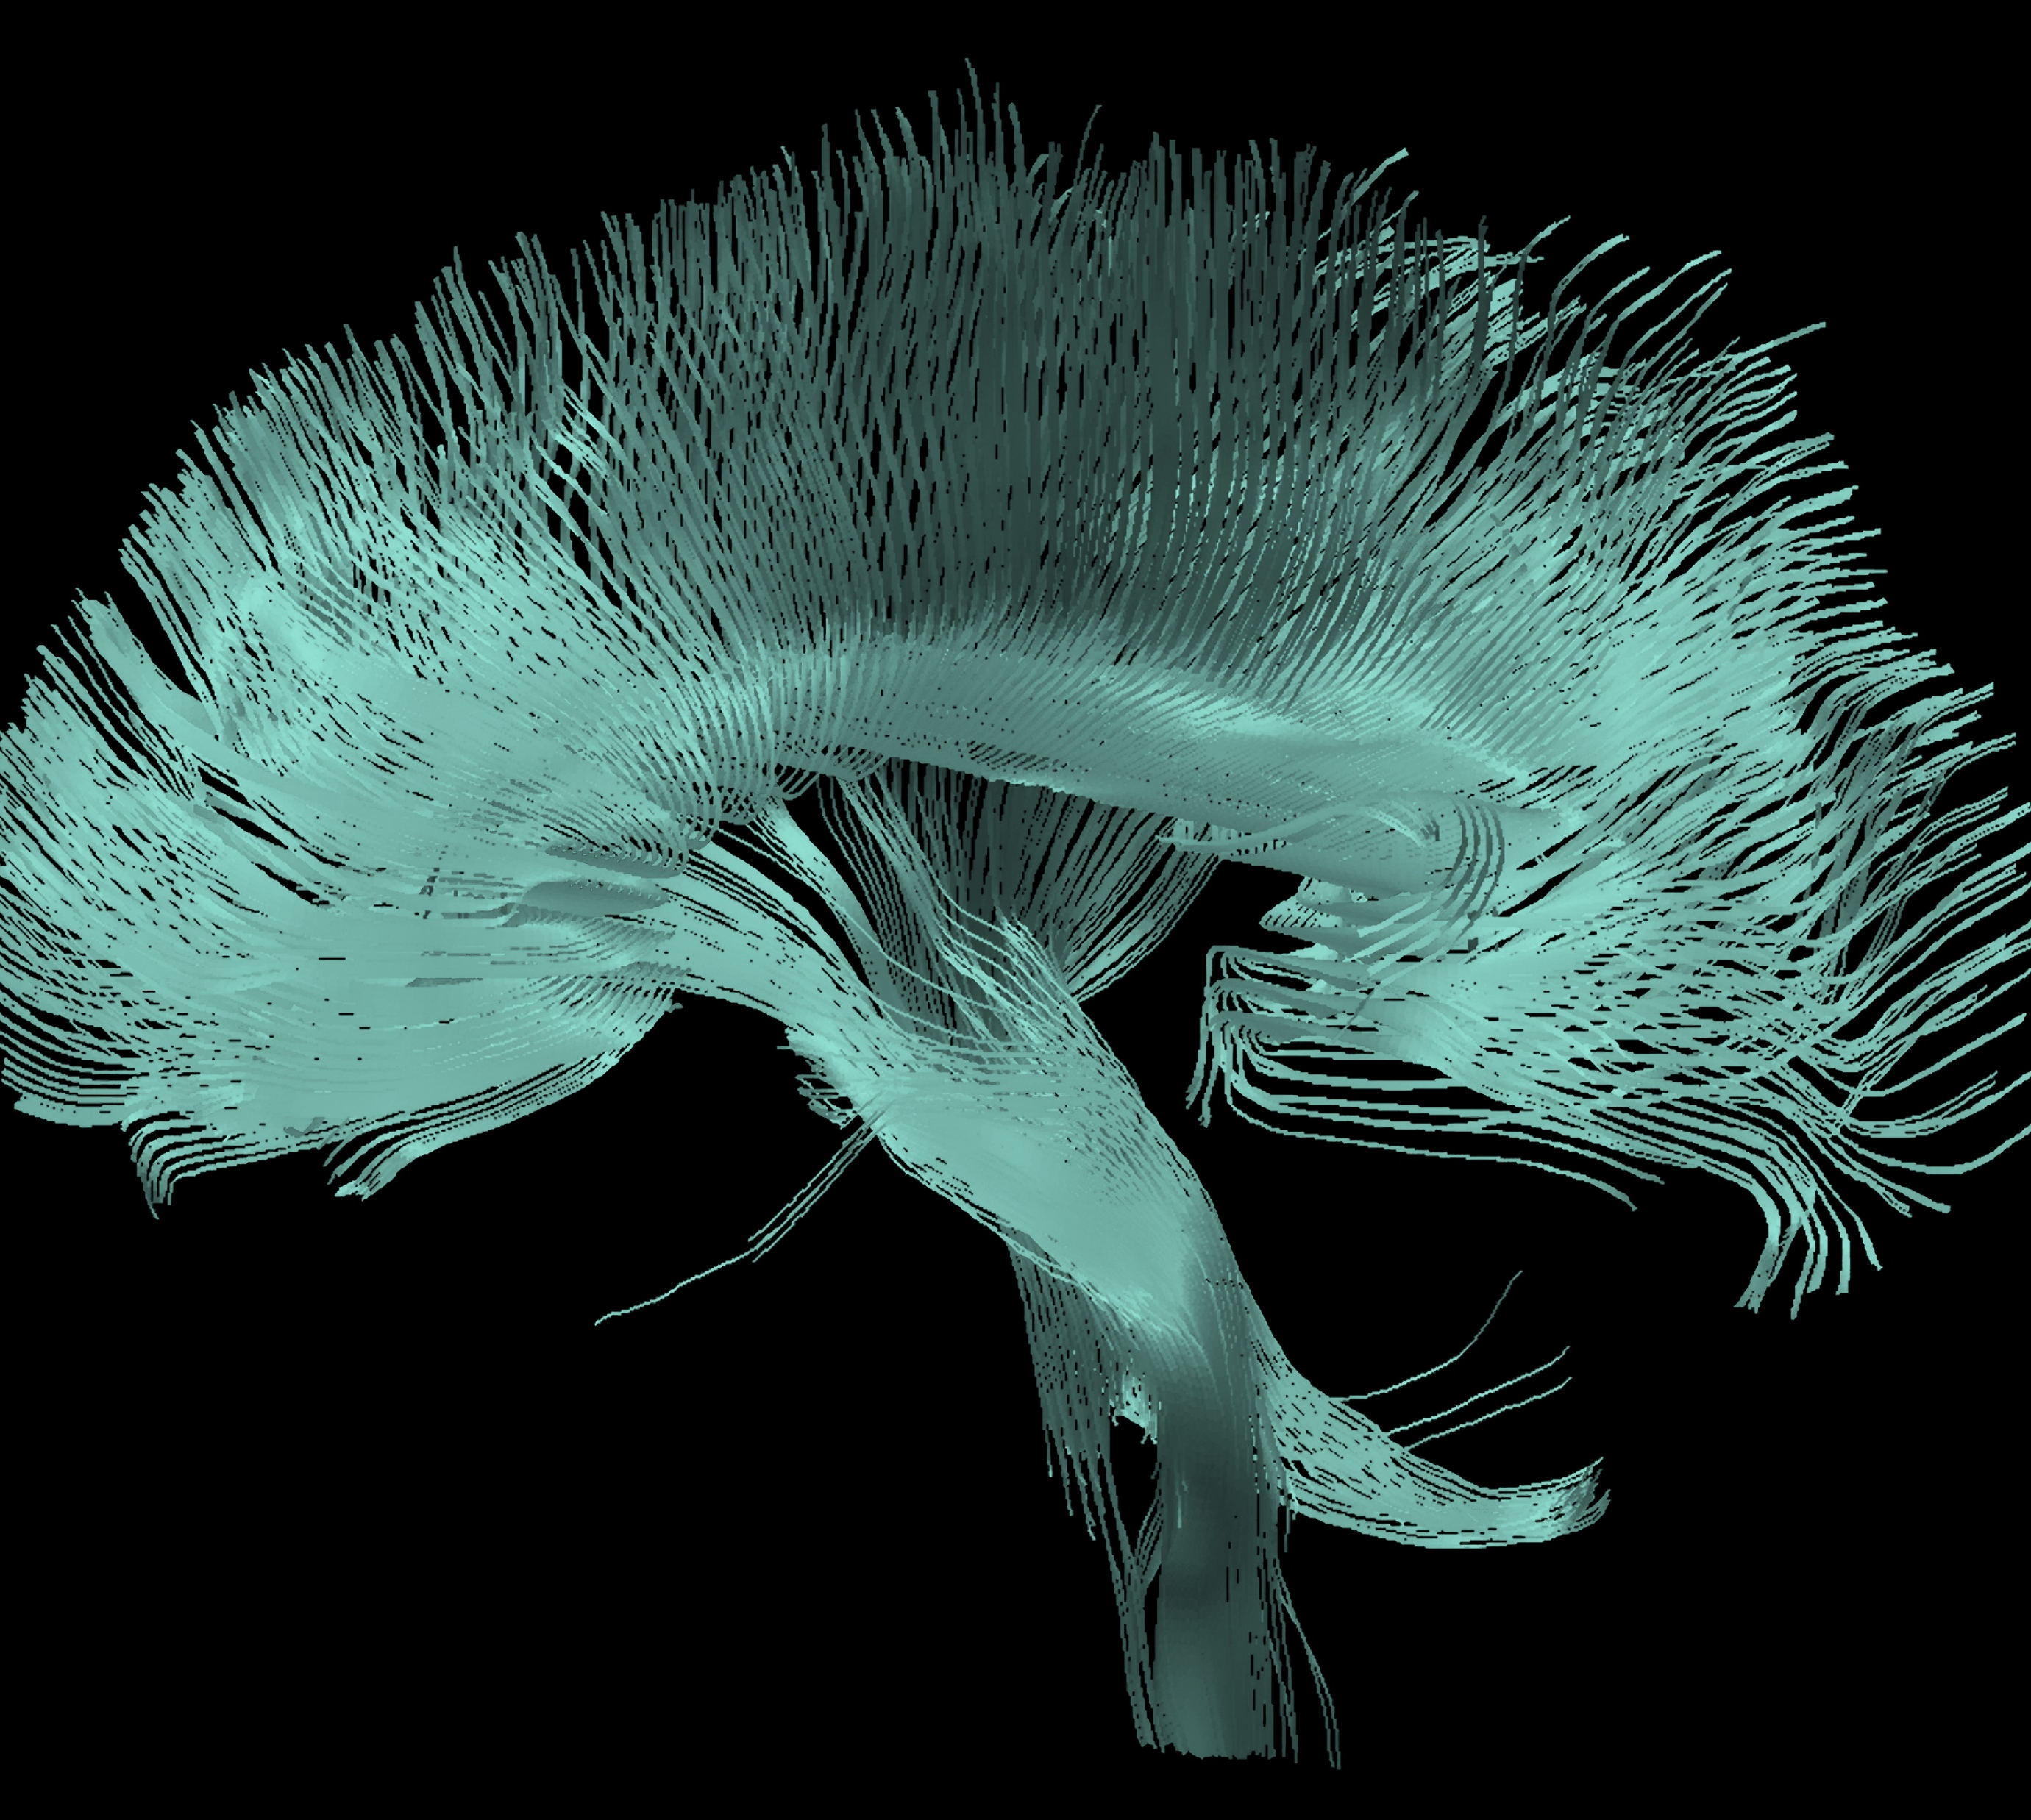
Bipolar disorder
Maintenance treatment

