Slide 1
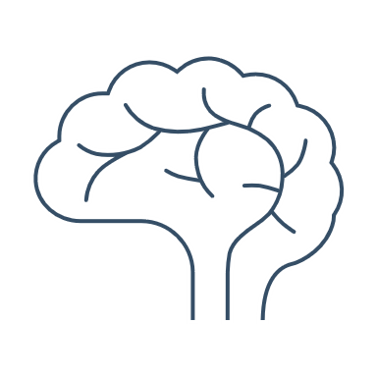

Other nonpharmacologic biological treatments
Bipolar disorder – Maintenance treatment
Transcranial magnetic stimulation (TMS): a magnetic field is used to depolarize superficial neurons and initiate action potentials in the brain. TMS can target specific sites in the brain
Vagus nerve stimulation (VNS): electrical stimulation of the afferent projections of the vagus nerve occurs through electrodes that are wrapped around the left vagus nerve and connected to a pulse generator implanted beneath the skin near the upper chest
Deep brain stimulation (DBS): electrical stimulation is delivered to specific brain regions through electrodes that are surgically implanted into the brain, and connected to a neurostimulator implanted beneath the skin just above the chest
Electroconvulsive therapy (ECT): an electric current is applied to the head, which induces a generalized seizure
Transcranial direct current stimulation (tDCS):
a weak (∼0.5–2 mA) direct current is applied via scalp electrodes overlying cortical areas. As a result, the excitability of cortical tissue is altered
Magnetic seizure therapy (MST): high-frequency magnetic pulses stimulate specific areas in the brain to induce a seizure
Mutz J. Bipolar Disord 2023;25(1):9–24
Notes:
There is increasing interest in brain stimulation techniques, as an add-on or as an alternative to existing treatments for bipolar disorder.¹ There are various such techniques, as outlined on the slide.¹ However, currently the evidence regarding the use of such treatments for the prevention of relapse or recurrence in bipolar disorder is limited.¹
Reference:
Mutz J. Brain stimulation treatment for bipolar disorder. Bipolar Disord 2023; 25 (1): 9–24.

