Slide 1
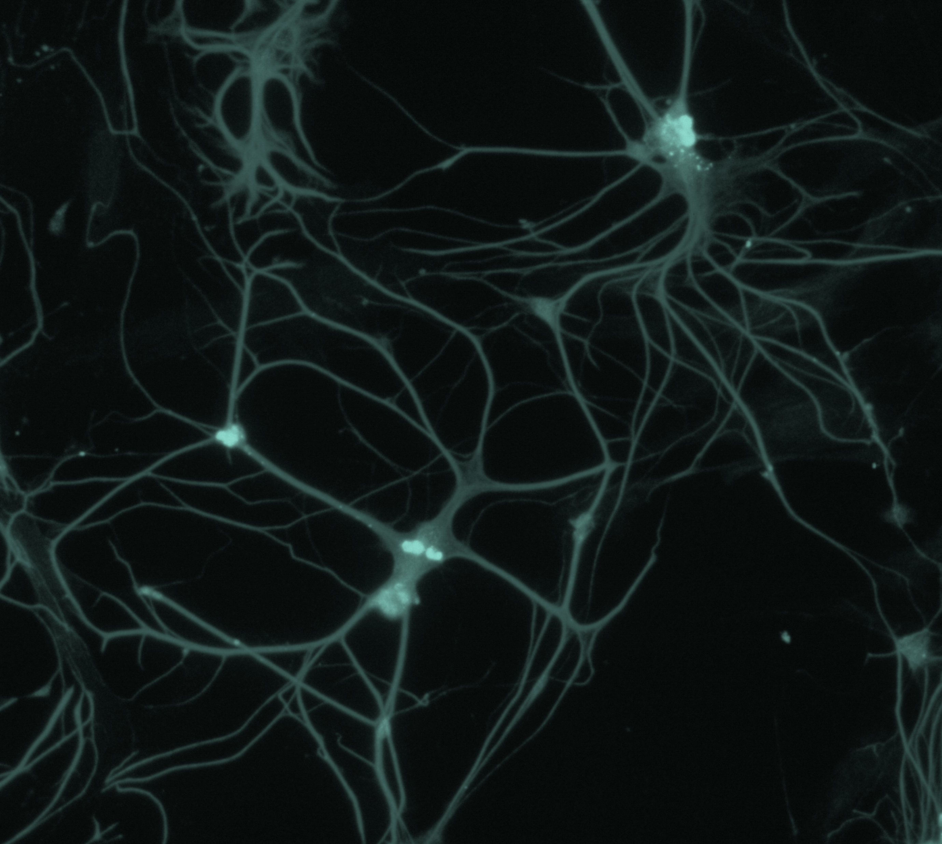
Bipolar disorder
Neurobiology and aetiology

