Slide 1
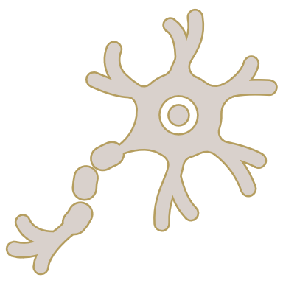
The aetiology of bipolar disorder
Bipolar disorder – Neurobiology and aetiology
Although the exact cause(s) of BD are not fully understood, the condition is thought to be the result of a complex interplay of genetic, environmental, and biochemical factors¹
Environment³
Factors such as early life trauma, substance and drug use, and stressful life events have been implicated in the aetiology of BD
Genetics^{1,2}
An increasing weight of GWAS data are suggesting that the function of some genes are important in the pathology of BD, including the function of calcium channels
Biochemical/neurochemical¹Many biochemical pathways interact in BD to cause cell damage, mitochondrial dysfunction, inflammation, and impairment in cell function
BD=bipolar disorder; GWAS=genome-wide association study
1. Scaini et al. Braz J Psychiatry 2020;42(5):536–551; 2. Harrison et al. Trends Neurosci 2018;41(1):18–30; 3. Vieta et al. Nat Rev Dis Primers 2018;4:18008
Notes:
Bipolar disorders are characterized by biphasic mood disturbances of (hypo)manic and depressive episodes.³ Better understood now than in the past, bipolar disorder is believed to be brought about by a complex interplay of genetic, environmental, and neurological factors.¹⁻⁴
References:
Scaini G, Valvassori SS, Diaz AP, et al. Neurobiology of bipolar disorders: a review of genetic components, signaling pathways, biochemical changes, and neuroimaging findings. Braz J Psychiatry 2020; 42 (5): 536–551.
Harrison PJ, Geddes JR, Tunbridge EM. The emerging neurobiology of bipolar disorder. Trends Neurosci 2018; 41 (1): 18–30.
Vieta E, Berk M, Schulze TG, et al. Bipolar disorders. Nat Rev Dis Primers 2018; 4: 18008.
Charney AW, Mullins N, Park YJ, Xu J. On the diagnostic and neurobiological origins of bipolar disorder. Transl Psychiatry 2020; 10 (1): 118.

