Slide 1
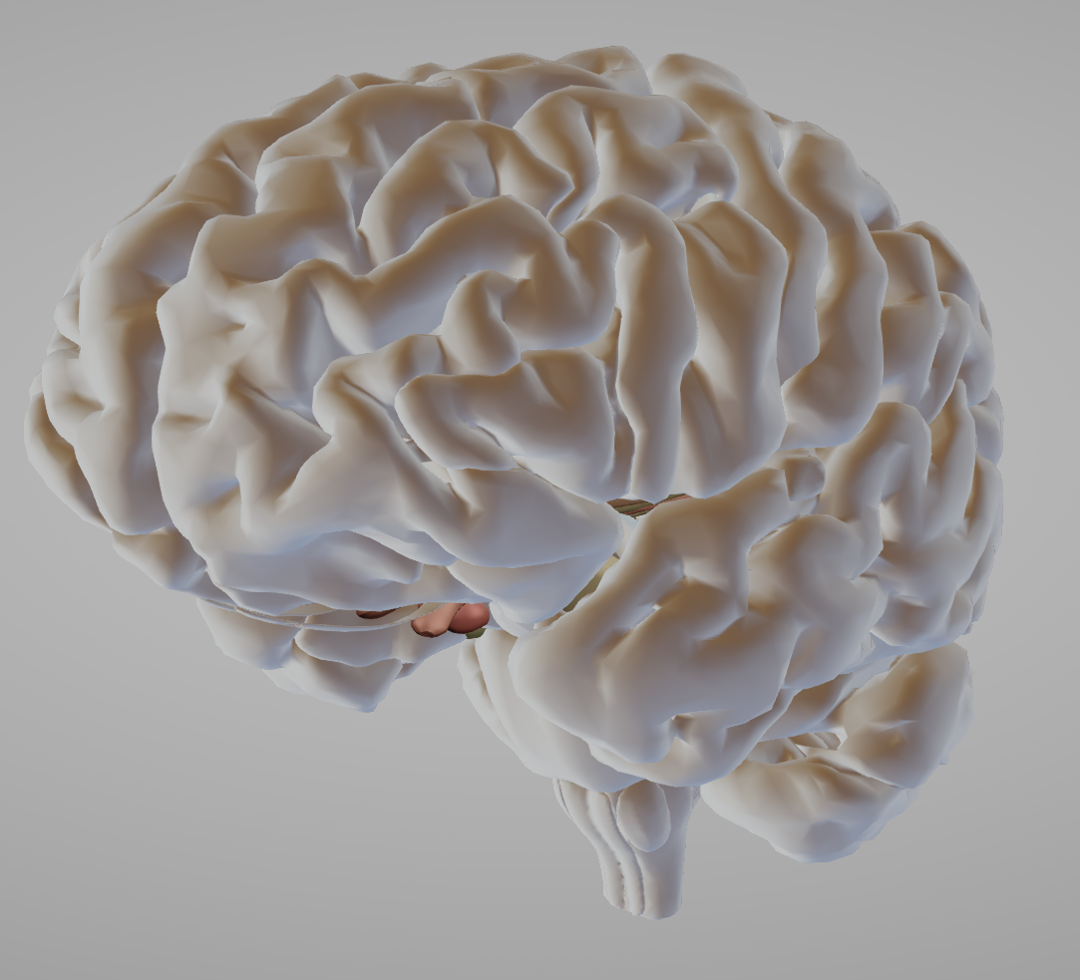
Structural neuroimaging
Bipolar disorder – Neurobiology and aetiology
Structural neuroimaging studies have revealed interesting changes in the brains of people with BD^{1,2}
Large-scale studies have analyzed the brains of people from the ENIGMA-BD working group using MRI¹⁻²
One analysis of 1,710 people with BD compared with 2,594 control brains found significant differences in brains of people with BD versus controls:¹
  Reductions in hippocampus volume (Cohen’s d: -0.232; p=3.50 x10⁻⁷)
  Reductions in thalamus volume (Cohen’s d: -0.148; p=4.27 x10⁻³)
  Enlargement in lateral ventricles volume (Cohen’s d: 0.260; p=3.93 x10⁻⁵)
Another analysis of 2,447 people with BD compared with control MRIs, found that people with BD showed significant differences in several areas on the left-side of the brain:²
  Left pars opercularis (Cohen’s d: -0.293; p=1.71 x10⁻²¹)
  Left fusiform gyrus (Cohen’s d: -0.288; p=8.25 x10⁻²¹)
  Left rostral middle frontal cortex (Cohen’s d: -0.276; p=2.99 x10⁻¹⁹)
Interestingly, when the brains of people with BD-I were compared with those of people with BD-II, no significant differences in cortical thickness or surface area were detected²
BD=bipolar disorder; ENIGMA=enhancing neuroimaging genetics through meta-analysis; MRI-magnetic resonance imaging
1. Hibar et al. Mol Psychiatry 2016;21(12):1710–1716; 2. Hibar et al. Mol Psychiatry 2018;23(4):932–942
Notes:
Several structural differences have been shown in neuroimaging studies of people with bipolar disorder.^{1,2} Interestingly, it is becoming possible to separate brain abnormalities that appear to be present early in the disease – such as prefrontal cortex, striatum, and amygdala changes – from changes that appear to present later in the disease – such as those in the cerebellar vermis, and the lateral ventricles.³ It has been hypothesized therefore, that whilst these latter changes may represent the effect of illness progression, the former changes may exist before illness onset.³
References:
Hibar DP, Westlye LT, van Erp TG, et al. Subcortical volumetric abnormalities in bipolar disorder. Mol Psychiatry 2016; 21 (12): 1710–1716.
Hibar DP, Westlye LT, Doan NT, et al. Cortical abnormalities in bipolar disorder: an MRI analysis of 6503 individuals from the ENIGMA Bipolar Disorder Working Group. Mol Psychiatry 2018; 23 (4): 932–942.
Strakowski SM, Delbello MP, Adler CM. The functional neuroanatomy of bipolar disorder: a review of neuroimaging findings. Mol Psychiatry 2005; 10 (1): 105–116.

