Slide 1
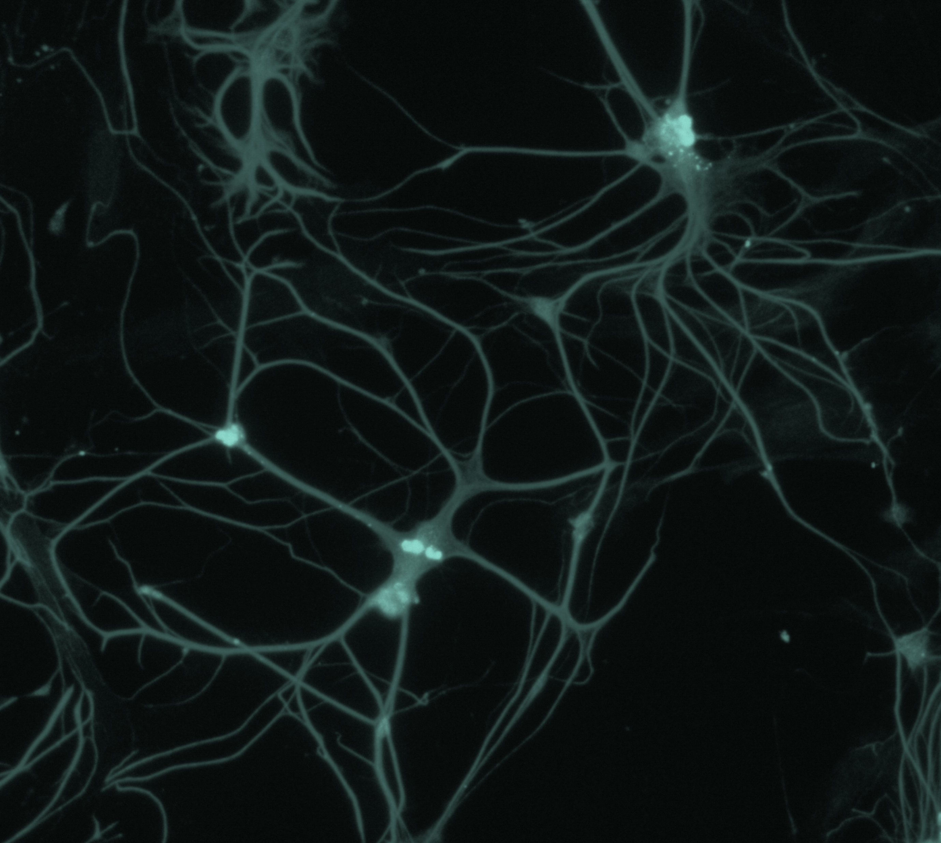
Bipolar disorder
Neurobiology and aetiology

Slide 2
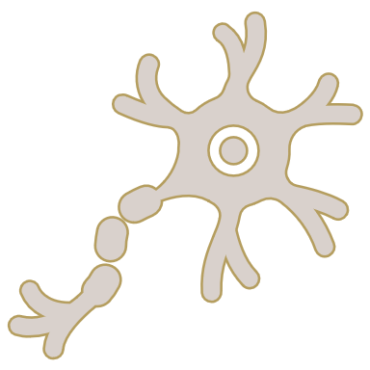
The aetiology of bipolar disorder
Bipolar disorder – Neurobiology and aetiology
Although the exact cause(s) of BD are not fully understood, the condition is thought to be the result of a complex interplay of genetic, environmental, and biochemical factors¹
Environment³
Factors such as early life trauma, substance and drug use, and stressful life events have been implicated in the aetiology of BD
Genetics^{1,2}
An increasing weight of GWAS data are suggesting that the function of some genes are important in the pathology of BD, including the function of calcium channels
Biochemical/neurochemical¹Many biochemical pathways interact in BD to cause cell damage, mitochondrial dysfunction, inflammation, and impairment in cell function
BD=bipolar disorder; GWAS=genome-wide association study
1. Scaini et al. Braz J Psychiatry 2020;42(5):536–551; 2. Harrison et al. Trends Neurosci 2018;41(1):18–30; 3. Vieta et al. Nat Rev Dis Primers 2018;4:18008
Notes:
Bipolar disorders are characterized by biphasic mood disturbances of (hypo)manic and depressive episodes.³ Better understood now than in the past, bipolar disorder is believed to be brought about by a complex interplay of genetic, environmental, and neurological factors.¹⁻⁴
References:
Scaini G, Valvassori SS, Diaz AP, et al. Neurobiology of bipolar disorders: a review of genetic components, signaling pathways, biochemical changes, and neuroimaging findings. Braz J Psychiatry 2020; 42 (5): 536–551.
Harrison PJ, Geddes JR, Tunbridge EM. The emerging neurobiology of bipolar disorder. Trends Neurosci 2018; 41 (1): 18–30.
Vieta E, Berk M, Schulze TG, et al. Bipolar disorders. Nat Rev Dis Primers 2018; 4: 18008.
Charney AW, Mullins N, Park YJ, Xu J. On the diagnostic and neurobiological origins of bipolar disorder. Transl Psychiatry 2020; 10 (1): 118.

Slide 3
The genetics of bipolar disorder

Slide 4
Heritability of bipolar disorders
Bipolar disorder – Neurobiology and aetiology
BD is a highly heritable disorder¹⁻⁴
The heritability of BD has been investigated in family studies, using twins and adopted pairs, as well as in cohort and population studies¹
One study used 303 pairs of twins to estimate the concordance rates of different disorders within the BD spectrum⁴
  Heritability of BD-I: 0.73
  Heritability of BD-I and BD-II: 0.77
  Heritability of BD-I and BD-II and cyclothymia: 0.71
Studying the heritability of BD is complicated by the lack of a consistent approach to diagnosis and definitions over the years^{2,3}
Estimated heritability of BD compared with other psychiatric disorders¹
1
Estimated heritability of BD
Heritability
0
Schizophrenia
Alcohol-use disorder
MDD
BD is thought to be highly heritable, more so than many other psychiatric conditions such as schizophrenia, alcohol-use disorder, or MDD¹
BD=bipolar disorder; MDD=major depressive disorder
1. O’Connell et al. Psychol Med 2021;51(13):2156–2167; 2. Vieta et al. Nat Rev Dis Primers 2018;4:18008;
3. McGuffin et al. Arch Gen Psychiatry 2003;60(5):497–502; 4. Edvardsen et al. J Affect Disord 2008;106(3):229–240
This work is adapted from ‘Genetic contributions to bipolar disorder: current status and future directions' by O’Connell et al., used under CC BY 4.0. This work is licensed under Creative Commons license CC BY-SA by The Lundbeck Foundation.
Notes:
As outlined on the slide, bipolar disorder is a highly heritable disorder.¹⁻⁴ The pathology of bipolar disorder is thought to be best explained by a model that takes account of this clear genetic involvement, interacting with a person’s environment and biochemistry, although the disease process is as-yet poorly understood.²
References:
O’Connell KS, Coombes BJ. Genetic contributions to bipolar disorder: current status and future directions. Psychol Med 2021; 51 (13): 2156–2167.
Vieta E, Berk M, Schulze TG, et al. Bipolar disorders. Nat Rev Dis Primers 2018; 4: 18008.
McGuffin P, Rijsdijk F, Andrew M, et al. The heritability of bipolar affective disorder and the genetic relationship to unipolar depression. Arch Gen Psychiatry 2003; 60 (5): 497–502.
Edvardsen J, Torgersen S, Røysamb E, et al. Heritability of bipolar spectrum disorders. Unity or heterogeneity? J Affect Disord 2008; 106 (3): 229–240.

Slide 5
Genome-wide association studies
Bipolar disorder – Neurobiology and aetiology
A 2019 GWAS of people with BD implicated several biochemical pathways and bodily processes in the BD disease process, including:¹
  Abnormal motor coordination/balance
  Abnormal locomotor activation/behaviour
  Abnormal voluntary movement
  Regulation of insulin secretion
  Integration of energy metabolism
  Endocannabinoid signalling
  Regulation of peptide secretion
In 2021 these results were corroborated by another GWAS analysis, which found additional loci including within gene sets involved in neurone functioning and synaptic signalling²
Interestingly, when GWAS results for different subtypes of bipolar disorders are analysed, the results only partially overlap^{1,2}
This suggests that BD-I and BD-II are closely related, but partially distinct phenotypes¹
GWAS have compared lithium responders and non-responders, finding novel genetic markers of response^{3,4}
Furthermore, whilst there are genetic similarities between the conditions, GWAS data have suggested a genetic distinction between BD-I and BD-II:^{1,2,5}
  BD-I is more closely related to schizophrenia
  BD-II is more closely related to depression
BD=bipolar disorder; GWAS=genome-wide association study
1. Stahl et al. Nat Genet 2019;51(5):793–803; 2. Mullins et al. Nat Genet 2021;53(6):817–829; 3. Song et al. Mol Psychiatry 2016;21(9):1290–1297;
4. Hou et al. Lancet 2016;387(10023):1085–1093; 5. Liu et al. Neuropsychiatr Dis Treat 2023;19:2617–2626
Notes:
It was once believed that genome-wide association studies (GWAS) might unlock the secrets of disease – that harnessing the power of genetic understanding would clarify disease processes and thereby help design new treatments.⁶ Whilst not this Holy Grail, GWAS analyses are powerful tools which – by comparing whole genomes of people with a disease and those without a disease – can identify genes and pathways involved in disease pathology.^{1,2,6} GWAS analyses of bipolar disorder, as outlined on the slide, have highlighted the possible importance of neuronal functioning in the disease pathology.^{1,2}
References:
Stahl EA, Breen G, Forstner AJ, et al.; Bipolar Disorder Working Group of the Psychiatric Genomics Consortium. Genome-wide association study identifies 30 loci associated with bipolar disorder. Nat Genet 2019; 51 (5): 793–803.
Mullins N, Forstner AJ, O’Connell KS, et al. Genome-wide association study of more than 40,000 bipolar disorder cases provides new insights into the underlying biology. Nat Genet 2021; 53 (6): 817–829.
Song J, Bergen SE, Di Florio A, et al. Genome-wide association study identifies SESTD1 as a novel risk gene for lithium-responsive bipolar disorder. Mol Psychiatry 2016; 21 (9): 1290–1297.
Hou L, Heilbronner U, Degenhardt F, et al. Genetic variants associated with response to lithium treatment in bipolar disorder: a genome-wide association study. Lancet 2016; 387 (10023): 1085–1093.
Liu H, Wang L, Yu H, et al. Polygenic risk scores for bipolar disorder: progress and perspectives. Neuropsychiatr Dis Treat 2023; 19: 2617–2626.
Gershon ES, Alliey-Rodriguez N, Liu C. After GWAS: searching for genetic risk for schizophrenia and bipolar disorder. Am J Psychiatry 2011; 168 (3): 253–256.

Slide 6
Loci associated with bipolar disorder in GWAS
Bipolar disorder – Neurobiology and aetiology
This GWAS used data from 41,917 patients with BD and 371,549 controls, and identified 64 loci associated with BD, including gene targets of antipsychotics, calcium channel blockers, antiepileptics, and anesthetics
Genetic loci associated with BD
LINC01748
NUF2
LMAN2L
SCN2A
CERS6
PCGEM1
TRANK1
ITIH1
MDFIC2
CD47
KIAA1109
ADCY2
HOMER1
SSBP2
KDM3B
DOCK2
MHC
POU3F2
SYNE1
RPS6KA2
MAD1L1
THSD7A
SP4
MPP6
SRPK2
PLXNA4
MRPS33
miR124–1
MSRA
RP1–84O15.2
PLEC
ZCCHC7
TUBBP5
CACNB2
ANK3
ADO
ADD3
FADS2
FKBP2
PACS1
PC
SHANK2
ODZ4
CACNA1C
CUL4A
BCL11B
C15orf53
STARD9
HOMER2
ZNF592
FURIN
C16orf72
GRIN2A
RPL13
RTN4RL1
ERBB2
ERBB2
HDAC5
STK4
WFDC12
KCNB1
OSBPL2
SLC25A17
(Gene names not given here)
BD=bipolar disorder; GWAS=genome-wide association study
Mullins et al. Nat Genet 2021;53(6):817–829
Notes:
The genome-wide association study (GWAS) outlined on the slide validated some previous GWAS data,² and went further adding more potential genomic loci of interest.¹ A previous GWAS had used data from 20,352 people with BD and 31,358 controls, and identified 30 loci associated with BD, including genes encoding ion channels, neurotransmitter receptors, and synaptic components.² The GWAS results outlined on the slide identified several gene loci already implicated in bipolar disorder or other psychiatric disorders, including gene targets of antipsychotics, calcium channel blockers, antiepileptics, and anesthetics.¹
References:
Mullins N, Forstner AJ, O’Connell KS, et al. Genome-wide association study of more than 40,000 bipolar disorder cases provides new insights into the underlying biology. Nat Genet 2021; 53 (6): 817–829.
Stahl EA, Breen G, Forstner AJ, et al.; Bipolar Disorder Working Group of the Psychiatric Genomics Consortium. Genome-wide association study identifies 30 loci associated with bipolar disorder. Nat Genet 2019; 51 (5): 793–803.

Slide 7
Heritability of bipolar disorders compared with other disorders
Bipolar disorder – Neurobiology and aetiology
GWAS studies into BD, autism, and schizophrenia have revealed overlapping risk loci, pointing towards the involvement of proteins associated with synaptic development and plasticity in the pathology of these disorders, e.g., calcium channel genes, neurexins and neuroligins¹
  These findings suggest that conditions such as BD are neurodevelopmental disorders
One study examined registry data from 9 million individuals, looking at the overlap between the genetic determinants of BD and schizophrenia²
  Having a first-degree relative with either BD or schizophrenia increased the risk of having that disorder
  Relatives of people with BD were at an increased risk of developing BD – including people who were adopted out of their birth family
  The comorbidity between BD and schizophrenia due to the additive genetic effects common to both disorders was 63%
However, one genome-wide study attempted to distinguish BD and schizophrenia at the genetic level, and found several loci that were associated with either one or the other, but not with both disorders³
  For instance, a DCAKD SNP was significantly associated with schizophrenia versus BD
BD=bipolar disorder; DCAKD=dephospho-CoA kinase domain containing; GWAS=genome-wide association study; SNP=single nucleotide polymorphism
1. Carroll & Owen. Genome Med 2009;1(10):102; 2. Lichtenstein et al. Lancet 2009;373(9659):234–239;
3. Bipolar Disorder and Schizophrenia Working Group of the Psychiatric Genomics Consortium. Cell 2018;173(7):1705–1715
Notes:
Bipolar disorder is a highly heritable condition, as are many other psychiatric disorders, such as schizophrenia.¹⁻³ Decades of research into the genetics of disorders such as bipolar disorder and schizophrenia have identified and corroborated several genetic loci implicated in these disorders.^{3,4}
References:
Carroll LS, Owen MJ. Genetic overlap between autism, schizophrenia and bipolar disorder. Genome Med 2009; 1 (10): 102.
Lichtenstein P, Yip BH, Björk C, et al. Common genetic determinants of schizophrenia and bipolar disorder in Swedish families: a population-based study. Lancet 2009; 373 (9659): 234–239.
Bipolar Disorder and Schizophrenia Working Group of the Psychiatric Genomics Consortium; Bipolar Disorder and Schizophrenia Working Group of the Psychiatric Genomics Consortium. Genomic dissection of bipolar disorder and schizophrenia, including 28 subphenotypes. Cell 2018; 173 (7): 1705–1715.
Craddock N, O’Donovan MC, Owen MJ. The genetics of schizophrenia and bipolar disorder: dissecting psychosis. J Med Genet 2005; 42 (3): 193–204.

Slide 8
Models for studying bipolar disorder

Slide 9

Animal models for bipolar disorders
Bipolar disorder – Neurobiology and aetiology
Many of the different symptoms and behaviours typical of BD can be modelled in animal behaviour, such as in rodents¹⁻³
Some pharmacological treatments can induce mania-like behaviour in mice, e.g., by administration of psychostimulants followed by attenuation using lithium or antipsychotics³
Alternatively, some specific models have been developed over years of research into BD that attempted to mimic the mania of BD:³
  Black Swiss mice – a strain of mice that innately show high reward-seeking and risk-taking, with increased vigour and low anxiety
  GluR₆ knockout mice – a knockout strain of mice that show high activity and risk-taking, are aggressive, and have low anxiety
  CLOCK mutant mice – mice with disrupted regulation of circadian rhythm that show increased risk-taking and drive for reward, are hyperactive with decreased sleep, low anxiety and depression, and show rapid mood cycling
  ERK1 knockout mice – a knockout strain of mice that are hyperactive, with increased goal-directed activity and reward drive
How specific human bipolar behaviours can be modelled in rodents¹
Depression
Forced swim test, tail suspension test, learned helplessness test
Risk-taking behaviour
The Iowa gambling task
Aggressive behaviour
The resident–intruder test
Hyperactivity
Homecage monitors, wheel running, behavioural pattern monitoring
Disrupted sleep
EEG, circadian activity,
sleep–wake monitoring
Although they can be powerful research tool, most models do not fully replicate both mania and depression^{1,3}
BD=bipolar disorder; CLOCK=clock circadian regulator (circadian locomotor output cycles protein kaput); ERK1=extracellular signal-regulated kinase 1; GluR₆=glutamate receptor 6
1. Logan & McClung. Neuroscience 2016;321:163–188; 2. Beyer & Freund. Int J Bipolar Disord 2017;5(1):35; 3. Cosgrove et al. Biol Psychiatry 2016;79(1):62–70
Notes:
As detailed on the slide, animal models can be used to model some of the characteristic symptoms of bipolar disorder.¹⁻³ However, whilst useful, these models cannot fully replicate the complex behaviours of humans with bipolar disorder, and the complex genetics of bipolar disorder; higher order functioning in humans, such as emotions and complex cognition, are effectively impossible to model in animals in a controlled way.³ Therefore, to translate findings from animal models into clinically applicable conclusions, they must be considered alongside the clinical presentation of the illness.³
References:
Logan RW, McClung CA. Animal models of bipolar mania: the past, present and future. Neuroscience 2016; 321: 163–188.
Beyer DKE, Freund N. Animal models for bipolar disorder: from bedside to the cage. Int J Bipolar Disord 2017; 5 (1): 35.
Cosgrove VE, Kelsoe JR, Suppes T. Toward a valid animal model of bipolar disorder: how the research domain criteria help bridge the clinical–basic science divide. Biol Psychiatry 2016; 79 (1): 62–70.

Slide 10

Postmortem tissue analysis of bipolar disorder
Bipolar disorder – Neurobiology and aetiology
Alongside genetic studies, GWAS, and animal models, an underused resource in the study of BD is postmortem brain tissue analysis¹
Powerful techniques can be used to study the expression of genes and proteins in brain tissue samples:¹
  RT-qPCR can be used to assay the level of gene expression, and validate larger-scale less-robust techniques
  Gene expression microarrays use an array of cDNA to plot and compare the expression of thousands of genes
  RNA sequencing can be used to compare gene expression, even covering the whole genome (including >20,000² genes), but in a more specific way than microarrays, because the RNA sequences can be very sensitive
Postmortem analyses of brain tissue from patients with BD have found decreased density of neurons and glia, and decreased neuronal size in certain brain areas (e.g., the hippocampus)³
Hypothetical link between oxidative stress and the postmortem tissue findings in BD³
Oxidative
stress
Apoptosis
Cell shrinkage
↓ Bcl-2 and BDNF
↑ Apoptotic genes
DNA fragmentation DNA damage
Reduced neuron size and density
Reduced glial density
Bcl-2=B-cell lymphoma 2; BDNF=brain-derived neurotrophic factor; BD=bipolar disorder; cDNA=complementary DNA (deoxyribonucleic acid);
GWAS=genome-wide association studies; RNA=ribonucleic acid; RT-qPCR=reverse transcription quantitative polymerase chain reaction
1. Vornholt et al. Neurosci Biobehav Rev 2019;102:195–207; 2. Marian. Methodist Debakey Cardiovasc J 2014;10(1):3–6; 3. Gigante et al. Int J Neuropsychopharmacol 2011;14(8):1075–1089
Notes:
Whilst genome-wide association studies are a powerful technique, bringing into focus several genes that might be involved in the pathology of bipolar disorder, several other genetic loci identified by genome-wide studies are outside of protein-coding regions, implying some involvement in regulation of gene expression.^{1,4} Indeed, a limitation of genome-wide analysis is the lack of gene-level data about expression.^{1,4} Postmortem brain analysis can fill-in this gap, by allowing analysis of DNA and RNA expression in the brain, potentially connecting the insights from genome-wide studies with the phenotype seen in people with bipolar disorder.¹ However, postmortem analysis can be logistically challenging; one clear methodological disadvantage of postmortem studies of brain tissue is the danger of deterioration of the sample before it is processed.¹
References:
Vornholt E, Luo D, Qiu W, et al. Postmortem brain tissue as an underutilized resource to study the molecular pathology of neuropsychiatric disorders across different ethnic populations. Neurosci Biobehav Rev 2019; 102: 195–207.
Marian AJ. Sequencing your genome: what does it mean? Methodist Debakey Cardiovasc J 2014; 10 (1): 3–6.
Gigante AD, Young LT, Yatham LN, et al. Morphometric post-mortem studies in bipolar disorder: possible association with oxidative stress and apoptosis. Int J Neuropsychopharmacol 2011; 14 (8): 1075–1089.
Mullins N, Forstner AJ, O’Connell KS, et al. Genome-wide association study of more than 40,000 bipolar disorder cases provides new insights into the underlying biology. Nat Genet 2021; 53 (6): 817–829.

Slide 11
Stem cell models of bipolar disorder
Bipolar disorder – Neurobiology and aetiology
hiPSCs – stem cells dedifferentiated from a person’s somatic cells – have been used to study the pathology of BD and schizophrenia^{1,2}
Cells from a person with BD can be used to create a culture of neurons, which can then be studied or manipulated to investigate the functioning of neurons in BD³
Several studies have generated neural cultures from patients with idiopathic BD, e.g., producing a culture reflecting hippocampal dentate gyrus-like neurons^{4,5}
Such stem cell studies have suggested that, compared with control neurons, neurons derived from people with BD have changes in ion channel expression, and calcium signalling, as well as changes in neuron morphology^{1,2}
Hypothetical interactions between genetics
and the environment leading to BD¹
Cellular
abnormalities
Genotype
Circuit dysfunction
Environmental insults
Disease phenotype
Genetic factors making up a person’s genotype interact with environmental factors resulting in the cellular and circuit dysfunctions that constitute a disease phenotype
BD=bipolar disorder; hiPSC=human induced pluripotent stem cell
1. Watmuff et al. Mol Cell Neurosci 2016;73:96–103; 2. O’Shea & McInnis. Mol Cell Neurosci 2016;73:63–83;
3. Hong et al. Mol Psychiatry 2023;28(4):1430–1439; 4. Wang et al. Protein Cell 2020;11(1):45–59; 5. Wen et al. Curr Opin Neurobiol 2016;36:118–127
Notes:
Whilst human induced pluripotent stem cells (hiPSCs) are a powerful tool for interrogating the mechanics of human disease (being genetically identical to the donor’s own cells, although not mature), there are limitations to their use.³ This is because differences in the sources of somatic cells and differences in the laboratory methods used to create a tissue culture lead to a risk of variability in the results across studies.³ Insights from stem cell studies should be used to compliment other models of human disease, to help develop novel pharmacological therapies for conditions such as bipolar disorder.³
References:
Watmuff B, Berkovitch SS, Huang JH, et al. Disease signatures for schizophrenia and bipolar disorder using patient-derived induced pluripotent stem cells. Mol Cell Neurosci 2016; 73: 96–103.
O’Shea KS, McInnis MG. Neurodevelopmental origins of bipolar disorder: iPSC models. Mol Cell Neurosci 2016; 73: 63–83.
Hong Y, Yang Q, Song H, Ming GL. Opportunities and limitations for studying neuropsychiatric disorders using patient-derived induced pluripotent stem cells. Mol Psychiatry 2023; 28 (4): 1430–1439.
Wang M, Zhang L, Gage FH. Modeling neuropsychiatric disorders using human induced pluripotent stem cells. Protein Cell 2020; 11 (1): 45–59.
Wen Z, Christian KM, Song H, Ming GL. Modeling psychiatric disorders with patient-derived iPSCs. Curr Opin Neurobiol 2016; 36: 118–127.

Slide 12

Human functional analysis
Bipolar disorder – Neurobiology and aetiology
Stem cell techniques have been used to study bipolar disorder in the lab, using tissue cultures of neurons derived from patients with BD (and are therefore a precise DNA model of the patient)¹⁻⁴
An hiPSC model for human BD has been generated, in which it is possible to investigate the cellular phenotypes of hippocampal dentate gyrus-like neurons derived from hiPSCs of patients with BD – this showed that neurons derived from the brains of people with BD were hyperexcitable compared with neurons derived from control people¹
In 2018, research suggested that such neurons derived from patients with BD divide into different sub-populations of neurons that behaved differently in culture, with different tendencies to produce action potentials – crucially, this population predicted the patients’ responsiveness to lithium²
Research published in 2020 focused in on hippocampal pyramidal cells, finding that in culture these neurons were only hyperexcitable if they had been derived from lithium-responsive patients³
Building on this previous work, and using data from neurons derived from 3 lithium-responsive people with BD, 3 non-lithium-responsive people with BD, and 4 control individuals, a computational model was developed that reproduced the experimental phenotypes of hyperexcitability and response to lithium^{4.}
BD=bipolar disorder; DNA=deoxyribonucleic acid; hiPSC=human induced pluripotent stem cell
1. Mertens et al. Nature 2015;527(7576):95–99; 2. Stern et al. Mol Psychiatry 2018;23(6):1453–1465;
3. Stern et al. Biol Psychiatry 2020;88(2):139–149; 4. Stern et al. Biol Psychiatry 2020;88(2):150–158
Notes:
As outlined on the slide, human induced pluripotent stem cell (hiPSC) model systems have been used to great effect to study bipolar disorder, leading to some interesting insights into lithium responsiveness in people with bipolar disorder.¹⁻⁴ More research is needed, using more complex model systems that can better model the whole brain, to understand how these insights translate into understanding the development of the brain in bipolar disorder, and ultimately how to help patients.³
References:
Mertens J, Wang QW, Kim Y, et al. Differential responses to lithium in hyperexcitable neurons from patients with bipolar disorder. Nature 2015; 527 (7576): 95–99.
Stern S, Santos R, Marchetto MC, et al. Neurons derived from patients with bipolar disorder divide into intrinsically different sub-populations of neurons, predicting the patients’ responsiveness to lithium. Mol Psychiatry 2018; 23 (6): 1453–1465.
Stern S, Sarkar A, Stern T, et al. Mechanisms underlying the hyperexcitability of CA3 and dentate gyrus hippocampal neurons derived from patients with bipolar disorder. Biol Psychiatry 2020; 88 (2): 139–149.
Stern S, Sarkar A, Galor D, et al. A physiological instability displayed in hippocampal neurons derived from lithium-nonresponsive bipolar disorder patients. Biol Psychiatry 2020; 88 (2): 150–158.

Slide 13
Lithium in patients with bipolar disorder

Slide 14
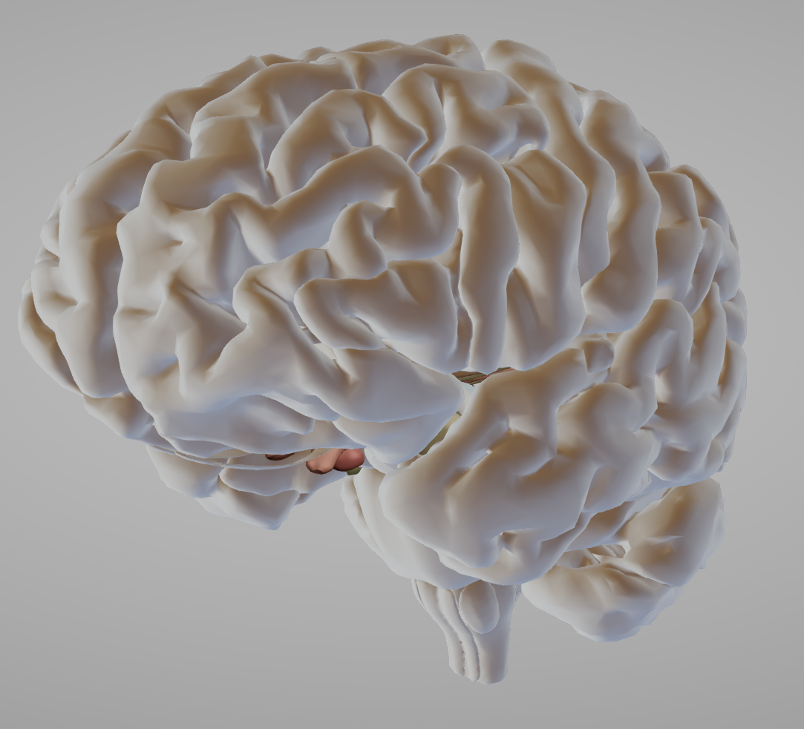
The mechanism of action of lithium in bipolar disorder
Bipolar disorder – Neurobiology and aetiology
Given the history of lithium treating BD, it can be seen as a way of understanding the pathology of BD
Although not completely understood, lithium – a small metal element and the gold standard of BD therapy – has many different effects on the brain^{1,2}
Among adherent patients, roughly 30% respond fully to lithium treatment; the remaining patients respond partially or do not respond at all¹
Effects of lithium on the brain²
Mild ADRs²
Apprehension
Diarrhoea
Vomiting
Micturition
Tremor
Inattentiveness
Dry mouth
Altered taste
Moderate ADRs²
Confusion
Agitation
Delirium
Tachycardia
Hypertonia
Severe ADRs^{2,3}
Coma
Seizures
Hyperthermia
Cerebellar signs
Arrythmias
Hypotension
Kidney damage
↓ Dopamine & glutamate
↑ GABA
Initially slows brain loss
Neuroprotective effects via Bcl-2 and BDNF
Stimulates stem cell generation
Vitalizes neurones in subventricular zone, striatum, and the forebrain
Modulates neurotransmitter signalling
Controls some hormonal and circadian systems
Modulates ion transport and gene expression
ADR=adverse drug reaction; Bcl-2=B-cell lymphoma 2; BD=bipolar disorder; BDNF=brain-derived neurotrophic factor; GABA=gamma-aminobutyric acid
1. Alda. Mol Psychiatry 2015;20(6):661–670; 2. Kamal et al. Cureus 2022;14(9):e29332; 3. Gitlin. Int J Bipolar Disord 2016;4(1):27
Notes:
The monovalent alkali metal lithium has been used to treat bipolar disorder for many decades.² Although the exact mechanism of action is still unclear, lithium has many effects on the brain as outlined on the slide.^{1,2}
References:
Alda M. Lithium in the treatment of bipolar disorder: pharmacology and pharmacogenetics. Mol Psychiatry 2015; 20 (6): 661–670.
Kamal ZM, Dutta S, Rahman S, et al. Therapeutic application of lithium in bipolar disorders: a brief review. Cureus 2022; 14 (9): e29332.
Gitlin M. Lithium side effects and toxicity: prevalence and management strategies. Int J Bipolar Disord 2016; 4 (1): 27.

Slide 15
Response to lithium treatment in bipolar disorder
Bipolar disorder – Neurobiology and aetiology
Not everybody with BD responds to treatment with lithium – predicting which people with BD will respond to lithium would improve the management of all patients¹⁻³
Lithium responsiveness can be assessed using the Alda score, which scores improvements in BD symptoms and to what extent the improvements are related to lithium treatment⁴
Lithium is the third smallest of the atoms, and has many different effects on the brain (e.g., on GSK3 and other enzymes and on signalling pathways), making it difficult to pin-point the exact mechanism of action in BD³
GWAS analysis and analytical models have had some limited successes in identifying potential genetic differences between lithium responders and non-responders^{3,5,6}
Some disease features have been linked to lithium responsiveness, including an episodic course of disease (consisting of a cycle of mania, depression, then an interval) and a family history of BD¹
What is known and what is less clear about the action of lithium in BD³
Lithium is effective for prevention of recurrences of BD, and reduces the risk of suicide
The response to prophylactic lithium treatment runs in the family
Most patients require lithium plasma levels
0.6–1.0 mmol/L for clinical effect
Lithium works best in patients with classical (typical) features of BD
Lithium is neuroprotective in vitro
What is known about lithium
?
How long does it take for lithium to exert
its prophylactic effect?
Is the mechanism of action the same for
all patients?
Is neuroprotection essential for mood stabilization?
Are partial responders clinically distinct from ‘excellent’ responders?
BD=bipolar disorder; GSK3=glycogen synthase kinase 3; GWAS=genome-wide association studies
1. Tighe et al. Ther Adv Chronic Dis 2011;2(3):209–226; 2. Hui et al. Acta Psychiatr Scand 2019;140(2):94–115; 3. Alda. Mol Psychiatry 2015;20(6):661–670;
4. Nunes et al. PLoS One 2020;15(1):e0225353; 5. Hou et al. Lancet 2016;387(10023):1085–1093; 6. Tripathi et al. Bipolar Disord 2023;25(2):110–127
Notes:
Whilst lithium constitutes the standard treatment for bipolar disorder, its mechanism of action as a mood stabilizer is not fully understood, although research over the years has pointed to the importance of cellular signalling in its mode of action (including glycogen synthase kinase 3 (GSK3) pathways, and modulation of inositol monophosphatase).³ Much research has been devoted to understanding why some people with bipolar disorder respond to lithium whilst others do not.³ Some of the hypothesis in this area comes from animal models and postmortem analysis of brain tissue which, as models of disease, only partially replicate the complex phenomenology of human behaviour.³
References:
Tighe SK, Mahon PB, Potash JB. Predictors of lithium response in bipolar disorder. Ther Adv Chronic Dis 2011; 2 (3): 209–226.
Hui TP, Kandola A, Shen L, et al. A systematic review and meta-analysis of clinical predictors of lithium response in bipolar disorder. Acta Psychiatr Scand 2019; 140 (2): 94–115.
Alda M. Lithium in the treatment of bipolar disorder: pharmacology and pharmacogenetics. Mol Psychiatry 2015; 20 (6): 661–670.
Nunes A, Trappenberg T, Alda M; international Consortium on Lithium Genetics (ConLiGen). Asymmetrical reliability of the Alda score favours a dichotomous representation of lithium responsiveness. PLoS One 2020; 15 (1): e0225353.
Hou L, Heilbronner U, Degenhardt F, et al. Genetic variants associated with response to lithium treatment in bipolar disorder: a genome-wide association study. Lancet 2016; 387 (10023): 1085–1093.
Tripathi U, Mizrahi L, Alda M, et al. Information theory characteristics improve the prediction of lithium response in bipolar disorder patients using a support vector machine classifier. Bipolar Disord 2023; 25 (2): 110–127.

Slide 16
Bipolar disorders and mortality and dementia

Slide 17
Premature mortality
Bipolar disorder – Neurobiology and aetiology
In a register-based study including the records of 7 million people, mood disorders including BD increased the risk of death from multiple causes, including from suicide:¹
  People with a mental disorder:
  28.70 per 1000 person-years
  General population:
  12.95 deaths per 1000 person-years
Suicide is a risk in people with mood disorders, including BD, although this risk is reduced with long-term medication²
Indeed, in patients with BD the rate of suicide has been estimated to be as much as 30-fold greater than in the general population³
Suicide in people with mood disorders followed for up-to 52 years⁴
Maniaª
BD-II
BD-I
Survival
MDD
0
25
50
Years from first episode
ªWith or without subthreshold depressive symptoms
BD=bipolar disorder; MDD=major depressive disorder
1. Plana-Ripoll et al. Lancet 2019;394(10211):1827–1835; 2. Angst et al. J Affect Disord 2002;68(2–3):167–181;
3. Dome et al. Medicina (Kaunas) 2019;55(8):403; 4. Angst et al. Eur Arch Psychiatry Clin Neurosci 2013;263(5):425–434;
Notes:
Mental disorders, including bipolar disorder, are a leading cause of premature mortality, partly driven by suicide.^{1,3} Suicide attempts are common in people with bipolar disorder, which makes suicide assessment an important part of the clinical assessment of patients.³ Prevention of suicide is a complicated ongoing clinical goal, involving patient and caregiver education to help identify warning signs, and to reinforce the importance of medication adherence.³
References:
Plana-Ripoll O, Pedersen CB, Agerbo E, et al. A comprehensive analysis of mortality-related health metrics associated with mental disorders: a nationwide, register-based cohort study. Lancet 2019; 394 (10211): 1827–1835.
Angst F, Stassen HH, Clayton PJ, Angst J. Mortality of patients with mood disorders: follow-up over 34–38 years. J Affect Disord 2002; 68 (2–3): 167–181.
Dome P, Rihmer Z, Gonda X. Suicide risk in bipolar disorder: a brief review. Medicina (Kaunas) 2019 Jul; 55 (8): 403.
Angst J, Hengartner MP, Gamma A, et al. Mortality of 403 patients with mood disorders 48 to 52 years after their psychiatric hospitalisation. Eur Arch Psychiatry Clin Neurosci 2013; 263 (5): 425–434.

Slide 18
Accelerated aging
Bipolar disorder – Neurobiology and aetiology
BD is associated with signs of aging: hypertension, metabolic imbalances, dementia, and cancer, leading to the idea of accelerated aging¹
Accelerated aging is a concept that includes telomere length, DNA methylation, mitochondrial DNA copy number, inflammation, and oxidative stress¹⁻³
In a meta-analysis including 14,827 individuals of the association between psychiatric disorders and telomere length, telomere shortening was seen across all disorders compared with control individuals³
BD was associated with telomere shortening, although less so than some of the other disorders included in the analysis (Hedge’s g effect size: -0.26 (95% CI: -0.75, 0.23))³
BD=bipolar disorder; CI=confidence interval; DNA=deoxyribonucleic acid
1. Fries et al. Neurosci Biobehav Rev 2020;112:107–116; 2. Rizzo LB, et al. Neurosci Biobehav Rev 2014;42:157–169; 3. Darrow et al. Psychosom Med 2016;78(7):776–787
Notes:
As summarized on the slide, bipolar disorder can be partly seen as a disease of accelerated aging.¹ Understanding the molecular processes that drive this accelerated aging may, in the future, help patients delay the onset of – or avoid altogether – many of the comorbidities that typify bipolar disorder.¹
References:
Fries GR, Zamzow MJ, Andrews T, et al. Accelerated aging in bipolar disorder: a comprehensive review of molecular findings and their clinical implications. Neurosci Biobehav Rev 2020; 112: 107–116.
Rizzo LB, Costa LG, Mansur RB, et al. The theory of bipolar disorder as an illness of accelerated aging: implications for clinical care and research. Neurosci Biobehav Rev 2014; 42: 157–169.
Darrow SM, Verhoeven JE, Révész D, et al. The association between psychiatric disorders and telomere length: a meta-analysis involving 14,827 persons. Psychosom Med 2016; 78 (7): 776–787.

Slide 19
Bipolar disorder and risk of dementia
Bipolar disorder – Neurobiology and aetiology
A longitudinal analysis of 1.7 million people in New Zealand found many different mental disorders were associated with the onset of dementia¹
One meta-analysis examining the link between history of BD and risk of dementia found 6 studies, including 3,026 people with BD²
  A history of BD increased the risk of dementia by 2.36 times (p<0.001)
Another meta-analysis of the link between BD and dementia found 10 studies, including 6,859 people with BD³
  People with BD were at 2.96-times greater risk of developing dementia compared with control individuals (p<0.001)
  Interestingly, treatment with lithium in this analysis halved this increased risk
A systematic review of FTD found that between 10.2–11.6% of patients with behavioural variant FTD had a preceding history of BD⁴
BD=bipolar disorder; FTD=frontotemporal dementia
1. Richmond-Rakerd et al. JAMA Psychiatry 2022;79(4):333–340; 2. Diniz et al. Am J Geriatr Psychiatry 2017;25(4):357–362;
3. Velosa et al. Acta Psychiatr Scand 2020;141(6):510–521; 4. Roman Meller et al. Acta Psychiatr Scand 2021;144(5):433–447
Notes:
Mood disorders, including bipolar disorder, appear to increase the risk of dementia.¹⁻⁴ More than this, the mood episodes in bipolar disorder appear to have an effect on cognitive functioning.⁵ One study found that, after cognitive functioning had declined during a manic episode, this functioning was improved in patients who experienced a sustained remission but not in patients who experienced recurrence of mood episodes.⁵
References:
Richmond-Rakerd LS, D’Souza S, Milne BJ, et al. Longitudinal associations of mental disorders with dementia: 30-year analysis of 1.7 million New Zealand citizens. JAMA Psychiatry 2022; 79 (4): 333–340.
Diniz BS, Teixeira AL, Cao F, et al. History of bipolar disorder and the risk of dementia: a systematic review and meta-analysis. Am J Geriatr Psychiatry 2017; 25 (4): 357–362.
Velosa J, Delgado A, Finger E, et al. Risk of dementia in bipolar disorder and the interplay of lithium: a systematic review and meta-analyses. Acta Psychiatr Scand 2020; 141 (6): 510–521.
Roman Meller M, Patel S, Duarte D, et al. Bipolar disorder and frontotemporal dementia: a systematic review. Acta Psychiatr Scand 2021; 144 (5): 433–447.
Kozicky JM, Torres IJ, Silveira LE, et al. Cognitive change in the year after a first manic episode: association between clinical outcome and cognitive performance early in the course of bipolar I disorder. J Clin Psychiatry 2014; 75 (6): e587–593.

Slide 20
The functional impact of bipolar disorder progression
Bipolar disorder – Neurobiology and aetiology
The average age of onset of BD is between 20–30 years, although the disorder can present later in life¹
9 in 10 people who experience a single manic episode go on to experience recurrent mood disturbances¹
Some people progress from a diagnosis of MDD to BD – in one meta-analysis, 22.5% of participants with MDD who were followed for >12 years developed BD²
Between episodes, approximately a third of patients experience impairment in their functioning, which can negatively impact work or school¹
This functional impairment can remain after typical BD symptoms have improved¹
People with BD can experience residual symptoms that impact on functioning and quality of life – these symptoms can benefit from an integrated approach to treatment:³
Improve psychosocial functioning
and neurocognitive performance
Personal recovery to improve
well-being and quality of life
Functional remediation
Pharmacological therapy
Pharmacological therapy
Physical activity
Cognitive remediation
Family-focused therapy
CBT and psychotherapies
Internet-based therapies
BD=bipolar disorder; CBT=cognitive–behavioural therapy; MDD=major depressive disorder
1. APA. DSM-5-TR. 2022; 2. Ratheesh et al. Acta Psychiatr Scand 2017;135(4):273–284; 3. Bonnín et al. Int J Neuropsychopharmacol 2019;22(8):467–477
Notes:
As outlined on the slide, bipolar disorder is often a progressive disease, characterized by recurrent mood episodes punctuating a background of persistent functioning impairments.¹ Because of this progressive nature, and the effect that symptoms can have on patient functioning, helping patients with bipolar disorder to improve their functioning is important.³ Moreover, some have argued that preventing or stalling the progression of bipolar disease can and should be a clinical goal.⁴
References:
American Psychiatric Association (APA). Diagnostic and Statistical Manual of Mental Disorders. Fifth edition, text revision. Washington DC: APA; 2022.
Ratheesh A, Davey C, Hetrick S, et al. A systematic review and meta-analysis of prospective transition from major depression to bipolar disorder. Acta Psychiatr Scand 2017; 135 (4): 273–284.
Bonnín CDM, Reinares M, Martínez-Arán A, et al. Improving functioning, quality of life, and well-being in patients with bipolar disorder. Int J Neuropsychopharmacol 2019; 22 (8): 467–477.
Post RM. How to prevent the malignant progression of bipolar disorder. Braz J Psychiatry 2020; 42 (5): 552–557.

Slide 21
Inflammation and bipolar disorder

Slide 22
Inflammation and bipolar disorder
Bipolar disorder – Neurobiology and aetiology
Inflammation appears to play a role in many mood disorders, including BD – the brains of people with BD carry many of the hallmarks of inflammation¹
An analysis of postmortem frontal cortex brain tissue from people with BD studied the levels of inflammatory markers compared with control brains²
  Whereas the levels of NMDA receptors, and its subunits NR-1 and NR-3A, were reduced…
  …many inflammatory markers were increased, including IL-1β receptor, MyD88, astroglial and microglial markers, and iNOS
  Taken together, these data suggest that the BD disease process involves excitotoxicity and neuroinflammation
A PET brain imaging study using a microglial activation visualizing agent
[¹¹C]-(R)-PK11195 found that, compared with controls, people with BD had focal neuroinflammation in the right hippocampus³
One study has also reported reduced numbers of oligodendrocytes in the brains of people with BD⁴
BD=bipolar disorder; IL-1β=interleukin-1 beta; iNOS=inducible nitric oxide synthase; NMDA=N-methyl-D-aspartate;
NR=NMDA receptor; MyD88=myeloid differentiation factor 88; PET=positron emission tomography
1. Benedetti et al. Front Psychiatry 2020;11:71; 2. Rao et al. Mol Psychiatry 2010;15(4):384–392;
3. Haarman et al. Brain Behav Immun 2014;40:219–225; 4. Vostrikov et al. Schizophr Res 2007;94(1–3):273–280
Notes:
Researchers initially connected the immune system and mood disorders by observing so-called ‘sickness behaviour’ – the idea that acute inflammatory states induced a complex set of behavioural and mood changes, that partly mimic the states of some psychiatric conditions.¹ Also, people with mood disorders appear to have a greater risk of autoimmune conditions than the general population.¹ This has led people to investigate the possible roles of the immune system and inflammation in the pathology of mood disorders, including bipolar disorder, as outlined on the slide.¹
References:
Benedetti F, Aggio V, Pratesi ML, et al. Neuroinflammation in bipolar depression. Front Psychiatry 2020; 11: 71.
Rao JS, Harry GJ, Rapoport SI, Kim HW. Increased excitotoxicity and neuroinflammatory markers in postmortem frontal cortex from bipolar disorder patients. Mol Psychiatry 2010; 15 (4): 384–392.
Haarman BCM, Riemersma-Van der Lek RF, de Groot JC, et al. Neuroinflammation in bipolar disorder – a [(11)C]-(R)-PK11195 positron emission tomography study. Brain Behav Immun 2014; 40: 219–225.
Vostrikov VM, Uranova NA, Orlovskaya DD. Deficit of perineuronal oligodendrocytes in the prefrontal cortex in schizophrenia and mood disorders. Schizophr Res 2007; 94 (1–3): 273–280.

Slide 23
Immune activation and bipolar disorder
Bipolar disorder – Neurobiology and aetiology
BD appears to be associated with dysfunction of the immune system¹
  BD is commonly comorbid with autoimmune diseases
  Patients with BD have high levels of inflammatory cytokines
Along with inflammatory cytokines, some lines of evidence have suggested that white blood cells may be dysregulated in patients with BD, including monocyte and lymphocyte activation, and T-cell imbalances^{2,3}
A ‘systemic toxicity index’ has been developed, constituting a set of targets related to oxidative stress, neurotrophins, and inflammation (as key mediators of the cognitive and general health impairment) in patients with recurrent mood episodes⁴
Helping the patient to prevent the bodily changes and transformation that characterise progression of bipolar disorder (including any immune dysregulation or functional brain changes) is an important clinical goal⁵
Various links between immune system dysfunction and bipolar disorder¹
1. Immune dysfunction as a common underlying cause
Immune dysfunction
2. BD may precede and drive the inflammatory state
Bipolar disorder
3. Inflammation may drive BD
Inflammatory conditions
Bipolar disorder
Inflammatory conditions
Immune dysfunction
A combination of all 3, with each perpetuating the other
Immune dysfunction
Inflammatory conditions
Immune dysfunction
Inflammatory
condition
Bipolar
disorder
Bipolar disorder
This work is adapted from ‘Bipolar disorder and immune dysfunction: epidemiological findings, proposed pathophysiology and clinical implications' by Rosenblat et al., used under CC BY.
This work is licensed under Creative Commons license CC BY-SA by The Lundbeck Foundation.
BD=bipolar disorder
1. Rosenblat & McIntyre. Brain Sci 2017;7(11):144; 2. Barbosa et al. Int J Neuropsychopharmacol 2014;18(1):pyu021;
3. Chen et al. Transl Psychiatry 2023;13(1):153; 4. Kapczinski et al. Mol Psychiatry 2010;15(8):784–786; 5. Post. Braz J Psychiatry 2020;42(5):552–557
Notes:
A clue to the connection between bipolar disorder and the immune system and inflammation comes from the observation that people with bipolar disorder appear to have high rates of inflammatory comorbidities.¹ However, correlation is not causation. It is possible that bipolar disorder and other inflammatory conditions share common underlying aetiologies, or that bipolar disorder leads to immune dysfunction and inflammation, or that the inflammatory disorders in some way lead to bipolar disorder.¹ In reality, the complex relationship observed in the real-world suggest that in part all three of these relationships exist, suggesting a situation where immune activation and dysfunction, inflammation, and bipolar disorder may be perpetuating each other.¹
References:
Rosenblat JD, McIntyre RS. Bipolar disorder and immune dysfunction: epidemiological findings, proposed pathophysiology and clinical implications. Brain Sci 2017; 7 (11): 144.
Barbosa IG, Rocha NP, Assis F, et al. Monocyte and lymphocyte activation in bipolar disorder: a new piece in the puzzle of immune dysfunction in mood disorders. Int J Neuropsychopharmacol 2014; 18 (1): pyu021.
Chen Z, Huang Y, Wang B, et al. T cells: an emerging cast of roles in bipolar disorder. Transl Psychiatry 2023; 13 (1): 153.
Kapczinski F, Dal-Pizzol F, Teixeira AL, et al. A systemic toxicity index developed to assess peripheral changes in mood episodes. Mol Psychiatry 2010; 15 (8): 784–786.
Post RM. How to prevent the malignant progression of bipolar disorder. Braz J Psychiatry 2020; 42 (5): 552–557.

Slide 24


The microbiome and bipolar disorder
Bipolar disorder – Neurobiology and aetiology
The expanding world of microbiome science has led to interesting avenues of potential new treatments for mood disorders, such as faecal transplants, probiotic therapy, and targeted dietary interventions¹
The composition of the gut microbiome is now thought to influence the pathology of mood disorders including schizophrenia and BD, via the microbiome–gut–brain axis¹⁻³
  There may be species-level differences between the microbiomes of people with different mood disorders, e.g., where one sort of bacteria is more common in a patient with BD versus control³
  There also may be differences in the diversity of the microbiomes from people with mood disorders, compared with controls, e.g., patients with schizophrenia appear to have less diverse gut flora²
However, this area of research is a relatively new field, and there are technical difficulties in producing valid reproducible and comparable results, making drawing conclusions and directions for treatment challenging³
Similarities and differences in gut flora between schizophrenia and BD⁴
Schizophrenia
Bacteroides
Haemophilus
Streptococcus
Prevotella
Megasphaera
Roseburia
Bifidobacterium
Oscillibacter
Bipolar disorder
BD=bipolar disorder
1. McGuinness et al. Biol Psychiatry 2024;95(4):319–328; 2. Dickerson et al. Brain Behav Immun 2017;62:46–52;
3. Nguyen et al. J Psychiatr Res 2018;99:50–61; 4. McGuinness et al. Mol Psychiatry 2022;27(4):1920–1935
This work is adapted from ‘A systematic review of gut microbiota composition in observational studies of major depressive disorder, bipolar disorder and schizophrenia' by McGuinness et al., used under CC BY 4.0. This work is licensed under Creative Commons license CC BY-SA by The Lundbeck Foundation.
Notes:
The composition of the gut flora can have quite wide-ranging effects on the human body.⁴ Differences in gut flora can lead to differences in lactic acid metabolism, and the production of butyrate and gamma-aminobutyric acid (GABA), which may help to explain some of the pathology of mood disorders, including bipolar disorder.⁴
References:
McGuinness AJ, Loughman A, Foster JA, Jacka F. Mood disorders: the gut bacteriome and beyond. Biol Psychiatry 2024; 95 (4): 319–328.
Dickerson F, Severance E, Yolken R. The microbiome, immunity, and schizophrenia and bipolar disorder. Brain Behav Immun 2017; 62: 46–52.
Nguyen TT, Kosciolek T, Eyler LT, et al. Overview and systematic review of studies of microbiome in schizophrenia and bipolar disorder. J Psychiatr Res 2018; 99: 50–61.
McGuinness AJ, Davis JA, Dawson SL, et al. A systematic review of gut microbiota composition in observational studies of major depressive disorder, bipolar disorder and schizophrenia. Mol Psychiatry 2022; 27 (4): 1920–1935.

Slide 25
Neuroimaging and bipolar disorder

Slide 26
Structural neuroimaging
Bipolar disorder – Neurobiology and aetiology
Structural neuroimaging studies have revealed interesting changes in the brains of people with BD^{1,2}
Large-scale studies have analyzed the brains of people from the ENIGMA-BD working group using MRI¹⁻²
One analysis of 1,710 people with BD compared with 2,594 control brains found significant differences in brains of people with BD versus controls:¹
  Reductions in hippocampus volume (Cohen’s d: -0.232; p=3.50 x10⁻⁷)
  Reductions in thalamus volume (Cohen’s d: -0.148; p=4.27 x10⁻³)
  Enlargement in lateral ventricles volume (Cohen’s d: 0.260; p=3.93 x10⁻⁵)
Another analysis of 2,447 people with BD compared with control MRIs, found that people with BD showed significant differences in several areas on the left-side of the brain:²
  Left pars opercularis (Cohen’s d: -0.293; p=1.71 x10⁻²¹)
  Left fusiform gyrus (Cohen’s d: -0.288; p=8.25 x10⁻²¹)
  Left rostral middle frontal cortex (Cohen’s d: -0.276; p=2.99 x10⁻¹⁹)
Interestingly, when the brains of people with BD-I were compared with those of people with BD-II, no significant differences in cortical thickness or surface area were detected²
BD=bipolar disorder; ENIGMA=enhancing neuroimaging genetics through meta-analysis; MRI-magnetic resonance imaging
1. Hibar et al. Mol Psychiatry 2016;21(12):1710–1716; 2. Hibar et al. Mol Psychiatry 2018;23(4):932–942
Notes:
Several structural differences have been shown in neuroimaging studies of people with bipolar disorder.^{1,2} Interestingly, it is becoming possible to separate brain abnormalities that appear to be present early in the disease – such as prefrontal cortex, striatum, and amygdala changes – from changes that appear to present later in the disease – such as those in the cerebellar vermis, and the lateral ventricles.³ It has been hypothesized therefore, that whilst these latter changes may represent the effect of illness progression, the former changes may exist before illness onset.³
References:
Hibar DP, Westlye LT, van Erp TG, et al. Subcortical volumetric abnormalities in bipolar disorder. Mol Psychiatry 2016; 21 (12): 1710–1716.
Hibar DP, Westlye LT, Doan NT, et al. Cortical abnormalities in bipolar disorder: an MRI analysis of 6503 individuals from the ENIGMA Bipolar Disorder Working Group. Mol Psychiatry 2018; 23 (4): 932–942.
Strakowski SM, Delbello MP, Adler CM. The functional neuroanatomy of bipolar disorder: a review of neuroimaging findings. Mol Psychiatry 2005; 10 (1): 105–116.

Slide 27
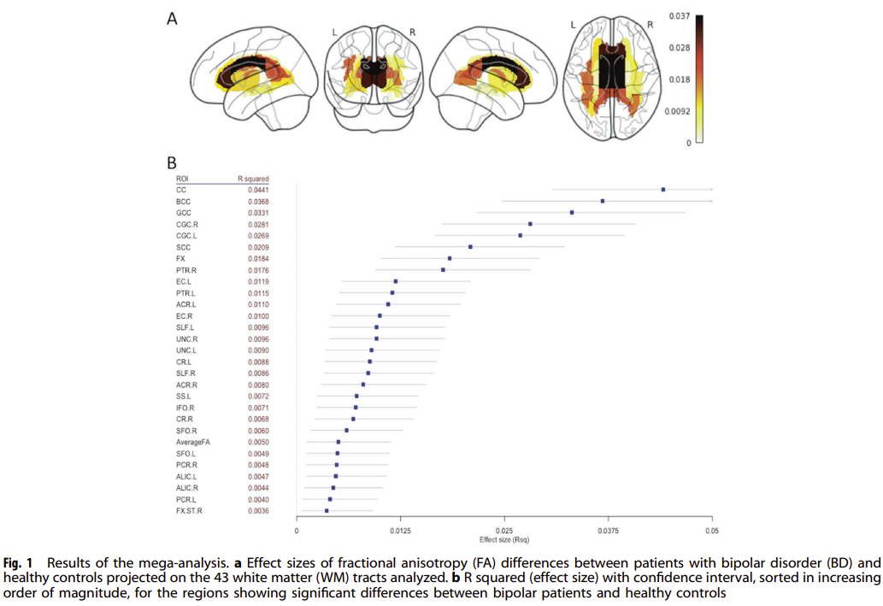
White matter abnormalities in bipolar disorder
Bipolar disorder – Neurobiology and aetiology
White matter abnormalities in the brain appear to play a role in the neuropathology of BD, these include:¹
  White matter hyperintensities
  Regional volumetric abnormalities
  Abnormal water diffusion along prefrontal–subcortical tracts
  Fewer oligodendrocytes in prefrontal white matter
  Altered expression of myelin- and oligodendrocyte-related genes
Although MRI studies have reported heterogeneous results, several reports comparing the brains of people with BD with control brains have identified abnormalities within several structures of the prefrontal white matter¹
Because these white matter abnormalities are found in regions known to be involved in emotional regulation, this had led to a model of BD that suggests dysconnectivity and dysregulation in emotional brain circuits may underly the condition¹
One study used data from the ENIGMA dataset to compare brains from people with BD with controls (n=1,482 BD, 1,551 controls), to identify white matter abnormalities that differentiate the two²
The results of the analysis showed differences between the brains of people with BD and controls in several
white-matter tracts:²
This altered white-matter connectivity within the corpus callosum and the cingulum may be useful in the future as a biomarker for BD^{2,3}
0.037
0.028
0.018
R² effect size
0.009
0.000
This work is from ‘Widespread white matter microstructural abnormalities in bipolar disorder: evidence from mega- and meta-analyses across 3033 individuals' by Favre et al., used under CC BY-NC-SA.
This work is licensed under Creative Commons license CC BY-NC-SA by The Lundbeck Foundation.
BD=bipolar disorder; ENIGMA=enhancing neuroimaging genetics through meta-analysis; MRI=magnetic resonance imaging
1. Mahon et al. Neurosci Biobehav Rev 2010;34(4):533–554; 2. Favre et al. Neuropsychopharmacology 2019;44(13):2285–2293; 3. Barysheva et al. Neuroimage Clin 2013;2:558–668
Notes:
As well as postmortem brain studies, data from computed tomography (CT), positron emission tomography (PET), and magnetic resonance imaging (MRI) studies have shown white matter abnormalities are a characteristic of bipolar disorder.¹ However, the clinical significance of these abnormalities is unclear.¹ In contrast to grey matter, white matter is responsible for connectivity within the brain; therefore, new imaging techniques that have allowed white matter imaging (e.g., diffusion tensor imaging), allow researchers to build connectivity-based models of bipolar disorder.¹
References:
Mahon K, Burdick KE, Szeszko PR. A role for white matter abnormalities in the pathophysiology of bipolar disorder. Neurosci Biobehav Rev 2010; 34 (4): 533–554.
Favre P, Pauling M, Stout J, et al. ENIGMA Bipolar Disorder Working Group. Widespread white matter microstructural abnormalities in bipolar disorder: evidence from mega- and meta-analyses across 3033 individuals. Neuropsychopharmacology 2019; 44 (13): 2285–2293.
Barysheva M, Jahanshad N, Foland-Ross L, et al. White matter microstructural abnormalities in bipolar disorder: a whole brain diffusion tensor imaging study. Neuroimage Clin 2013; 2: 558–668.

Slide 28
Functional neuroimaging
Bipolar disorder – Neurobiology and aetiology
A large meta-analysis of functional MRI studies concluded that, across many mood disorders, reduced inhibitory control and salience processing was a consistent neurobiological feature¹
A meta-analysis of functional and structural neuroimaging studies in BD found several hallmarks of the disorder:²
  Hypo-connectivity within the default network
  Hyper-connectivity within the affective network, and ventral attention network
  Hypo- and hyper-connectivity within the frontoparietal network
  Decreased grey matter volume within the insula, inferior frontal gyrus, and anterior cingulate cortex
BD is therefore characterized by functional, as well as structural, abnormalities^{2,3}
Functional neuroimaging results have been explored as biomarkers for BD, to improve the diagnostic accuracy of BD^{3,4}
BD=bipolar disorder; MRI=magnetic resonance imaging
1. Janiri et al. JAMA Psychiatry 2020;77(2):172–179; 2. Gong et al. J Affect Disord 2021;292:9–20;
3. Phillips & Vieta. Schizophr Bull 2007;33(4):893–904; 4. Zhang et al. Neuropsychiatr Dis Treat 2023;19:2797–2806
Notes:
Since the publication of the fifth edition of the Diagnostic and Statistical Manual of Mental Disorders (DSM-5), there has been an awareness of the need to translate the increasing depth of mechanistic and neurobiological knowledge of psychiatric disease back into the classification systems used to diagnose patients.³ Understanding bipolar disorder using techniques such as functional and structural neuroimaging, and translating this understanding into biomarkers, may allow such accuracy of diagnosis in the future.³
References:
Janiri D, Moser DA, Doucet GE, et al. Shared neural phenotypes for mood and anxiety disorders a meta-analysis of 226 task-related functional imaging studies. JAMA Psychiatry 2020; 77 (2): 172–179.
Gong J, Wang J, Chen P, et al. Large-scale network abnormality in bipolar disorder: a multimodal meta-analysis of resting-state functional and structural magnetic resonance imaging studies. J Affect Disord 2021; 292: 9–20.
Phillips ML, Vieta E. Identifying functional neuroimaging biomarkers of bipolar disorder: toward DSM-V. Schizophr Bull 2007; 33 (4): 893–904.
Zhang H, Chen J, Fang Y. Functional alterations in patients with bipolar disorder and their unaffected first-degree relatives: insight from genetic, epidemiological, and neuroimaging data. Neuropsychiatr Dis Treat 2023; 19: 2797–2806.

Slide 29
Healthy lifestyle and bipolar disorder
Bipolar disorder – Neurobiology and aetiology
Physical activity¹
A systematic review found that 40–65% of people with BD had a sedentary lifestyle
In people with BD, physical activity and exercise was associated with:
  Lower depressive symptoms
  Better QoL
  Increased patient functioning
Blood sugars²
People with BD have an elevated risk of type-2 diabetes
Glucose dysregulation can be a medication adverse effect
There is some evidence that poor glucose metabolism may be associated with disease indicators, such as rapid cycling, and lack of treatment response
Omega-3³
Omega oils, and other specific essential oils, have been linked to general good health
A meta-analysis of omega-3 consumption in people with BD, compared with non-consumption, found:
  Consumption significantly reduced bipolar depression
  There was a non-significant reduction in bipolar mania
Caffeine, alcohol,
and nicotine⁴
Caffeine, alcohol, and nicotine are widely consumed worldwide
These substances can create dependence, can be abused, or used to ‘self-medicate’
The pharmacological effects of these substances can overlap with disease processes or with therapies
BD=bipolar disorder; QoL=quality of life
1. Melo et al. J Affect Disord. 2016;198:32–38; 2. Łojko et al. Int J Environ Res Public Health 2019;16(7):1132;
3. Sarris et al. J Clin Psychiatry 2012;73(1):81–86; 4. Crocq. Dialogues Clin Neurosci 2003;5(2):175–185
Notes:
As outlined on the slide, it is important to promote a healthy lifestyle in patients with bipolar disorder.¹⁻⁴
References:
Melo MC, Daher Ede F, Albuquerque SG, de Bruin VM. Exercise in bipolar patients: a systematic review. J Affect Disord 2016; 198: 32–38.
Łojko D, Owecki M, Suwalska A. Impaired glucose metabolism in bipolar patients: the role of psychiatrists in its detection and management. Int J Environ Res Public Health 2019; 16 (7): 1132.
Sarris J, Mischoulon D, Schweitzer I. Omega-3 for bipolar disorder: meta-analyses of use in mania and bipolar depression. J Clin Psychiatry 2012; 73 (1): 81–86.
Crocq MA. Alcohol, nicotine, caffeine, and mental disorders. Dialogues Clin Neurosci 2003; 5 (2): 175–185.

Slide 30
Summary

Slide 31
Summary
Bipolar disorder – Neurobiology and aetiology
BD is a heterogenous disorder, which has slowed research in the area
The heterogeneity is exemplified in the symptoms and treatment response of individual patients
Although the exact cause(s) of BD are not fully understood, the condition is thought to be the result of a complex interplay of genetic, environmental, and biochemical factors
Several models for studying BD have been developed, involving animal models, stem cells, postmortem tissue analysis, and functional analysis of human brains
The biological processes that have been revealed suggest that patients with BD are susceptible to disease processes in the brain
It is hoped that within the next decade, personalized treatment based on various biomarkers will emerge to help patients with BD across the globe

Slide 32
Our understanding of BD remains frustratingly limited. It continues to be a descriptive syndrome, since we lack sufficient knowledge to allow its characterization or conceptualization based on aetiology or mechanism
Harrison et al. Trends Neurosci 2018;41(1):18–30
Notes:
Reference:
Harrison PJ, Geddes JR, Tunbridge EM. The emerging neurobiology of bipolar disorder. Trends Neurosci 2018; 41 (1): 18–30.

