Slide 1
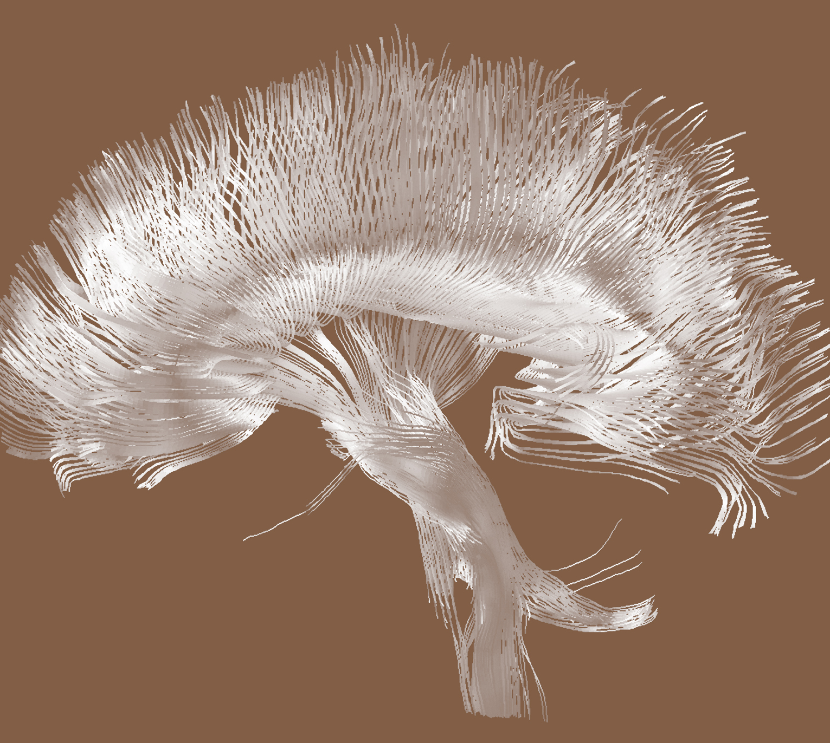
Epilepsy
Epidemiology and burden

