Slide 1
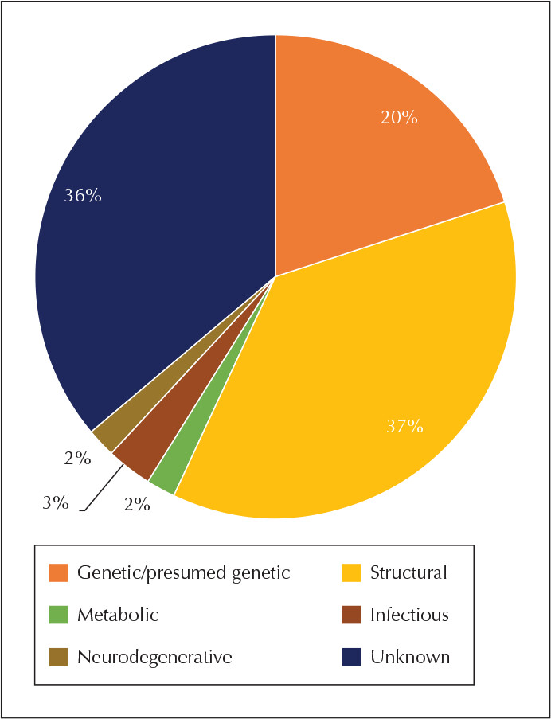
Risk factors for epilepsy – high-income countries
Epilepsy – Epidemiology and burden
One study using a systematic search of electronic medical records from a high-income country (Norway) has shown that the cause of active epilepsy in 1717 people was unknown in 36% of cases, and was associated with underlying structural-metabolic abnormalities in another 43% of cases^{1,2}
Epilepsy with a genetic/presumed genetic cause was determined in 20% of cases^{1,2}
Epilepsy caused by neurodegenerative and infectious disorders or diseases was rare (~5%)^{1,2}
The authors concluded that the prevalence of epilepsy estimated in this Nordic study was comparable to that
reported by previous studies conducted in other Western European countries¹
They added that as an accurate diagnosis of epilepsy is important, general awareness of specific epilepsy syndromes needs to be increased¹
Aetiologies of epilepsy in a resource-rich European region²
1. Syvertsen et al. Epilepsia 2015;56(5):699–706; 2. Balestrini et al. Epileptic Disord 2021;23(1):1–16
This work is from ‘The aetiologies of epilepsy’ by Balestrini et al., used under CC-BY-NC-ND. This work is licensed under Creative Commons license CC-NC-ND-SA by The Lundbeck Foundation.
Notes:
References:
Syvertsen M, Nakken KO, Edland A, et al. Prevalence and etiology of epilepsy in a Norwegian county – a population based study. Epilepsia 2015; 56 (5): 699–706.
Balestrini S, Arzimanoglou A, Blümcke I, et al. The aetiologies of epilepsy. Epileptic Disord 2021; 23 (1): 1–16.

