Slide 1
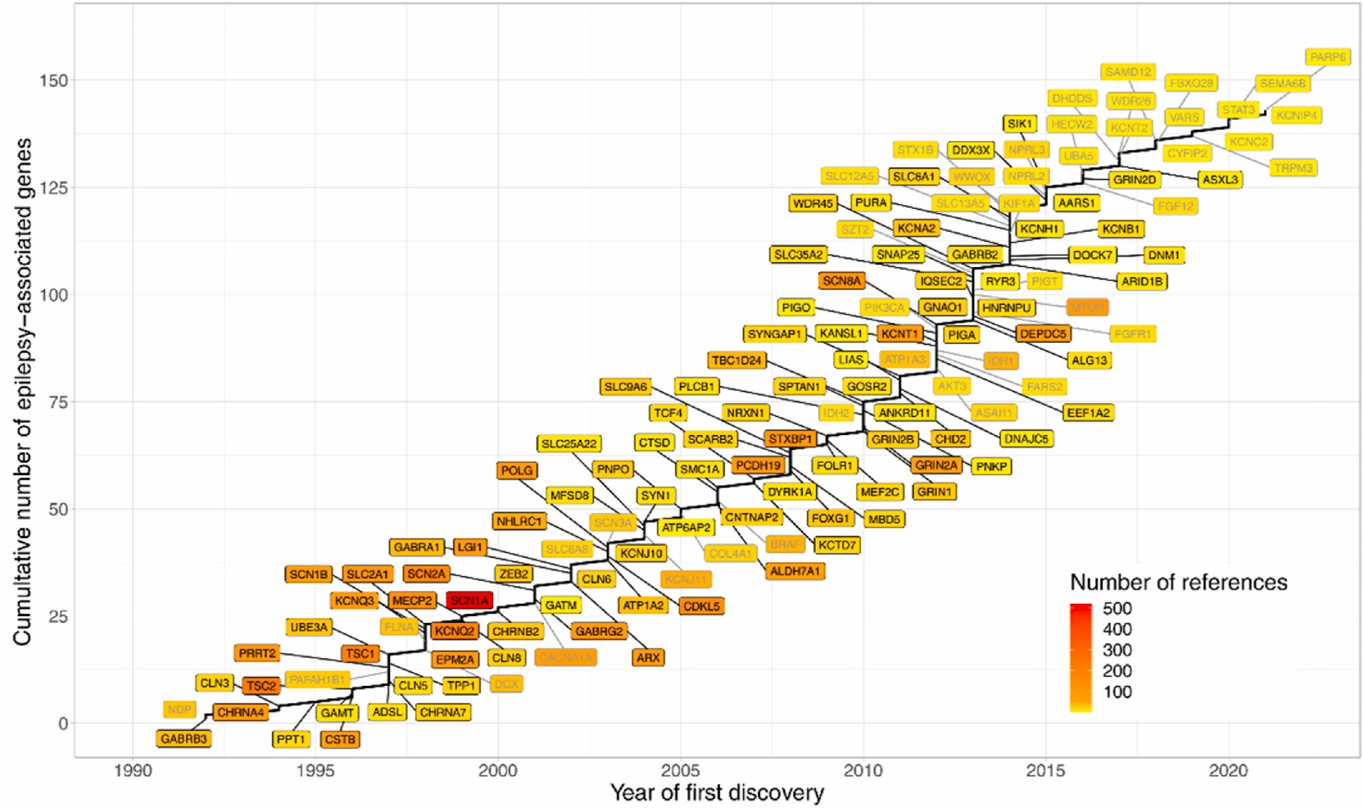
Genetic epilepsies
Epilepsy – Definitions and diagnosis
Familial epilepsies run in families, with polygenic and environmental contributions¹⁻³
Genetic epilepsies are defined by a known or presumed underlying genetic aetiology, and the absence of an acquired cause, e.g., trauma or infection^{3,4}
  Only a very small number of epilepsies are caused by variations in a single gene (monogenic epilepsies)
A precise genetic epilepsy diagnosis is important for individuals and their families³
  Identifying the causative gene may guide antiseizure medication choice in three-quarters of children with epilepsy
  In adults, treatment based on a genetic diagnosis may avoid drug resistance, and improve seizure control, quality of life, and cognition
Increasingly, some of these genes are also being identified in ‘non-genetic’ epilepsies⁵
  For example, somatic mutations in focal epilepsies caused by focal cortical dysplasias
The history of gene discoveries
implicated in epilepsies⁶
This work is adapted from ‘Data-driven historical characterization of epilepsy-associated genes’ by Macnee et al., used under CC-BY-NC-ND. This work is licensed under Creative Commons license CC-BY-NC-ND-SA by The Lundbeck Foundation.
1. Berkovic et al. Ann Neurol 1996;40(2):227‒235; 2. Grinton et al. Epilepsia 2015;56(7):1071‒1080; 3. Krey et al. Epileptic Disord 2022;24(5):765‒786;
4. McTague et al. Lancet Neurol 2016;15(3):304‒316; 5. Johannesen et al. Epilepsia 2023;64(12):3143‒3154; 6. Macnee et al. Eur J Paediatr Neurol 2023;42:82‒87
Notes:
A search of the published literature up to December 2021 found reports of 881 genes implicated in epilepsy.⁶ The average number of Tier 1 (epilepsy) genes identified per year between 1992 and 2021 was 4.8, with the highest Tier 2 (epilepsy candidate) gene average over a decade reported between 2010 and 2019 (7.1).⁶
References:
Berkovic SF, McIntosh A, Howell RA, et al. Familial temporal lobe epilepsy: A common disorder identified in twins. Ann Neurol 1996; 40 (2): 227‒235.
Grinton BE, Heron SE, Pelekanos JT, et al. Familial neonatal seizures in 36 families: Clinical and genetic features correlate with outcome. Epilepsia 2015; 56 (7): 1071‒1080.
Krey I, Platzer K, Esterhuizen A, et al. Current practice in diagnostic genetic testing of the epilepsies. Epileptic Disord 2022; 24 (5): 765‒786.
McTague A, Howell KB, Cross JH, et al. The genetic landscape of the epileptic encephalopathies of infancy and childhood. Lancet Neurol 2016; 15 (3): 304‒316.
Johannesen KM, Tumer Z, Weckhuysen S, et al. Solving the unsolved genetic epilepsies: Current and future perspectives. Epilepsia 2023; 64 (12): 3143‒3154.
Macnee M, Pérez-Palma E, López-Rivera JA, et al. Data-driven historical characterization of epilepsy-associated genes. Eur J Paediatr Neurol 2023; 42: 82‒87.

