Slide 1
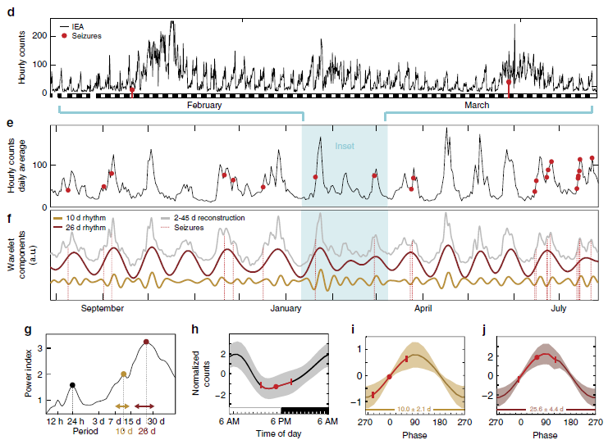
Diagnostic tools for ongoing care
Epilepsy – Definitions and diagnosis
Epilepsy is a chronic condition with intermittent symptoms¹
Self-reported seizure burden does not correlate well with electroencephalographic seizure counts²
Diagnostic devices are now becoming available to allow long-term seizure burden tracking²⁻⁵
  These include subcutaneous EEG, implantable EEG or implantable cortical neurostimulation devices
Hourly and daily EEG activity with an implanted brain stimulation device³
This work is from ‘Multi-day rhythms modulate seizure risk in epilepsy’ by Baud et al., used under CC-BY. This work is licensed under Creative Commons license CC-BY-SA by The Lundbeck Foundation.
EEG=electroencephalography
1. Fisher et al. Epilepsia 2014; 55 (4): 475‒482; 2. Weisdorf et al. Epilepsia 2019;60(11):2204‒2214; 3. Baud et al. Nat Commun 2018;9(1):88;
4. Cook et al. Lancet Neurol 2013;12(6):563‒571; 5. Heck et al. Epilepsia 2014;55(3):432‒441
Notes:
In one study, nine adults with epilepsy and known or suspected temporal/frontotemporal seizure foci and self-reported seizure frequency of at least one seizure per month had a subcutaneous EEG device implanted to enable continuous at-home monitoring and were provided with electronic or paper diaries to record any seizures that occurred.² A total of 491 days of EEG recordings were collected.² There were often mismatches between the number of seizures reported by participants and those recorded on EEG – two participants had many electroencephalographic seizures without corresponding diary entries, and the reverse was true for another two participants.² There was only complete agreement between diary entries and EEG activity for one participant.²
References:
Fisher RS, Acevedo C, Arzimanoglou A, et al. ILAE official report: a practical clinical definition of epilepsy. Epilepsia 2014; 55 (4): 475‒482.
Weisdorf S, Duun-Henriksen J, Kjeldsen MJ, et al. Ultra-long-term subcutaneous home monitoring of epilepsy – 490 days of EEG from nine patients. Epilepsia 2019; 60 (11): 2204‒2214.
Baud MO, Kleen JK, Mirro EA, et al. Multi-day rhythms modulate seizure risk in epilepsy. Nat Commun 2018; 9: 88.
Cook MJ, O’Brien TJ, Berkovic SF, et al. Prediction of seizure likelihood with a long-term, implanted seizure advisory system in patients with drug-resistant epilepsy: a first-in-man study. Lancet Neurol 2013; 12 (6): 563‒571.
Heck CN, King-Stephens D, Massey AD, et al. Two-year seizure reduction in adults with medically intractable partial onset epilepsy treated with responsive neurostimulation: Final results of the RNS System Pivotal trial. Epilepsia 2014; 55 (3): 432‒441.

