Slide 1
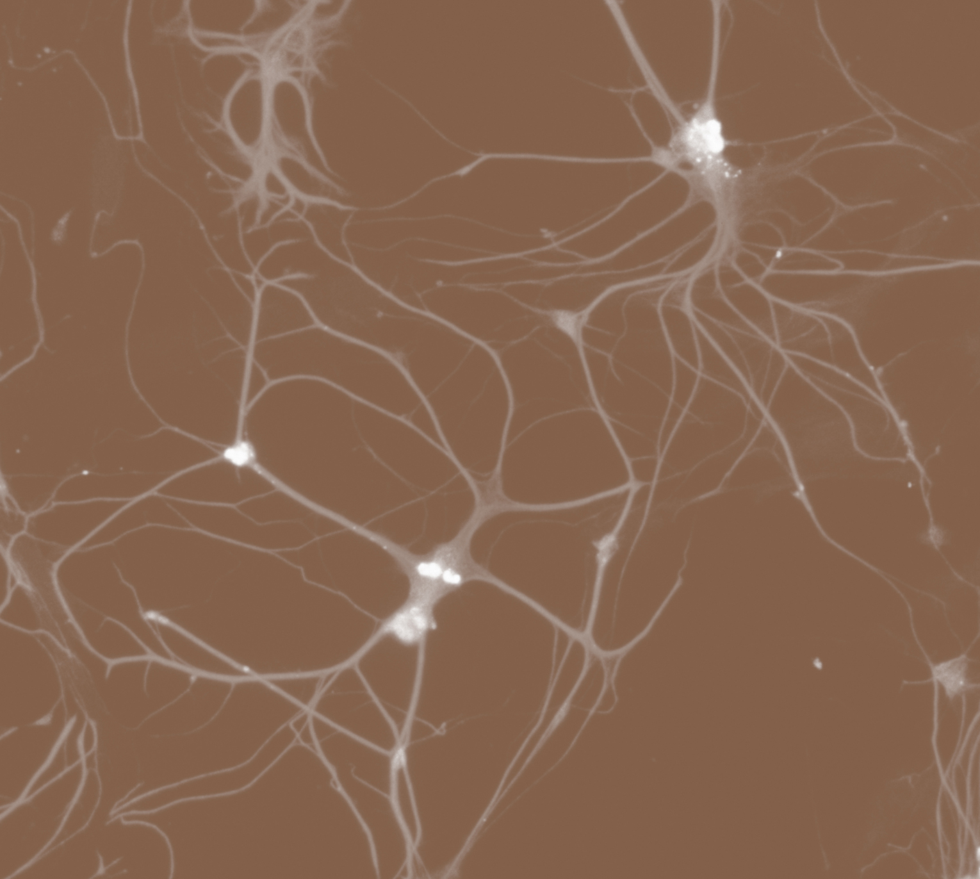
Epilepsy
Neurobiology and aetiology

