Slide 1
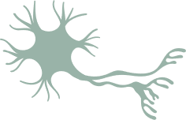


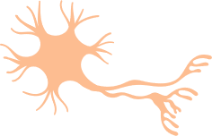
The blood–brain barrier
Epilepsy – Neurobiology and aetiology
The blood–brain barrier is the dynamic and complex boundary separating the circulating blood from the extracellular fluid of the brain
The blood–brain barrier is often dysregulated in epilepsy, which may be a cause and/or consequence of eplileptic seizures
Increased BBB permeability and epilepsy
Tight
junction
Astrocyte
foot process
Claudin 3,5,12
Occludin
Tight
junction
Neuron
Lumen
Pericyte
JAMs, ESAM
Brain capillary
(neurovascular unit)
Endothelial cell
Basal membrane
Blood
Pgp
BCRP
Lymphocyte
Monocyte
Neutrophil
Albumin
Tight junction
CYP450
enzymes
Endothelial cell
Endothelial cell
Basal membrane
Astrocytes
Neuron
Brain parenchyma
Microglia
This work is from ‘Structural, molecular, and functional alterations of the blood–brain barrier during epileptogenesis and epilepsy: a cause, consequence, or both?’ by Löscher & Friedman, used under CC-BY. This work is licensed under Creative Commons license CC-BY-SA by The Lundbeck Foundation.
BBB=blood–brain barrier; BCRP=breast cancer resistance protein; CYP450=cytochrome P450;
ESAM=endothelial selective adhesion molecule; JAM=junctional adhesion molecule; Pgp=P-glycoprotein
Löscher & Friedman. Int J Mol Sci 2020;21(2):591
Notes:
The blood–brain barrier is the complex, highly-selective barrier controlling what macro-molecules and immune cells may enter the brain.¹ However, as summarised on the slide, after epileptogenic brain insults this barrier can become dysfunctional.¹ More research is needed to better understand the functioning of the blood–brain barrier in epilepsy, and help patients by developing novel therapeutic interventions.¹
Reference:
Löscher W, Friedman A. Structural, molecular, and functional alterations of the blood–brain barrier during epileptogenesis and epilepsy: a cause, consequence, or both? Int J Mol Sci 2020; 21 (2): 591.

