Slide 1
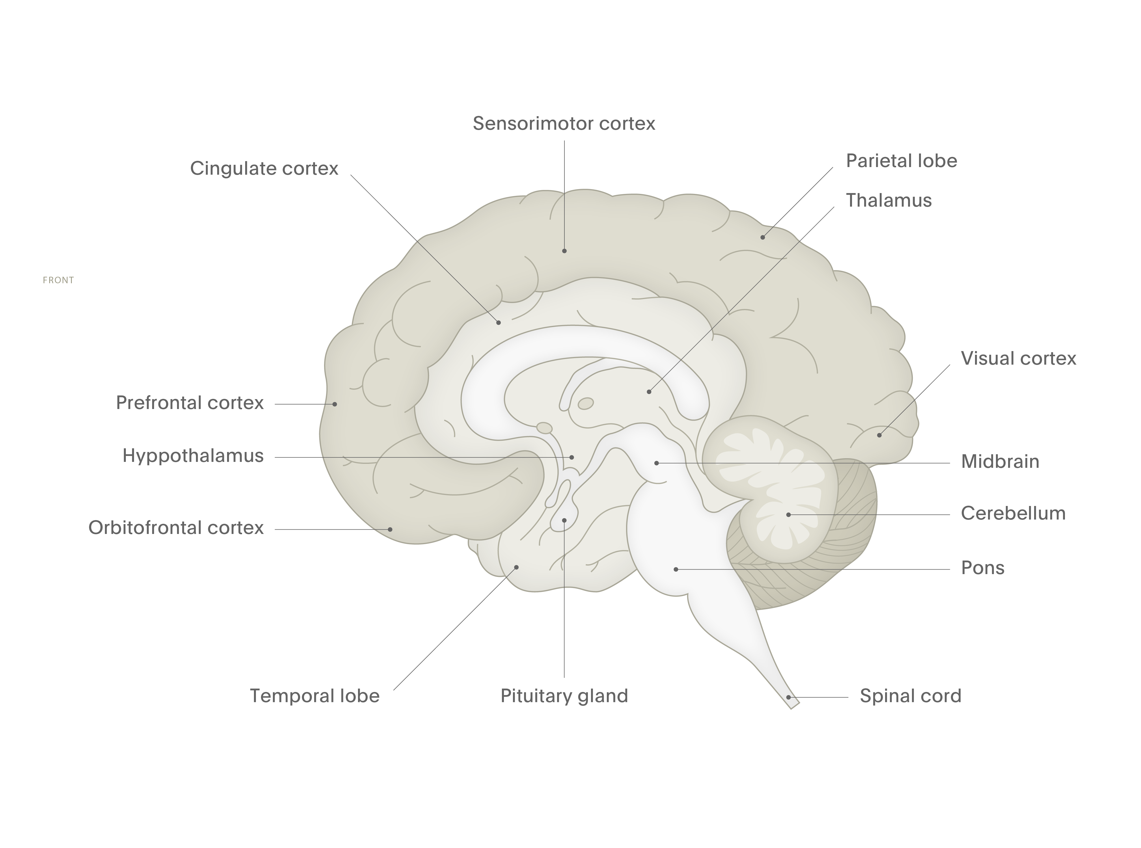
Glutamate
Fundamentals of neurobiology – Cellular and molecular neuroscience
Thalamo–cortical glutamate pathways⁴
This pathway innervates neurons in the cortex
Glutamate is the principal excitatory neurotransmitter in
the CNS^{1,2}
Glutamate is an amino acid that is produced from glutamine^{1,2}
Glutamate is removed from the synapse by transporters present in glia and presynaptic terminals, then metabolised to glutamine, and resupplied to the relevant neuron terminals^{1,2}
Glutamate plays key roles in nearly every function of the brain³
Cortico–thalamic glutamate pathways⁴
Cortico–cortical glutamate pathways⁴
These can be direct, or indirect via GABA neurons
Striatum
Cortico–striatal glutamate pathway⁴
Hypothalamus
O
O
Cortico–brainstem glutamate projection⁴
Regulates neurotransmitter release from the brainstem
Hippocampal–striatal glutamate pathway⁴
HO
OH
Hippocampus
NH₂
Arrows show direction of tracts, from filled circles towards the direction of the arrows. CNS=central nervous system; GABA=gamma-aminobutyric acid
1. Kandel et al. Principles of Neural Science. 6th edition. 2021; 2. Augustine et al. Neuroscience. 7th edition. 2023;
3. Hassel & Dingledine. In: Brady et al. Basic Neurochemistry. 8th edition. 2012; 4. Stahl SM. Stahl’s Essential Psychopharmacology. 5th edition. 2021
Notes:
Control of the CNS can be thought of in terms of a balance between ‘go’ (excitatory) and ‘stop’ (inhibitory) signals.⁵ If the sum of the ‘go’ signals that a neuron receives outweighs the sum of the ‘stop’ signals, then that neuron is more likely to fire an action potential.^{4,5}
Glutamate is the main excitatory neurotransmitter.² Nearly all excitatory neurons in the CNS are glutamatergic – more than half of the neurons in the brain.^{2,6} It is noteworthy, though, that high concentrations of glutamate are neurotoxic, capable of triggering excitotoxicity.⁶ There are three types of receptor to which glutamate can bind (named after the synthetic agonists that activate them), each of which has slightly different properties:³
NMDA (N-methyl-d-aspartate)
AMPA (α-amino-3-hydroxyl-5-methyl-4-isoxazole-propionate)
kainate (kainic acid).
References:
Neurotransmitters. In: Kandel ER, Koester JD, Mack SH, Siegelbaum SA (eds). Principles of Neural Science. 6th edition. McGraw-Hill, 2021.
Neurotransmitters. In: Augustine GJ, Groh J, Huettel S, et al. (eds). Neuroscience. 7th edition. Oxford University Press, 2023.
Hassel B, Dingledine R. Glutamate and glutamate receptors. In: Brady ST, Siegel CJ, Albers RW, Price DL (eds). Basic Neurochemistry: Principles of Molecular, Cellular and Medical Neurobiology. 8th edition. Academic Press, 2012.
Stahl SM. Psychosis, schizophrenia, and the neurotransmitters networks dopamine, serotonin, and glutamate. In: Stahl’s Essential Psychopharmacology. Neuroscientific Basis and Practical Applications. 5th edition. © Cambridge University Press, 2021.
Ochoa-de la Paz LN, Gulias-Cañizo R, D´Abril Ruíz-Leyja E, et al., The role of GABA neurotransmitter in the human central nervous system, physiology, and pathophysiology. Revista Mexicana de Neurociencia 2021; 22 (2): 67–76.
Zhou Y, Danbolt NC. Glutamate as a neurotransmitter in the healthy brain. J Neural Transm (Vienna) 2014; 121 (8): 799–817.

