Slide 1
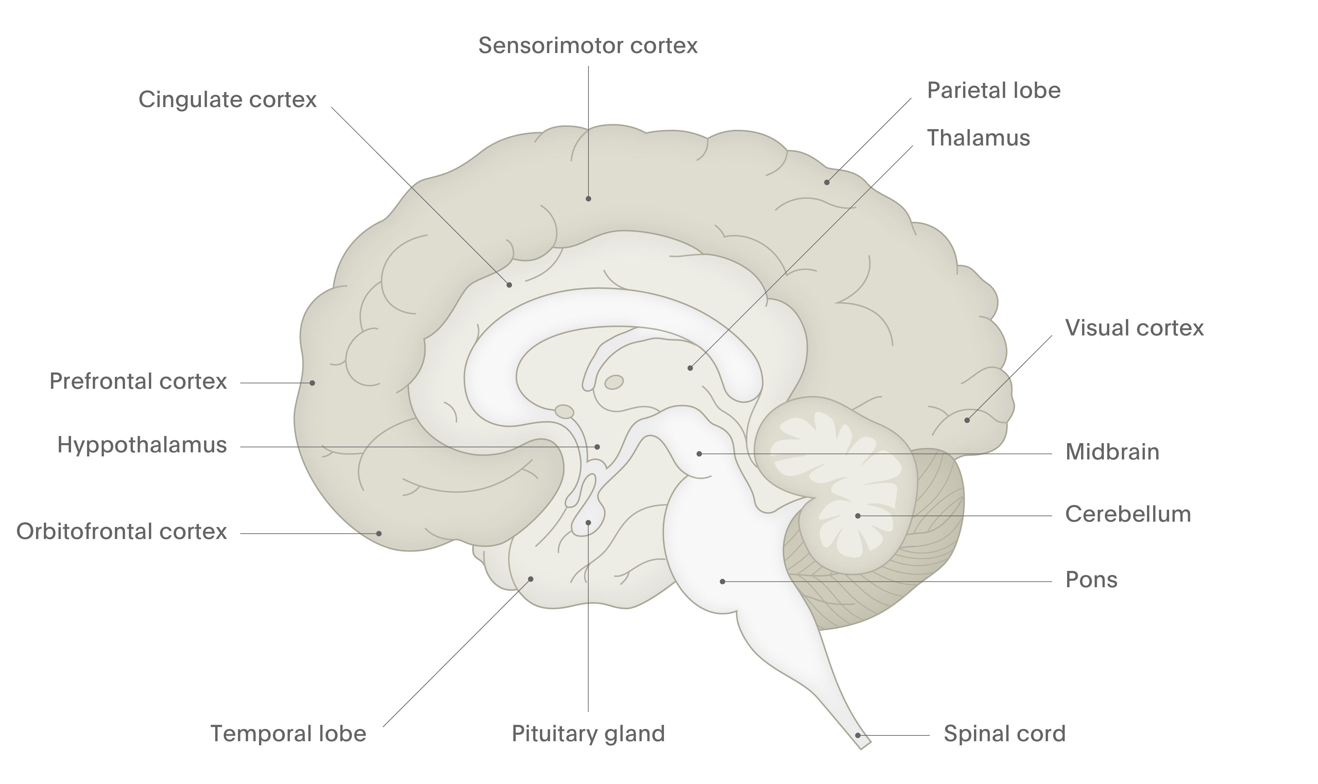
Dopamine
Fundamentals of neurobiology – Cellular and molecular neuroscience
Dopamine is produced from the precursor molecule L-DOPA (dihydroxyphenylalanine) by
DOPA decarboxylase^{1,2}
Dopamine is removed from the synapse by specialised dopamine transporters, and is catabolised by monoamine oxidase (MAO) and catechol-O-methyltransferase (COMT)^{1,2}
Dopamine is involved in movement control, motivation, reward, and reinforcement; many addictive substances work by affecting dopaminergic neurons^{1,2}
Striatum
Nigrostriatal pathway
Dopamine has influence over control of fine movements and initiation of movement^{2,3}
Mesocortical pathway
Here, dopamine influences perception, cognition, and social behaviour³
Hypothalamus
Substantia
nigra
Tegmentum
Tuberoinfundibular pathway
Dopamine normally inhibits the release of prolactin³
HO
NH₂
Mesolimbic pathway
Dopamine is thought to be involved in emotion and memory, pleasurable sensations and reward, the euphoric effects of addictive substances, as well as psychotic symptoms, such as delusions and hallucinations^{2,3}
HO
Arrows show direction of tracts, from filled circles towards the direction of the arrows.
1. Kandel et al. Principles of Neural Science. 6th edition. 2021; 2. Augustine et al. Neuroscience. 7th edition. 2023; 3. Stahl SM. Stahl’s Essential Psychopharmacology. 5th edition. 2021
Notes:
Dopamine receptors influence the activity of the second messenger, cyclic AMP, which is involved in many biochemical processes within a neuron.⁴ Dopamine receptor subtypes D₁ and D₅ increase the levels of cyclic AMP, whereas D₂, D₃, and D₄ subtypes decrease the levels of cyclic AMP (both mechanisms work via the promotion or inhibition, respectively, of adenyl cyclase, which catalyses the conversion of ATP to cAMP).⁴ Depending on which receptor subtype the neurotransmitter binds with on the postsynaptic neuron, dopamine can increase or decrease cellular activity.⁵
Dopamine also plays a key role in the regulation of prolactin – a hormone, produced and released into the bloodstream by the pituitary gland, involved in the secretion of milk and breast growth; unusually high amounts are responsible for impotence and loss of libido in men, and changes in the menstrual cycle in women.⁶ Certain D₂ receptor antagonists such as some antipsychotics, can cause hyperprolactinaemia.⁶
References:
Neurotransmitters. In: Kandel ER, Koester JD, Mack SH, Siegelbaum SA (eds). Principles of Neural Science. 6th edition. McGraw-Hill, 2021.
Neurotransmitters. In: Augustine GJ, Groh J, Huettel S, et al. (eds). Neuroscience. 7th edition. Oxford University Press, 2023.
Stahl SM. Psychosis, schizophrenia, and the neurotransmitters networks dopamine, serotonin, and glutamate. In: Stahl’s Essential Psychopharmacology. Neuroscientific Basis and Practical Applications. 5th edition. © Cambridge University Press, 2021.
Beaulieu JM, Gainetdinov RR. The physiology, signaling, and pharmacology of dopamine receptors. Pharmacol Rev 2011; 63 (1): 182–217.
Speranza L, di Porzio U, Viggiano D, et al. Dopamine: The neuromodulator of long-term synaptic plasticity, reward and movement control. Cells 2021; 10 (4): 735.
Al-Chalabi M, Bass AN, Alsalman I. Physiology, prolactin. StatPearls [internet]. 2023.

