Slide 1
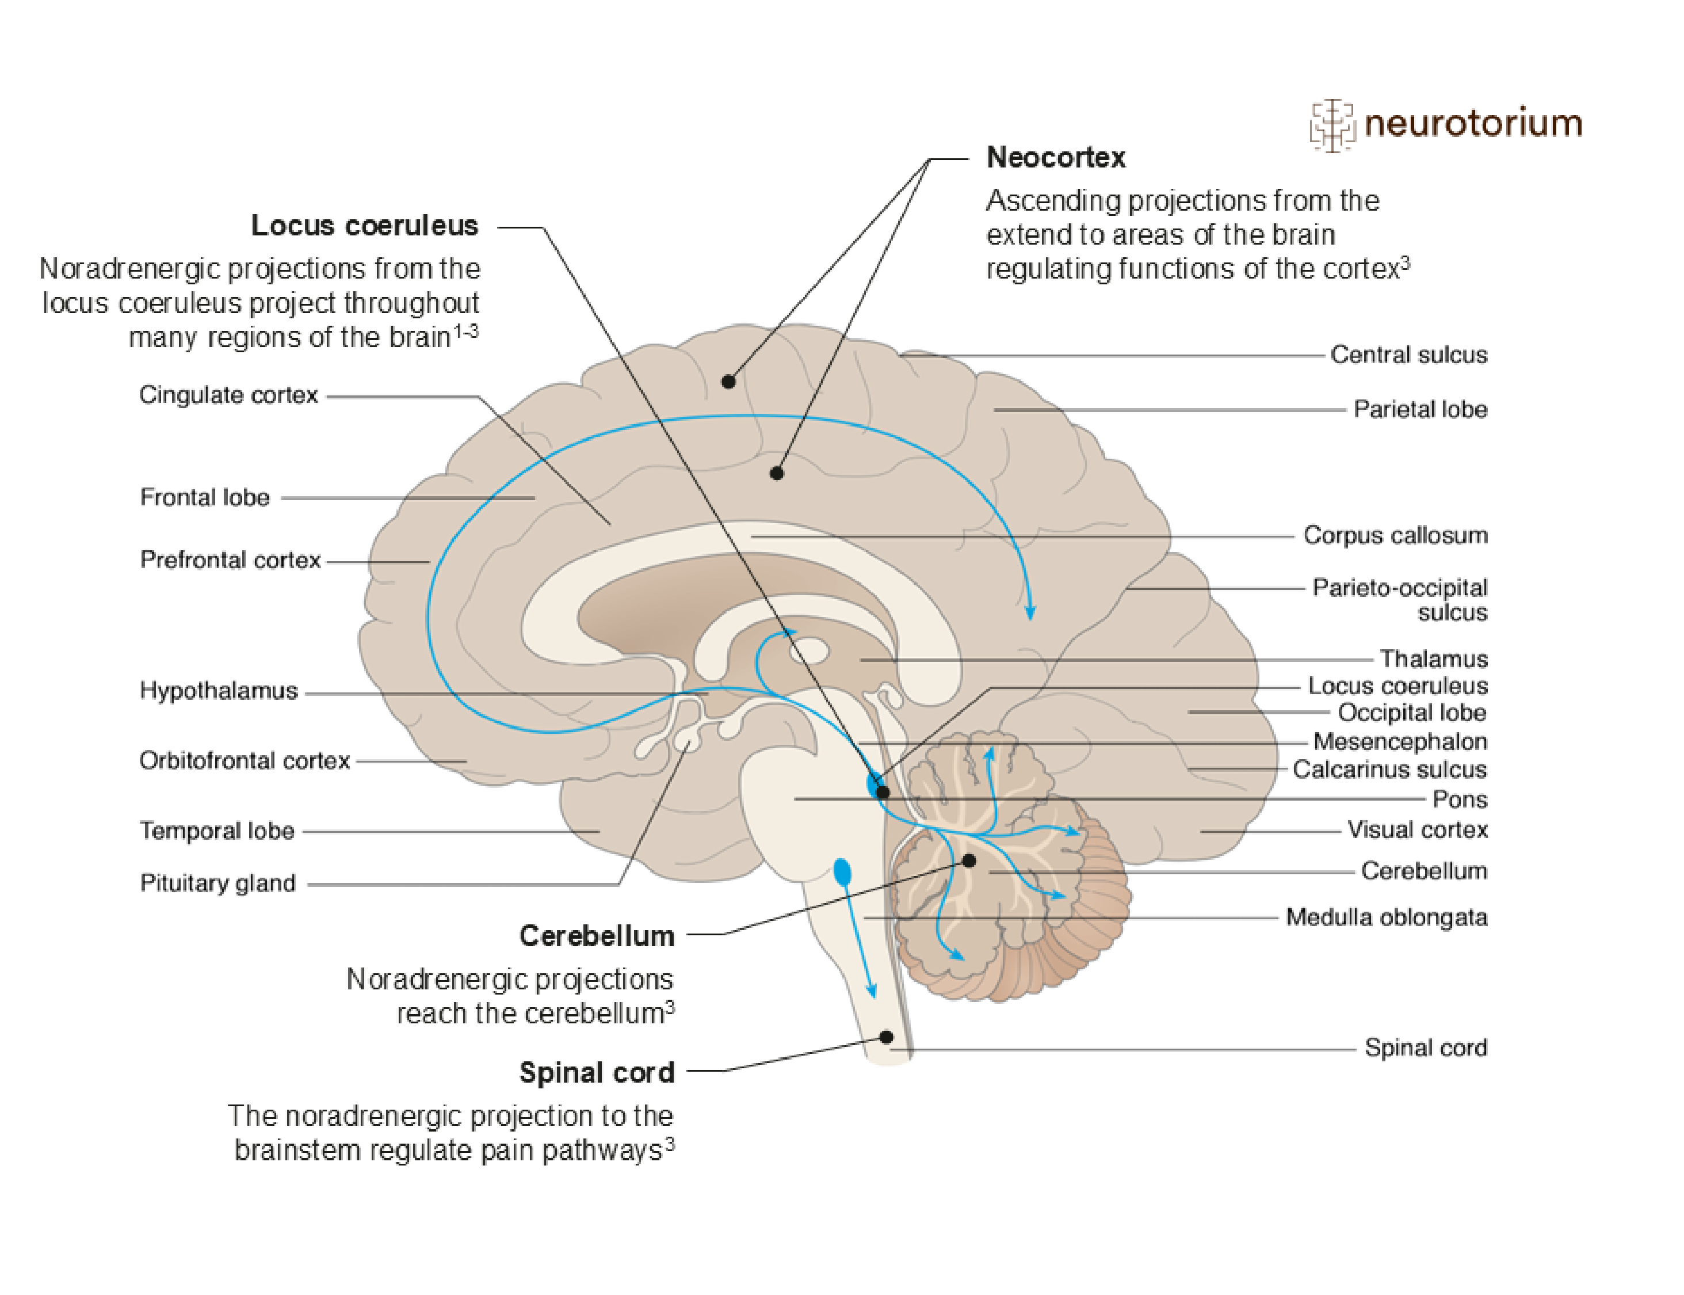
Noradrenaline
Fundamentals of neurobiology – Cellular and molecular neuroscience
Noradrenaline (also called norepinephrine) is a neurotransmitter primarily found within neurons in the locus coeruleus^{1,2}
Noradrenaline is synthesized from dopamine¹
The actions of noradrenaline in the synapse are terminated by reuptake or enzymatic breakdown¹
The principal function of the locus coeruleus is to prioritise competing incoming stimuli, whether external (e.g., a threat from the environment) or internal (e.g., pain), and to
focus attention^{1,2}
OH
HO
NH₂
HO
Arrows show direction of tracts, from filled circles towards the direction of the arrows.
1. Augustine et al. Neuroscience. 7th edition. 2023; 2. Kandel et al. Principles of Neural Science. 6th edition. 2021; 3. Stahl SM. Stahl’s Essential Psychopharmacology. 5th edition. 2021
Notes:
Noradrenergic neurons project widely throughout the brain, and there are many brain areas where serotonin, noradrenaline and dopamine projections overlap, allowing interactions between these transmitter systems.^{1,4}
Noradrenaline and the locus coeruleus are thought to have important input into the control the CNS exerts over cognition, memory, stress response, arousal, pain, and other functions.⁵⁻⁷ Malfunction of the locus coeruleus is thought to underlie disorders such as depression, anxiety, and Alzheimer’s disease, and Parkinson’s disease.⁵ In addition, abnormalities in the noradrenergic projection to the hypothalamus – which mediates stress response – are thought to be involved in the pathology of depressive and anxiety disorders.⁸
References:
Neurotransmitters. In: Augustine GJ, Groh J, Huettel S, et al. (eds). Neuroscience. 7th edition. Oxford University Press, 2023.
Neurotransmitters. In: Kandel ER, Koester JD, Mack SH, Siegelbaum SA (eds). Principles of Neural Science. 6th edition. McGraw-Hill, 2021.
Stahl SM. Psychosis, schizophrenia, and the neurotransmitters networks dopamine, serotonin, and glutamate. In: Stahl’s Essential Psychopharmacology. Neuroscientific Basis and Practical Applications. 5th edition. © Cambridge University Press, 2021.
Blier P, Briley M. The noradrenergic symptom cluster: clinical expression and neuropharmacology. Neuropsychiatr Dis Treat 2011; 7 (Suppl 1): 15–20.
Khroud NK, Reddy V, Saadabadi A. Neuroanatomy, locus coeruleus. StatPearls [internet]. 2022.
Hussain LS, Reddy V, Maani CV. Physiology, noradrenergic synapse. StatPearls [internet]. 2023.
Taylor BK, Westlund KN. The noradrenergic locus coeruleus as a chronic pain generator. J Neurosci Res 2017; 95 (6): 1336–1346.
Dunn AJ, Swiergiel AH. The role of corticotropin-releasing factor and noradrenaline in stress-related responses, and the inter-relationships between the two systems. Eur J Pharmacol 2008; 583 (2–3): 186–193.

