Slide 1
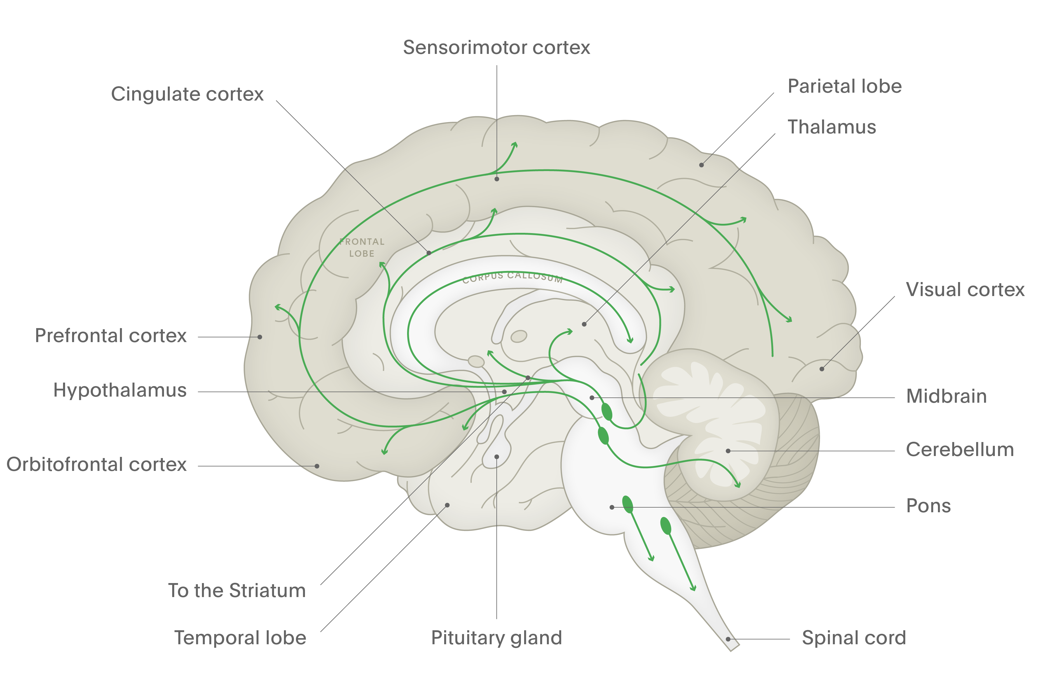
Serotonin
Fundamentals of neurobiology – Cellular and molecular neuroscience
Serotonin (also known as 5-HT) is a neurotransmitter that is found throughout the body. High concentrations are found in the CNS, blood platelets, and certain cells in the gastrointestinal tract¹
Serotonin is synthesized from the amino acid tryptophan, and is removed from the synaptic cleft by reuptake or enzymatic breakdown²
There are many receptor subtypes for serotonin^{1,3}
Serotonergic neurons project widely throughout the brain from their origin in the raphe nuclei of the brainstem¹
Cerebral cortex
Within the forebrain, serotonin is thought to regulate sleep and wakefulness²
NH₂
Raphe nuclei²
HO
Spinal cord
Serotonergic projections to the spinal cord may regulate pain⁴
NH
Arrows show direction of tracts, from filled circles towards the direction of the arrows. CNS=central nervous system
1. Bakshi & Tadi. Biochemistry, serotonin. StatPearls [internet]. 2022; 2. Augustine et al. Neuroscience. 7th edition. 2023;
3. Olivier. Eur J Pharmacol 2015;753:2–18; 4. Tao et al. Neural Plast 2019;2019:1389296
Notes:
Serotonin (also known as 5-HT) is a neurotransmitter that is found throughout the body.¹ The wide dispersal of serotonergic neurons throughout the brain enables serotonin to be involved in modulating diverse body functions:^{1,3,5}
mood
sleep
cognition
sensory processing
pain perception
movement
regulation of internal temperature
appetite
sexual behaviour
hormone secretion.
References:
Bakshi A, Tadi P. Biochemistry, serotonin. StatPearls [internet]. 2022.
Neurotransmitters. In: Augustine GJ, Groh J, Huettel S, et al. (eds). Neuroscience. 7th edition. Oxford University Press, 2023.
Olivier B. Serotonin: A never-ending story. Eur J Pharmacol 2015; 753: 2–18.
Tao Z, Wang P, Wei S, et al. The role of descending pain modulation in chronic primary pain: Potential applications of drugs targeting serotonergic system. Neural Plast 2019; 2019: 1389296.
Millan MJ, Marin P, Bockaert J, Mannoury la Cour C. Signaling at G-protein-coupled serotonin receptors: recent advances and future directions. Trends Pharmacol Sci 2008; 29 (9): 454–464.

