Slide 1
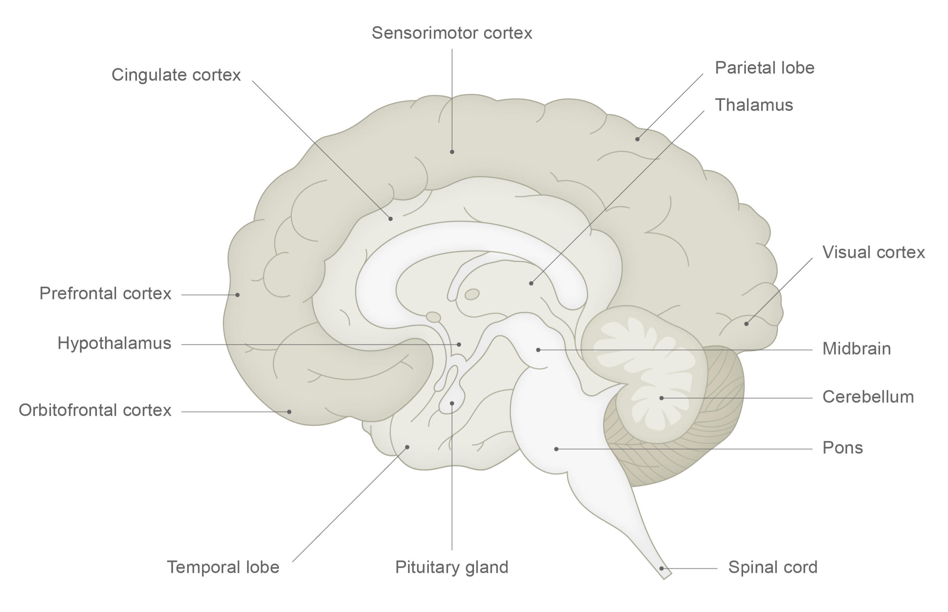
Acetylcholine
Fundamentals of neurobiology – Cellular and molecular neuroscience
Acetylcholine is used throughout the nervous system at skeletal neuromuscular junctions, and within the central nervous system¹
Acetylcholine is synthesized in nerve terminals from acetyl coenzyme A (produced from glucose) and choline¹
Acetylcholine is removed from the synapse by AChE¹
Involved in memory and attention within the brain and muscle contraction at the neuromuscular junction^{1,2}
CH₃
Medial septal nucleus
O
Nucleus basalis of Meynert
N
H₃C
O
CH₃
H₃C
Arrows show direction of tracts, from filled circles towards the direction of the arrows. AChE=acetylcholinesterase
1. Augustine et al. Neuroscience. 7th edition. 2023; 2. Decker & Duncan. Curr Opin Behav Sci 2020;32:1–8
Notes:
In the CNS, Acetylcholine (ACh) acts mainly via muscarinic (metabotropic) and nicotinic (ionotropic) receptors.¹
References:
Neurotransmitters. In: Augustine GJ, Groh J, Huettel S, et al. (eds). Neuroscience. 7th edition. Oxford University Press, 2023.
Decker AL, Duncan K. Acetylcholine and the complex interdependence of memory and attention. Curr Opin Behav Sci 2020; 32: 1–8.

