Slide 1
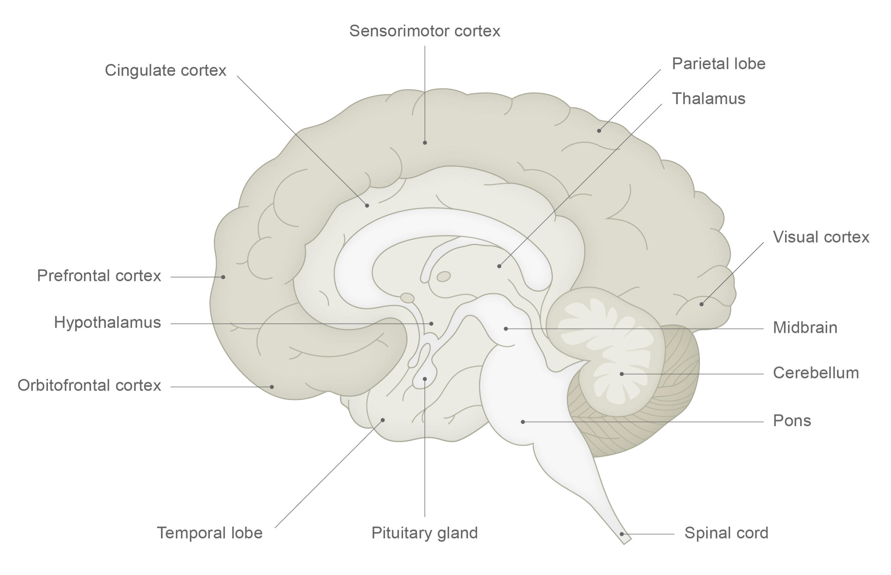
Histamine
Fundamentals of neurobiology – Cellular and molecular neuroscience
Histamine is produced from the amino acid histidine by histidine decarboxylase, and degraded by a methyltransferase and monoamine oxidase¹
Found in mast cells in the body, whereas in the brain histamine is found in neurons of the hypothalamus that project throughout the brain^{1,2}
Histaminergic neurons are important in vestibular regulation, and the regulation of arousal, attention, and wakefulness¹⁻³
Tuberomammillary nucleus of hypothalamus
N
NH₂
N
H
Arrows show direction of tracts, from filled circles towards the direction of the arrows
1. Augustine et al. Neuroscience. 7th edition. 2023; 2. Haas et al. Physiol Rev 2008;88(3):1183–1241; 3. Thakkar. Sleep Med Rev 2011;15(1):65–74
Notes:
References:
Neurotransmitters. In: Augustine GJ, Groh J, Huettel S, et al. (eds). Neuroscience. 7th edition. Oxford University Press, 2023.
Haas HL, Sergeeva OA, Selbach O. Histamine in the nervous system. Physiol Rev 2008; 88 (3): 1183–1241.
Thakkar MM. Histamine in the regulation of wakefulness. Sleep Med Rev 2011; 15 (1): 65–74.

