Slide 1
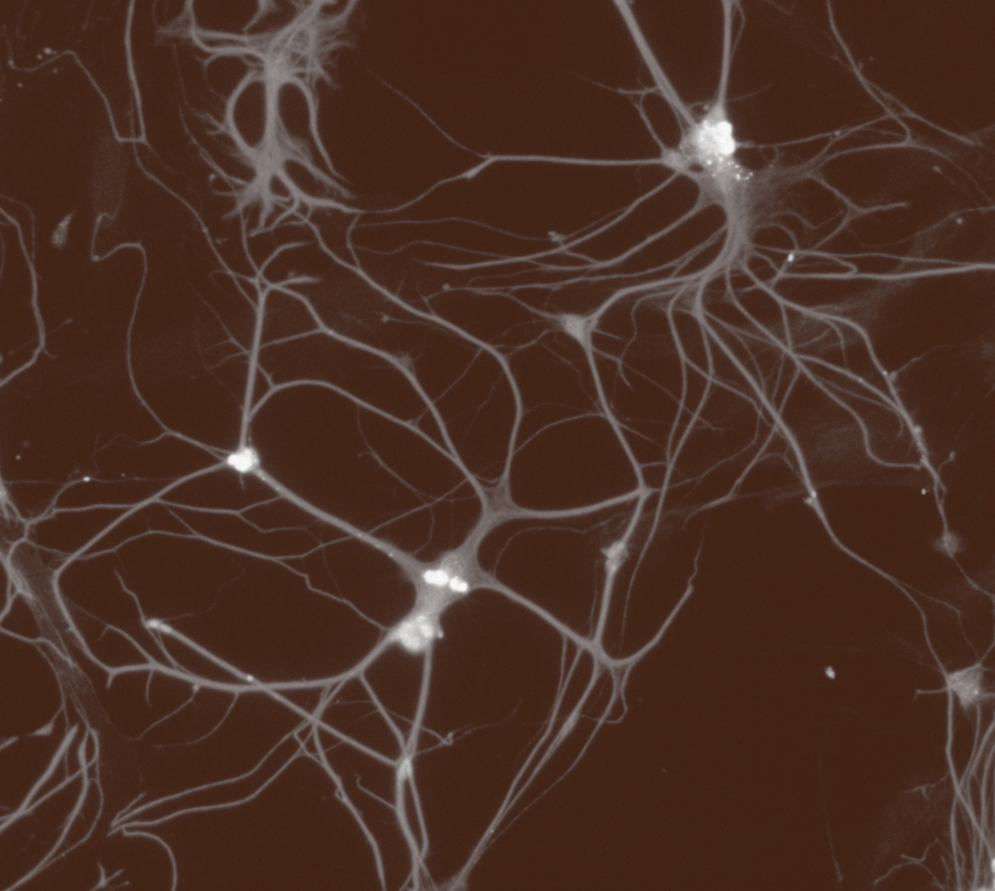
Fundamentals of neurobiology
Regional neuroscience

Slide 2
Organisation of the nervous system
Fundamentals of neurobiology – Regional neuroscience
The nervous system transmits information within and between different parts of the body in order to co-ordinate and regulate its actions¹
It can be split into 2 components:^{1,2}
  The central nervous system (CNS), which consists of the brain and spinal cord
  The peripheral nervous system (PNS), encompasses the nervous system that lies outside of the CNS
Brain
Spinal cord
Central Nervous System (CNS)¹
Other nerves lying outside the CNS
Peripheral Nervous System (PNS)¹
CNS=central nervous system; PNS=peripheral nervous system
1. Thau et al. Anatomy, central nervous system. [Updated 2022 Oct]. In: StatPearls [internet]. Treasure Island (FL): StatPearls Publishing; 2022.
Available at: https://www.ncbi.nlm.nih.gov/books/NBK542179; 2. Squire et al. Basic plan of the nervous system. In: Fundamental Neuroscience. 4th edition; 2012
Notes:
References:
Thau et al. Anatomy, central nervous system. [Updated 2022 Oct]. In: StatPearls [internet]. Treasure Island (FL): StatPearls Publishing; 2022. Available at: https://www.ncbi.nlm.nih.gov/books/NBK542179.
Basic plan of the nervous system. In: Squire L, Berg D, Bloom FE, Lac Sd, Ghosh A, Spitzer NC. Fundamental Neuroscience. 4th edition, 2012. Burlington: Elsevier Science.

Slide 3
Terminology: structures in the CNS and PNS
Fundamentals of neurobiology – Regional neuroscience
Functionally related neurons and axons are often aggregated to form distinct structures in the nervous system¹
The table lists the main terms used for these structures
Name¹ | Description | Examples
CNS
Nucleus | A cluster of functionally related neuronal cell bodies and dendrites | Caudate nucleus
Column | Groups of cells related by function and the location of their stimuli arranged in a column | Ocular dominance column of the visual cortex
Layer (lamina) | Functionally related cell bodies arranged in a layer | Layer IV of the cerebral cortex
Tract (fasciculus) | Bundle of parallel axons (fibres) | Corticospinal tract that runs from the cerebral cortex to motor neurons in the spinal cord
PNS
Ganglion | A cluster of neuron cell bodies | Trigeminal ganglion
Nerve root | A peripheral structure consisting of parallel axons and associated cells | Ventral roots of spinal nerves
CNS=central nervous system; PNS=peripheral nervous system
1. Mihailoff & Haines. The cell biology of neurons and glia. In: Haines et al. Fundamental Neuroscience for Basic and Clinical Applications. 6th edition, 2025
Notes:
Reference:
Mihailoff GA, Haines DE. The cell biology of neurons and glia. In: Haines DE, Mihailoff GA, Willis MA. Fundamental Neuroscience for Basic and Clinical Applications. 6th edition, 2025. Philadelphia: Elsevier.

Slide 4
The peripheral nervous system (PNS)

Slide 5
Overview of the peripheral nervous system (PNS)
Fundamentals of neurobiology – Regional neuroscience
The PNS is responsible for communication from the CNS to the periphery, and from the periphery back to the CNS. It consists mainly of:^{1,2}
  Nerves – bundles of axons
  Ganglia – clusters of neuron cell bodies
Efferent pathways transmit information from the CNS^{1,2}
  These include somatic motor pathways responsible for regulating skeletal muscles and autonomic motor pathways responsible for regulating activity of the visceral organs
Afferent pathways conduct information to the CNS^{1,3}
  These include somatic sensory pathways (carrying sensory information from skin, muscles, joints and tendons) and visceral sensory pathways (carrying information from the internal organs)
Components of the PNS: cross-section through the spinal cord⁴
CNS
Sensory ganglion
Interneurons
Afferent (sensory) fibre
Efferent (motor) fibre
PNS
Grey matter
White matter
PNS
This work is adapted from ‘Introduction to Neuroscience’ By Hedges, used under CC-BY. This work is licensed under Creative Commons license CC-BY-NC-SA by the Lundbeck Foundation.
CNS=central nervous system; PNS=peripheral nervous system
1. Squire et al. Basic plan of the nervous system. In: Fundamental Neuroscience. 4th edition; 2012;
2. Hedges. Peripheral nervous system. In: Introduction to Neuroscience. https://openbooks.lib.msu.edu/introneuroscience1/;
Accessed December 2025 3. Sanvictores et al. Neuroanatomy, autonomic nervous system visceral afferent fibers and pain. [Updated 2023 Jul].
In: StatPearls [internet]. Treasure Island (FL): StatPearls Publishing; 2022. Available at: https://www.ncbi.nlm.nih.gov/books/NBK560843/;
4. Hedges. Spinal cord structure. In: Introduction to Neuroscience. https://openbooks.lib.msu.edu/introneuroscience1/. Accessed December 2025
Notes:
The cell bodies of efferent pathways (motor and autonomic) lie in the spinal cord of the central nervous system (CNS) and peripheral nerves contain axons from these neuronal cell bodies as well as those situated in peripheral ganglia.^{1,2} The central/peripheral distinction is therefore to some extent an anatomical convenience that ignores this aspect of circuit organisation.¹
References:
Basic plan of the nervous system. In: Squire L, Berg D, Bloom FE, Lac Sd, Ghosh A, Spitzer NC. Fundamental Neuroscience. 4th edition, 2012. Burlington: Elsevier Science.
Hedges V. Peripheral nervous system. In: Introduction to Neuroscience. Available at: https://openbooks.lib.msu.edu/introneuroscience1/. Accessed December 2025.
Sanvictores T, Jozsa F, Tadi P. Neuroanatomy, autonomic nervous system visceral afferent fibers and pain. [Updated 2023 Jul]. In: StatPearls [internet]. Treasure Island (FL): StatPearls Publishing; 2022. Available at: https://www.ncbi.nlm.nih.gov/books/NBK560843/.
Hedges V. Spinal cord structure. In: Introduction to Neuroscience. Available at: https://openbooks.lib.msu.edu/introneuroscience1/. Accessed December 2025.

Slide 6

Peripheral nerves
Fundamentals of neurobiology – Regional neuroscience
Peripheral nerves consist of bundles of axons that are myelinated by Schwann cells,¹ they can be classified as sensory, motor or mixed²
Axons of different diameters have different levels of myelination, different functions and properties, such as conduction velocities¹ (conduction velocity increases with diameter):
  Efferent (motor) axons
  α: myelinated efferent fibres that conduct signals to muscle fibres to control movements (conduction velocity 70–120 m/s)^{3,4}
  γ: efferent fibres that conduct impulses to muscle spindles and together with afferent Ia fibres regulate muscle tone (conduction velocity 15–30 m/s)³⁻⁵
  Afferent (sensory) axons
  Group I (Aα): myelinated afferent fibres that conduct signals from muscle spindles and provide sensory information about extent of stretch and contraction of muscles (conduction velocity 70–120 m/s)^{4,5}
  Group II (Aβ): myelinated fibres that carry signals regarding proprioception, touch, and pressure to the CNS (conduction velocity 30–70 m/s)⁴
  Group III (Aδ): myelinated fibres that transmit pain and cold temperature signals to the CNS (12–30 m/s conduction velocity)⁴
  Group IV (C): small unmyelinated nerve fibres that serve several functions including the conduction of pain, temperature and touch signals to the CNS (0.5–2.0 m/s conduction velocity)⁴
Each segment of myelin sheath is separated from the next by a small gap known as the node of Ranvier, a point at which ion channels are concentrated¹
In myelinated axons, Schwann cells wrap tightly around the axon and form the myelin sheath¹
CNS=central nervous system
1. Grider et al. Neuroanatomy, nodes of Ranvier. [Updated 2023 Jul]. In: StatPearls [internet]. Treasure Island (FL): StatPearls Publishing; 2023. Available at: https://www.ncbi.nlm.nih.gov/books/NBK537273/;
2. Squire et al. Basic plan of the nervous system. In: Fundamental Neuroscience. 4th edition; 3. Stifani. Front Cell Neurosci 2014;8:293; 4. De Hert et al. Phlebology 2014;29(7):428–441;
5. Hedges. Spinal motor control and proprioception. In: Introduction to Neuroscience. Available at: https://openbooks.lib.msu.edu/introneuroscience1/. Accessed December 2025
Notes:
Because of the electrical properties of the myelin sheath, and the concentration of sodium channels at nodes of Ranvier, conduction velocities in myelinated axons are much greater than those in unmyelinated axons.¹
Clinical considerations: The diagnosis of peripheral neuropathy is very common.⁶ The subsets of nerve fibres affected can vary so symptoms can vary from person to person and can include numbness (particularly in the feet), weakness and imbalance.^{6,7} There are many causes of neuropathy but in general they affect either the axon or myelin.⁶ A prototypic demyelinating neuropathy is Guillain-Barré syndrome in which peripheral myelin is disrupted leading to profound weakness.⁸ Duplication of the PMP22 gene (abundantly expressed in myelin) gives rise to a form of Charcot-Marie-Tooth disease, a demyelinating neuropathy that causes progressive weakness beginning in the legs.⁹
References:
Grider MH, Belcea CQ, Covington BP, et al. Neuroanatomy, nodes of Ranvier. [Updated July 2023]. In: StatPearls [internet]. Treasure Island (FL): StatPearls Publishing; 2023. Available at: https://www.ncbi.nlm.nih.gov/books/NBK537273/.
Basic plan of the nervous system. In: Squire L, Berg D, Bloom FE, Lac Sd, Ghosh A, Spitzer NC. Fundamental Neuroscience. 4th edition, 2012. Burlington: Elsevier Science.
Stifani N. Motor neurons and the generation of spinal motor neuron diversity. Front Cell Neurosci 2014; 8: 293.
De Hert S, De Baerdemaeker L, De Maeseneer M. What the phlebologist should know about local anaesthetics. Phlebology 2014; 29 (7): 428–441.
Hedges V. Spinal motor control and proprioception. In: Introduction to Neuroscience. Available at: https://openbooks.lib.msu.edu/introneuroscience1/. Accessed December 2025.
Hammi C, Yeung B. Neuropathy. [Updated October 2022] In: StatPearls [internet]. Treasure Island (FL): StatPearls Publishing; 2022. Available at: https://www.ncbi.nlm.nih.gov/books/NBK542220/.
Beaulieu ML, Müller MLTM, Bohnen NI. Peripheral neuropathy is associated with more frequent falls in Parkinson’s disease. Parkinsonism Relat Disord 2018; 54: 46–50.
Bellanti R, Rinaldi S. Guillain-Barré syndrome: a comprehensive review. Eur J Neurol 2024; 31 (8): e16365.
Stefanski KM, Wilkinson MC, Sanders CR. Roles for PMP22 in Schwann cell cholesterol homeostasis in health and disease. Biochem Soc Trans 2024; 52 (4): 1747–1756.

Slide 7
The somatic motor system
Fundamentals of neurobiology – Regional neuroscience
The somatic motor system carries information for the control of voluntary movement from the spinal cord to muscle tissue.¹ Information for the control of involuntary movement, such as adjustment of muscle tone needed for posture and balance is also transmitted by the somatic motor system²
Upper motor neurons are located in the motor cortex.³ They are not part of the peripheral motor system, but they control the activity of spinal motor neurons (lower motor neurons) located in the grey matter of the spinal cord (in the CNS) in the ventral horn (coloured in red) which project axons out of the spinal cord via the ventral root (PNS).³ Motor axons then terminate at muscles with which they form the neuromuscular junction.⁴ Here the neurotransmitter acetylcholine released from motor axons binds to acetylcholine receptors, which is then converted to an electrical signal within the muscle leading to muscle contraction^{1,4}
Cross section of the spinal column⁵
CNS
Grey matter
White matter
Dorsal root
Sensory neuron
cell bodies
In: afferent
(sensory) fibres
Out: efferent (motor) fibres
Spinal nerve
PNS
PNS
Motor neuron
cell bodies
Ventral root
This work is adapted from ‘Biology for Majors II’ By the State University of New York, used under CC-BY. This work is licensed under Creative Commons license CC-BY-SA by the Lundbeck Foundation.
1. Hedges. Peripheral nervous system. In: Introduction to Neuroscience. Available at: https://openbooks.lib.msu.edu/introneuroscience1/.
Accessed December 2025; 2. Squire et al. Fundamentals of Motor Systems. In: Fundamental Neuroscience. 4th edition; 2012;
3. Stifani. Front Cell Neurosci 2014;8:293; 4. Hedges. Spinal motor control and proprioception. In: Introduction to Neuroscience.
Available at: https://openbooks.lib.msu.edu/introneuroscience1/. Accessed December 2025;
5. State University of New York. Peripheral nervous system. In: Biology for Majors II.
Available at: https://courses.lumenlearning.com/suny-wmopen-biology2/chapter/the-peripheral-nervous-system/. Accessed December 2025
Notes:
The cell bodies of large myelinated axons reside in the grey matter of the spinal cord in the anterior horn.^{6,7} They send their axons out of the ventral root and either directly into peripheral nerves, or nerve plexuses (a branching network of intersecting nerves) which give rise to peripheral nerves.^{4,7}
References:
Hedges V. Peripheral nervous system. In: Introduction to Neuroscience. Available at: https://openbooks.lib.msu.edu/introneuroscience1/. Accessed December 2025.
Fundamentals of motor systems. In: Squire L, Berg D, Bloom FE, Lac Sd, Ghosh A, Spitzer NC. Fundamental Neuroscience. 4th edition, 2012. Burlington: Elsevier Science.
Stifani N. Motor neurons and the generation of spinal motor neuron diversity. Front Cell Neurosci 2014; 8: 293.
Hedges V. Spinal motor control and proprioception. In: Introduction to Neuroscience. Available at: https://openbooks.lib.msu.edu/introneuroscience1/. Accessed December 2025.
State University of New York. Peripheral nervous system. In: Biology for Majors II. Available at: https://courses.lumenlearning.com/suny-wmopen-biology2/chapter/the-peripheral-nervous-system/. Accessed December 2025.
Mercadante AA, Tadi P. Neuranatomy, gray matter. [Updated 2023 Jul]. In: StatPearls [internet]. Treasure Island (FL): StatPearls Publishing; 2023. Available at: https://www.ncbi.nlm.nih.gov/books/NBK553239/.
Harrow-Mortelliti M, Reddy V, Jimsheleishvili G. Physiology, spinal cord. [Updated 2023 Mar]. In: StatPearls [internet]. Treasure Island (FL): StatPearls Publishing; 2023. Available at: https://www.ncbi.nlm.nih.gov/books/NBK544267.

Slide 8
The autonomic motor system
Fundamentals of neurobiology – Regional neuroscience
The autonomic nervous system is primarily divided into the sympathetic and parasympathetic systems which are efferent pathways that conduct information from the CNS out to the viscera to regulate involuntary autonomic functions (e.g. airway tone, digestion and regulation of heart rate and blood pressure)^{1,2}
Unlike the somatic sensory or motor systems of the PNS, the autonomic nervous system is a two-neuron pathway:¹
  The cell body of the first neuron (preganglionic) is located in the brainstem or spinal cord.^{1,3} Its axon projects and forms synapses with a second neuron (postganglionic)^{1,3}
  The second neuron is situated in a peripheral ganglion, the axon of this neuron then projects to a peripheral target (e.g., smooth muscle, cardiac muscle or gland)¹
Effects of sympathetic and parasympathetic activation of the body²
Parasympathetic
Sympathetic
Constricts pupil
Dilates pupil
Stimulates flow of saliva
Medulla
oblongata
Inhibits flow of saliva
Slows heartbeat
Accelerates heartbeat
Vagus
nerve
Solar
plexus
Dilates bronchi
Constricts bronchi
Inhibits peristalsis and secretion
Stimulates peristalsis and secretion
Conversion of glycogen to glucose
Stimulates release of bite
Secretion of adrenaline and noradrenaline
Contracts bladder
Inhibits bladder contraction
Chain of sympathetic ganglia
CNS=central nervous system; PNS=peripheral nervous system
1. Hedges. Peripheral nervous system. In: Introduction to Neuroscience.
Available at: https://openbooks.lib.msu.edu/introneuroscience1/. Accessed December 2025;
2. Autonomic nervous system basics. In: Ernstmeyer & Christman (eds) Nursing Pharmacology.
Available at: https://wtcs.pressbooks.pub/pharmacology/chapter/4-2-ans-basics/. Accessed December 2025;
3. McCorry. Am J Pharm Educ 2007;71(4):78
This work is adapted from ‘Nursing Pharmacology’ by Ernstmeyer and Christman, used under CC-BY. This work is licensed under Creative Commons license
CC-BY-SA by the Lundbeck Foundation.
Notes:
The parasympathetic and sympathetic systems differ with respect to the neurotransmitters used: both use acetylcholine as a transmitter in the preganglionic neurons, but most postganglionic sympathetic neurons use noradrenaline whereas postganglionic parasympathetic neurons use acetylcholine.¹ They are also located differently; the sympathetic division includes neurons with ganglia near the spinal cord (shown on the slide), whereas the parasympathetic division includes long presynaptic neurons that connect with postsynaptic neurons in peripheral ganglia located close to the target organ.¹
The actions of the sympathetic and parasympathetic system are often antagonistic, but always divergent.¹ The sympathetic system mediates the ‘fight or flight’ response (increasing heart rate and airway dilation, decreasing blood flow to viscera (internal organs) and increasing blood flow to muscle).^{1,2} The parasympathetic system mediates the ‘rest and digest’ response (slowing heart rate, increasing blood flow to digestive organs and increasing gastric motility.^{1,2} The functions of the sympathetic and parasympathetic systems are summarised in the table on the next slide.
References:
Hedges V. Peripheral nervous system. In: Introduction to Neuroscience. Available at: https://openbooks.lib.msu.edu/introneuroscience1/. Accessed December 2025.
Autonomic nervous system basics. In: Ernstmeyer K, Christman E (eds) Nursing Pharmacology. Available at: https://wtcs.pressbooks.pub/pharmacology/chapter/4-2-ans-basics/. Accessed December 2025.
McCorry LK. Physiology of the autonomic nervous system. Am J Pharm Educ 2007; 71 (4): 78.

Slide 9
Important functions of autonomic pathways
Fundamentals of neurobiology – Regional neuroscience
Organ/tissue | Sympathetic | Parasympathetic
Iris^{1,2} | Dilates pupil | Constricts pupil
Lacrimal gland¹ | Inhibits secretion | Stimulates secretion
Salivary gland^{1,2} | Inhibits secretion | Stimulates secretion
Sweat glands¹ | Stimulates secretion | No innervation
Lungs^{1,2} | Airway dilation | Airway constriction
Heart^{1,2} | Accelerates heart rate, augments contraction | Decreases heart rate
GI motility and secretion¹ | Inhibits | Stimulates
GI sphincters¹ | Constricts | Relaxes
Reproductive organs^{1,3} | Contraction of ductus deferens, seminal vesicle, prostatic and uterine muscles | Vasodilation and erection, inhibits uterine muscle contraction
Urinary bladder¹ | Relaxes bladder wall muscle, inhibits emptying | Contracts bladder wall muscle, promotes emptying
Adrenal medulla^{1,2} | Stimulates secretion of adrenaline and noradrenaline | No innervation
Blood vessels^{1,2} | Constrict | No innervation
1. Marieb et al. The autonomic nervous system and visceral sensory neurons. In: Human Anatomy & Physiology. 7th edition.;
2. Hedges. Peripheral nervous system. In: Introduction to Neuroscience. Available at: https://openbooks.lib.msu.edu/introneuroscience1/. Accessed December 2025;
3. Everaert et al. Spinal Cord 2010;48(3):182–191
Notes:
References:
The autonomic nervous system and visceral sensory neurons. In: Marieb EN, Wilhelm PB, Mallat J. Human anatomy & Physiology; 7th edition, 2012. Boston: Pearson Education.
Hedges V. Peripheral nervous system. In: Introduction to Neuroscience. Available at: https://openbooks.lib.msu.edu/introneuroscience1/. Accessed December 2025.
Everaert K, de Waard WIQ, Van Hoof T, et al. Neuroanatomy and neurophysiology related to sexual dysfunction in male neurogenic patients with lesions to the spinal cord or peripheral nerves. Spinal Cord 2010; 48 (3): 182–191.

Slide 10
Functional organisation of the peripheral sensory system
Fundamentals of neurobiology – Regional neuroscience
The somatic sensory system carries information from the skin, muscles, and tendons to the spinal cord.¹ The visceral sensory system transmits information from the internal organs (viscera)²
In the somatic sensory system, receptors in the skin, muscles and joints are specialised nerve endings or cells that detect specific types of stimuli:¹⁻³
  Mechanoreceptors detect touch, pressure, and vibration
  Thermoreceptors detect temperature
  Nociceptors detect painful stimuli
  Proprioceptors in muscles, tendons and joints sense limb and body position, and are therefore crucial for producing smooth coordinated movement
The visceral sensory system transmits information from the viscera about organ stretch (e.g., bladder, stomach distension), chemical changes (blood pH and oxygen levels) and pain^{4,5}
Signals are transmitted to the spinal cord by sensory (afferent) neurons.⁶ The cell bodies of spinal sensory afferents lie in dorsal root ganglia, or cranial sensory ganglia for the cranial nerves. Each sensory neuron has a peripheral process that extends to the receptor in the skin, muscle or organ and a central process that enters the spinal cord or brainstem that sends sensory information to the CNS^{1,7}
Cross section of the spinal column⁶
CNS
Lateral column
Dorsal column
Dorsal horn
Dorsal root
Dorsal root ganglion
Afferent (sensory) fibre
Efferent (motor) fibre
Lateral horn
Ventral root
PNS
Ventral column
Ventral horn
PNS
This work is adapted from ‘Introduction to Neuroscience’ By Hedges, used under CC-BY. This work is licensed under Creative Commons license CC-BY-NC-SA by the Lundbeck Foundation.
1. Squire et al. The somatosensory system. In: Fundamental Neuroscience. 4th edition; 2. Sanvictores et al. Neuroanatomy, autonomic nervous system visceral afferent fibers and pain. [Updated 2023 Jul].
In: StatPearls [internet]. Treasure Island (FL): StatPearls Publishing; 2022. Available at: https://www.ncbi.nlm.nih.gov/books/NBK560843/; 3. Hedges. Spinal motor control and proprioception.
In: Introduction to Neuroscience. Available at: https://openbooks.lib.msu.edu/introneuroscience1/. Accessed December 2025; 4. Marieb et al. The autonomic nervous system and visceral sensory neurons.
In: Human Anatomy & Physiology. 7th edition; 5. Bertucci & Arendt. BMC Biol 2013;11:54; 6. Hedges. Spinal cord structure. In: Introduction to Neuroscience.
Available at: https://openbooks.lib.msu.edu/introneuroscience1/. Accessed December 2025; 7. Cranial nerves. In: Lumen Learning Anatomy. Available at:
https://courses.lumenlearning.com/suny-dutchess-anatomy-physiology/. Accessed December 2025
10
Notes:
Specialised sensory receptors in the periphery convert stimuli (e.g. touch, heat) into action potentials in a process known as sensory transduction.⁸
References:
The somatosensory system. In: Squire L, Berg D, Bloom FE, Lac Sd, Ghosh A, Spitzer NC. Fundamental Neuroscience. 4th edition, 2012. Burlington: Elsevier Science.
Sanvictores T, Jozsa F, Tadi P. Neuroanatomy, autonomic nervous system visceral afferent fibers and pain. [Updated 2023 Jul]. In: StatPearls [internet]. Treasure Island (FL): StatPearls Publishing; 2022. Available at: https://www.ncbi.nlm.nih.gov/books/NBK560843/.
Hedges V. Spinal motor control and proprioception. In: Introduction to Neuroscience. Available at: https://openbooks.lib.msu.edu/introneuroscience1/. Accessed December 2025.
The autonomic nervous system and visceral sensory neurons. In: Marieb EN, Wilhelm PB, Mallat J. Human anatomy & Physiology; 7th edition, 2012. Boston: Pearson Education.
Bertucci P, Arendt D. Somatic and visceral nervous systems – an ancient duality. BMC Biol 2013; 11: 54.
Hedges V. Spinal cord structure. In: Introduction to Neuroscience. Available at: https://openbooks.lib.msu.edu/introneuroscience1/. Accessed December 2025.
Cranial nerves. In: Lumen Learning Anatomy. Available at: https://courses.lumenlearning.com/suny-dutchess-anatomy-physiology/. Accessed December 2025.
Sensory perception. In: OpenStax Anatomy and Physiology. Available at: https://openstax.org/books/anatomy-and-physiology. Accessed December 2025.

Slide 11
The central nervous system (CNS)

Slide 12
Regions of the central nervous system
Fundamentals of neurobiology – Regional neuroscience
The CNS can be defined anatomically and by its different regions
The main regions of the CNS are:
  The brain¹
  The spinal cord¹
  Ventricles, choroid plexus, and cerebrospinal fluid^{1,2}
The meninges and cerebrospinal fluid protect the brain¹
The cerebrovascular system supplies the brain with nutrients³
CNS=central nervous system
1. Thau et al. Anatomy, central nervous system. [updated 2022 Oct]. In: StatPearls [internet]. Treasure Island (FL): StatPearls Publishing; 2022. Available at: https://www.ncbi.nlm.nih.gov/books/NBK542179/;
2. Shenoy & Lui. Neuroanatomy, ventricular system. [updated 2023 Jul]. In: StatPearls [internet]. Treasure Island (FL): StatPearls Publishing; 2023. Available at: https://www.ncbi.nlm.nih.gov/books/NBK532932/;
3. Konan et al. Neuroanatomy, cerebral blood supply. [updated 2023 Jul]. In: StatPearls [internet]. Treasure Island (FL): StatPearls Publishing; 2023. Available at: https://www.ncbi.nlm.nih.gov/books/NBK532297/
Notes:
References:
Thau L, Reddy V, Singh P. Anatomy, central nervous system. [updated October 2022]. In: StatPearls [internet]. Treasure Island (FL): StatPearls Publishing; 2022. Available at: https://www.ncbi.nlm.nih.gov/books/NBK542179/.
Shenoy SS, Lui F. Neuroanatomy, ventricular system. [updated July 2023]. In: StatPearls [internet]. Treasure Island (FL): StatPearls Publishing; 2023. Available at: https://www.ncbi.nlm.nih.gov/books/NBK532932/.
Konan LM, Reddy V, Mesfin FB. Neuroanatomy, cerebral blood supply. [updated July 2023]. In: StatPearls [internet]. Treasure Island (FL): StatPearls Publishing; 2023. Available at: https://www.ncbi.nlm.nih.gov/books/NBK532297/.

Slide 13
The spinal cord – function
Fundamentals of neurobiology – Regional neuroscience
The neurocircuitry of a reflex^{5,6}
  The spinal cord acts as a conduit for information:
  Circuits in the spinal cord receive sensory information from receptors in the skin, skeletal muscle and tendons (somatosensory fibres) and from receptors from the viscera (viscerosensory fibres).¹ This sensory input is relayed by ascending tracts to the brain²
  Descending tracts in the spinal cord carry motor commands from the brain that control the activity of somatic and visceral motor neurons which control the activity of skeletal muscles and visceral organs, respectively²⁻⁴
  The spinal cord contains the circuits for generating reflexes
  Spinal reflex circuits generate rapid, stereotyped responses; they can operate without cortical initiation (but can be modulated by descending pathways)^{2,5}
  Sensory fibres enter the spinal cord and influence spinal motor neurons (either directly or indirectly) that then produce rapid involuntary contractions of skeletal muscles⁵
  Reflexes perform a protective function e.g. withdrawal reflex – pulling away from a painful stimulus.⁵ The stretch reflex (knee jerk) can be used as a diagnostic tool to assess the integrity of the spinal cord²
Sensory ganglion
Interneurons
Afferent fibre synapses with interneurons in spinal cord
Stimulation of stretch receptors activates ascending afferent 1a (sensory) fibre
Afferent 1a (sensory) fibre
Efferent (motor) fibre
Interneuron synapses with descending efferent (motor) fibre in spinal cord
Grey matter
White matter
Descending motor fibre innervates quadriceps muscle spindles leading to contraction and a forward kick
Quadriceps
muscle
Stretch receptors in quadriceps muscle stimulated by patellar tendon stretch following tendon tap
Tendon tap
1. Squire et al. Basic plan of the nervous system. In: Fundamental Neuroscience. 4th edition; 2012; 2. Harrow-Mortelliti et al. Physiology, spinal cord. [Updated 2023 Mar].
In: StatPearls [internet]. Treasure Island (FL): StatPearls Publishing; 2023. Available at: https://www.ncbi.nlm.nih.gov/books/NBK544267; 3. Stifani. Front Cell Neurosci 2014;8:293;
4. AbuHasan & Munakomi. Neuroanatomy, pyramidal tract. [Updated 2023 [Jul]. In: StatPearls [internet]. Treasure Island (FL): StatPearls Publishing; 2023. Available at: https://www.ncbi.nlm.nih.gov/books/NBK545314/; 5. Knierim. Spinal reflexes and descending motor pathways. In: Neuroscience Online. Available at: https://nba.uth.tmc.edu/neuroscience/. Accessed September 2025; 6. Hedges. Spinal cord structure. In: Introduction to Neuroscience. https://openbooks.lib.msu.edu/introneuroscience1/. Accessed December 2025
Notes:
Because so many important functions are concentrated into such a small region of the CNS, injury to the spinal cord can cause devastating neurological impairment.² Damage to the thoracic spinal cord can produce paraplegia (paralysis of both legs), and loss of bowel and bladder control.² Damage to the cervical spinal cord results in quadriplegia (paralysis of arms and legs).² Such damage is generally irreversible because the CNS in contrast to the PNS has severely limited ability to regenerate.⁷
References:
Basic plan of the nervous system. In: Squire L, Berg D, Bloom FE, Lac Sd, Ghosh A, Spitzer NC. Fundamental Neuroscience. 4th edition, 2012. Burlington: Elsevier Science.
Harrow-Mortelliti M, Reddy V, Jimsheleishvili G. Physiology, spinal cord. [Updated 2023 Mar]. In: StatPearls [internet]. Treasure Island (FL): StatPearls Publishing; 2023. Available at: https://www.ncbi.nlm.nih.gov/books/NBK544267.
Stifani N. Motor neurons and the generation of spinal motor neuron diversity. Front Cell Neurosci 2014; 8: 293.
AbuHasan Q, Munakomi S. Neuroanatomy, pyramidal tract. [Updated 2023 [Jul]. In: StatPearls [internet]. Treasure Island (FL): StatPearls Publishing; 2023. Available at: https://www.ncbi.nlm.nih.gov/books/NBK545314/.
Knierim J. Spinal reflexes and descending motor pathways. In: Neuroscience Online.
Available at: https://nba.uth.tmc.edu/neuroscience/. Accessed September 2025.
Hedges V. Spinal cord structure. In: Introduction to Neuroscience. Available at: https://openbooks.lib.msu.edu/introneuroscience1/. Accessed December 2025.
Kvistad CE, Kråkenes T, Gavasso S, Bø L. Neural regeneration in the human nervous system – from understanding the underlying mechanisms to developing treatments. Where do we stand today? Front Neurol 2024; 15: 1398089.

Slide 14
The spinal cord – structure (I)
Fundamentals of neurobiology – Regional neuroscience
A key feature of spinal cord structure is that it consists of a continuous series of repeating segments¹
  Each of these segments performs the same basic types of sensory processing, and contain the same basic circuitry, but they differ in the region of the trunk and limbs that they innervate¹
  Each segment gives rise to a pair of spinal nerves that receive and send signals to different regions of the body¹
Sensory information from the periphery is conveyed to the spinal cord by afferent nerve fibres bundled together in peripheral nerves¹
  These impulses travel from the peripheral nerves into the dorsal roots and then into the spinal cord¹
  The area of skin innervated by a single dorsal root is known as a dermatome¹
  The group of muscles innervated by each ventral root is known as a myotome¹
Dermatomes can be used to map loss of sensation in people with spinal injury to the affected section of spinal cord¹
Spinal nerves innervate different regions of the body^{2,3}
Spinal cord
Spinal nerves
Head & neck
Diaphragm
Deltoids & biceps
Wrist extenders
Triceps
Hands
C1
C2
C3
C4
C5
C6
C7
C8
Cervical (C1–C8)
Thoracic
(T1–T12)
T1–12: Chest & abdominal muscles
Lumbar
(L1–L5)
L1–5: Leg muscles
Sacral
(S1–S5)
S1–5: Bowel, bladder, sexual function
Dermatome
Coccyx
Coccygeal
This work is adapted from ‘Foundations of Neuroscience’ by Henley, used under CC-BY. This work is licensed under Creative Commons license CC-BY-NC-SA by the Lundbeck Foundation.
1. Harrow-Mortelliti et al. Physiology, spinal cord. [Updated 2023 Mar].
In: StatPearls [internet]. Treasure Island (FL): StatPearls Publishing; 2023. Available at: https://www.ncbi.nlm.nih.gov/books/NBK544267
2. Henley. Somatosensory systems. In: Foundations of Neuroscience.
Available at: https://openbooks.lib.msu.edu/neuroscience/chapter/somatosensory-systems/. Accessed December 2025;
3. Ernstmeyer & Christmas (eds). Anatomy of the nervous system. In: Open RN Medical Terminology – 2e.
Available at: https://wtcs.pressbooks.pub/medterm/. Accessed December 2025
Notes:
There are 31 segments of the spinal cord grouped into regions:^{1,3,4}
8 cervical (C1–C8): head, neck, arms, hands, and diaphragm
12 thoracic (T1–T12): chest and upper abdominal muscles
5 lumbar (L1–L5): lower back, hips, thighs, and knees
5 sacral (S1–S5): pelvic organs, legs and feet
Below the sacral area there is the coccyx that is innervated by the single coccygeal nerve
References:
Harrow-Mortelliti M, Reddy V, Jimsheleishvili G. Physiology, spinal cord. [Updated 2023 Mar]. In: StatPearls [internet]. Treasure Island (FL): StatPearls Publishing; 2023. Available at: https://www.ncbi.nlm.nih.gov/books/NBK544267.
Henley C. Somatosensory systems. In: Foundations of Neuroscience. Available at: https://openbooks.lib.msu.edu/neuroscience/chapter/somatosensory-systems/. Accessed December 2025.
Ernstmeyer K, Christmas E (eds). Section 16.4 Anatomy of the nervous system. In: Medical Terminology. Available at: https://wtcs.pressbooks.pub/medterm/chapter/16-4-anatomy-of-the-nervous-system/. Accessed December 2025.
Kaiser JT, Lugo-Pico JG. Neuroanatomy, spinal nerves. [Updated 2023 Aug]. In: StatPearls [internet]. Treasure Island (FL): StatPearls Publishing; 2023. Available at: https://www.ncbi.nlm.nih.gov/books/NBK542218/.

Slide 15
The spinal cord – structure (II)
Fundamentals of neurobiology – Regional neuroscience
Cross section of the spinal column¹
  Grey matter is composed of neuron cell bodies, dendrites, and unmyelinated axons¹⁻³
    The grey matter is divided into:¹
      Dorsal horn: contains synapses of neurons that receive sensory information from the body
      Ventral horn: contains motor neuron cell bodies that send signals to muscles
      Lateral horn: found only in the thoracic and upper lumbar regions, contains cell bodies of autonomic nervous system neurons
  White matter surrounds the grey matter and consists of myelinated axons that form ascending and descending tracts^{1,3}
    Ascending tracts carry sensory information towards the brain, while descending tracts carry motor information from the brain to the body³
CNS
White matter (myelinated axons)
Dorsal column
Dorsal horn
PNS
PNS
Lateral column
Dorsal root
Dorsal root ganglion
Spinal nerve
Lateral horn
Ventral root
Grey matter (neuron cell bodies, dendrites & unmyelinated axons)
Ventral column
Ventral horn
This work is adapted from ‘Introduction to Neuroscience’ By Hedges, used under CC-BY. This work is licensed under Creative Commons license CC-BY-NC-SA by the Lundbeck Foundation.
1. Hedges. Spinal cord structure. In: Introduction to Neuroscience. Available at: https://openbooks.lib.msu.edu/introneuroscience1/. Accessed December 2025;
2. Mercadante & Tadi. Neuroanatomy, gray matter. [Updated 2023 Jul]. In: StatPearls [internet]. Treasure Island (FL): StatPearls Publishing; 2023. Available at: https://www.ncbi.nlm.nih.gov/books/NBK553239/;
3. Spinal cord. In: Lumen Learning Anatomy. https://courses.lumenlearning.com/suny-dutchess-anatomy-physiology/. Accessed December 2025
Notes:
The grey matter is located centrally in the spinal cord, forming a butterfly shape when viewed in cross section.⁴
References:
Hedges V. Spinal cord structure. In: Introduction to Neuroscience. Available at: https://openbooks.lib.msu.edu/introneuroscience1/. Accessed December 2025.
Mercadante AA, Tadi P. Neuroanatomy, gray matter. [Updated 2023 Jul]. In: StatPearls [internet]. Treasure Island (FL): StatPearls Publishing; 2023. Available at: https://www.ncbi.nlm.nih.gov/books/NBK553239/.
Spinal cord. In: Lumen Learning Anatomy. https://courses.lumenlearning.com/suny-dutchess-anatomy-physiology/chapter/spinal-cord/. Accessed December 2025.
Siebert JR, Kennedy K, Osterhout DJ. Neurons are not all the same: diversity in neuronal populations and their intrinsic responses to spinal cord injury. ASN Neuro 2025; 17 (1): 2440299.

Slide 16
The spinal cord – pathways and tracts
Fundamentals of neurobiology – Regional neuroscience
Ascending tracts (afferent)
  The gracile and cuneate fasciculi (collectively known as the posterior columns) are composed of sensory fibres that convey proprioceptive, tactile and vibratory information from the body to higher levels of the CNS^{1,2}
  The anterolateral system (ALS) conveys nociceptive, thermal and touch information to higher levels of the CNS^{1,2}
Descending tracts (efferent)
  The lateral funiculus contains the lateral corticospinal and rubrospinal tracts¹
  Corticospinal fibres arise from the cerebral cortex and descend through the brainstem¹
  Descending pathways control the activity of motor neurons to control voluntary movement, posture and balance¹
Pathways of the spinal column^{3,4}
Cross section of spinal cord
Pain, temperature, touch: ascending spinothalamic tract from receptors
Descending corticospinal tract to effector to modulate fine movement
CNS=central nervous system
1. Siebert et al. ASN Neuro 2025; 17 (1): 2440299; 2. Basinger & Hogg. Neuroanatomy, brainstem. [Updated 2023 Jul]. In: StatPearls [internet]. Treasure Island (FL): StatPearls Publishing; 2023.
Available at: https://www.ncbi.nlm.nih.gov/books/NBK544297/; 3. Ghazni et al. Am J Neuroradiol 2010;31(4):661–667;
4. Trakimas & Ayubcha. Spinal cord anatomy and blood supply. In: OpenAnesthesia. Available at: https://www.openanesthesia.org/. Accessed December 2025
Notes:
Ascending tracts
The posterior (dorsal) spinocerebellar and anterior (ventral) spinocerebellar tracts are located on the lateral surface of the spinal cord and convey proprioceptive information to the cerebellum.⁵
Descending tracts
The anterior funiculus contains reticulospinal and vestibulospinal fibres, the anterior corticospinal tract and the medial longitudinal fasciculus.^{6,7}
References:
Siebert JR, Kennedy K, Osterhout DJ. Neurons are not all the same: diversity in neuronal populations and their intrinsic responses to spinal cord injury. ASN Neuro 2025; 17 (1): 2440299.
Basinger H, Hogg JP. Neuroanatomy, brainstem. [Updated 2023 Jul]. In: StatPearls [internet]. Treasure Island (FL): StatPearls Publishing; 2023. Available at: https://www.ncbi.nlm.nih.gov/books/NBK544297/.
Ghazni NF, Cahill CM, Stroman. Tactile sensory and pain networks in the human spinal cord and brain stem mapped by means of functional MR imaging. Am J Neuroradiol 2010; 31 (4): 661–667.
Trakimas A, Ayubcha D. Spinal cord anatomy and blood supply. In: OpenAnesthesia. Available at: https://www.openanesthesia.org/. Accessed December 2025.
Kang JH, Im S. Functional anatomy of the spinal tracts based on evolutionary perspectives. Korean J Neurotrauma 2023; 19 (3): 275–287.
Khan YS, Lui F. Neuroanatomy, spinal cord. [Updated July 2023] In: StatPearls [internet]. Treasure Island (FL): StatPearls Publishing; 2023. Available at: https://www.ncbi.nlm.nih.gov/books/NBK559056/.
Li M, Yeh F, Zeng Q, et al. The trajectory of the medial longitudinal fasciculus in the human brain: A diffusion imaging-based tractography study. Hum Brain Mapp 2021; 42 (18): 6070–6086.

Slide 17
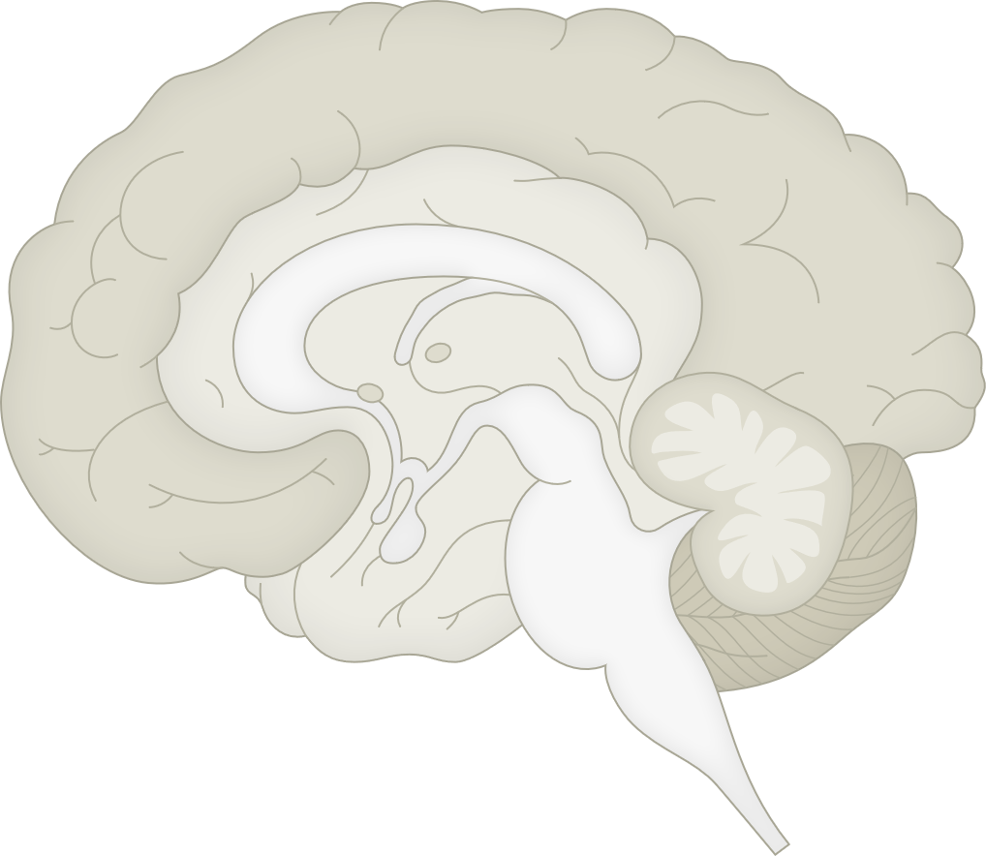
Major anatomical areas of the brain
Fundamentals of neurobiology – Regional neuroscience
The major anatomical divisions of the brain are:¹
Prosencephalon (forebrain) which is divided into:
  Telencephalon – comprises the cerebral hemispheres which include cerebral cortex, basal ganglia, hippocampus and amygdala^{1,2}
  Diencephalon – located beneath the telencephalon and includes thalamus, hypothalamus, epithalamus (pineal gland), and subthalamus¹
Mesencephalon (midbrain) – located between the diencephalon and hindbrain and includes superior and inferior colliculi³
Rhombencephalon (hindbrain) which is divided into:¹
  Metencephalon – including the pons and cerebellum
  Myelencephalon – develops into the medulla oblongata
Major divisions of the CNS²
1. Maldonado & Alsayouri. Physiology, brain. [Updated 2023 Mar]. In: StatPearls [internet]. Treasure Island (FL): StatPearls Publishing; 2023. Available at: https://www.ncbi.nlm.nih.gov/books/NBK551718/; 2. Garcia-Moreno et al. Nat Neurosci 2010;13(6):680–691; 3. Caminero & Cascella. Neuroanatomy, mesencephalon midbrain.
[Updated 2024 Sep]. In: StatPearls [internet]. Treasure Island (FL): StatPearls Publishing; 2024. Available at: https://www.ncbi.nlm.nih.gov/books/NBK551509/
Notes:
References:
Maldonado KA, Alsayouri K. Physiology, brain. [Updated March 2023] In: StatPearls [internet]. Treasure Island (FL): StatPearls Publishing; 2023. Available at: https://www.ncbi.nlm.nih.gov/books/NBK551718/.
Garcia-Moreno F, Pedraza M, Giovannantonio LG, et al. A neuronal migratory pathway crossing from the diencephalon to telencephalon populates amygdala nuclei. Nat Neurosci 2010; 13 (6): 680–691.
Caminero F, Cascella M. Neuroanatomy, mesencephalon midbrain. [Updated September 2024]. In: StatPearls [internet]. Treasure Island (FL): StatPearls Publishing; 2024. Available at: https://www.ncbi.nlm.nih.gov/books/NBK551509/.

Slide 18
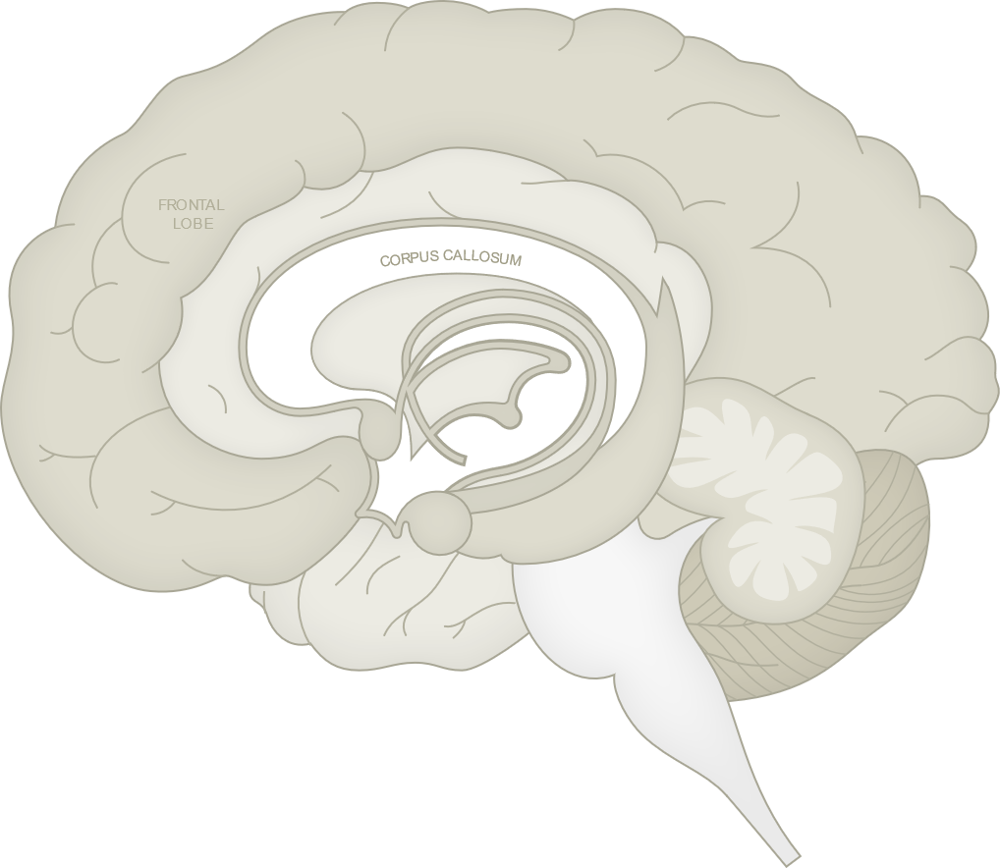
Telencephalon
Fundamentals of neurobiology – Regional neuroscience
The telencephalon is the largest part of the human brain, constituting approximately 85% of the total weight¹
Various sensory inputs are localized in some areas, whereas motor functions are represented in others¹
The telencephalon consists of 2 large cerebral hemispheres separated by a deep longitudinal cerebral fissure¹
Each hemisphere has an outer layer (the cerebral cortex), which is itself composed of layers of cells¹
The cortex has ridges called gyri (singular, gyrus), separated by grooves called sulci (singular, sulcus)¹
Below the cortex are large amounts of subcortical white matter along with aggregates of grey matter that form the basal ganglia and amygdala¹
Dorsal (top) view of the brain^{1,2}
Mid-sagittal section of the brain
Coronal section of the brain
Left cerebral hemisphere
Right cerebral hemisphere
Cerebral cortex
Caudate nucleus
Corpus callosum
Precentral gyrus
Primary motor cortex
Subthalamic nucleus
Frontal lobe
Central sulcus
Putamen
Globus
pallidus
Parietal lobe
Cerebellum
Postcentral gyrus Primary somatosensory cortex
Occipital lobe
Substantia nigra
Thalamus
Longitudinal fissure
Amygdala
This work is adapted from ‘Foundations of Neuroscience’ By Henley, used under CC-BY.
This work is licensed under Creative Commons license CC-BY-NC-SA by the Lundbeck Foundation.
1. Haines & Mihailoff. The telencephalon. In: Haines et al. Fundamental Neuroscience for Basic and Clinical Applications. 6th edition, 2025;
2. Henley. External brain anatomy. In: Foundations of Neuroscience. Available at: https://openbooks.lib.msu.edu/neuroscience/. Accessed December 2025
Notes:
Information flows into and out of the cerebral cortex via the subcortical white matter. The myelinated fibres forming the white matter are grouped into:
Association fibre bundles that connect gyri within one hemisphere
Commissural fibres that connect the two hemispheres (the largest of these is the corpus callosum)
The internal capsule which contains axons projecting to downstream nuclei (corticofugal fibres) and to the cerebral cortex (corticopetal fibres)
Reference:
Haines DE, Mihailoff GA. The telencephalon. In: Haines DE, Mihailoff GA, Willis MA. Fundamental Neuroscience for Basic and Clinical Applications. 6th edition, 2025. Philadelphia: Elsevier.
Henley C. External brain anatomy. In: Foundations of Neuroscience. Available at: https://openbooks.lib.msu.edu/neuroscience/. Accessed December 2025.

Slide 19
Lobes of the cerebral cortex (I)
Fundamentals of neurobiology – Regional neuroscience
The cerebral cortex is divided into five lobes (on the basis of the arrangement of the major sulci)¹
Four lobes are on the surface of the cerebral hemisphere, and are named according to the overlying skull bones¹
One lobe (the insular lobe/cortex) is located internal to the lateral sulcus²
Lobes of the cerebral cortex³
Central sulcus
Precentral gyrus
Postcentral gyrus
Parietal lobe
Frontal lobe
Lateral sulcus (lateral fissure)
Occipital lobe
Lateral sulcus
Temporal lobe
Insula
(deep within the brain)
1. Hedges. Brain anatomy. In: Introduction to Neuroscience. Available at: https://openbooks.lib.msu.edu/introneuroscience1/. Accessed December 2025;
2. Uddin et al. J Clin Neurophysiol 2017;34(4):300–306;
3. The brain. In: Hove & Martinez. Biological Psychiatry; 2024. Available at: https://rotel.pressbooks.pub/biologicalpsychology. Accessed December 2025
Notes:
References:
Hedges V. Brain anatomy. In: Introduction to Neuroscience. Available at: https://openbooks.lib.msu.edu/introneuroscience1/. Accessed December 2025.
Uddin LQ, Nomi JS, Hebert-Seropian B, et al. Structure and function of the human insula. J Clin Neurophysiol 2017; 34 (4): 300–306.
The brain. In: Hove & Martinez. Biological Psychiatry; 2024. Available at: https://rotel.pressbooks.pub/biologicalpsychology. Accessed December 2025.

Slide 20
Lobes of the cerebral cortex (II)
Fundamentals of neurobiology – Regional neuroscience
Functions associated with the frontal lobe:
  Motor control, executive functions, speech production, and social and affective control¹⁻³
Functions associated with the parietal lobe:
  Sensory perception (touch, pressure, temperature and pain), spatial awareness and navigation, and processing of sensory information.^{1,3}
Functions associated with the temporal lobe:
  Hearing, smell, taste, language comprehension, emotion, learning, memory, spatial and visual perception, and facial recognition¹⁻³
Functions associated with the occipital lobe:
  Vision and visual perception¹⁻³
Functions associated with the insular lobe/cortex:
  Interoception and visceral functions, emotion and empathy, awareness and consciousness, taste, and risk assessment and decision-making^{4,5}
1. Henley. External brain anatomy. In: Foundations of Neuroscience. Available at: https://openbooks.lib.msu.edu/neuroscience/. Accessed December 2025;
2. Maldonado & Alsayouri. Physiology, brain. [Updated 2023 Mar]. In: StatPearls [internet]. Treasure Island (FL): StatPearls Publishing; 2023. Available at: https://www.ncbi.nlm.nih.gov/books/NBK551718/; 3. Jawabri & Sharma. Physiology, cerebral cortex functions. [Updated 2023 Apr]. In: StatPearls [internet]. Treasure Island (FL): StatPearls Publishing; 2023. Available at: https://www.ncbi.nlm.nih.gov/books/NBK538496/;4. Uddin et al. J Clin Neurophysiol 2017;34(4):300–306; 5. Namkung et al. Trends Neurosci 2017;40(4):200–207
Notes:
References:
Henley C. External brain anatomy. In: Foundations of Neuroscience. Available at: https://openbooks.lib.msu.edu/neuroscience/. Accessed December 2025.
Maldonado & Alsayouri. Physiology, brain. [Updated 2023 Mar]. In: StatPearls [internet]. Treasure Island (FL): StatPearls Publishing; 2023. Available at: https://www.ncbi.nlm.nih.gov/books/NBK551718/.
Jawabri & Sharma. Physiology, cerebral cortex functions. [Updated 2023 Apr]. In: StatPearls [internet]. Treasure Island (FL): StatPearls Publishing; 2023. Available at: https://www.ncbi.nlm.nih.gov/books/NBK538496/.
Uddin LQ, Nomi JS, Hebert-Seropian B, et al. Structure and function of the human insula. J Clin Neurophysiol 2017; 34 (4): 300–306.
Namkung H, Kim S, Sawa A. The insula, an underestimated brain area in clinical neuroscience, psychiatry, and neurology. Trends Neurosci 2017; 40 (4): 200–207.

Slide 21
Basal ganglia
Fundamentals of neurobiology – Regional neuroscience
Basic anatomy:¹
The basal ganglia consist of the caudate nucleus, putamen, nucleus accumbens, globus pallidus (pallidum), substantia nigra and subthalamic nucleus (STN)
  The globus pallidus is divided into internus (GPi) and externus (GPe)
  The substantia nigra is divided into pars reticulata (SNr) and pars compacta (SNc)
  Together the caudate, putamen, and nucleus accumbens form the striatum
Function:¹⁻³
  Most projection neurons in the basal ganglia are inhibitory. Therefore, the direct pathway from the striatum to GPi/SNr functions to inhibit the inhibitory output of the basal ganglia and thereby facilitate movement
  The net effect of the indirect pathway (from striatum to GPe, to STN, to GPi, and SNr) is an increase in the activity of the inhibitory output neurons resulting in inhibition of movement. Thus, the direct and indirect pathways counterbalance one another
Clinical relevance:^{1,4}
  In general, lesions of the basal ganglia result in hyperkinesia (excessive movement), e.g., Huntington’s disease, or hypokinesia (lack of movement), e.g., Parkinson’s disease
  During deep brain stimulation, electrodes can be implanted in the STN, and electrical impulses sent into brain areas including the STN and GPi to regulate abnormal motor activity and reduce symptoms such as tremors, rigidity, and bradykinesia in patients with Parkinson’s disease
The basal ganglia
Caudate nucleus
Corpus callosum
Subthalamic nucleus
Putamen
Globus
pallidus
Substantia nigra
Thalamus
1. Squire et al. Basal ganglia. In: Fundamental Neuroscience. 4th edition, 2012; 2. Rocha et al. Front Syst Neurosci 2023;17:1242929;
3. Young et al. Neuroanatomy, basal ganglia. [Updated 2023 Jul]. In: StatPearls [internet]. Treasure Island (FL): StatPearls Publishing; 2023. Available at: https://www.ncbi.nlm.nih.gov/books/NBK537141/;
4. Fariba & Gupta. Deep brain stimulation. [Updated 2023 Jul]. In: StatPearls [internet]. Treasure Island (FL): StatPearls Publishing; 2023. Available at: https://www.ncbi.nlm.nih.gov/books/NBK557847/
Notes:
The basal ganglia are a group of subcortical nuclei that are important in motor control.¹
Pathways:
The caudate and putamen (striatum) the main input structures of the basal ganglia. GPi and SNr are the main output structures^{1,2}
Basal ganglia receives excitatory input from virtually all regions of the cortex. Sensory, motor, association and limbic areas of cortex all project to striatum¹
The major output from the basal ganglia is to the portions of the thalamus that project to prefrontal, premotor and motor cortex^{1,3}
The basal ganglia do not project directly to the spinal cord, therefore their effects on movement are indirect mediated by their connections between the thalamus and cortex.^{1,3}
There are two main pathways through the basal ganglia: the direct pathway is a direct connection from the striatum to GPi/SNr. The second, indirect pathway is from striatum to GPe to subthalamic nucleus to GPi/SNr^{1,2}
References:
The basal ganglia. In: Squire L, Berg D, Bloom FE, Lac Sd, Ghosh A, Spitzer NC. Fundamental Neuroscience. 4th edition, 2012. Burlington: Elsevier Science.
Rocha GS, Freire MAM, Britto AM, et al. Basal ganglia for beginners: the basic concepts you need to know and their role in the control of movement. Front Syst Neurosci 2023; 17: 1242929.
Young CB, Reddy V, Sonne J. Neuroanatomy, basal ganglia. [Updated 2023 Jul]. In: StatPearls [internet]. Treasure Island (FL): StatPearls Publishing; 2023. Available at: https://www.ncbi.nlm.nih.gov/books/NBK537141/.
Fariba KA, Gupta V. Deep brain stimulation. [Updated 2023 Jul]. In: StatPearls [internet]. Treasure Island (FL): StatPearls Publishing; 2023. Available at: https://www.ncbi.nlm.nih.gov/books/NBK557847/.

Slide 22

Hippocampus
Fundamentals of neurobiology – Regional neuroscience
Basic anatomy:
  The hippocampus is a small, curved structure located deep within the temporal lobe of the brain. It lies within the medial temporal lobe, with two hippocampi in the brain, i.e., one in each hemisphere^{1,2}
  The hippocampus consists of several key regions: the dentate gyrus, CA1, CA2, CA3, and CA4 regions, and the subiculum¹
Function:
  Episodic memory formation²
  Spatial navigation and memory^{2,3}
  Learning³
  Emotional regulation (as part of the limbic system)³
Clinical relevance:
  Damage to the hippocampus, through trauma, stroke, or neurodegenerative disease (e.g., Alzheimer’s disease), can lead to anterograde amnesia (an inability to form new memories) and impaired spatial orientation^{1,3,4}
Mid-sagittal section of the brain showing the hippocampus
Cerebral cortex
Amygdala
Cerebellum
Pons
Hippocampus
1. Fogwe et al. Neuroanatomy, hippocampus. [Updated 2023 Jul]. In: StatPearls [internet]. Treasure Island (FL): StatPearls Publishing; 2023. Available at: https://www.ncbi.nlm.nih.gov/books/NBK482171/; 2. Knierim Curr Biol 2015;25:R1107–R1125; 3. The brain. In: Hove & Martinez. Biological Psychiatry; 2024. Available at: https://rotel.pressbooks.pub/biologicalpsychology/. Accessed December 2025; 4. Watson et al. Hippocampus 2013;23(7):570–580
Notes:
Structure continued:
The dentate gyrus is a key region that plays a role in forming new memories and in neurogenesis⁵
The CA1 and CA3 regions are subfields responsible for the processing and relay of information, particularly in memory formation and retrieval⁶
The subiculum is a transitional zone between the hippocampus and other brain regions, contributing to the output of the hippocampal network⁷
The hippocampus is functionally involved in:
Memory formation: the hippocampus is essential for converting short-term memories into long-term memories (a process known as memory consolidation).⁸ This is particularly important for explicit or declarative memory, which involves memories of facts, events, and experiences²
Spatial navigation and memory: the hippocampus is crucial for spatial memory and navigation.³ It helps in forming mental maps of the environment, enabling individuals to remember locations and navigate through spaces⁹
Learning: the hippocampus is involved in learning, especially the formation of new associations and the ability to understand relationships between different pieces of information⁹
Emotional regulation: while not directly responsible for emotions, the hippocampus interacts with other parts of the limbic system (such as the amygdala) to regulate emotional responses, particularly those tied to memories¹⁰
References:
Fogwe LA, Reddy V, Mesfin FB. Neuroanatomy, hippocampus. [Updated 2023 Jul]. In: StatPearls [internet]. Treasure Island (FL): StatPearls Publishing; 2023. Available at: https://www.ncbi.nlm.nih.gov/books/NBK482171/.
Knierim JJ. The hippocampus. Curr Biol 2015; 25: R1107–R1125.
The brain. In: Hove M, Martinez SA. Biological Psychiatry; 2024. Available at: https://rotel.pressbooks.pub/biologicalpsychology/. Accessed December 2025.
Watson PD, Voss JL, Warren DE, et al. Spatial reconstruction by patients with hippocampal damage is dominated by relational memory errors. Hippocampus 2013; 23 (7): 570–580.
Hainmueller T, Bartos M. Dentate gyrus circuits for encoding, retrieval and discrimination of episodic memories. Nat Rev Neurosci 2020; 21 (3): 153–168.
Langston RF, Stevenson CH, Wilson CL, et al. The role of hippocampal subregions in memory for stimulus associations. Behav Brain Res 2010; 215 (2): 275–291.
Douglass NP, Willis MA, Haines DE. The limbic system. In: Haines DE, Mihailoff GA, Willis MA. Fundamental Neuroscience for Basic and Clinical Applications. 6th edition, 2025. Philadelphia: Elsevier.
Almaraz-Espinoza A, Grider MH. Physiology, long term memory. [Updated 2023 Jul]. In: StatPearls [internet]. Treasure Island (FL): StatPearls Publishing; 2023. Available at: https://www.ncbi.nlm.nih.gov/books/NBK549791/.
Bird CM, Burgess N. The hippocampus and memory: insights from spatial processing. Nat Rev Neurosci 2008; 9 (3): 182–194.
Song J. Amygdala activity and amygdala-hippocampus connectivity: Metabolic diseases, dementia, and neuropsychiatric issues. Biomed Pharmacother 2023; 162: 114647.

Slide 23
Amygdala
Fundamentals of neurobiology – Regional neuroscience
Basic anatomy:
  The amygdala is a collection of anatomically and functionally heterogeneous nuclei¹
  The major areas of the amygdala are the basolateral amygdala complex (BLA) and the central nucleus of the amygdala (CEA)¹
Function:
  The amygdala is involved in regulating emotional responses, mediating emotional influences on attention and perception and contributing to emotional memory (e.g., learned preferences and aversions, and mediating the influence of emotion on memory consolidation)^{2,3}
Clinical relevance:
  Damage or dysfunction of the amygdala – often resulting from trauma, stroke, tumour, or neurodegenerative disease – can lead to profound alterations in emotional processing and behaviour¹
  Conditions such as Klüver–Bucy syndrome (characterized by emotional blunting and inappropriate social behaviours) can arise from bilateral amygdala damage.¹ Damage to the amygdala is additionally implicated in anxiety disorders,⁴ and post-traumatic stress disorder (PTSD)⁵
  Impaired fear conditioning and reduced ability to recognize emotional expressions, especially fear, can also result from amygdala damage^{5,6}
Mid-sagittal section of the brain showing the amygdala
Cerebral cortex
Amygdala
Cerebellum
Pons
Hippocampus
1. Douglass et al. The limbic system. In: Haines et al. Fundamental Neuroscience for Basic and Clinical Applications. 6th edition, 2025; 2. Song.Biomed Pharmacother 2023; 162: 114647;
3. Davis. Annu Rev Neurosci 1992;15:353–375; 4. Hu et al. Int J Mol Sci 2022;23:11076; 5. Ressler. Biol Psychiatry 2010;67(12):1117–1119; 6. Cristinzio et al. Brain 2010;133(Pt 1):248–261
Notes:
Structure continued:
The BLA receives input from widespread cortical areas as well as from sensory nuclei of the thalamus.^{1,7} It therefore has access to high-level information from association areas as well as lower-level sensory information⁷
The BLA projects to the CEA which has outputs to subcortical areas controlling a broad range of fear-related behaviours including autonomic and motor responses (heart rate, blood pressure, startle response)⁸
References:
Douglass NP, Willis MA, Haines DE. The limbic system. In: Haines DE, Mihailoff GA, Willis MA. Fundamental Neuroscience for Basic and Clinical Applications. 6th edition, 2025. Philadelphia: Elsevier.
Song J. Amygdala activity and amygdala-hippocampus connectivity: Metabolic diseases, dementia, and neuropsychiatric issues. Biomed Pharmacother 2023; 162: 114647.
Davis M. The role of the amygdala in fear and anxiety. Annu Rev Neurosci 1992; 15: 353–375.
Hu P, Lu Y, Pan B, Zhang W. New insights into the pivotal role of the amygdala in inflammation-related depression and anxiety disorder. Int J Mol Sci 2022; 23: 11076.
Ressler KJ. Amygdala activity, fear, and anxiety: modulation by stress. Biol Psychiatry 2010; 67 (12): 1117–1119.
Cristinzio C, N’Diaye K, Seeck M, et al. Integration of gaze direction and facial expression in patients with unilateral amygdala damage. Brain 2010; 133 (Pt 1): 248–261.
Sepahvand T, Power KD, Qin T, Yuan Q. The basolateral amygdala: the core of a network for threat conditioning, extinction, and second-order threat conditioning. Biology 2023; 12: 1274.
Keifer OP Jr., Hurt RC, Ressler KJ, Marvar PJ. The physiology of fear: Reconceptualizing the role of the central amygdala in fear learning. Physiology 2015; 30 (5): 391–401.

Slide 24
Thalamus
Fundamentals of neurobiology – Regional neuroscience
Basic anatomy:
  The thalamus is the largest part of the four main subdivisions of the diencephalon, it consists of neurons that collectively project to nearly all areas of the cerebral cortex¹
  Some thalamic nuclei receive input from subcortical motor areas and project to those parts of the overlying cortex that influence the successful execution of a motor act¹
  A few thalamic nuclei receive more diffuse input and accordingly project in a more diffuse way to a widespread area of cortex¹
Function:
  Many thalamic nuclei receive somatosensory visual or auditory input and transmit this information to the relevant area of the cerebral cortex. All sensory systems (with the exception of olfaction) have a synaptic relay in
  the thalamus before reaching the cortex^{1,2}
  The vast majority of information that reaches the cerebral cortex is firstly processed within the thalamus. The thalamus is therefore termed ‘the functional gateway to the cerebral cortex’. In turn nearly all regions of
  the cerebral cortex give rise to reciprocal projections that return to the thalamic region from which they originally received input¹
Clinical relevance:
  Damage to the thalamus can lead to a variety of sensory and motor deficits, and can affect motor control, leading to movement disorders such as tremors or ataxia^{3,4}
  Cognitive and emotional disturbances, including memory impairments and emotional dysregulation, may also result from thalamic lesions, given its connections with the limbic system⁵
Mid-sagittal section of the brain showing the thalamus
Cerebral cortex
Thalamus
Hypothalamus
Midbrain
Cerebellum
1. Mihailoff & Haines. The diencephalon. In: Haines et al. Fundamental Neuroscience for Basic and Clinical Applications. 6th edition, 2025;
2. The diencephalon. In: Lumen Anatomy. Available at: https://courses.lumenlearning.com/suny-dutchess-anatomy-physiology;
3. Torrico & Munakomi. Neuroanatomy, thalamus. [Updated 2023 Jul]. In: StatPearls [internet]. Treasure Island (FL): StatPearls Publishing; 2023. Available at: https://www.ncbi.nlm.nih.gov/books/NBK542184/;
4. Marek et al. J Neurol 2015;262(1):54–58; 5. Wilkos et al. Neuropsychiatr Dis Treat 2015;11:1031–1038
Notes:
References:
Mihailoff GA, Haines DE. The diencephalon. In: Haines DE, Mihailoff GA, Willis MA. Fundamental Neuroscience for Basic and Clinical Applications. 6th edition, 2025. Philadelphia: Elsevier.
The diencephalon. In: Lumen Anatomy. Available at: https://courses.lumenlearning.com/suny-dutchess-anatomy-physiology.
Torrico TJ, Munakomi S. Neuroanatomy, thalamus. [Updated 2023 Jul]. In: StatPearls [internet]. Treasure Island (FL): StatPearls Publishing; 2023. Available at: https://www.ncbi.nlm.nih.gov/books/NBK542184/
Marek M, Paus S, Allert N, et al. Ataxia and tremor due to lesions involving cerebellar projection pathways: a DTI tractographic study in six patients. J Neurol 2015; 262 (1): 54–58.
Wilkos E, Brown TJB, Slawinska K, Kucharska KA. Social cognitive and neurocognitive deficits in patients with unilateral thalamic lesions – pilot study. Neuropsychiatr Dis Treat 2015; 11: 1031–1038.

Slide 25
Hypothalamus
Fundamentals of neurobiology – Regional neuroscience
Basic anatomy:
  The hypothalamus is an integrative centre, and is a key part of the body’s regulatory system¹
  Almost every major subdivision of the CNS communicates with the hypothalamus and is also subject to its influence. The hypothalamus also communicates with the peripheral organs by converting synaptic information to hormonal signals²
Function:
Clinical relevance:
  Hypothalamic dysfunction can lead to a variety of disorders, including diabetes insipidus, obesity, sleep disorders, and hormonal imbalances^{1,2,4}
Mid-sagittal section of the brain showing the hypothalamus
Cerebral cortex
Thalamus
  Regulation of autonomic functions (e.g., heart rate, blood pressure) via sympathetic and parasympathetic branches of the autonomic nervous system¹
  Endocrine system control^{1,3}
  Thermoregulation^{1,3}
  Hunger and thirst³
  Sleep and circadian rhythms³
  Emotional and behavioural responses³
  Control of sexual and reproductive behaviour²
Hypothalamus
Midbrain
Cerebellum
CNS=central nervous system
1. Mihailoff & Haines. The diencephalon. In: Haines et al. Fundamental Neuroscience for Basic and Clinical Applications. 6th edition, 2025;
2. Shahid et al. Physiology, hypothalamus. [Updated 2023 May]. In: StatPearls [internet]. Treasure Island (FL): StatPearls Publishing; 2023. Available at: https://www.ncbi.nlm.nih.gov/books/NBK535380/;
3. The central nervous system. In: Lumen Anatomy. Available at: https://courses.lumenlearning.com/suny-dutchess-anatomy-physiology; 4. Müller. Biomedicines 2025;13(10):2356
Notes:
Regulation of autonomic functions: heart rate, blood pressure, and digestion are regulated by the hypothalamus, via its influence on the sympathetic and parasympathetic branches of the autonomic nervous system.^{1,3}
Endocrine system control: The hypothalamus connects the nervous system to the endocrine system via the pituitary gland.¹ It produces releasing and inhibiting hormones that regulate the secretion of hormones from the pituitary, which in turn controls other endocrine glands (e.g., thyroid, adrenal glands, and reproductive organs).² Examples of hypothalamic hormones include oxytocin and vasopressin: synthesised in the hypothalamus and stored in the posterior pituitary, these hormones are involved in childbirth, lactation, and water balance.^{1,2}
Thermoregulation: The hypothalamus monitors and regulates body temperature.² It responds to changes in internal and external temperatures by initiating processes like sweating, shivering, and altering blood flow to the skin to maintain an optimal core temperature.^{3,5}
Hunger and thirst: The hypothalamus plays a key role in regulating hunger and thirst through specific nuclei.³ Activation of the lateral hypothalamus, stimulates hunger and feeding behaviour, while activation the ventromedial hypothalamus signals satiety.^{1,6}
Sleep and circadian rhythms: The hypothalamus helps regulate sleep patterns and circadian rhythms through its control of the suprachiasmatic nucleus (SCN), which is the body’s internal clock.¹
Emotional and behavioural responses: The hypothalamus plays a role in emotional expression (such as anger and pleasure) and influences sexual behaviour, aggression, and stress responses.³
Control of sexual and reproductive behaviour: The hypothalamus regulates reproduction through the release of gonadotropin-releasing hormone (GnRH), which controls the release of hormones from the anterior pituitary that modulate reproductive organ function and development.⁷
References:
Mihailoff GA, Haines DE. The diencephalon. In: Haines DE, Mihailoff GA, Willis MA. Fundamental Neuroscience for Basic and Clinical Applications. 6th edition, 2025. Philadelphia: Elsevier.
Shahid et al. Physiology, hypothalamus. [Updated 2023 May]. In: StatPearls [internet]. Treasure Island (FL): StatPearls Publishing; 2023. Available at: https://www.ncbi.nlm.nih.gov/books/NBK535380/.
The central nervous system. In: Lumen Anatomy. Available at: https://courses.lumenlearning.com/suny-dutchess-anatomy-physiology.
Müller HL. Sleep disorders, dysregulation of circadian rhythms, and fatigue after craniopharyngioma – A narrative review. Biomedicines 2025; 13 (10): 2356.
Osilla EV, Marsidi JL, Shumway KR, Sharma S. Physiology, temperature regulation. [Updated 2023 Jul]. In: StatPearls [internet]. Treasure Island (FL): StatPearls Publishing; 2023. Available at: https://www.ncbi.nlm.nih.gov/books/NBK507838/.
Kongstorp M, Karnani MM, McCutcheon JE. Does the lateral hypothalamus govern the transition between appetitive and consummatory feeding? Neuropharmacology 2025; 275: 110438.
Hormonal control of human reproduction. In: State University of New York. Biology for Majors II. Available at: https://courses.lumenlearning.com/suny-wmopen-biology2/chapter/hormonal-control-of-human-reproduction/.

Slide 26
Epithalamus
Fundamentals of neurobiology – Regional neuroscience
Basic anatomy:
  Located at the posterior aspect of the thalamus, near the midline of the brain.¹ The epithalamus includes key structures, such as the pineal gland and the habenular nuclei¹
Functions:
  Regulation of circadian rhythm (largely due to the actions of melatonin secreted from the pineal gland),² which has been linked to many biological processes, including sleep onset,³ core body temperature regulation,⁴ and seasonal rhythms⁵
  Influence on the limbic system¹
Clinical relevance:
  Sleep disorders – given the role of the pineal gland in synthesising melatonin, the epithalamus, particularly the pineal gland, is central to sleep regulation.¹ Dysfunction in melatonin production can lead to insomnia or other sleep-related issues²
  Mood and depression – dysfunction in the habenula, especially the lateral habenula, has been implicated in mood disorders such as MDD⁶
Mid-sagittal section of the brain showing the epithalamus
Cerebral cortex
Thalamus
Epithalamus
Hypothalamus
Midbrain
Cerebellum
MDD=major depressive disorder
1. Mihailoff & Haines. The diencephalon. In: Haines et al. Fundamental Neuroscience for Basic and Clinical Applications. 6th edition, 2025;
2. Hardeland. Sci World J 2012;2012:640389; 3. Cajochen et al. J Neuroendocrinol 2003;15(4):432–437; 4. Cagnacci et al. J Clin Endocrinol Metab 1992;75(2):447–452;
5. Adamsson et al. J Physiol Anthropol 2017;36(6):1–15; 6. Hu et al. Nat Rev Neurosci 2020;21(5):277–295
Notes:
References:
Mihailoff GA, Haines DE. The diencephalon. In: Haines DE, Mihailoff GA, Willis MA. Fundamental Neuroscience for Basic and Clinical Applications. 6th edition, 2025. Philadelphia: Elsevier.
Hardeland R. Neurobiology, pathophysiology, and treatment of melatonin deficiency and dysfunction. Sci World J 2012; 2012: 640389.
Cajochen C, Kräuchi K, Wirz-Justice A. Role of melatonin in the regulation of human circadian rhythms and sleep. J Neuroendocrinol 2003; 15 (4): 432–437.
Cagnacci A, Elliott JA, Yen SSC. Melatonin: A major regulator of the circadian rhythm of core temperature in humans. J Clin Endocrinol Metab 1992; 75 (2): 447–452.
Adamsson M, Laike T, Morita T. Annual variation in daily light exposure and circadian change or melatonin and cortisol concentrations at a northern latitude with large seasonal differences in photoperiod length. J Physiol Anthropol 2017; 36 (6): 1–15.
Hu H, Cui Y, Yang Y. Circuits and functions of the lateral habenula in health and in disease. Nat Rev Neurosci 2020; 21 (5): 277–295.

Slide 27
Brainstem
Fundamentals of neurobiology – Regional neuroscience
Basic anatomy:
  The term brainstem can be used in 2 ways – it can either mean the part of the brain that includes the medulla oblongata, pons and midbrain, or the part of the brain that includes these structures plus the diencephalon¹
  Here the former convention is used - therefore the brainstem consists of the rhombencephalon (pons and medulla oblongata but excluding the cerebellum) and the mesencephalon (midbrain)¹
Functions:
  Regulates essential life-sustaining functions, including breathing, heart rate, and blood pressure, and serves as the main pathway for sensory and motor information between the brain and spinal cord. It also plays a critical role in maintaining alertness and coordinating basic reflexes and movements^{1,2}
Clinical relevance:
  Damage to the brainstem can lead to severe and life-threatening consequences, including impaired consciousness, respiratory failure, and loss of autonomic control, as it houses vital centres for these functions. Brainstem lesions may also affect cranial nerve function, leading to deficits in sensation, movement, and reflexes, often resulting in significant disability^{1,2}
Mid-sagittal section of the brain showing the brainstem
Cerebral cortex
Thalamus
Brainstem
Hypothalamus
Midbrain
Pons
Medulla
oblongata
1. Haines & Mihailoff. An overview of the brainstem. In: Haines et al. Fundamental Neuroscience for Basic and Clinical Applications. 6th edition, 2025;
2. Basinger & Hogg. Neuroanatomy, brainstem. [Updated 2023 Jul]. In: StatPearls [internet]. Treasure Island (FL): StatPearls Publishing; 2023. Available at: https://www.ncbi.nlm.nih.gov/books/NBK544297/
Notes:
References:
Haines DE, Mihailoff GA. An overview of the brainstem. In: Haines DE, Mihailoff GA, Willis MA. Fundamental Neuroscience for Basic and Clinical Applications. 6th edition, 2025. Philadelphia: Elsevier.
Basinger H, Hogg JP. Neuroanatomy, brainstem. [Updated 2023 Jul]. In: StatPearls [internet]. Treasure Island (FL): StatPearls Publishing; 2023. Available at: https://www.ncbi.nlm.nih.gov/books/NBK544297/.

Slide 28
Superior colliculus
Fundamentals of neurobiology – Regional neuroscience
Basic anatomy:
  The superior colliculus is a paired structure located in the midbrain, playing a crucial role in integrating sensory information and coordinating eye movements¹
Functions:
  Visual functions:
    A primary function is to direct saccadic eye movements that shift the focus of gaze¹
    It is responsible for orienting the eyes and head toward objects in the visual field¹
  Multisensory integration:
    The superior colliculus receives inputs from multiple sensory systems (e.g., visual and auditory systems). The superior colliculus ensures that visual and auditory maps of the surroundings are aligned¹
Clinical relevance:
  Damage to the superior colliculus can lead to deficits in eye movement control, problems with orienting to visual stimuli, and disruptions in reflexive behaviour²
Mid-sagittal section of the brain showing the superior colliculus
Cerebral cortex
Thalamus
Superior colliculus
Hypothalamus
Inferior colliculus
Pons
1. Zubricky & Das. Neuroanatomy, superior colliculus. [Updated 2024 Jan]. In: StatPearls [internet]. Treasure Island (FL): StatPearls Publishing; 2024.
Available at: https://www.ncbi.nlm.nih.gov/books/NBK544224/; 2. Benarroch. Neurology 2023;100(16):784–790
Notes:
Structure continued:
The superior colliculus is located on the roof of the midbrain, above the inferior colliculus (which is involved in auditory processing)^{1,3}
It is a layered structure with the superficial layers mainly processing visual input from the retina and visual cortex.^{1,2} Deeper layers respond to auditory signals and have movement related activity^{1,2}
Pathways and connections:
The superior colliculus receives visual inputs from the retina and top down from visual cortex^{1,2}
It sends outputs from deeper, movement-related layers to various brain regions, including the thalamus and brainstem^{1,2}
Control of motor commands for eye movement generated by the brainstem by the superior colliculus make it possible to bring eye movement under the control of higher order processes such as attention, perception and cognition^{1,2}
References:
Zubricky RD, Das JM. Neuroanatomy, superior colliculus. [Updated 2024 Jan]. In: StatPearls [internet]. Treasure Island (FL): StatPearls Publishing; 2024. Available at: https://www.ncbi.nlm.nih.gov/books/NBK544224/.
Benarroch E. What are the functions of the superior colliculus and its involvement in neurologic disorders? Neurology 2023; 100 (16): 784–790.
King AJ. The superior colliculus. Curr Biol 2004; 14 (9): R335–R338.

Slide 29
Inferior colliculus (IC)
Fundamentals of neurobiology – Regional neuroscience
Basic anatomy:
  The IC is a principal midbrain structure that plays a crucial role in the auditory pathway¹
Function:
  The IC acts as a major integration hub for auditory information. It processes various aspects of sound, such as pitch, volume, spatial localization, and temporal patterns¹
  It receives and integrates input from several auditory brainstem nuclei, such as the cochlear nucleus and the superior olivary complex¹
  The IC also projects to the thalamus (medial geniculate nucleus) for further relay to the auditory cortex, where conscious sound perception occurs¹
Clinical relevance:
  Damage to the IC can result in auditory processing disorders, such as difficulty localizing sounds.¹ Additionally, associations between the IC and tinnitus have been reported¹
Mid-sagittal section of the brain showing the inferior colliculus
Cerebral cortex
Thalamus
Superior colliculus
Hypothalamus
Inferior colliculus
Pons
1. Driscoll & Tadi. Neuroanatomy, inferior colliculus. [Updated 2023 Aug]. In: StatPearls [internet]. Treasure Island (FL): StatPearls Publishing; 2023.
Available at: https://www.ncbi.nlm.nih.gov/books/NBK554468/
Notes:
The IC is divided into:¹
Central nucleus, which is the largest portion
External cortex
Dorsal cortex
The IC is involved in processing sound information before it is relayed to higher brain centres, particularly the auditory thalamus (medial geniculate body) and eventually the auditory cortex.¹ The IC integrates auditory signals that help in sound localization, which is essential for determining the direction and distance of a sound source.¹ This is partly achieved through inputs from the superior olivary complex, which processes binaural (both ears) auditory cues.² Besides its primary role in hearing, the IC is involved in some non-auditory functions, such as the coordination of eye movements and orienting responses to stimuli (especially in conjunction with the superior colliculus).¹
References:
Driscoll ME, Tadi P. Neuroanatomy, inferior colliculus. [Updated 2023 Aug]. In: StatPearls [internet]. Treasure Island (FL): StatPearls Publishing; 2023. Available at: https://www.ncbi.nlm.nih.gov/books/NBK554468/.
Paul MS, Das JM. Neuroanatomy, superior and inferior olivary nucleus (superior and inferior olivary complex). [Updated 2023 Jul]. In: StatPearls [internet]. Treasure Island (FL): StatPearls Publishing; 2023. Available at: https://www.ncbi.nlm.nih.gov/books/NBK542242/.

Slide 30
Pons
Fundamentals of neurobiology – Regional neuroscience
Basic anatomy:
  The pons is situated in the brainstem, directly above the medulla oblongata and below the midbrain^{1,2}
  The pons contains both grey and white matter, the latter of which includes ascending and descending nerve tracts¹
  Cranial nerves: several cranial nerves originate in the pons^{1,2}
Functions:
  One of the primary functions of the pons is to serve as a relay station for messages between various parts of the brain, particularly between the cerebrum and cerebellum¹
  Motor and sensory functions¹
  Respiratory control³
  Sleep regulation³
Clinical relevance:
  Damage to the pons can result in significant motor and sensory deficits, including locked-in syndrome.³ Because the pons regulates vital functions such as breathing and sleep, damage can lead to respiratory problems, loss of consciousness, coordination issues, or death³⁻⁵
Mid-sagittal section of the brain showing the pons
Cerebral cortex
Midbrain
Pons
Medulla
oblongata
1. Rahman & Tadi. Neuroanatomy, pons. [Updated 2023 Jan]. In: StatPearls [internet]. Treasure Island (FL): StatPearls Publishing; 2023. Available at: https://www.ncbi.nlm.nih.gov/books/NBK560589/2. Mihailoff & Haines. The pons and cerebellum. In: Haines et al. Fundamental Neuroscience for Basic and Clinical Applications. 6th edition, 2025;
3. Pons. In: Anatomy and Physiology. LibreText Health. Available at: https://med.libretexts.org/Bookshelves/Anatomy_and_Physiology/Anatomy_and_Physiology_(Boundless).
Accessed December 2025; 4. Das et al. Locked-in syndrome. [Updated 2023 Jul]. In: StatPearls [internet]. Treasure Island (FL): StatPearls Publishing; 2023. Available at: https://www.ncbi.nlm.nih.gov/books/NBK559026/; 5. Cleveland Clinic. Pontine stroke. Available at: https://my.clevelandclinic.org/health/diseases/pontine-stroke. Accessed December 2025
Notes:
Several cranial nerves originate in the pons, including:^{2,6}
The trigeminal nerve (V) – responsible for sensation in the face and motor functions like biting and chewing
The abducens nerve (VI) – controls the lateral rectus responsible for lateral eye movement
The facial nerve (VII) – controls facial muscles, taste and secretion by salivary and lacrimal glands
The vestibulocochlear nerve (VIII) – associated with hearing and balance
References:
Rahman M, Tadi P. Neuroanatomy, pons. [Updated 2023 Jan]. In: StatPearls [internet]. Treasure Island (FL): StatPearls Publishing; 2023. Available at: https://www.ncbi.nlm.nih.gov/books/NBK560589/.
Milhailoff GA, Haines DE. The pons and cerebellum. In: Haines DE, Mihailoff GA, Willis MA. Fundamental Neuroscience for Basic and Clinical Applications. 6th edition, 2025. Philadelphia: Elsevier.
Pons. In: Anatomy and Physiology. LibreText Health. Available at: https://med.libretexts.org/Bookshelves/Anatomy_and_Physiology/Anatomy_and_Physiology_(Boundless). Accessed December 2025.
Das JM, Anosike K, Asuncion RMD. Locked-in syndrome. [Updated 2023 Jul]. In: StatPearls [internet]. Treasure Island (FL): StatPearls Publishing; 2023. Available at: https://www.ncbi.nlm.nih.gov/books/NBK559026/.
Cleveland Clinic. Pontine stroke. Available at: https://my.clevelandclinic.org/health/diseases/pontine-stroke. Accessed December 2025.
Libreros-Jiménez HM, Manzo J, Rojas-Durán F, et al. On the cranial nerves. NeuroSci 2024; 5: 8–38.

Slide 31
Medulla oblongata
Fundamentals of neurobiology – Regional neuroscience
Basic anatomy:
  The medulla oblongata is positioned at the base of the brain, below the pons and above the spinal cord^{1,2}
  It contains both white matter and grey matter³
  The white matter carries signals between the brain and spinal cord, while the grey matter houses several nuclei that control key functions³
Functions:
  The medulla oblongata regulates several critical bodily functions, including:
    Respiratory control^{1,2}
    Cardiovascular regulation (control of heart rate and blood pressure by regulating the contraction of blood vessels and cardiac muscles)^{1,2,4}
    Some reflexes (such as swallowing, coughing, sneezing, and vomiting)^{1,4}
Clinical relevance:
  Damage to the medulla oblongata can have life-threatening consequences, including respiratory failure, cardiovascular dysfunction, and impaired swallowing.⁵ Medullary strokes, such as lateral medullary syndrome (Wallenberg syndrome), can result in symptoms of vertigo, difficulty swallowing, and sensory deficits⁶
Mid-sagittal section of the brain showing the medulla oblongata
Cerebral cortex
Midbrain
Pons
Medulla
oblongata
1. The brain. In: Hove & Martinez. Biological Psychiatry; 2024. Available at: https://rotel.pressbooks.pub/biologicalpsychology/;
2. Haines & Mihailoff. The medulla oblongata. In: Haines et al. Fundamental Neuroscience for Basic and Clinical Applications. 6th edition, 2025;
3. The Brainstem: medulla oblongata, pons, and midbrain. In: Lumen Anatomy. Available at: https://courses.lumenlearning.com/suny-dutchess-anatomy-physiology/chapter/medulla-oblongata/;
4. Thau et al. Anatomy, central nervous system. [Updated 2022 Oct]. In: StatPearls [internet]. Treasure Island (FL): StatPearls Publishing; 2022. Available at: https://www.ncbi.nlm.nih.gov/books/NBK542179/;
5. Medulla oblongata. In: EBSCO Research Starters. Available at: https://www.ebsco.com/research-starters/health-and-medicine/medulla-oblongata/;
6. Iordanova et al. Neuranatomy, medulla oblongtata. [Updated 2023 Jul]. In: StatPearls [internet]. Treasure Island (FL): StatPearls Publishing; 2023. Available at: https://www.ncbi.nlm.nih.gov/books/NBK551589/
Notes:
The medulla oblongata is part of the brainstem, located just above the spinal cord. It plays a crucial role in controlling autonomic functions, such as breathing, heart rate, and blood pressure.^{1,2,4}
Several cranial nerves emerge from or pass through the medulla, governing functions like taste, swallowing, and movements of the neck and tongue:⁶
Glossopharyngeal (IX, mixed) – taste, swallowing and monitoring of blood pressure
Vagus (X, mixed) – regulation of heart, lungs, digestive tract, speech, swallowing
Accessory (XI, motor)
Hypoglossal (XII, motor) – controls movement of tongue needed for speech and swallowing
References:
The brain. In: Hove & Martinez. Biological Psychiatry; 2024. Available at: https://rotel.pressbooks.pub/biologicalpsychology/.
Haines DE, Mihailoff GA. The medulla oblongata. In: Haines DE, Mihailoff GA, Willis MA. Fundamental Neuroscience for Basic and Clinical Applications. 6th edition, 2025. Philadelphia: Elsevier.
The Brainstem: medulla oblongata, pons, and midbrain. In: Lumen Anatomy. Available at: https://courses.lumenlearning.com/suny-dutchess-anatomy-physiology/chapter/medulla-oblongata/.
Thau et al. Anatomy, central nervous system. [Updated 2022 Oct]. In: StatPearls [internet]. Treasure Island (FL): StatPearls Publishing; 2022. Available at: https://www.ncbi.nlm.nih.gov/books/NBK542179/.
Medulla oblongata. In: EBSCO Research Starters. Available at: https://www.ebsco.com/research-starters/health-and-medicine/medulla-oblongata/.
Iordanova R, Reddivari AKR. Neuronatomy, medulla oblongtata. [Updated 2023 Jul]. In: StatPearls [internet]. Treasure Island (FL): StatPearls Publishing; 2023. Available at: https://www.ncbi.nlm.nih.gov/books/NBK551589/.

Slide 32
Cerebellum
Fundamentals of neurobiology – Regional neuroscience
Basic anatomy:
  The cerebellum overlies the pons and medulla on the dorsal surface of the brainstem¹
  The cerebellum is attached to the brainstem by 3 pairs of fibre bundles: the superior, the middle, and the inferior cerebellar peduncles²
  Sagittal fissures near the midline divide the cerebellum into 3 major areas: 2 lateral hemispheres divided by fissures, and a midline ridge called the vermis³
Functions:
  The cerebellum plays a critical role in motor control and motor learning, particularly for fast or complex movements.^{1,3} It is also involved in balance, as well as having sensory, cognitive, and language functions^{1,3}
Clinical relevance:
  Damage to the cerebellum can result in a range of motor deficits, collectively known as cerebellar ataxia, characterized by:^{1,3}
    Poor coordination of voluntary movements
    Difficulty with balance and posture
    Unsteady gait
    Tremors and speech difficulties (dysarthria)
Mid-sagittal section of the brain showing the cerebellum
Cerebral cortex
Midbrain
Cerebellum
Pons
Medulla
oblongata
1. Amore et al. Front Syst Neurosci 2021;15:646052; 2. Mihailoff & Haines. The pons and cerebellum. In: Haines et al. Fundamental Neuroscience for Basic and Clinical Applications. 6th edition, 2025;
3. Jimsheleishvili & Dididze. Neuroanatomy, cerebellum. [Updated 2023 Jul]. In: StatPearls [internet]. Treasure Island (FL): StatPearls Publishing; 2023. Available at: https://www.ncbi.nlm.nih.gov/books/NBK538167/
Notes:
The cerebellum, located at the back of the brain beneath the cerebral cortex, has a distinctive surface featuring many folds, or folia, that increase its surface area.^{1,2} It is divided into three main lobes (the anterior, posterior, and flocculonodular lobes) by transverse fissures that extend through its hemispheres and central region, the vermis.^{1,2} Structurally, the cerebellum consists of a thin outer layer of grey matter (the cerebellar cortex) surrounding an inner core of white matter, which houses four pairs of deep cerebellar nuclei that serve as critical relay points for cerebellar output.²
References:
Amore G, Spoto G, Ieni A, et al. A focus on the cerebellum: from embryogenesis to an age-related clinical perspective. Front Syst Neurosci 2021; 15: 646052.
Mihailoff GA, Haines DE. The pons and cerebellum. In: Haines DE, Mihailoff GA, Willis MA. Fundamental Neuroscience for Basic and Clinical Applications. 6th edition, 2025. Philadelphia: Elsevier.
Jimsheleishvili S, Dididze M. Neuroanatomy, cerebellum. [Updated 2023 Jul]. In: StatPearls [internet]. Treasure Island (FL): StatPearls Publishing; 2023. Available at: https://www.ncbi.nlm.nih.gov/books/NBK538167/.

Slide 33
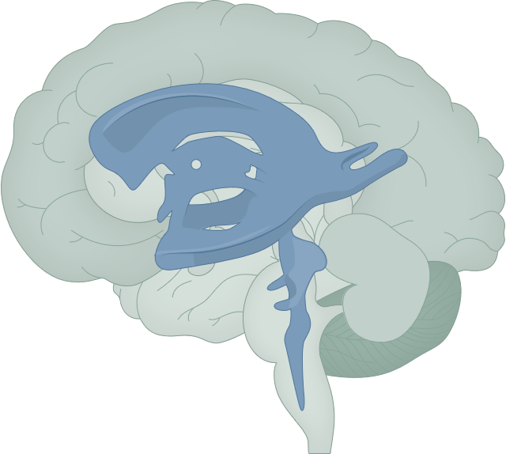
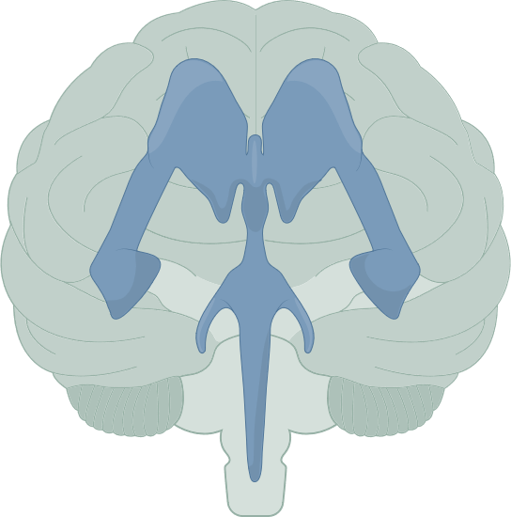
The ventricular system
Fundamentals of neurobiology – Regional neuroscience
Basic anatomy:
  The ventricles of the brain are a series of interconnected, fluid-filled cavities. They form part of the ventricular system that produces and circulates CSF¹
  The four ventricles of the brain: two lateral ventricles, and the third and fourth ventricles¹
  The choroid plexus is a network of specialised cells (ependymal cells) and blood vessels that is located within all the ventricles of the brain^{1,2}
Functions:
  The primary function of the choroid plexus is to produce the CSF that circulates throughout the ventricular system and subarachnoid space of the brain and spinal cord. The choroid plexus is crucial for the regulation of the CSF, which protects and cushions the brain, maintains intracranial pressure, supplies nutrients, and removes waste from the CNS²
Clinical relevance:
  Blockage of CSF, or failure of CSF absorption, can result in hydrocephalus – accumulation of fluid in the ventricular spaces of the brain and moderate to severe increase in intracranial pressure^{1,2}
Anatomy of the ventricular system³
Lateral ventricles
Interventricular foramen
Third ventricle
Cerebral aqueduct
Fourth ventricle
Central canal
Lateral view
Anterior view
This work is adapted from BruceBlaus/Wikimedia Commons. This work is licensed under Creative Commons license CC-BY-SA by the Lundbeck Foundation.
CNS=central nervous system; CSF=cerebrospinal fluid
1. Shenoy & Lui. Neuroanatomy, ventricular system. [Updated 2023 Jul]. In: StatPearls [internet]. Treasure Island (FL): StatPearls Publishing; 2023. Available at: https://www.ncbi.nlm.nih.gov/books/NBK532932/;
2. Javed et al. Neuroanatomy, choroid plexus. [Updated 2023 Jul]. In: StatPearls [internet]. Treasure Island (FL): StatPearls Publishing; 2023. Available at: https://www.ncbi.nlm.nih.gov/books/NBK538156/;
3. Bailey. Ventricular system of the brain. ThoughtCo. Available at: https://www.thoughtco.com/ventricular-system-of-the-brain-3901496. Accessed December 2025
Notes:
The two lateral ventricles – one in each cerebral hemisphere are the largest of the ventricles. The third ventricle is a narrow midline cavity between the thalamus and hypothalamus. The fourth ventricle is positioned between the brainstem and cerebellum.¹
References:
Shenoy SS, Lui F. Neuroanatomy, ventricular system. [Updated 2023 Jul]. In: StatPearls [internet]. Treasure Island (FL): StatPearls Publishing; 2023. Available at: https://www.ncbi.nlm.nih.gov/books/NBK532932/.
Javed K, Reddy V, Lui F. Neuroanatomy, choroid plexus. [Updated 2023 Jul]. In: StatPearls [internet]. Treasure Island (FL): StatPearls Publishing; 2023. Available at: https://www.ncbi.nlm.nih.gov/books/NBK538156/.
Bailey R. Ventricular system of the brain. ThoughtCo. Available at: https://www.thoughtco.com/ventricular-system-of-the-brain-3901496. Accessed December 1, 2025.

Slide 34
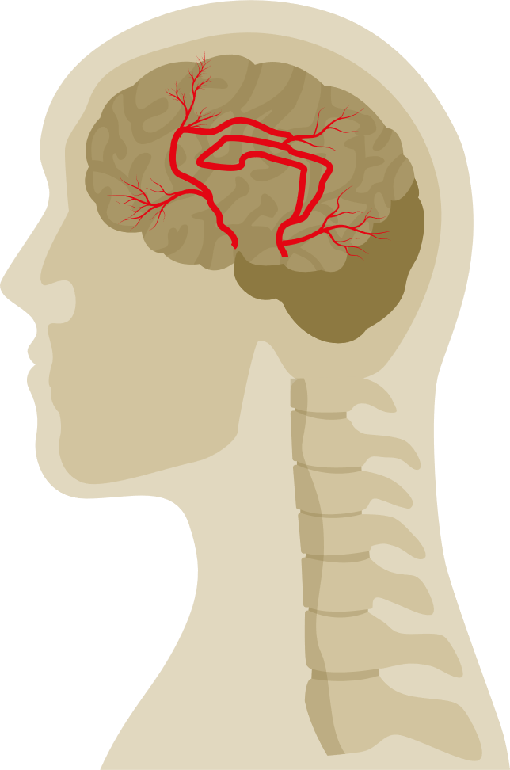
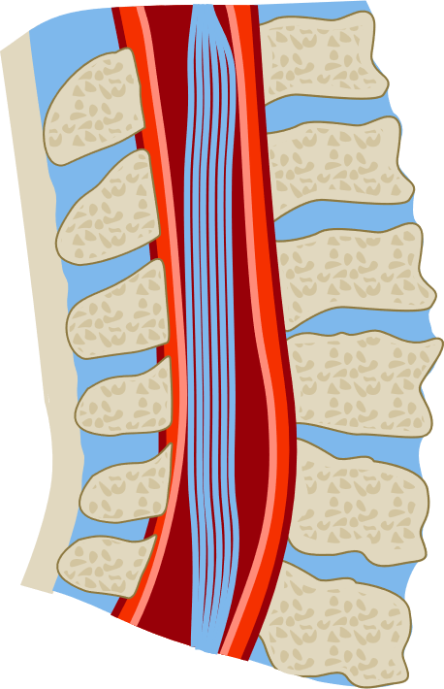
The meninges
Fundamentals of neurobiology – Regional neuroscience
Basic anatomy:
  The meninges are protective membranous coverings that surround the CNS, positioned internally to the skull and vertebral column.¹ They consist of three distinct layers: the dura mater, the arachnoid mater, and the
  pia mater¹
Functions:
  The meninges serve multiple crucial functions in CNS health and stability
    Protection – they form a barrier for the brain and spinal cord, shielding them from impact and infection¹
    Supportive framework – the meninges provide a structural framework for essential blood vessels, including arteries, veins, and venous sinuses¹
    CSF circulation – enclosing the subarachnoid space, the meninges allow circulation of CSF, which maintains the brain’s homeostasis, supports nutrient transport, and removes waste¹
Clinical relevance:
  Meningitis: infection or inflammation of the meninges can lead to meningitis, a potentially life-threatening condition that increases intracranial pressure and may cause headaches, fever, and neck stiffness^{1,3}
  Subdural and epidural haematomas: trauma to the head can result in bleeding between meningeal layers, leading to pressure on brain tissue and requiring urgent medical intervention¹
  CSF leak: tears or damage to the meninges can cause cerebrospinal fluid leaks, potentially leading to complications such as headaches and increased risk of meningitis⁴
Anatomy of the meninges²
Hair
Skin of scalp
Periosteum
Bone of the skull
Epidural space
Periosteal layer
Dura
Meningeal layer
Subdural space
Leptomeningeal Vessel
Arachnoid
Subarachnoid space
Subarachnoid lymphatic-like
membrane (SLYM)
Dura
Arachnoid trabeculae
Pia
Pia
Grey matter
Subarachnoid
White matter
Spinal cord
Vertebra
This work is adapted from ‘Meningeal T cells function in the central nervous system homeostasis and neurodegenerative diseases’ by Abbaoui et al, used under CC-BY. This work is licensed under Creative Commons license
CC-BY-SA by the Lundbeck Foundation.
CNS=central nervous system; CSF=cerebrospinal fluid
1. Ghannam & Kharazi. Neuroanatomy, cranial meninges. [Updated 2023 Jul]. In: StatPearls [internet]. Treasure Island (FL): StatPearls Publishing; 2022.
Available at: https://www.ncbi.nlm.nih.gov/books/NBK539882/; 2. Abbaoui et al. Front Cell Neurosci 2023;17:1181071; 3. Cleveland Clinic. Meningitis.
Available at: https://my.clevelandclinic.org/health/diseases/14600-meningitis. Accessed December 2025; 4. Bhat et al. Clin Chim Acta 2025;577:120458
Notes:
The dura mater is a tough, thick layer composed of two sublayers, the periosteal dura (attached to the skull) and the meningeal dura (closer to the brain).^{1,2} The dura mater provides a protective layer for the brain and spinal cord.^{1,2}
The arachnoid mater has a spider’s web appearance and is thinner and more delicate than the dura mater.^{1,2,5} The subarachnoid space, filled with CSF, is beneath this layer.^{1,2}
The pia mater is the very thin innermost layer which is closely adhered to the surface of the brain and spinal cord.^{1,2} It contains many blood vessels which supply oxygen and nutrients to the brain.²
References:
Ghannam JY, Al Kharazi KA. Neuroanatomy, cranial meninges. [Updated 2023 Jul]. In: StatPearls [internet]. Treasure Island (FL): StatPearls Publishing; 2022. Available at: https://www.ncbi.nlm.nih.gov/books/NBK539882/.
Abbaoui A, Fatoba O, Yamashita T. Meningeal T cells function in the central nervous system homeostasis and neurodegenerative diseases. Front Cell Neurosci 2023; 17: 1181071.
Cleveland Clinic. Meningitis. Available at: https://my.clevelandclinic.org/health/diseases/14600-meningitis. Accessed December 2025.
Bhat SN, Thunga G, Kamath A, et al. CSF biomarkers and leak detection: A systematic review and meta-analysis of diagnostic test accuracy (DTA) studies. Clin Chim Acta 2025; 577: 120458.
Adeeb N, Deep A, Griessenauer CJ, et al. The intracranial arachnoid mater: A comprehensive review of its history, anatomy, imaging, and pathology. Childs Nerv Syst 2013; 29 (1): 17–33.

Slide 35
The cerebrovascular system
Fundamentals of neurobiology – Regional neuroscience
Basic anatomy:
  The brain receives oxygenated blood primarily through the internal carotid arteries and the vertebral arteries¹ Deoxygenated blood exits the brain through a network of superficial and deep veins that drain into the dural venous sinuses, which then flow into the internal jugular vein to return blood to the heart¹
Functions:
  Oxygen and nutrient supply²
  Removal of carbon dioxide and metabolic waste²
  Capillaries form part of the blood–brain barrier^{1,2}
Clinical relevance:
  Stroke: blockage (ischaemic stroke) or rupture (haemorrhagic stroke) of the cerebrovasculature, which can result in brain damage and death³
  An aneurysm is the dilation of a blood vessel (usually an artery).¹ Large aneurysms may cause symptoms by compression of adjacent structures such as cranial nerve roots¹
Arteries of the brain⁴
Anterior cerebral artery
Circle of Willis
Left middle cerebral artery
Right middle cerebral artery
Anterior communicating artery
Basilar artery
Posterior cerebral artery
External
carotid arteries
Posterior communicating artery
Vertebral arteries
Internal carotid arteries
Common carotid arteries
This work is adapted from ‘Neuroanatomy, cerebral blood supply’ by Konan et al, used under CC-BY. This work is licensed under Creative Commons license CC-BY-SA by the Lundbeck Foundation.
1. Haines. A survey of the cerebrovascular system. In: Haines et al. Fundamental Neuroscience for Basic and Clinical Applications. 6th edition, 2025;
2. Kaur et al. Front Neuroanat 2021;15:665803; 3. Mayo Clinic. Stroke. Available at: https://www.mayoclinic.org/diseases-conditions/stroke/symptoms-causes/syc-20350113. Accessed December 2025;
4. Konan et al. Neuroanatomy, cerebral blood supply. [Updated 2023 Jul]. In: StatPearls [internet]. Treasure Island (FL): StatPearls Publishing; 2023. Available at: https://www.ncbi.nlm.nih.gov/books/NBK532297/
Notes:
The brain makes up approximately 2% of total body weight but consumes about 20% of the oxygen used.¹ Oxygenated blood is supplied by the internal carotid and vertebral arteries.¹ The internal carotid arteries enter the skull and branch into the anterior and middle cerebral arteries, supplying the front (anterior) portion of the brain.¹ The vertebral arteries converge to form the basilar artery, which itself divides into the left and right posterior cerebral arteries, supplying the back (posterior) portion of the brain.¹ These arteries are interconnected at the base of the brain in a roughly circular formation called the circle of Willis, which helps ensure blood supply continuity.¹ A network of capillaries (the smallest blood vessels) distributes blood throughout the brain, enabling nutrient and gas exchange at a cellular level.⁵
A continuous flow of oxygenated blood is essential for brain function.¹ Loss of consciousness will occur if the brain is deprived of oxygen for 10–12 seconds.¹ After 3 to 5 minutes irreparable brain damage or death may result.¹ About 50% of problems that occur inside the cranial cavity and result in neurologic deficits are vascular in origin.¹
References:
Haines DE. A survey of the cerebrovascular system. In: Haines DE, Mihailoff GA, Willis MA. Fundamental Neuroscience for Basic and Clinical Applications. 6th edition, 2025. Philadelphia: Elsevier.
Kaur J, Fahmy LM, Davoodi-Bojd, et al. Waste clearance in the brain. Front Neuroanat 2021; 15: 665803.
Mayo Clinic. Stroke. Available at: https://www.mayoclinic.org/diseases-conditions/stroke/symptoms-causes/syc-20350113. Accessed December 2025.
Konan LM, Reddy V, Mesfin FB. Neuroanatomy, cerebral blood supply. [Updated 2023 Jul 24]. In: StatPearls [Internet]. Treasure Island (FL): StatPearls Publishing; 2023. Available at: https://www.ncbi.nlm.nih.gov/books/NBK532297/.
Bracko O, Harraz OF. Editorial: small and mighty: Brain capillaries in health and disease. Front Mol Neurosci 2022; 15: 1108978.

Slide 36
Summary

Slide 37
Summary
Fundamentals of neurobiology – Regional neuroscience
The nervous system has two major divisions: the CNS and PNS
Efferent (motor) pathways transmit information from the CNS to the rest of the body via nerves descending from the brain and emerging through the spinal cord
Afferent (sensory) pathways conduct information from tissues and organs through the spinal cord and onwards to the brain
The autonomic nervous system consists of the sympathetic and parasympathetic nervous systems that regulate involuntary functions of organs and tissues, with opposing effects
The spinal cord acts as a conduit for information transfer, and also contains the circuits involved in generating reflexes
The brain is divided into the forebrain (telencephalon and diencephalon), midbrain (mesencephalon), and hindbrain (metencephalon and myelencephalon)
The cerebral cortex and the numerous subcortical structures each have specific functions but are highly connected to each other, allowing effective relay, processing, and integration of information
CNS=central nervous system; PNS=peripheral nervous system

