Slide 1
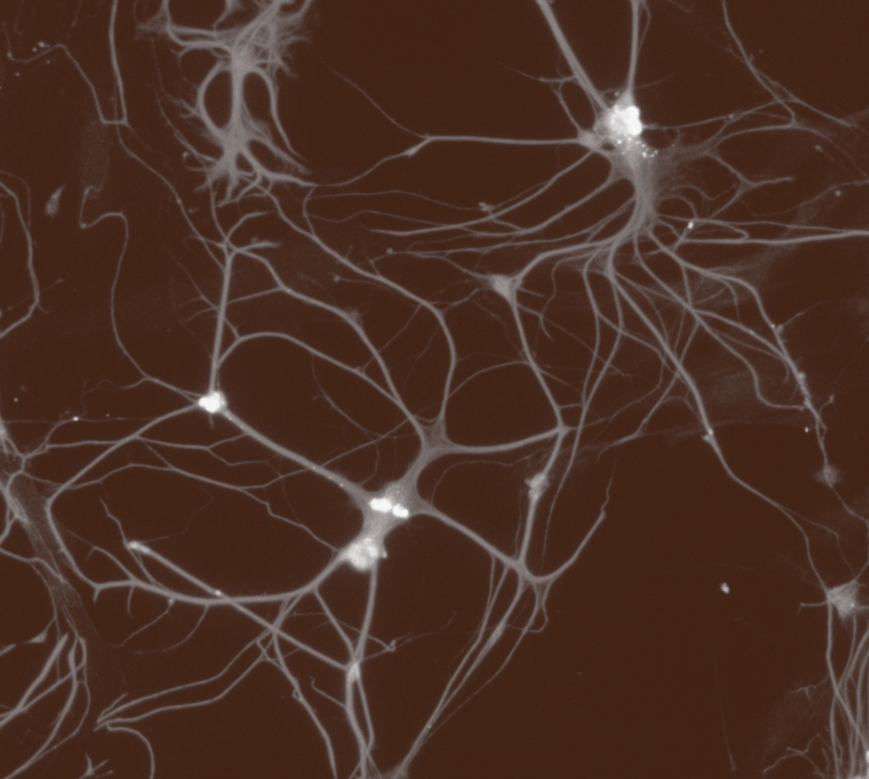
Fundamentals of neurobiology
Regional neuroscience

