Slide 1
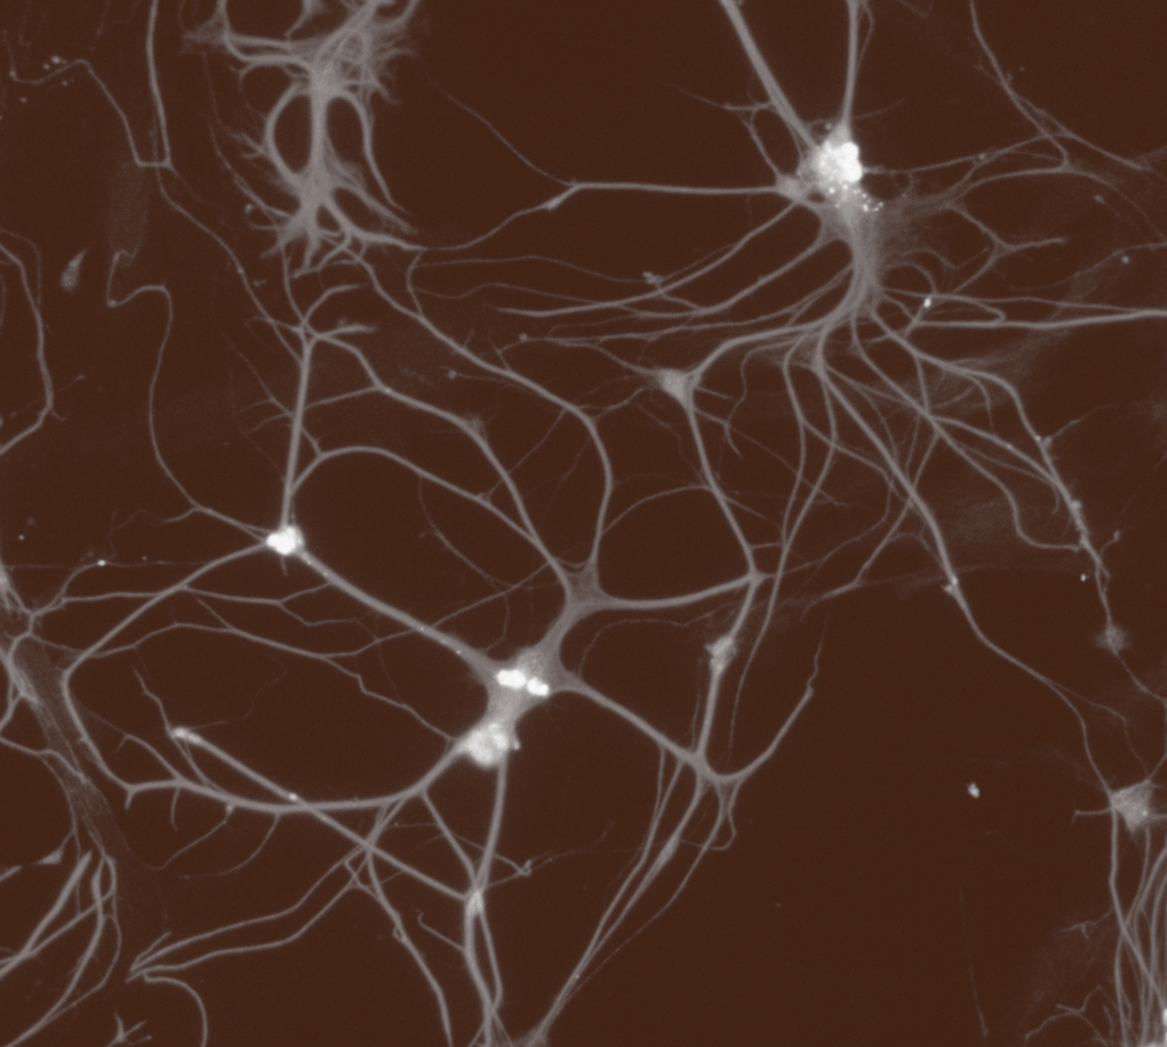
Fundamentals of neurobiology
Systems neuroscience

