Slide 1
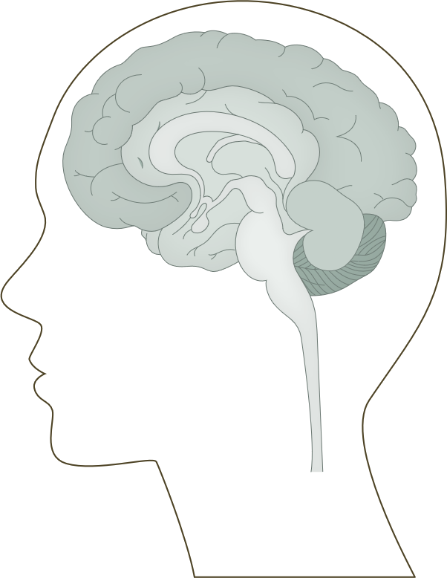
Sensory systems of the brain: the auditory pathway
Fundamentals of neurobiology – Systems neuroscience
Bipolar neurons of the spiral ganglion located in the cochlea relay signals from the hair cells to the brain¹
The axons of the bipolar neurons form the auditory (cochlear) nerve which transmits the electrical signals from the ear to the brainstem¹
Signals are relayed to the superior olivary complex and subsequently the lateral lemniscus in the pons, and then travel to the inferior colliculus of the midbrain, a relay and integration centre for ascending auditory information²
  Along the way, axons may terminate in various nuclear complexes in the pons²
From the inferior colliculus, fibres project mainly to the medial geniculate nucleus of the thalamus, which in turn projects to the auditory cortex²
The auditory pathway^{3,4}
Auditory cortex
BRAIN
Medial geniculate nucleus
MIDBRAIN
Inferior colliculus
MIDBRAIN
Nucleus of lateral lemniscus
PONS
Superior olivary complex
PONS
Dorsal acoustic stria
Intermediate acoustic stria
Ventral acoustic stria
MEDULLA
CN VIII
(Cochlear nerve)
Cochlear nuclei
Cochlea
1. Squire et al. Fundamental Neuroscience, 4th edition. 2012; 2. Kandel et al. Principles of Neural Science, 6th edition. 2021;
3. Peelle. Auditory pathway. Available at: https://commons.wikimedia.org/wiki/File:Auditory_Pathway.png; 4. Peterson et al. Neuroanatomy, Auditory Pathway. StatPearls [internet]. October 2023
Notes:
References:
Squire LR, Berg D, Bloom FE, et al. Fundamental Neuroscience, 4th edition. Elsevier S&T; 2012.
Kandel ER, Koester JD, Mack SH, Siegelbaum SA. Principles of Neural Science, 6th edition. McGraw-Hill Professional; 2021.
Peelle JE. Auditory pathway. Available at: https://commons.wikimedia.org/wiki/File:Auditory_Pathway.png. Accessed September 2025.
Peterson DC, Reddy V, Mayes DA, Hamel RN. Neuroanatomy, Auditory Pathway. StatPearls [internet]. October 2023. Accessed September 2025.

