Slide 1
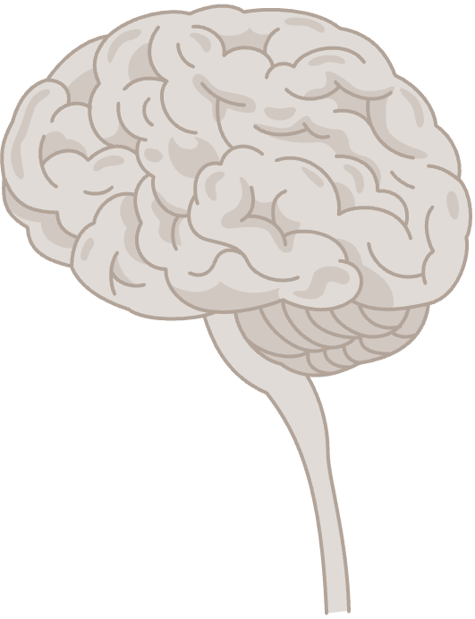
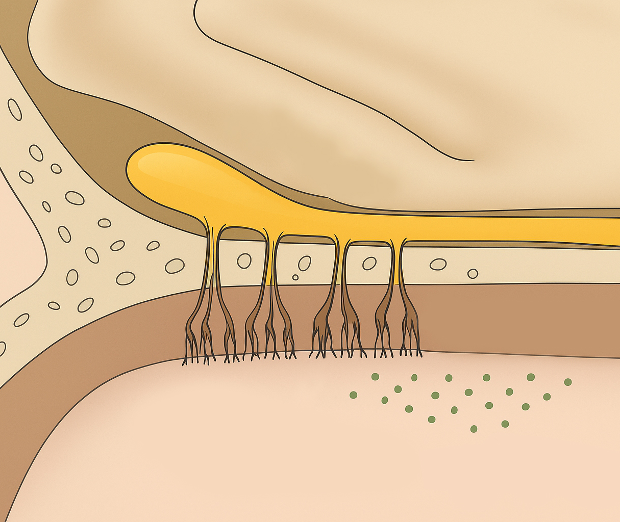


Sensory systems of the brain: the olfactory system
Fundamentals of neurobiology – Systems neuroscience
Olfaction, responsible for a sense of smell, is one of the two chemosensory processes; the other is gustation (taste)
The olfactory pathway
The olfactory epithelium in the nose contains specialized
sensory cells, the olfactory receptor neurons (ORNs)¹
ORNs have hair-like structures (cilia) projecting into the nasal cavity. These contain receptors that bind to airborne odorants,
and transduce olfactory signals into neural ones¹
ORN axons project to the olfactory bulb in the brain; the ORNs with the same odorant receptors converge in olfactory glomeruli¹
  The olfactory system is unique in that it initially bypasses the thalamus
  (a relay station for most other sensory systems)²
From the olfactory bulb, signals are transmitted through the olfactory tract to other brain regions, including the pyriform
cortex (the primary olfactory cortex, involved in odour
identification and in the cognitive aspects of olfaction), and the orbitofrontal cortex (integrating olfactory information with taste
for flavour perception)¹
The olfactory system¹
Olfactory bulb
Olfactory bulb
Cribriform plate
Cribriform plate
Olfactory epithelium
Nasal cavity
Olfactory nerve
Olfactory epithelium
Airborne odorants
Olfactory nerve
Olfactory receptors
Olfactory bulb
Olfactory tract
Olfactory bulb targets
Entorhinal cortex
Amygdala
Olfactory tubercle
Pyriform cortex
Hippocampal formation
Hypothalamus
Thalamus
Orbitofrontal cortex
ORN=olfactory receptor neuron
1. Augustine et al. Neuroscience, 7th edition. 2023; 2. Courtiol & Wilson. Front Neural Circuits 2015;9:49.
Notes:
Apart from the main olfactory pathway, many species also have an accessory olfactory pathway for the detection of pheromones: species- and gender-specific chemical cues that provide information about an individual’s social, sexual and reproductive status.³ The sensory structure for pheromone detection in mammals is the vomeronasal organ (VNO).³
Anatomical studies suggest that the VNO exists in adult humans, but it lacks sensory neurons and nerve bundles.³ The likely explanation for this phenomenon is that humans either do not detect pheromones and have developed other strategies for recognizing potential partners or attackers, or that they detect odours acting as pheromones in triggering behaviours involved in reproduction or aggression through the main olfactory pathway.³
References:
Augustine GJ, Groh JM, Huettel SA, et al. Neuroscience, 7th edition. Oxford University Press Academic US; 2023.
Courtiol E, Wilson DA. The olfactory thalamus: unanswered questions about the role of the mediodorsal thalamic nucleus in olfaction. Front Neural Circuits 2015; 9: 49.
Squire LR, Berg D, Bloom FE, et al. Fundamental Neuroscience, 4th edition. Elsevier S&T; 2012.

