Slide 1

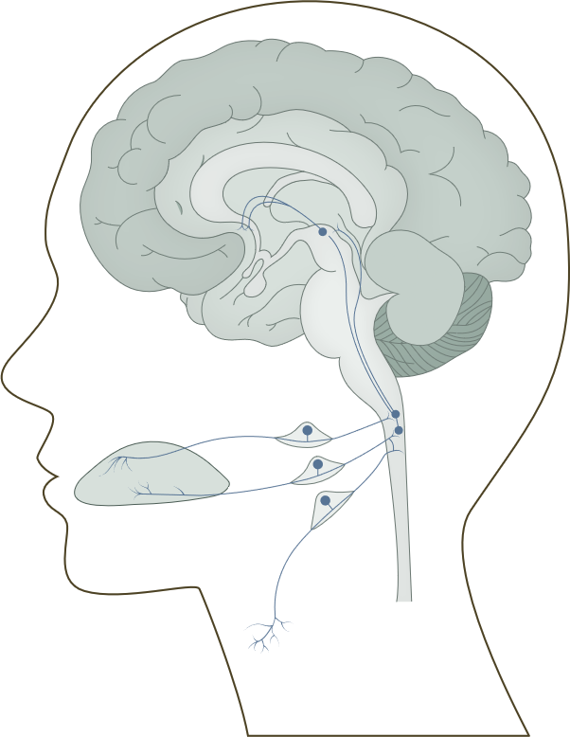
Sensory systems of the brain: the gustatory system
Fundamentals of neurobiology – Systems neuroscience
Gustation, responsible for a sense of taste, is one of the two chemosensory processes; the other is olfaction (smell)
The gustatory (taste) pathway
Tastants are detected by taste receptor cells, clustered in
taste buds; these are located primarily on the tongue, but also on the palate and throat
The basal end of taste cells touches the afferent fibres of gustatory sensory neurons, which transmit signals to the gustatory nucleus in the brainstem through cranial nerves VII, IX and X:
  A branch of the facial nerve (VII) called chorda tympani transmits signals from the front two-thirds of the tongue
  The glossopharyngeal nerve (IX) carries signals from the rest of the tongue
  The vagus nerve (X) transmits taste signals from the throat
From the gustatory end, the signals are relayed to the thalamus, and finally to the gustatory cortex in the insular and frontal operculum regions of the brain, where taste perception occurs
The gustatory (taste) system
Gustatory cortex (anterior insula
frontal operculum)
Ventral posterior medial nucleus of the thalamus
N VII
Nucleus of the solitary tract
Chorda tympani
Tongue
N IX
N X
Kandel et al. Principles of Neural Science, 6th edition. 2021
Notes:
The gustatory system is a specialized sensory system dedicated to evaluating potential food sources, and is the main driver of feeding decisions.¹ In contrast to the olfactory system, which can distinguish millions of kinds of odours, the gustatory system can only distinguish five basic taste qualities: sweet, salty, bitter, sour, and umami (the flavour associated with the ‘savoury’ taste of amino acids).¹ While limited, this taste palate is sufficient to meet all essential dietary requirements:
Sweet taste promotes the consumption of foods rich in energy;
Salty taste promotes a diet with correctly balanced electrolytes;
Bitter taste offers warning against the ingestion of toxic or otherwise noxious compounds;
Sour taste suggests the ingested food may not be fully ripe, or may be fermented;
Umami taste promotes sufficient intake of protein.¹
Taste is often used interchangeably with flavour.¹ However, while taste only refers to the five basic qualities recognized by the gustatory system, flavour is a result of the integration of multisensory inputs from gustatory, olfactory and somatosensory inputs.¹
Reference:
Kandel ER, Koester JD, Mack SH, Siegelbaum SA. Principles of Neural Science, 6th edition. McGraw-Hill Professional; 2021.

