Slide 1
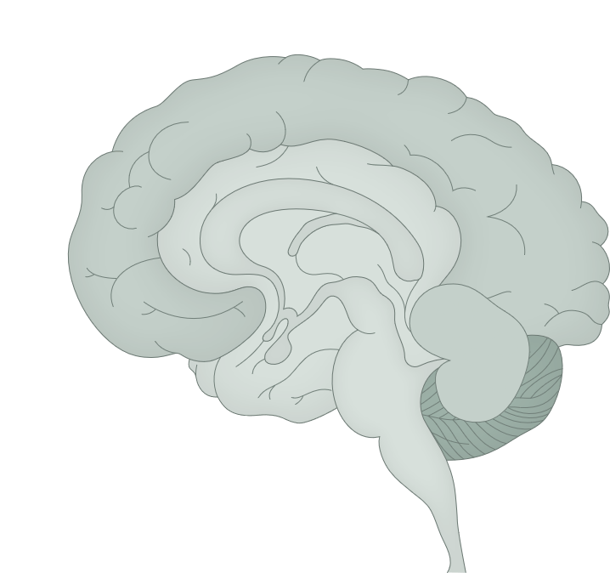
The cerebellum
Fundamentals of neurobiology – Systems neuroscience
Signalling pathways of the cerebellum⁴
The cerebellum is responsible for fine-tuning motor activities and adjusting ongoing movements, and plays a role in maintaining balance and posture, coordinating voluntary movements (e.g., gait), and motor learning¹⁻³
It receives sensory input from the body (muscles, tendons, and joints) and motor input from the cerebral cortex^{1,3}
The cerebellum also receives information concerning balance from the vestibular system³
Damage to the cerebellum can result in ataxia (problems with fine movements, impaired coordination and balance)^{2,3}
Neocortex
Thalamic nuclei
Deep nuclei
Pontine nuclei
Cerebellar cortex
The interaction between the cerebrum and the cerebellum occurs through reciprocal connections between specific cerebral and cerebellar areas. Purkinje cells in the cerebellar cortex project to areas in the neocortex through the cerebellar nuclei and the thalamus; the neocortex in turn projects back to the original cerebellar area through the pontine nuclei.
This work is from ‘Cerebellar coordination of neuronal communication in cerebral cortex’ by McAfee et al., used under CC-BY. This work is licensed under Creative Commons license CC-BY-SA by The Lundbeck Foundation.
1. Knierim. Cerebellum. In: Neuroscience Online. Available at: https://nba.uth.tmc.edu/neuroscience; 2. Amore et al. Front Syst Neurosci 2021;15:646052;
3. Jimsheleishvili & Dididze. Neuroanatomy, cerebellum. StatPearls [internet]. July 2023; 4. McAfee et al. Front Syst Neurosci 2022;15:781527
Notes:
The cerebellum represents only 10% of the total volume of the brain, but contains over 50% of the brain’s neurons.⁵ The cerebellar cortex is composed of multiple units that are highly repetitive and regular in their structure and contain the same basic microcircuits, with different cerebellar regions receiving projections from distinct brain and spinal structures and then projecting back to the neocortex.⁵ The uniformity of cerebellar architecture and physiology suggests that different regions of the cerebellum perform similar computational tasks on varying inputs.⁵
The physiological function of the cerebellum is underpinned by the following key principles:⁵
The cerebellum acts prior to sensory feedback arising from movement, and therefore provides feedforward control of muscular contractions
For achieving this control, the cerebellum relies on internal body models to process and compare sensory inputs with copies of motor commands
The cerebellum is key for motor and perceptual timing, and for adapting and learning motor skills
The cerebellum of primates is deeply interconnected with non-motor areas of the cerebral cortex, likely performing similar actions in the execution and learning of motor and non-motor behaviours
References:
Knierim J. Chapter 5: Cerebellum. In: Neuroscience Online. Available at: https://nba.uth.tmc.edu/neuroscience. Accessed September 2025.
Amore G, Spoto G, Ieni A, et al. A focus on the cerebellum: From embryogenesis to an age-related clinical perspective. Front Syst Neurosci 2021 15: 646052.
Jimsheleishvili S, Dididze M. Neuroanatomy, cerebellum. StatPearls [internet]. July 2023. Accessed September 2025.
McAfee SS, Liu Y, Sillitoe RV, Heck DH. Cerebellar coordination of neuronal communication in cerebral cortex. Front Syst Neurosci 2022; 15: 781527.
Kandel ER, Koester JD, Mack SH, Siegelbaum SA. Principles of Neural Science, 6th edition. McGraw-Hill Professional; 2021.

