Slide 1
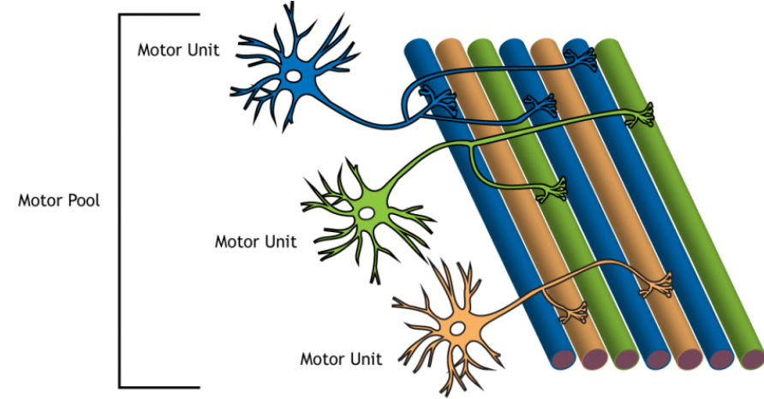
Motor units
Fundamentals of neurobiology – Systems neuroscience
The multiple branches of each alpha motor neuron can innervate several fibres within one muscle
A motor neuron and all the muscle fibres it innervates are known as a motor unit
  The muscle fibres within a single motor unit are typically spread throughout the whole muscle to spread contractions
  Muscles are protected from fatigue by the asynchronous contraction of individual motor units
  A graded contraction of a muscle is achieved by activating different numbers of motor units
Motor units vary in size:
  Small motor units innervate fewer muscle fibres and control fine movements, e.g., in the eyes and fingers
  Large motor units innervate many muscle fibres and are generally found in weight-bearing muscles, e.g., those of the thighs
  Recruitment of different motor units allows the generation of appropriate muscle tension to move a load – increasingly larger motor units are recruited to lift heavier loads
The group of motor neurons that innervate all the fibres within a single muscle is known as a motor pool
A motor pool of a muscle is formed by a group of motor units innervating all the muscle fibres in that muscle
Motor unit
Motor pool
Motor unit
Motor unit
This work is from ‘Introduction to Neuroscience’ by Hedges, used under CC-NC-BY.
This work is licensed under Creative Commons license CC-NC-BY-SA by The Lundbeck Foundation.
Hedges. Spinal motor control and proprioception. In: Introduction to Neuroscience. Available at: https://openbooks.lib.msu.edu/introneuroscience1/
Notes:
When a peripheral nerve is damaged or destroyed, the muscles innervated by that nerve immediately become paralyzed, and gradually start wasting away (atrophy).² Since peripheral nerves carry sensory as well as motor fibres, sensation in the area innervated by the nerve is also lost, along with tendon reflexes.²
References:
Hedges V. Chapter 40: Spinal motor control and proprioception. In: Introduction to Neuroscience. Available at: https://openbooks.lib.msu.edu/introneuroscience1. Accessed September 2025.
Kandel ER, Koester JD, Mack SH, Siegelbaum SA. Principles of Neural Science, 6th edition. McGraw-Hill Professional; 2021.

