Slide 1
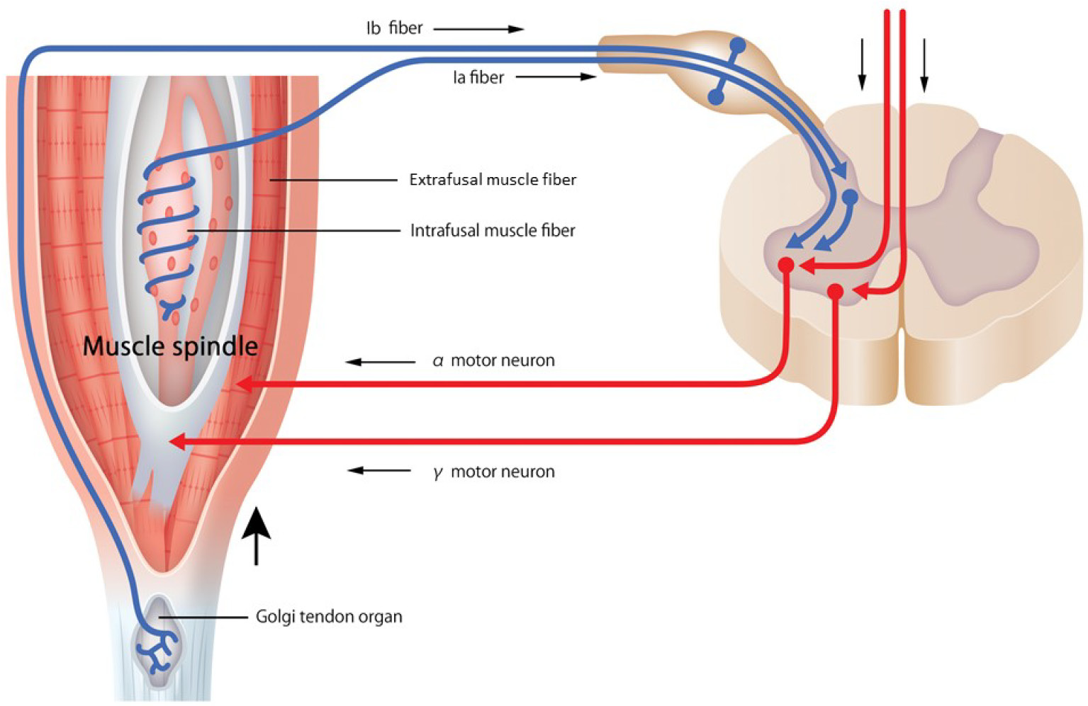
Proprioception and sensory feedback
Fundamentals of neurobiology – Systems neuroscience
Controlled movement relies on sensory feedback, particularly proprioception (the sense of body position in space and movement)¹
Sensory information from muscles, tendons, and joints is constantly fed back to the CNS, allowing the motor system to adjust movements in real time for precision, balance and coordination¹
Proprioceptors provide information to the brain regarding body positioning and movement:¹
  Muscle spindles (fibrous capsules within the muscles) measure muscle stretch (length)
  Golgi tendon organs (located between the outer muscle fibres and their points of attachment at the bones) measure muscle tension
Proprioception and sensory feedback²
This work is from Sakai et al. Spine Surg Relat Res 2022, licensed under CC BY-NC-ND. Published by Spine Surgery and Related Research on behalf of The Japanese Society for Spine Surgery and Related Research. The work cannot be changed in any way or used commercially without permission from the journal. https://www.jstage.jst.go.jp/article/ssrr/6/5/6_2021-0269/_article
CNS=central nervous system
1. Hedges. Spinal motor control and proprioception. In: Introduction to Neuroscience. Available at: https://openbooks.lib.msu.edu/introneuroscience1/;
2. Sakai et al. Spine Surg Relat Res 2022;6(5):422‒432
Notes:
For additional information about the integration of input from the sensory and motor systems for successful motor control, please see slide 20 and its slide notes.
References:
Hedges V. Spinal motor control and proprioception. In: Introduction to Neuroscience. Available at: https://openbooks.lib.msu.edu/introneuroscience1/. Accessed September 2025.
Sakai Y, Watanabe T, Wakao N, et al. Proprioception and geriatric low back pain. Spine Surg Relat Res 2022; 6 (5): 422‒432.

