Slide 1
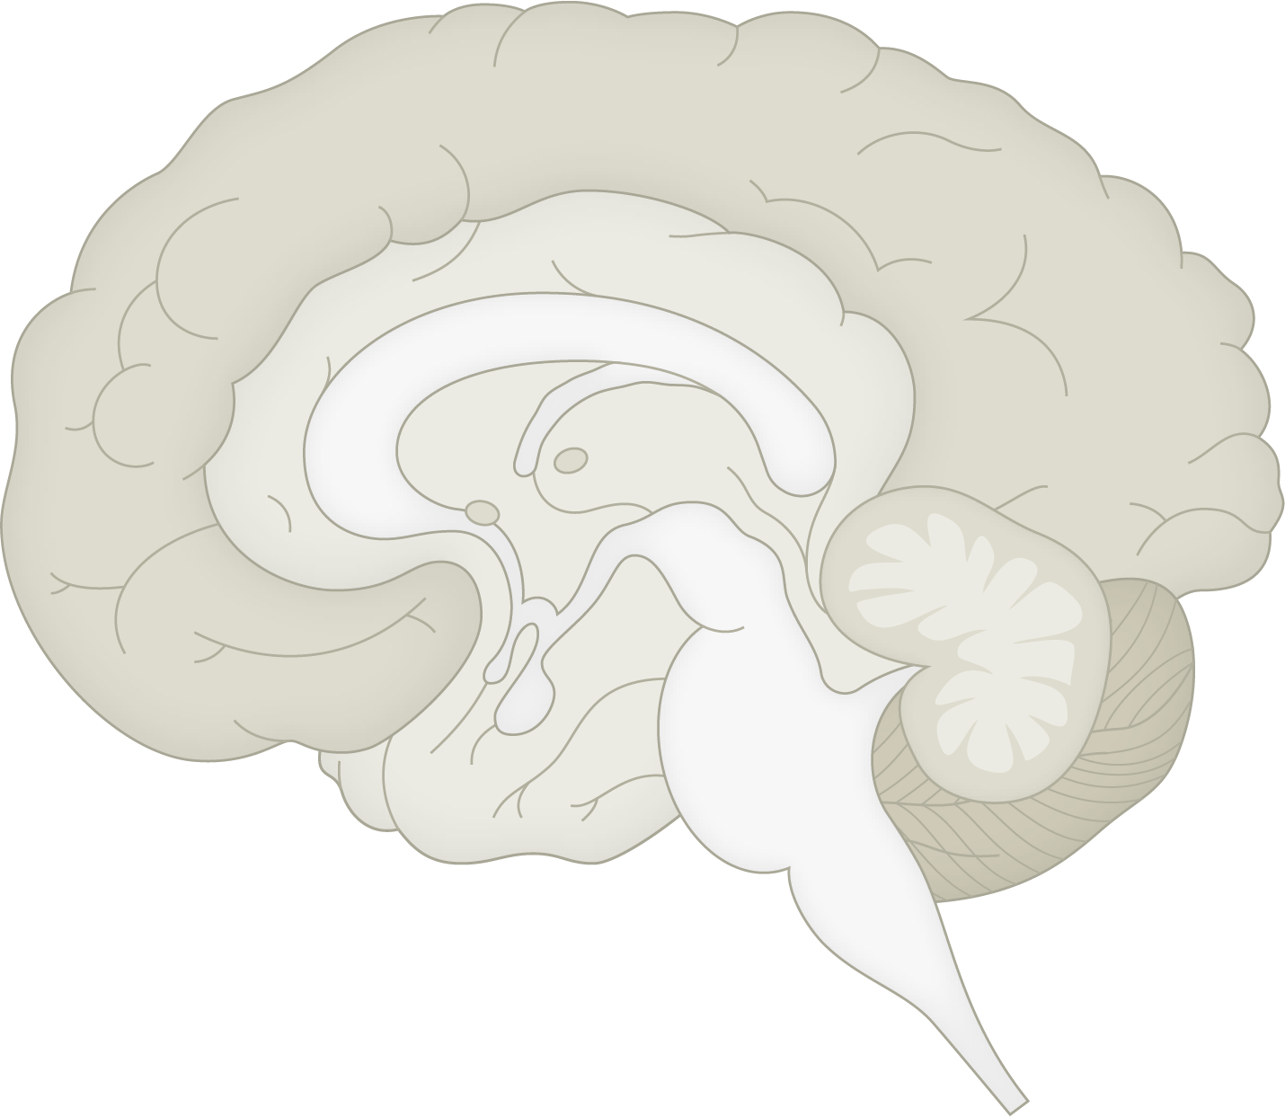
The limbic system
Fundamentals of neurobiology – Systems neuroscience
Structures of the limbic system⁷
There is no single, universally agreed and distinct definition of the limbic system;¹ it is a complex set of connected structures in the brain that plays a key role in:^{2,3}
  Regulating emotional responses
  Forming and processing emotional memories
  Learning, attention, decision making
  Certain aspects of behaviour, e.g., motivation
  Regulation of autonomic and neuroendocrine functions
The limbic system influences behaviour tied to survival, such as feeding, reproduction, and responses to threats³⁻⁵
Disruption of the limbic system may play a role in disorders like anxiety, depression, and post-traumatic stress disorder, due to altered emotional responses^{2,6}
Cingulate gyrus
Fornix
Hypothalamus
Thalamus
Septum
Olfactory bulb
Amygdala
Mammillary body
Hippocampus
This work is from ‘Neuroanatomical abnormalities in chronic tinnitus in the human brain’ by Adjamian et al., used under CC-BY. This work is licensed under Creative Commons license
CC-BY-SA by The Lundbeck Foundation.
1. Rolls. Cortex 2015;62:119–157; 2. Song. Biomed Pharmacother 2023;162:114647;
3. Jones et al. Neurogastroenterol Motil 2006;18(2):91‒103; 4. Stover et al. J Intern Med 2023;294(5):582‒604; 5. Yang et al. Cell Mol Life Sci 2018;75(12):2197‒2210;
6. Liberati & Perrotta. Ibrain 2024;10(1):46‒58; 7. Adjamian et al. Neurosci Biobehav Rev 2014;45:119‒133
Notes:
References:
Rolls ET. Limbic systems for emotion and for memory, but no single limbic system. Cortex 2015; 62: 119–157.
Song J. Amygdala activity and amygdala-hippocampus connectivity: Metabolic diseases, dementia, and neuropsychiatric issues. Biomed Pharmacother 2023; 162: 114647.
Jones MP, Dilley JB, Drossman D, Crowell MD. Brain–gut connections in functional GI disorders: anatomic and physiologic relationships. Neurogastroenterol Motil 2006; 18 (2): 91‒103.
Stover PJ, Field MS, Andermann ML, et al. Neurobiology of eating behavior, nutrition, and health. J Intern Med 2023; 294 (5): 582‒604.
Yang L, Comninos WS, Dhillo WS. Intrinsic links among, sex, emotion, and reproduction. Cell Mol Life Sci 2018; 75 (12): 2197‒2210.
Liberati AS, Perrotta G. Neuroanatomical and functional correlates in post-traumatic stress disorder: A narrative review. Ibrain 2024; 10 (1): 46‒58.
Adjamian P, Hall DA, Palmer AR, et al. Neuroanatomical abnormalities in chronic tinnitus in the human brain. Neurosci Biobehav Rev 2014; 45: 119‒133.

