Slide 1



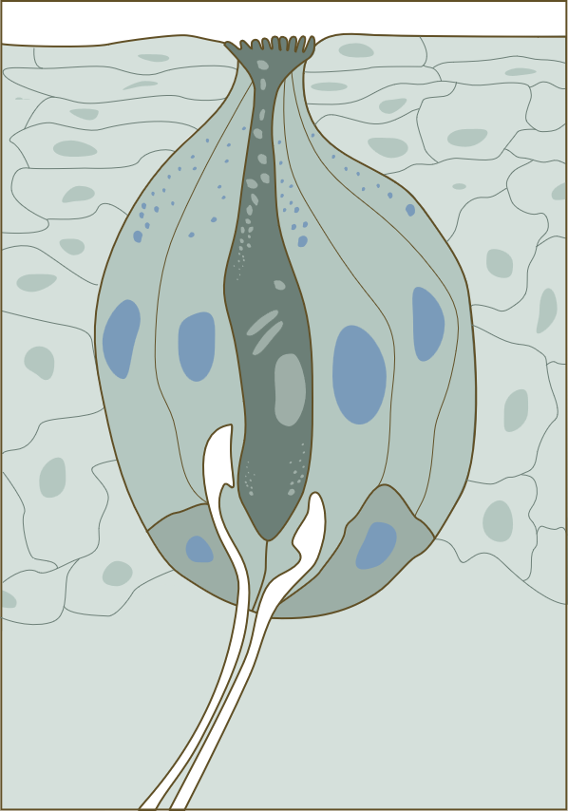
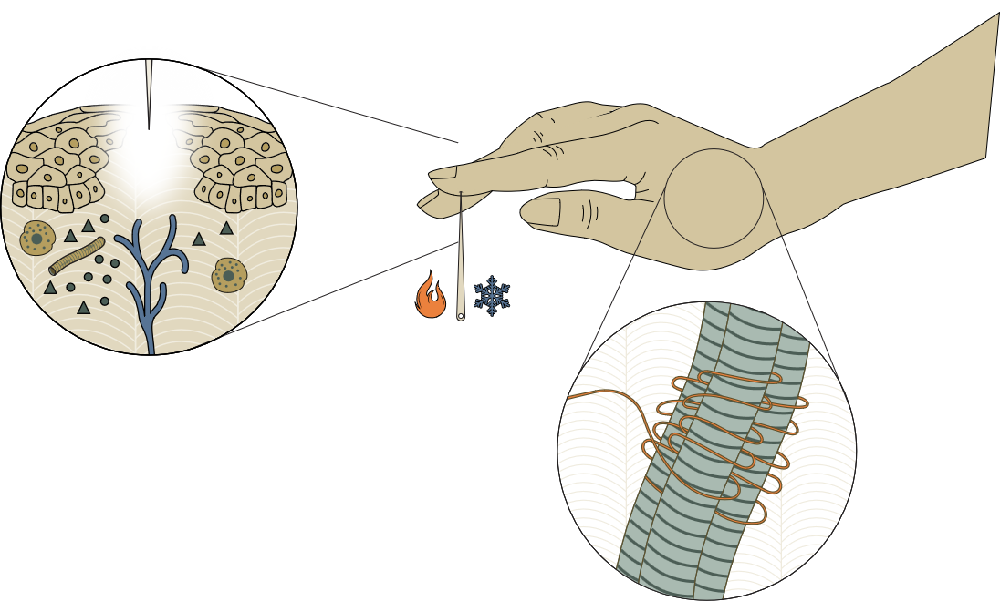
Principles of sensory systems (I)
Fundamentals of neurobiology – Systems neuroscience
The following principles apply to all sensory modalities: vision, hearing, touch/proprioception, taste, and smell
Sensory receptors and transduction
Each sensory system relies on specialized receptors that respond to specific types of stimuli.^{1,2} These receptors transduce (convert) external stimuli (such as light, sound,
or touch) into electrical signals that can be interpreted by the nervous system.^{1,2} Examples include photoreceptors
in the retina for vision, mechanoreceptors in the skin
for touch, or proprioceptors in muscles for stretch^{1,2}
Types of sensory receptors¹
Vision
Smell
1
Touch/pain/thermal senses Proprioception
Taste
Hearing
Balance
1. Kandel et al. Principles of Neural Science, 6th edition. 2021; 2. Squire et al. Fundamental Neuroscience, 4th edition. 2012
Notes:
Receptors are crucial for transducing chemical, mechanical, thermal or light stimuli into signals that the rest of the nervous system will understand.² They are highly specialized in their transduction: even receptor classes that are part of the same (e.g., somatosensory) system are specifically sensitive to one type of stimulus (e.g., heat), and not another (e.g., muscle stretch), and there is a correlation between the number of receptor types of a given sensory system, and the types of stimuli the system can detect.² The specificity in receptor response is underpinned by differences in receptor structure and chemistry; for example, the variation in the sensitivity of individual olfactory sensory neurons to particular odorants is caused by differences in the primary sequence of a single receptor protein.²
References:
Kandel ER, Koester JD, Mack SH, Siegelbaum SA. Principles of Neural Science, 6th edition. McGraw-Hill Professional; 2021.
Squire LR, Berg D, Bloom FE, et al. Fundamental Neuroscience, 4th edition. Elsevier S&T; 2012.

