Slide 1
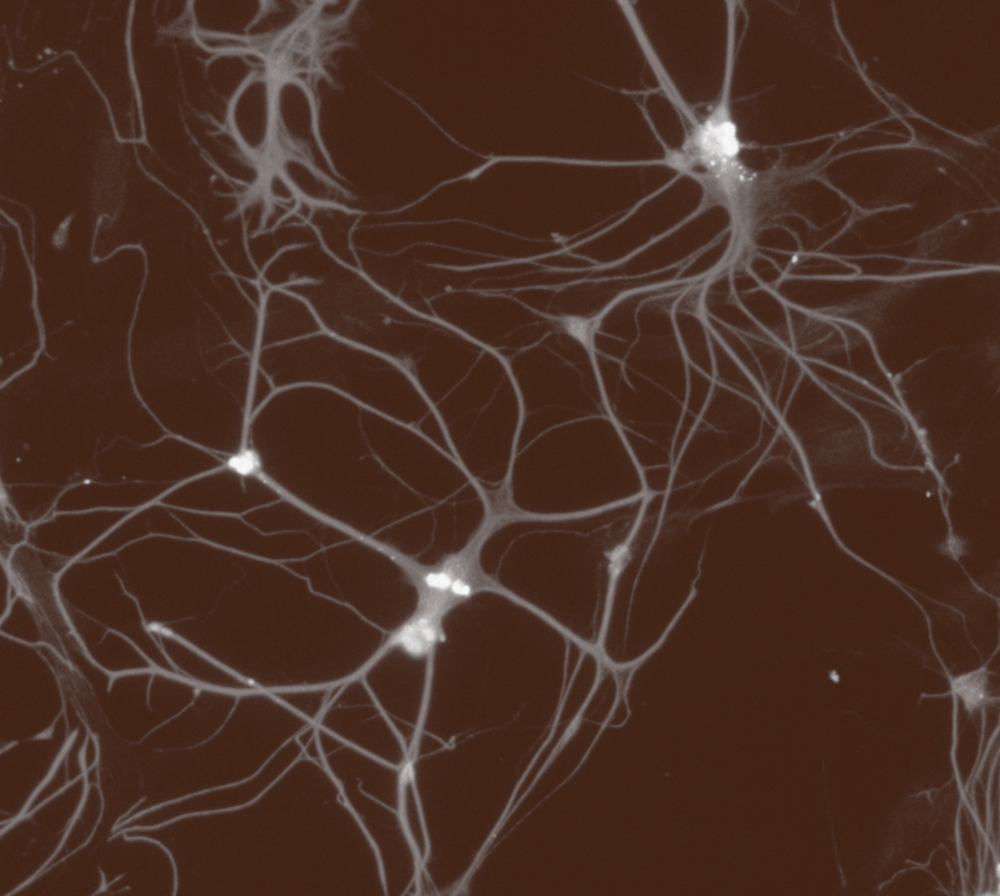
Fundamentals of neurobiology
Systems neuroscience

Slide 2
Neural systems
Fundamentals of neurobiology – Systems neuroscience
The nervous system can also be described as a set of functional systems¹
  A system is a circuit of neurons linked together to process functionally related information and perform specific tasks
  A functional system of the nervous system will generally traverse more than one region of the brain
Neural systems fall into three broad categories:¹
Sensory systems
These include peripheral sensory specializations in the eyes, ears, skin, nose and tongue that transduce external stimuli (e.g., light, touch, or sound) into electrical signals. After transduction, information travels via specific pathways in the PNS and CNS to enable perception and cognition^{1,2}
Motor systems
The motor systems are a network of brain and spinal cord structures and peripheral nerves that control and execute voluntary and involuntary movements¹
Associational systems
Associational systems are a network of brain regions that integrate and process information from different sensory and motor areas as well as past experience to enable complex thought and behaviour. They are involved in higher cognitive functions such as language, memory, perception or planning¹
CNS=central nervous system; PNS=peripheral nervous system
1. Augustine et al. Neuroscience, 7th edition. 2023; 2. Kandel et al. Principles of Neural Science, 6th edition. McGraw-Hill Professional; 2021
Notes:
References:
Augustine GJ, Groh JM, Huettel SA, et al. Neuroscience, 7th edition. Oxford University Press Academic US; 2023.
Kandel ER, Koester JD, Mack SH, Siegelbaum SA. Principles of Neural Science, 6th edition. McGraw-Hill Professional; 2021.

Slide 3
Sensory systems

Slide 4
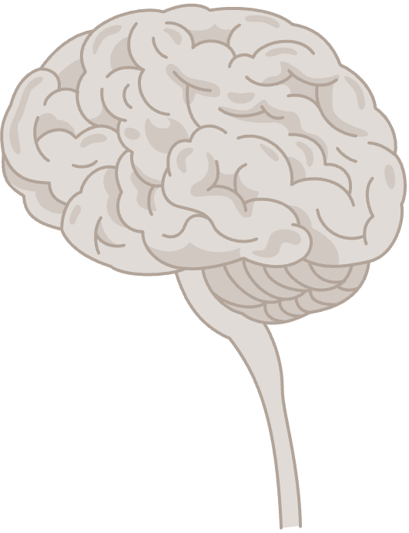

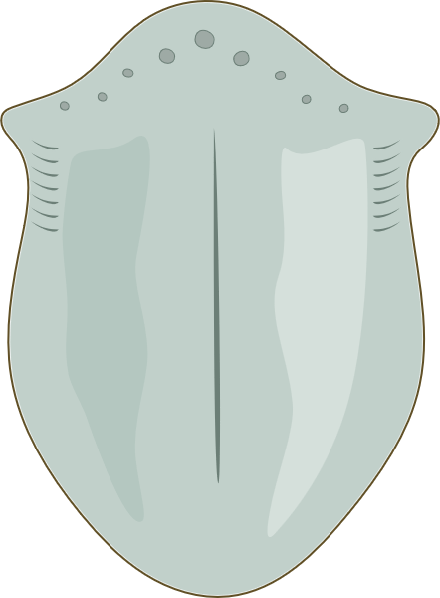
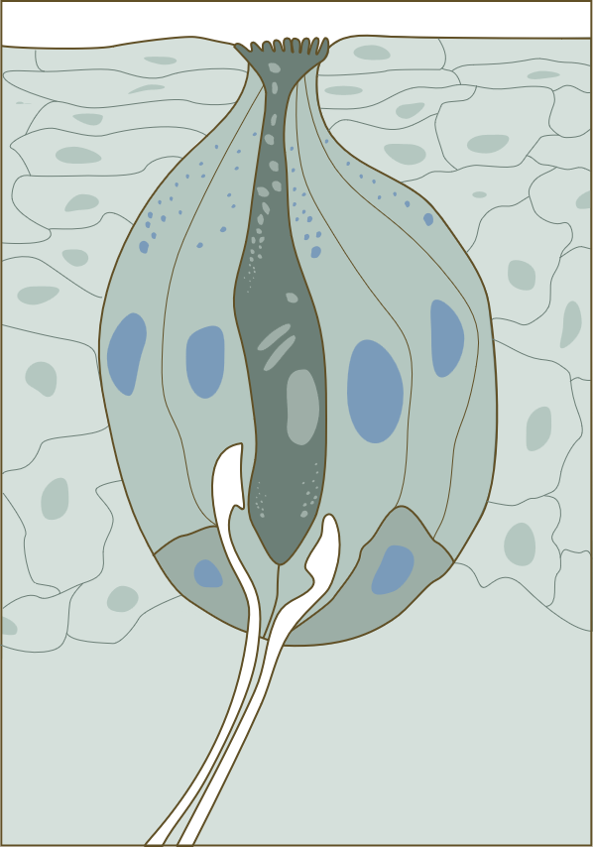
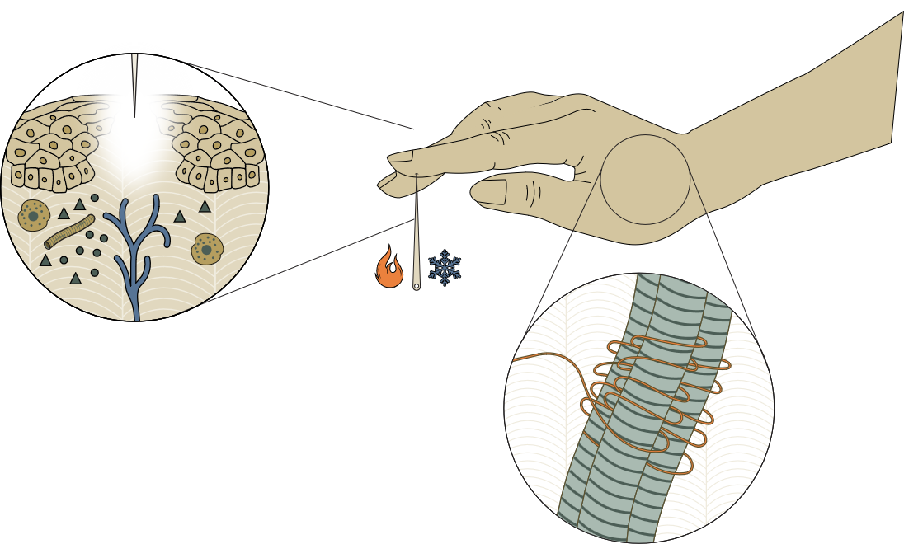
Principles of sensory systems (I)
Fundamentals of neurobiology – Systems neuroscience
The following principles apply to all sensory modalities: vision, hearing, touch/proprioception, taste, and smell
Sensory receptors and transduction
Each sensory system relies on specialized receptors that respond to specific types of stimuli.^{1,2} These receptors transduce (convert) external stimuli (such as light, sound,
or touch) into electrical signals that can be interpreted by the nervous system.^{1,2} Examples include photoreceptors
in the retina for vision, mechanoreceptors in the skin
for touch, or proprioceptors in muscles for stretch^{1,2}
Types of sensory receptors¹
Vision
Smell
1
Touch/pain/thermal senses Proprioception
Taste
Hearing
Balance
1. Kandel et al. Principles of Neural Science, 6th edition. 2021; 2. Squire et al. Fundamental Neuroscience, 4th edition. 2012
Notes:
Receptors are crucial for transducing chemical, mechanical, thermal or light stimuli into signals that the rest of the nervous system will understand.² They are highly specialized in their transduction: even receptor classes that are part of the same (e.g., somatosensory) system are specifically sensitive to one type of stimulus (e.g., heat), and not another (e.g., muscle stretch), and there is a correlation between the number of receptor types of a given sensory system, and the types of stimuli the system can detect.² The specificity in receptor response is underpinned by differences in receptor structure and chemistry; for example, the variation in the sensitivity of individual olfactory sensory neurons to particular odorants is caused by differences in the primary sequence of a single receptor protein.²
References:
Kandel ER, Koester JD, Mack SH, Siegelbaum SA. Principles of Neural Science, 6th edition. McGraw-Hill Professional; 2021.
Squire LR, Berg D, Bloom FE, et al. Fundamental Neuroscience, 4th edition. Elsevier S&T; 2012.

Slide 5
Principles of sensory systems (II)
Fundamentals of neurobiology – Systems neuroscience
The following principles apply to all sensory modalities: vision, hearing, touch/proprioception, taste, and smell
Receptive fields
Sensory neurons have a specific region of the sensory space they respond to, called a receptive field. For example, in vision, photoreceptors in the retina respond to changes in light over a small region of visual space,¹ and in touch, different types of mechanoreceptors respond to different types of mechanical stimuli, and each receptor responds to touch on a small area of the body surface²
Coding
Sensory systems encode information about the type (modality), intensity (strength), timing and location of a stimulus²
Receptive fields of mechanoreceptors in the human skin²
2
Receptive field
3
1. Augustine et al. Neuroscience, 7th edition. 2023; 2. Kandel et al. Principles of Neural Science, 6th edition. 2021
Notes:
The receptive field of a neuron usually coincides with its perceptive field – the area from which a sensation is perceived to arise.² The overlapping of receptive fields of individual neurons allows for perception to smoothly move from one sensory neuron to the next.²
The spatial resolution of a sensory system depends on the total number of receptors, and the distribution of their receptive fields over the area covered.² In body regions where the receptor density is high, neurons receive input from only a few receptors with small receptive fields close together, providing a very detailed sensory perception (e.g., the fovea in the eye for visual perception, or fingertips for tactile perception); conversely, lower receptor density at the edge of the retina or in the skin of the arm provide less detailed sensory perception.²
References:
Augustine GJ, Groh JM, Huettel SA, et al. Neuroscience, 7th edition. Oxford University Press Academic US; 2023.
Kandel ER, Koester JD, Mack SH, Siegelbaum SA. Principles of Neural Science, 6th edition. McGraw-Hill Professional; 2021.

Slide 6
Principles of sensory systems (III)
Fundamentals of neurobiology – Systems neuroscience
The following principles apply to all sensory modalities: vision, hearing, touch/proprioception, taste, and smell
Adaptation
Sensory systems exhibit adaptation, i.e., they decrease their responsiveness to a constant stimulus over time.¹ This helps the brain focus on new or changing stimuli.¹ An example includes initially noticing, but later not sensing, cigarette smoke in a smoking area¹
Topographic mapping
Many sensory systems are organized topographically, i.e., there is a systematic, spatial relationship between stimulus location and the organization of neurons in sensory systems.^{1,2} This enables the brain to localize the stimulus in body-centred space^{1,2}
An example of topographic mapping in the visual system³
4
Left visual field
Right visual field
Nasal retina
Optical lens
Temporal retina
Temporal retina
Optic nerve
5
Optic chiasma
Lateral geniculate nucleus (LGN)
Pretectal nucleus
Primary visual cortex
Neighbouring retinal ganglion cells (the output cells of the retina) respond to neighbouring locations in visual space.² Their axons project to neighbouring targets in the lateral geniculate nucleus, and from there to neighbouring sites in the primary visual cortex.²
1. Augustine et al. Neuroscience, 7th edition. 2023; 2. Squire et al. Fundamental Neuroscience, 4th edition. 2012;
3. Nieto. Human visual pathway. Available at: https://commons.wikimedia.org/w/index.php?curid=37868501
This work is adapted from ‘Human visual pathway' by Nieto, used under CC-BY.
This work is licensed under Creative Commons license CC-BY-SA by The Lundbeck Foundation.
Notes:
‘Slowly adapting receptors’ respond to prolonged and constant stimulation, and generate action potentials throughout the entire stimulation period; ‘rapidly adapting receptors’ fire only at the beginning and at the end of a stimulus, and stop firing in response to stimulation whose frequency does not change.⁴ Rapidly and slowly adapting receptors illustrate another key aspect of sensory coding: neurons report on important characteristics of the stimuli perceived not only when they fire, but also when they slow down or stop.⁴
References:
Augustine GJ, Groh JM, Huettel SA, et al. Neuroscience, 7th edition. Oxford University Press Academic US; 2023.
Squire LR, Berg D, Bloom FE, et al. Fundamental Neuroscience, 4th edition. Elsevier S&T; 2012.
Nieto MP. Human visual pathway. Available at: https://commons.wikimedia.org/w/index.php?curid=37868501. Accessed September 2025.
Kandel ER, Koester JD, Mack SH, Siegelbaum SA. Principles of Neural Science, 6th edition. McGraw-Hill Professional; 2021.

Slide 7
Principles of sensory systems (IV)
Fundamentals of neurobiology – Systems neuroscience
The following principles apply to all sensory modalities: vision, hearing, touch/proprioception, taste, and smell
Sensory pathways
After transduction, sensory information travels through specific neural pathways to different brain regions to enable sensory perception and cognition.¹ The pathways are hierarchical, moving from the receptors through to subcortical regions and then to the sensory areas of the cortex.¹ Information travels bidirectionally: feedback from the brain regulates sensation and perception (see point 10)¹
Hierarchical processing
Information is processed hierarchically along the sensory pathways, with more basic features processed at lower levels and more complex features at higher levels.¹ The brain gradually integrates and refines sensory information as it moves through successive stages of processing¹
An example of hierarchical processing of sensory information in the visual system³
6
Retina
Peripheral impulse
Fovea
Optic nerve
Decussation
Primary sensory cortical areas project back to their principal afferent relay thalamic nuclei, modulating sensory activity; feedback axons outnumber the afferent axons¹
Lateral
geniculate
nucleus (LGN)
Specific thalamic nucleus
Primary
visual
cortex
7
Unique field
in the cerebral cortex
As visual information passes from the retina to the optic nerve, the lateral geniculate nucleus, and then to the primary visual cortex, it is processed in a hierarchical manner; e.g., photoreceptors in the retina respond to light levels over small regions of visual space, while higher cortical visual areas respond selectively to more complex objects such as faces²
This work is adapted from ‘Human visual pathway' by Nieto, used under CC-BY.
This work is licensed under Creative Commons license CC-BY-SA by The Lundbeck Foundation.
1. Kandel et al. Principles of Neural Science, 6th edition. 2021; 2. Squire et al. Fundamental Neuroscience, 4th edition. 2012; 3. Nieto. Human visual pathway. Available at: https://commons.wikimedia.org/w/index.php?curid=37868501
Notes:
References:
Kandel ER, Koester JD, Mack SH, Siegelbaum SA. Principles of Neural Science, 6th edition. McGraw-Hill Professional; 2021.
Squire LR, Berg D, Bloom FE, et al. Fundamental Neuroscience, 4th edition. Elsevier S&T; 2012.
Nieto MP. Human visual pathway. Available at: https://commons.wikimedia.org/w/index.php?curid=37868501. Accessed September 2025.

Slide 8
Principles of sensory systems (V)
Fundamentals of neurobiology – Systems neuroscience
The following principles apply to all sensory modalities: vision, hearing, touch/proprioception, taste, and smell
Modality-specific processing
Each sensory modality is processed in its own specialized areas of the brain.^{1,2} While there is some interaction between sensory modalities (multisensory integration), the initial stages of processing are largely modality-specific (e.g., visual cortex for sight, auditory cortex for sound)¹⁻³
Parallel processing
Sensory stimuli are typically made of multiple features, e.g., visual objects can be of different sizes, colours, or textures, or move in different directions.² Sensory systems often process different features of the same stimulus in parallel pathways.² For example, touch and pain are processed in parallel pathways in the somatosensory system¹
8
9
1. Augustine et al. Neuroscience, 7th edition. 2023; 2. Kandel et al. Principles of Neural Science, 6th edition. 2021; 3. Pennartz et al. Philos Trans R Soc Lond B Biol Sci 2023;378(1886):20220336
Notes:
Sensory perception and movement, as well as complex cognitive functions such as language, thought and memory, are made possible by the interlinkage of serial and parallel processing in different brain regions.² Damage to a single specific area therefore may not result in the complete loss of a cognitive function or faculty; the affected function may eventually at least partially return once the undamaged parts of the brain reorganize the connections between themselves.²
References:
Augustine GJ, Groh JM, Huettel SA, et al. Neuroscience, 7th edition. Oxford University Press Academic US; 2023.
Kandel ER, Koester JD, Mack SH, Siegelbaum SA. Principles of Neural Science, 6th edition. McGraw-Hill Professional; 2021.
Pennartz CMA, Oude Lohuis MN, Olcese U. How ‘visual’ is the visual cortex? The interactions between the visual cortex and other sensory, motivational and motor systems as enabling factors for visual perception. 2023; 378 (1886): 20220336.

Slide 9

Principles of sensory systems (VI)
Fundamentals of neurobiology – Systems neuroscience
The following principles apply to all sensory modalities: vision, hearing, touch/proprioception, taste, and smell
Perception as an active process
Sensory perception is not just a passive reception of stimuli. How a stimulus is perceived depends on how the brain responds to sensory input based on context, prior experience and internal states. What stimuli are perceived also depends on attention. These active processes lead to the subjective experience of a stimulus
The subjective nature of sensory perception
10
The same image can be perceived as showing either a vase, or two faces nose to nose, depending on the viewer’s experiences, goals or attention
Squire et al. Fundamental Neuroscience, 4th edition. 2012
This work is adapted from ‘A version of Rubin’s vase' by Dilmen, used under CC-BY-SA.
This work is licensed under Creative Commons license CC-BY-SA by The Lundbeck Foundation.
Notes:
Interestingly, sensory information used to control actions is processed in neural pathways separate from the afferent pathways that contribute to conscious perception.² For example, visual information seems to flow in two separate streams in the brain: a dorsal stream projecting to the posterior parietal lobe cortex is involved in the use of vision for action, while a ventral stream projecting to the inferotemporal cortex is instrumental in conscious visual perception.² Damage to one does not have to impact the flow of sensory information in the other: research has shown that a person with a damaged ventral stream may be unable to indicate the position of a slot carved into a box either verbally or with their hand, but has no problem manoeuvring their hand appropriately to put a card through the slot.²
References:
Squire LR, Berg D, Bloom FE, et al. Fundamental Neuroscience, 4th edition. Elsevier S&T; 2012.
Kandel ER, Koester JD, Mack SH, Siegelbaum SA. Principles of Neural Science, 6th edition. McGraw-Hill Professional; 2021.

Slide 10
Sensory systems of the brain: the auditory system
Fundamentals of neurobiology – Systems neuroscience
The auditory system is responsible for the sense
of hearing
Key components of the auditory system include:
  Outer ear: Captures sound waves from the environment and focuses them on the eardrum
  Middle ear: Amplifies sound vibrations and transmits them to the inner ear
  Inner ear: Transduces sound vibrations and physical motion into neural signals through hair cells, sensory receptors
  located inside a coiled structure called the cochlea.
  The neural signals then travel to the brain, where they are processed to generate sound perception and localization.
  Structures in the inner ear are also key components of the vestibular system, which processes sensory
  information related to self-motion, head position,
  and spatial orientation relative to gravity
Key components of the auditory system
Outer ear
Middle ear
Inner ear
Malleus
Semicircular canals
Incus
Vestibular nerve
Bone
Auditory nerve
Ear canal
Cochlea
Stapes
Pinna
Eardrum
(tympanic membrane)
Augustine et al. Neuroscience, 7th edition. 2023
Notes:
Adults with normal hearing can detect sounds falling within the frequency range of 20 to 20,000 Hz; the higher end of the audible range usually decreases slightly with age.¹ The human ear is especially sensitive to frequencies around 2,000 to 5,000 Hz.¹ This appears to be directly related to speech perception: although human speech contains many frequencies, important cues used for distinguishing different speech sounds are concentrated around 3,000 Hz.¹ Selective hearing loss in the frequency range of 2,000 to 5,000 Hz, which is likely to ensue following exposure to high-intensity broadband noise such as that generated by explosives or heavy machinery, therefore, disproportionately affects speech recognition.¹
Reference:
Augustine GJ, Groh JM, Huettel SA, et al. Neuroscience, 7th edition. Oxford University Press Academic US; 2023.

Slide 11
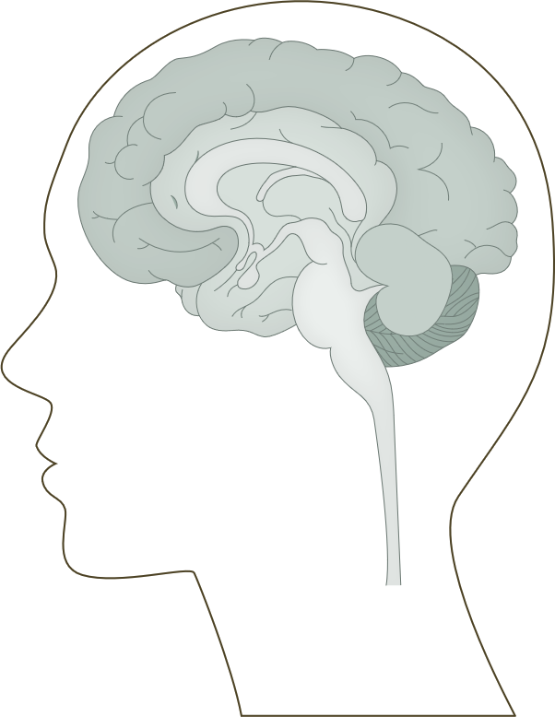
Sensory systems of the brain: the auditory pathway
Fundamentals of neurobiology – Systems neuroscience
Bipolar neurons of the spiral ganglion located in the cochlea relay signals from the hair cells to the brain¹
The axons of the bipolar neurons form the auditory (cochlear) nerve which transmits the electrical signals from the ear to the brainstem¹
Signals are relayed to the superior olivary complex and subsequently the lateral lemniscus in the pons, and then travel to the inferior colliculus of the midbrain, a relay and integration centre for ascending auditory information²
  Along the way, axons may terminate in various nuclear complexes in the pons²
From the inferior colliculus, fibres project mainly to the medial geniculate nucleus of the thalamus, which in turn projects to the auditory cortex²
The auditory pathway^{3,4}
Auditory cortex
BRAIN
Medial geniculate nucleus
MIDBRAIN
Inferior colliculus
MIDBRAIN
Nucleus of lateral lemniscus
PONS
Superior olivary complex
PONS
Dorsal acoustic stria
Intermediate acoustic stria
Ventral acoustic stria
MEDULLA
CN VIII
(Cochlear nerve)
Cochlear nuclei
Cochlea
1. Squire et al. Fundamental Neuroscience, 4th edition. 2012; 2. Kandel et al. Principles of Neural Science, 6th edition. 2021;
3. Peelle. Auditory pathway. Available at: https://commons.wikimedia.org/wiki/File:Auditory_Pathway.png; 4. Peterson et al. Neuroanatomy, Auditory Pathway. StatPearls [internet]. October 2023
Notes:
References:
Squire LR, Berg D, Bloom FE, et al. Fundamental Neuroscience, 4th edition. Elsevier S&T; 2012.
Kandel ER, Koester JD, Mack SH, Siegelbaum SA. Principles of Neural Science, 6th edition. McGraw-Hill Professional; 2021.
Peelle JE. Auditory pathway. Available at: https://commons.wikimedia.org/wiki/File:Auditory_Pathway.png. Accessed September 2025.
Peterson DC, Reddy V, Mayes DA, Hamel RN. Neuroanatomy, Auditory Pathway. StatPearls [internet]. October 2023. Accessed September 2025.

Slide 12

Sensory systems of the brain: the visual system
Fundamentals of neurobiology – Systems neuroscience
The visual system is a complex network of structures and processes allowing for the perception, interpretation, and response to visual information from the environment
A key component of the visual system is the eye:
  Light enters the eye via the pupil and is focussed by
  the cornea and lens onto the innermost part of the eye,
  the retina
  The retina is a part of the CNS and contains specialized neurons called photoreceptors (rods and cones), which
  can transduce light signals into neural signals
  At a small depression near the centre of the retina lies
  the fovea, a region with a very high density of photoreceptors, providing the highest visual acuity in the retina
  The output cells of the retina are the retinal ganglion
  cells. These convey feature-specific information (e.g.,
  colour, movement, luminance) through their axons, which converge at the optic disc and form the optic nerve,
  carrying information to the brain
Key components of the eye (left), and of the retina (right)
Zonule
fibers
Pupil
Iris
Cornea
Aqueous humour
in anterior chamber
Ciliary muscle
Posterior chamber
Pigment epithelium
Lens
Photoreceptor outer segments
Outer nuclear layer
Choroid
Vitreous humour
Rod
Cone
Outer plexiform layer
Sclera
Retina
Horizontal cell
Optic disk
Bipolar cell
Inner nuclear layer
Amacrine cell
Inner plexiform layer
Fovea
Ganglion cell layer
Optic nerve and retinal vessels
Ganglion cell
To optic nerve
Nerve fiber layer
CNS=central nervous system
Augustine et al. Neuroscience, 7th edition. 2023
Notes:
The retina is a thick (few hundred micrometres) sheet of neurons.² It contains five major cell types, arranged in three cellular layers (i. photoreceptors [rods or cones]; ii. horizontal, bipolar and amacrine cells; iii. ganglion cells), separated by the outer and inner (synaptic) plexiform layers.² The photoreceptor cells absorb light, convert it into a neural signal through a process called phototransduction, and pass the signal synaptically to bipolar cells, which in turn pass it to retinal ganglion cells in the innermost layer of the retina. The axons of the retinal ganglion cells form the optic nerve.² The horizontal and amacrine cells provide the lateral connections in the outer and inner synaptic layers.²
The neural circuit in the retina performs low-level visual processing by extracting certain spatial and temporal features and conveying these to the higher visual centres.²
References:
Augustine GJ, Groh JM, Huettel SA, et al. Neuroscience, 7th edition. Oxford University Press Academic US; 2023.
Kandel ER, Koester JD, Mack SH, Siegelbaum SA. Principles of Neural Science, 6th edition. McGraw-Hill Professional; 2021.

Slide 13
Sensory systems of the brain: the visual pathway (I)
Fundamentals of neurobiology – Systems neuroscience
Binocular vision
In animals with forward-facing eyes, each eye views mostly the same region of visual space but from a slightly different angle, i.e., they have binocular vision.
The visual pathway is organized so that each half of the brain gets information from both eyes about the opposite visual field.
The visual cortex fuses the two images into a coherent picture. This fusion creates a sense of depth (stereopsis); binocular vision thus enables better depth perception and the ability to judge distances accurately.
The visual pathway²
The visual pathway:
The temporal retina of the left eye views the right half of the visual field, while the nasal retina of the left eye views the left visual field. The temporal and nasal parts of the retina of the right eye view the left and right visual fields respectively
Retinal ganglion cell axons exit the retina to form the optic nerve. When these axons reach the optic chiasma, they partially decussate (cross) such that axons from the temporal side of each retina project ipsilaterally (stay on the same side of the brain) and axons from the nasal side of the retina project contralaterally (to the opposite side of the brain)¹
Thus the temporal axons of the left eye join the nasal axons of the right eye to form the left optic tract which carries information from both eyes to the left side of the brain about the right visual field. The same logic applies to the right optic tract
Left visual field
Right visual field
Nasal retina
Optical lens
Temporal retina
Temporal retina
Optic nerve
Optic chiasma
Lateral geniculate nucleus (LGN)
Pretectal nucleus
Primary visual cortex
This work is adapted from ‘Human visual pathway' by Nieto, used under CC-BY.
This work is licensed under Creative Commons license CC-BY-SA by The Lundbeck Foundation.
1. Augustine et al. Neuroscience, 7th edition. 2023; 2. Nieto. Human visual pathway. Available at: https://commons.wikimedia.org/w/index.php?curid=37868501
Notes:
References:
Augustine GJ, Groh JM, Huettel SA, et al. Neuroscience, 7th edition. Oxford University Press Academic US; 2023.
Nieto MP. Human visual pathway. Available at: https://commons.wikimedia.org/w/index.php?curid=37868501. Accessed September 2025.

Slide 14


Sensory systems of the brain: the visual pathway (II)
Fundamentals of neurobiology – Systems neuroscience
Retinal axons innervate a variety of locations across the hypothalamus, the thalamus, and the midbrain.¹ The light-derived information can be used to generate visual perception (‘image-forming pathways’), or to regulate key physiological functions unrelated to vision (‘non-image forming pathways’)¹
Most retinal axons project to lateral geniculate nucleus in the thalamus, a relay centre of the image-forming pathway that sends visual information to the visual cortex in the occipital lobe of the brain¹
  The primary visual (‘striate’) cortex (V1) processes basic features (e.g., orientation, direction of object motion)¹
  Visual information is then passed for more complex processing to secondary (‘extrastriate’) visual areas
  (V2, V3, V4, and V5), organized into two largely separate higher brain pathways:¹
Non-image forming pathways project to:
  The suprachiasmatic nucleus, which controls circadian rhythms¹
  The olivary pretectal nucleus, which regulates the pupillary light reflex (controlling the amount of light let into the eye)¹
  The superior colliculus, which coordinates head and eye movement to visual targets and is key for spatial attention²
  The accessory optic system, which analyzes self-motion to stabilize gaze²
The visual pathway^{1,3}
The dorsal stream
Parietal cortex
  The ventral stream (the ‘what’ pathway)
  Key for: high-resolution vision and high-level object recognition, such as shapes, textures, or colour, including specific objects (e.g., faces, animals)
  Signal pathway: V1>V2>V3>V4>inferior temporal cortex
  The dorsal stream (the ‘where’ pathway)
  Key for: analyzing motion and the positional relationship between objects
  Signal pathway: V2>V5>parietal cortex
V5
V1
V2
V3
V4
Inferior temporal cortex
The ventral stream
1. Augustine et al. Neuroscience, 7th edition. 2023; 2. Kandel et al. Principles of Neural Science, 6th edition. 2021; 3. Liu et al. Multimed Tools Appl 2024;83:25085–25103
Notes:
A greater portion of the brain is devoted to processing visual information than to any other sensory function:⁴ almost half of the cerebral cortex.²
Visual/light input is crucial for multiple other key biological functions apart from visual perception.² An important example includes the circadian rhythms, which drive a wide range of autonomic, endocrine and behavioural functions, and control body temperature.² Circadian rhythms are regulated by the suprachiasmatic nucleus located in the hypothalamus above the optic chiasm.² In most people, the coordinated activity of suprachiasmatic neurons results in an approximately 24.1 h daily rhythm in cells across the body.² However, direct input from a special class of retinal ganglion cells is crucial to signal light levels to the suprachiasmatic clock to entrain it to the external world, and to allow a person to adjust to seasonal variations in sunrise and sunset.² Blind people in whom the specialized retinal ganglion cells are damaged lack the visual input to their suprachiasmatic nucleus, frequently resulting in a non–24-hour sleep–wake rhythm disorder, in which their circadian rhythms drift, progressively becoming out of synch with the rest of the world.²
References:
Augustine GJ, Groh JM, Huettel SA, et al. Neuroscience, 7th edition. Oxford University Press Academic US; 2023.
Kandel ER, Koester JD, Mack SH, Siegelbaum SA. Principles of Neural Science, 6th edition. McGraw-Hill Professional; 2021.
Liu Y, Li C, Ning K, Li Y. Path aggregation one‑stage anchor free 3D object detection. Multimed Tools Appl 2024;83:25085–25103.
Squire LR, Berg D, Bloom FE, et al. Fundamental Neuroscience, 4th edition. Elsevier S&T; 2012.

Slide 15
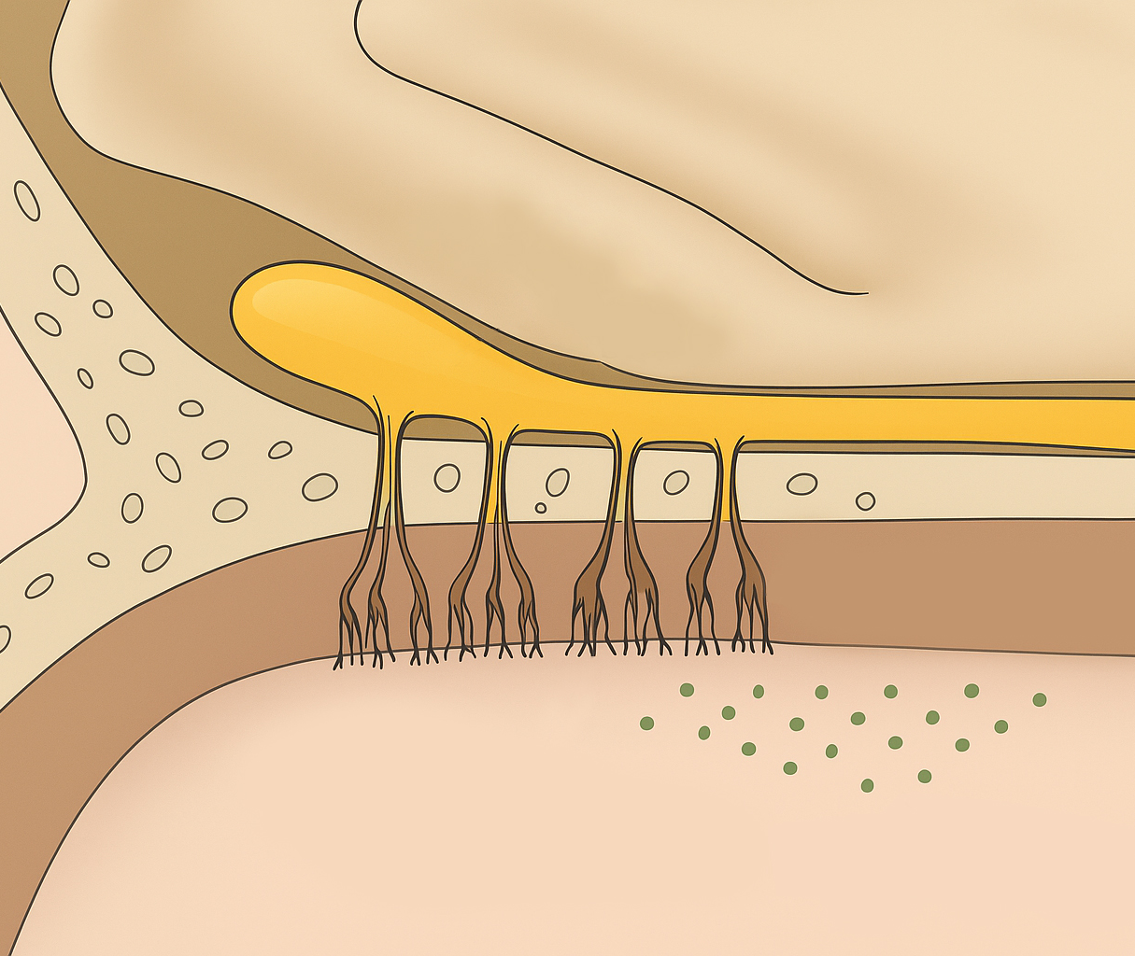

Sensory systems of the brain: the olfactory system
Fundamentals of neurobiology – Systems neuroscience
Olfaction, responsible for a sense of smell, is one of the two chemosensory processes; the other is gustation (taste)
The olfactory pathway
The olfactory epithelium in the nose contains specialized
sensory cells, the olfactory receptor neurons (ORNs)¹
ORNs have hair-like structures (cilia) projecting into the nasal cavity. These contain receptors that bind to airborne odorants,
and transduce olfactory signals into neural ones¹
ORN axons project to the olfactory bulb in the brain; the ORNs with the same odorant receptors converge in olfactory glomeruli¹
  The olfactory system is unique in that it initially bypasses the thalamus
  (a relay station for most other sensory systems)²
From the olfactory bulb, signals are transmitted through the olfactory tract to other brain regions, including the pyriform
cortex (the primary olfactory cortex, involved in odour
identification and in the cognitive aspects of olfaction), and the orbitofrontal cortex (integrating olfactory information with taste
for flavour perception)¹
The olfactory system¹
Olfactory bulb
Olfactory bulb
Cribriform plate
Cribriform plate
Olfactory epithelium
Nasal cavity
Olfactory nerve
Olfactory epithelium
Airborne odorants
Olfactory nerve
Olfactory receptors
Olfactory bulb
Olfactory tract
Olfactory bulb targets
Entorhinal cortex
Amygdala
Olfactory tubercle
Pyriform cortex
Hippocampal formation
Hypothalamus
Thalamus
Orbitofrontal cortex
ORN=olfactory receptor neuron
1. Augustine et al. Neuroscience, 7th edition. 2023; 2. Courtiol & Wilson. Front Neural Circuits 2015;9:49.
Notes:
Apart from the main olfactory pathway, many species also have an accessory olfactory pathway for the detection of pheromones: species- and gender-specific chemical cues that provide information about an individual’s social, sexual and reproductive status.³ The sensory structure for pheromone detection in mammals is the vomeronasal organ (VNO).³
Anatomical studies suggest that the VNO exists in adult humans, but it lacks sensory neurons and nerve bundles.³ The likely explanation for this phenomenon is that humans either do not detect pheromones and have developed other strategies for recognizing potential partners or attackers, or that they detect odours acting as pheromones in triggering behaviours involved in reproduction or aggression through the main olfactory pathway.³
References:
Augustine GJ, Groh JM, Huettel SA, et al. Neuroscience, 7th edition. Oxford University Press Academic US; 2023.
Courtiol E, Wilson DA. The olfactory thalamus: unanswered questions about the role of the mediodorsal thalamic nucleus in olfaction. Front Neural Circuits 2015; 9: 49.
Squire LR, Berg D, Bloom FE, et al. Fundamental Neuroscience, 4th edition. Elsevier S&T; 2012.

Slide 16
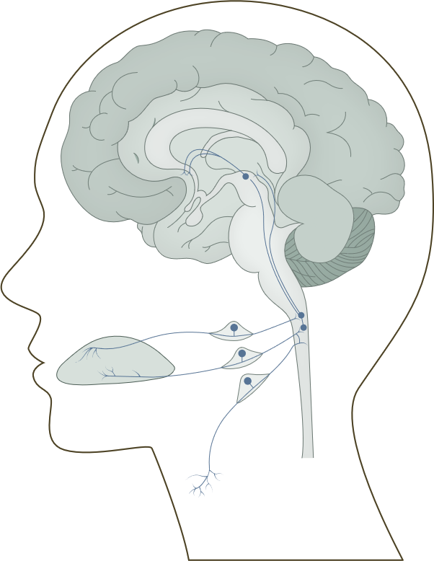
Sensory systems of the brain: the gustatory system
Fundamentals of neurobiology – Systems neuroscience
Gustation, responsible for a sense of taste, is one of the two chemosensory processes; the other is olfaction (smell)
The gustatory (taste) pathway
Tastants are detected by taste receptor cells, clustered in
taste buds; these are located primarily on the tongue, but also on the palate and throat
The basal end of taste cells touches the afferent fibres of gustatory sensory neurons, which transmit signals to the gustatory nucleus in the brainstem through cranial nerves VII, IX and X:
  A branch of the facial nerve (VII) called chorda tympani transmits signals from the front two-thirds of the tongue
  The glossopharyngeal nerve (IX) carries signals from the rest of the tongue
  The vagus nerve (X) transmits taste signals from the throat
From the gustatory end, the signals are relayed to the thalamus, and finally to the gustatory cortex in the insular and frontal operculum regions of the brain, where taste perception occurs
The gustatory (taste) system
Gustatory cortex (anterior insula
frontal operculum)
Ventral posterior medial nucleus of the thalamus
N VII
Nucleus of the solitary tract
Chorda tympani
Tongue
N IX
N X
Kandel et al. Principles of Neural Science, 6th edition. 2021
Notes:
The gustatory system is a specialized sensory system dedicated to evaluating potential food sources, and is the main driver of feeding decisions.¹ In contrast to the olfactory system, which can distinguish millions of kinds of odours, the gustatory system can only distinguish five basic taste qualities: sweet, salty, bitter, sour, and umami (the flavour associated with the ‘savoury’ taste of amino acids).¹ While limited, this taste palate is sufficient to meet all essential dietary requirements:
Sweet taste promotes the consumption of foods rich in energy;
Salty taste promotes a diet with correctly balanced electrolytes;
Bitter taste offers warning against the ingestion of toxic or otherwise noxious compounds;
Sour taste suggests the ingested food may not be fully ripe, or may be fermented;
Umami taste promotes sufficient intake of protein.¹
Taste is often used interchangeably with flavour.¹ However, while taste only refers to the five basic qualities recognized by the gustatory system, flavour is a result of the integration of multisensory inputs from gustatory, olfactory and somatosensory inputs.¹
Reference:
Kandel ER, Koester JD, Mack SH, Siegelbaum SA. Principles of Neural Science, 6th edition. McGraw-Hill Professional; 2021.

Slide 17
Sensory systems of the brain: the somatosensory system
Fundamentals of neurobiology – Systems neuroscience
The somatosensory system processes sensory information from specialized receptors in muscles, joint capsules, and the skin, allowing a person to have a sense of touch, temperature, pain, proprioception (awareness of body posture and movements), and helps regulate the function of major organ systems and the body’s internal state
Receptor types active in somatic processing | Modality
Cutaneous mechanoreceptors Meissner corpuscle Merkel disc receptor Pacinian corpuscle Ruffini ending, field receptors | Touch Stroking, flutter Pressure, texture Vibration Skin stretch
Musculoskeletal mechanoreceptors Muscle spindle (primary and secondary) Golgi tendon organ Joint capsule receptors Stretch-sensitive free endings | Proprioception Muscle length, speed, and stretch Muscle contraction Joint angle Excess stretch or force
Thermoreceptors Cool receptors Warm receptors Heat nociceptors Cold nociceptors | Temperature Skin cooling (<25°C) Skin warming (>35°C) Hot temperature (>45°C) Cold temperature (<5°C)
Nociceptors Mechanical Thermal-mechanical (heat or cold) Polymodal (activated by noxious mechanical, thermal or chemical stimuli, or by visceral distension or swelling) | Pain Sharp, pricking pain Burning pain or freezing pain Dull, burning pain
Kandel et al. Principles of Neural Science, 6th edition. 2021
Notes:
The primary sensory cells of the somatosensory system are the dorsal root ganglion (DRG) neurons.¹ Individual neurons within a DRG respond selectively to specific types of stimuli because of specific morphological and molecular features of their peripheral terminals.¹
When a mechanical, thermal or chemical stimulus is registered by its corresponding somatosensory receptor in the skin, muscle or viscera, it is converted into a depolarizing receptor potential and subsequently a stream of action potentials, which travel down the peripheral nerve fibre from the distal terminal of the DRG neuron to its cell body, contained within a ganglion on the dorsal root of a spinal or a cranial nerve, adjacent to the spinal cord or brainstem.¹
Peripheral nerve fibres are divided into four functional groups based on their axon diameter and myelination, conduction velocity, and whether they are sensory or motor in nature (sensory fibres from muscle [Group I-IV] are classified based on their diameter from large to small, whereas sensory fibres from the skin [Aα, Aβ, Aδ, or C] are classified by conduction velocity from high to low).¹ Group I/Aα fibres innervate primary muscle spindle receptors and Golgi tendon organs, Group II/Aβ fibres innervate secondary spindle endings and receptors in joint capsules, and Groups III/Aδ and IV/C signal thermal or painful stimuli.¹
Reference:
Kandel ER, Koester JD, Mack SH, Siegelbaum SA. Principles of Neural Science, 6th edition. McGraw-Hill Professional; 2021.

Slide 18


Sensory systems of the brain: the somatosensory pathway (I)
Fundamentals of neurobiology – Systems neuroscience
Somatosensory information is carried via the peripheral nerves to the CNS through distinct pathways:
The dorsal column–medial lemniscal pathway
transmits information about touch, pressure,
vibration, and proprioception:^{1,2}
Primary somatosensory cortex
Ventral posterior lateral and
medial nuclei of the thalamus
Decussation (crossing over
to the opposite side) and
ascension via the medial lemniscus
Gracile and cuneate nuclei in
the medulla
Dorsal column of the spinal cord
Mechanoreceptor/proprioceptor
Primary somatosensory cortex
Dorsal anterior insular cortex
Ventral posterior lateral and medial nuclei
Midbrain
Medial lemniscus
The anterolateral (spinothalamic) pathway
transmits information about pain, temperature,
itch, crude touch, and viscera:^{1,2}
Primary somatosensory cortex and
dorsal anterior insular cortex
Ventral posterior lateral and medial
nuclei of the thalamus
Crossing over to the opposite side of
the spinal cord and ascension via the spinothalamic tract
Dorsal horn of the spinal cord
Nociceptor/thermoreceptor
The anterolateral (spinothalamic) pathway
Pons
Direction of signal travel
Dorsal column–medial lemniscal pathway
Medulla
Gracile nuclei
Dorsal horn of the spinal cord
Medulla
Cuneate nuclei
Direction of signal travel
Dorsal root ganglion cells
Sensory decussation
Spinal cord
CNS=central nervous system
1. Kandel et al. Principles of Neural Science, 6th edition. 2021; 2. Augustine et al. Neuroscience, 7th edition. 2023
Mechanoreceptor
Thermoreceptor/nociceptor
Notes:
References:
Kandel ER, Koester JD, Mack SH, Siegelbaum SA. Principles of Neural Science, 6th edition. McGraw-Hill Professional; 2021.
Augustine GJ, Groh JM, Huettel SA, et al. Neuroscience, 7th edition. Oxford University Press Academic US; 2023.

Slide 19
Sensory systems of the brain: the somatosensory pathway (II)
Fundamentals of neurobiology – Systems neuroscience
Somatosensory cortex and processing
Sensory information coming from the thalamus is mostly processed in the somatosensory cortex in the postcentral gyrus of the parietal lobe:¹
The primary somatosensory cortex (S1) has a precise, topographically organized representation of the body
(a somatotopic map)¹
The secondary somatosensory cortex (S2) integrates information from S1 and other areas involved in tactile perception and contributes to tactile learning and memory¹
Other cortical regions (e.g., the posterior parietal cortex) further integrate somatosensory information with visual or motor signals, contributing to spatial awareness/coordination^{1,2}
Somatosensory system dysfunctions can lead to conditions such as:
Neuropathy (damage to peripheral nerves manifesting as numbness or tingling)²
Phantom limb (sensation or pain in an amputated limb due to abnormal reorganization of cortical areas representing the limb)¹
Somatosensory agnosia, also known as astereognosis (a loss of ability to recognize objects by touch)³
1. Augustine et al. Neuroscience, 7th edition. 2023; 2. Kandel et al. Principles of Neural Science, 6th edition. 2021; 3. Gottfried. Neurobiology of Sensation and Reward. 2011
Notes:
An important source of information about the function of different neural structures, including the posterior parietal cortex, are studies of naturally occurring or experimental lesions, which have demonstrated the crucial role of the parietal cortex in linking sensory information to motor actions.² The parietal lobe extracts sensory information about the external world and the person’s own body for the planning and guidance of movements.² Accordingly, people with lesions affecting certain parts of the parietal lobe may for example struggle with directing their arm and hand accurately to the location of objects in space, and with shaping the orientation and grip aperture of their hand before grasping the object in question.² They may also be unable to make rapid adjustments to their ongoing reach and grasping for the object in response to the object suddenly changing location or orientation.²
It is important to note that effects of lesions to specific regions of the brain should be interpreted with caution, as it may be incorrect to conclude a specific function is directed solely by a single region, or that the region in question only performs that function.² In addition, the adverse impact of an injury to a specific neural structure can be masked or adjusted by compensatory mechanisms in the remaining, uninjured structures.²
References:
Augustine GJ, Groh JM, Huettel SA, et al. Neuroscience, 7th edition. Oxford University Press Academic US; 2023.
Kandel ER, Koester JD, Mack SH, Siegelbaum SA. Principles of Neural Science, 6th edition. McGraw-Hill Professional; 2021.
Gottfried JA. Neurobiology of sensation and reward. CRC Press / Taylor & Francis; 2011.

Slide 20
Motor systems

Slide 21
Motor systems
Fundamentals of neurobiology – Systems neuroscience
The motor systems control and coordinate voluntary and involuntary movements of the body
They involve several regions of the brain, spinal cord, peripheral nerves, and muscles, which all work together to produce the coordinated movement of skeletal muscles, the autonomic activity of the cardiac muscle and the visceral smooth muscles, and glandular secretions
Neural structures involved in the control of movement
BASAL GANGLIA
Initiation of intended movement and suppression of unwanted movement
DESCENDING SYSTEMS
Upper motor neurons
*
Motor cortex
Planning, initiating, and directing voluntary movements
CEREBELLUM
Coordination of ongoing movement
*
Brainstem centres
Stereotyped movements, postural control, and gain adjustments
Motor neuron pools
Lower motor neurons
Local circuit neurons
Sensorimotor integration and central pattern generation
Spinal cord and brainstem circuits
Augustine et al. Neuroscience, 7th edition. 2023
Skeletal muscles
Sensory inputs
Notes:
*The connections between the basal ganglia, cerebellum and descending motor systems are indirect and functionally bidirectional. Connections are organized in a loop involving the thalamus rather than simple back-and-forth wiring.¹
Reference:
Augustine GJ, Groh JM, Huettel SA, et al. Neuroscience, 7th edition. Oxford University Press Academic US; 2023.

Slide 22
The upper and lower motor neurons of the motor systems
Fundamentals of neurobiology – Systems neuroscience
Upper and lower motor neurons³
  Upper motor neurons (UMNs) originate in the cerebral cortex (the primary motor cortex, premotor cortex, and supplemental motor areas) and in brainstem motor centres, and are involved in initiating and modulating voluntary movements¹⁻⁵
    Axons of the UMNs descend and synapse either directly with lower motor neurons (LMNs), or via interneurons in the
    spinal cord^{2,4}
  LMNs are located in the brainstem (where somatic MN, parasympathetic visceral MN and branchial MN contribute to the cranial nerves innervating the muscles of the face and neck), and in the spinal cord (which contains sympathetic and parasympathetic visceral MN, and spinal somatic MN, innervating skeletal muscles)^{1,2}
    LMNs receive inputs from the UMNs, sensory neurons,
    and interneurons^{1,3}
    Commands are relayed from the LMNs to the muscles
    to initiate movement²
    LMNs also play a role in the reflex arc²
Primary motor cortex
Upper motor neuron
Lower motor neuron
Muscle fiber
This work is from ‘Mechanisms of different motor neurons in the occurrence of spasticity after spinal cord injury: A narrative review’ by Gong et al., used under CC-BY. This work is licensed under Creative Commons license CC-BY-SA by The Lundbeck Foundation.
LMN=lower motor neuron; MN=motor neuron; UMN=upper motor neuron
1. Stifani. Front Cell Neurosci 2014;8:293; 2. Zayia & Tadi. Neuroanatomy, motor neuron. StatPearls [internet]. July 2023; 3. Gong et al. Int J Mol Sci 2025;26(11):5162;
4. Lohia & McKenzie. Neuroanatomy, pyramidal tract lesions. StatPearls [internet]. July 2023; 5. Augustine et al. Neuroscience, 7th edition. 2023
Notes:
References:
Stifani N. Motor neurons and the generation of spinal motor neuron diversity. Front Cell Neurosci 2014; 8: 293.
Gong H, Zhang Z, Duan Z, et al. Mechanisms of different motor neurons in the occurrence of spasticity after spinal cord injury: A narrative review. Int J Mol Sci 2025; 26 (11): 5162.
Zayia LC, Tadi P. Neuroanatomy, motor neuron. StatPearls [internet]. July 2023. Accessed September 2025.
Lohia A, McKenzie J. Neuroanatomy, pyramidal tract lesions. StatPearls [internet]. July 2023. Accessed September 2025.
Augustine GJ, Groh JM, Huettel SA, et al. Neuroscience, 7th edition. Oxford University Press Academic US; 2023.

Slide 23
Principal descending pathways of the motor system
Fundamentals of neurobiology – Systems neuroscience
Efferent (descending) neurons originate from the brain and brainstem and project their axons down the spinal cord¹
The major descending pathway responsible for controlling voluntary movement is the corticospinal (pyramidal) tract (CST), originating in the motor cortex^{1,2}
CST
The lateral CST controls the distal muscles in limbs and digits (gross and fine motor control),^{2,3} while the anterior CST controls axial and proximal limb movement, involved in posture⁴
Corticobulbar tract
Controls voluntary movements of the face, head, and neck through cranial nerves^{2,3}
Rubrospinal tract
Involved in regulation of flexor and extensor muscles of the limbs²
Involuntary/automatic control of muscle tone is controlled by motor pathways outside the CST, which form the extrapyramidal system:⁵
Reticulospinal tract
Involved in multiple aspects of motor control, including posture and orientation²
Vestibulospinal tract
Involved in maintaining balance, adjusting posture, and stabilizing the position of the head^{1,2}
Tectospinal
tract
Controls head movements in response to visual stimuli^{2,5}
CST=corticospinal (pyramidal) tract
1. Siebert et al. ASN Neuro 2025;17(1):2440299; 2. Knierim. Spinal reflexes and descending motor pathways. In: Neuroscience Online. Available at: https://nba.uth.tmc.edu/neuroscience/;
3. AbuHasan & Munakomi. Neuroanatomy, pyramidal tract. StatPearls [internet]. July 2023; 4. Zayia & Tadi. Neuroanatomy, motor neuron. StatPearls [internet]. July 2023;
5. Lee & Muzio. Extrapyramidal system. StatPearls [internet]. November 2022
Notes:
References:
Siebert JR, Kennedy K, Osterhout DJ. Neurons are not all the same: diversity in neuronal populations and their intrinsic responses to spinal cord injury. ASN Neuro 2025; 17 (1): 2440299.
Knierim K. Chapter 2: Spinal reflexes and descending motor pathways. In: Neuroscience Online. August 2025. Available at: https://nba.uth.tmc.edu/neuroscience/. Accessed September 2025.
AbuHasan Q, Munakomi S. Neuroanatomy, pyramidal tract. StatPearls [internet]. July 2023. Accessed September 2025.
Zayia LC, Tadi P. Neuroanatomy, motor neuron. StatPearls [internet]. July 2023. Accessed September 2025.
Lee J, Muzio MR. Neuroanatomy, extrapyramidal system. StatPearls [internet]. November 2022. Accessed September 2025.

Slide 24
The basal ganglia
Fundamentals of neurobiology – Systems neuroscience
The basal ganglia include the striatum (composed of the caudate nucleus, putamen, and nucleus accumbens), substantia nigra, globus pallidus, and subthalamic nucleus¹
The basal ganglia process sensory and motor inputs from the cortex, modulating the activity of the thalamus, which in turn projects back to the cortex²
The basal ganglia provide input to spinal circuits via the motor cortex and the brainstem to regulate the initiation or inhibition of voluntary movements;^{3,4} they also play a central role in motor learning and the suppression of unwanted movements^{1,3}
Dysfunction in the basal ganglia can lead to movement disorders, such as Parkinson’s disease (characterized by tremors, rigidity, and bradykinesia) and Huntington’s disease (characterized by involuntary movements)^{1,4}
The basal ganglia circuitry⁵
Cortex
Striatum
D₁
D₂
Thalamus
GPe
STN
Dopamine
GABA
SNc
GPi/SNr
Glutamate
D=dopamine; GABA=γ-aminobutyric acid; GPe=globus pallidus externus; GPi=globus pallidus internus; SNc=substantia nigra pars compacta; SNr=substantia nigra pars reticulata; STN=subthalamic nucleus
1. Rocha et al. Front Syst Neurosci 2023;17:1242929; 2. Asan et al. Front Neurosci 2022;15:791824; 3. Young et al. Neuroanatomy, basal ganglia. StatPearls [internet]. July 2023;
4. Knierim. Basal ganglia. In: Neuroscience Online. Available at: https://nba.uth.tmc.edu/neuroscience; 5. Kandel et al. Principles of Neural Science, 6th edition. 2021
Notes:
Apart from the motor cortex and the thalamus, basal ganglia also project to a wide range of areas in the brainstem and, via the thalamus, to non-motor areas of the cortex and the limbic system.⁵ The basal ganglia contribute to a variety of cognitive, motivational and affective operations through selecting between incompatible cognitive representations, motivational goals, or sensorimotor options, and mediating reinforcement learning.⁵ The intrinsic circuits in the basal ganglia nuclei are similar across the limbic, associative, and sensorimotor regions, suggesting that similar computational processes are applied to inputs from multiple different sources.⁵
References:
Rocha GS, Freire MAM, Britto AM, et al. Basal ganglia for beginners: the basic concepts you need to know and their role in movement control. Front Syst Neurosci 2023; 17: 1242929.
Asan AS, McIntosh JR, Carmel JB. Targeting sensory and motor integration for recovery of movement after CNS injury. Front Neurosci 2022; 15: 791824.
Young CB, Reddy V, Sonne J. Neuroanatomy, basal ganglia. StatPearls [internet]. July 2023. Accessed September 2025.
Knierim J. Chapter 4: Basal ganglia. In: Neuroscience Online. Available at: https://nba.uth.tmc.edu/neuroscience. Accessed September 2025.
Kandel ER, Koester JD, Mack SH, Siegelbaum SA. Principles of Neural Science, 6th edition. McGraw-Hill Professional; 2021.

Slide 25
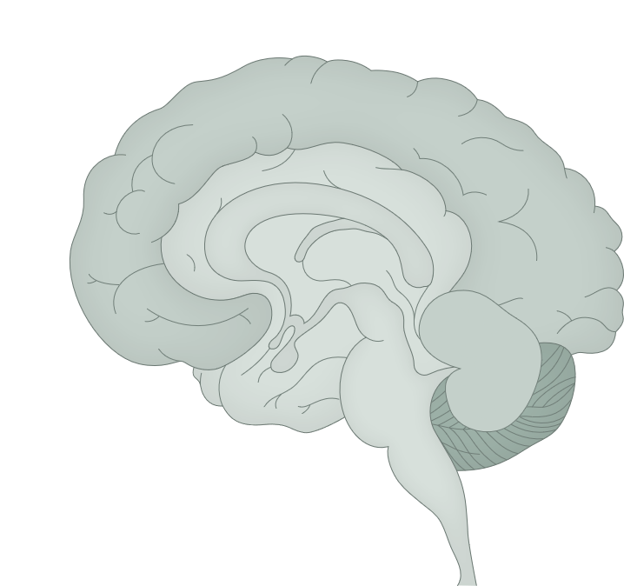
The cerebellum
Fundamentals of neurobiology – Systems neuroscience
Signalling pathways of the cerebellum⁴
The cerebellum is responsible for fine-tuning motor activities and adjusting ongoing movements, and plays a role in maintaining balance and posture, coordinating voluntary movements (e.g., gait), and motor learning¹⁻³
It receives sensory input from the body (muscles, tendons, and joints) and motor input from the cerebral cortex^{1,3}
The cerebellum also receives information concerning balance from the vestibular system³
Damage to the cerebellum can result in ataxia (problems with fine movements, impaired coordination and balance)^{2,3}
Neocortex
Thalamic nuclei
Deep nuclei
Pontine nuclei
Cerebellar cortex
The interaction between the cerebrum and the cerebellum occurs through reciprocal connections between specific cerebral and cerebellar areas. Purkinje cells in the cerebellar cortex project to areas in the neocortex through the cerebellar nuclei and the thalamus; the neocortex in turn projects back to the original cerebellar area through the pontine nuclei.
This work is from ‘Cerebellar coordination of neuronal communication in cerebral cortex’ by McAfee et al., used under CC-BY. This work is licensed under Creative Commons license CC-BY-SA by The Lundbeck Foundation.
1. Knierim. Cerebellum. In: Neuroscience Online. Available at: https://nba.uth.tmc.edu/neuroscience; 2. Amore et al. Front Syst Neurosci 2021;15:646052;
3. Jimsheleishvili & Dididze. Neuroanatomy, cerebellum. StatPearls [internet]. July 2023; 4. McAfee et al. Front Syst Neurosci 2022;15:781527
Notes:
The cerebellum represents only 10% of the total volume of the brain, but contains over 50% of the brain’s neurons.⁵ The cerebellar cortex is composed of multiple units that are highly repetitive and regular in their structure and contain the same basic microcircuits, with different cerebellar regions receiving projections from distinct brain and spinal structures and then projecting back to the neocortex.⁵ The uniformity of cerebellar architecture and physiology suggests that different regions of the cerebellum perform similar computational tasks on varying inputs.⁵
The physiological function of the cerebellum is underpinned by the following key principles:⁵
The cerebellum acts prior to sensory feedback arising from movement, and therefore provides feedforward control of muscular contractions
For achieving this control, the cerebellum relies on internal body models to process and compare sensory inputs with copies of motor commands
The cerebellum is key for motor and perceptual timing, and for adapting and learning motor skills
The cerebellum of primates is deeply interconnected with non-motor areas of the cerebral cortex, likely performing similar actions in the execution and learning of motor and non-motor behaviours
References:
Knierim J. Chapter 5: Cerebellum. In: Neuroscience Online. Available at: https://nba.uth.tmc.edu/neuroscience. Accessed September 2025.
Amore G, Spoto G, Ieni A, et al. A focus on the cerebellum: From embryogenesis to an age-related clinical perspective. Front Syst Neurosci 2021 15: 646052.
Jimsheleishvili S, Dididze M. Neuroanatomy, cerebellum. StatPearls [internet]. July 2023. Accessed September 2025.
McAfee SS, Liu Y, Sillitoe RV, Heck DH. Cerebellar coordination of neuronal communication in cerebral cortex. Front Syst Neurosci 2022; 15: 781527.
Kandel ER, Koester JD, Mack SH, Siegelbaum SA. Principles of Neural Science, 6th edition. McGraw-Hill Professional; 2021.

Slide 26
Types of motor neuron
Fundamentals of neurobiology – Systems neuroscience
Alpha motor neurons innervate skeletal muscle fibres, leading to muscle contraction¹⁻³
  They are lower motor neurons and form the final pathway in the motor systems for producing voluntary movement⁴
  Alpha neurons may also receive innervation directly from sensory neurons, enabling spinal reflexes²
Gamma motor neurons control muscle spindle sensitivity, which helps regulate muscle tone and proprioception, and they are key for executing movement and maintaining balance and posture^{1,2,5,6}
  They also maintain the equilibrium between muscle contraction and relaxation¹
  They modulate the activity of stretch reflexes^{1,5}
Precise coordination between alpha and gamma motor neurons is required for neuromechanical efficiency during the execution of movements¹
Muscle innervation²
Alpha motor neuron
Gamma motor neuron
Sensory neurons
MS
OC
IF
EF
This work is from ‘Motor neurons and the generation of spinal motor neuron diversity’ by Stifani, used under CC-BY. This work is licensed under Creative Commons license CC-BY-SA by The Lundbeck Foundation.
EF=extrafusal fibres; IF=intrafusal fibres; MS=muscle spindle; OC=outer capsule
1. Gong et al. Int J Mol Sci 2025;26(11):5162; 2. Stifani. Front Cell Neurosci 2014;8:293;
3. Hedges. Spinal motor control and proprioception. In: Introduction to Neuroscience. Available at: https://openbooks.lib.msu.edu/introneuroscience1/;
4. Augustine et al. Neuroscience, 7th edition. 2023; 5. Ganguly et al. Toxins 2021;13(4):282; 6. Tuthill & Azim. Curr Biol 2018;28(5):R194‒R203
Notes:
References:
Gong H, Zhang Z, Duan Z, et al. Mechanisms of different motor neurons in the occurrence of spasticity after spinal cord injury: A narrative review. Int J Mol Sci 2025; 26 (11): 5162.
Stifani N. Motor neurons and the generation of spinal motor neuron diversity. Front Cell Neurosci 2014; 8: 293.
Hedges. Spinal motor control and proprioception. In: Introduction to Neuroscience. Available at: https://openbooks.lib.msu.edu/introneuroscience1/. Accessed September 2025.
Augustine GJ, Groh JM, Huettel SA, et al. Neuroscience, 7th edition. Oxford University Press Academic US; 2023.
Ganguly J, Kulshreshtha D, Almotiri M, Jog M. Muscle tone physiology and abnormalities. Toxins 2021; 13 (4): 282.
Tuthill JC, Azim E. Proprioception. Curr Biol 2018; 28 (5): R194‒R203.

Slide 27
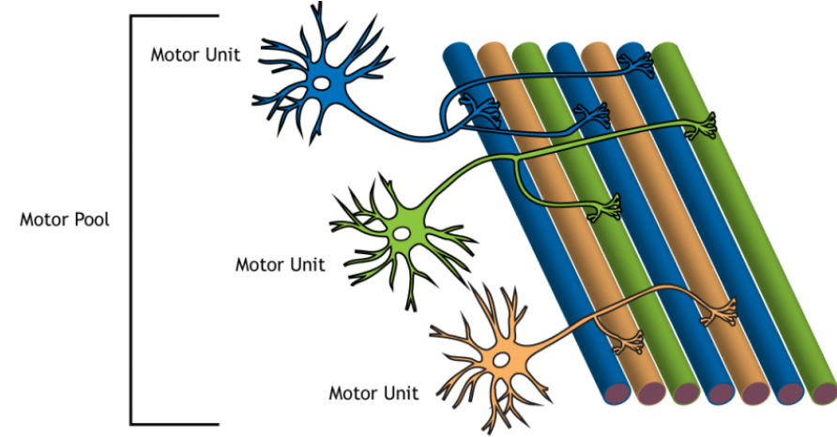
Motor units
Fundamentals of neurobiology – Systems neuroscience
The multiple branches of each alpha motor neuron can innervate several fibres within one muscle
A motor neuron and all the muscle fibres it innervates are known as a motor unit
  The muscle fibres within a single motor unit are typically spread throughout the whole muscle to spread contractions
  Muscles are protected from fatigue by the asynchronous contraction of individual motor units
  A graded contraction of a muscle is achieved by activating different numbers of motor units
Motor units vary in size:
  Small motor units innervate fewer muscle fibres and control fine movements, e.g., in the eyes and fingers
  Large motor units innervate many muscle fibres and are generally found in weight-bearing muscles, e.g., those of the thighs
  Recruitment of different motor units allows the generation of appropriate muscle tension to move a load – increasingly larger motor units are recruited to lift heavier loads
The group of motor neurons that innervate all the fibres within a single muscle is known as a motor pool
A motor pool of a muscle is formed by a group of motor units innervating all the muscle fibres in that muscle
Motor unit
Motor pool
Motor unit
Motor unit
This work is from ‘Introduction to Neuroscience’ by Hedges, used under CC-NC-BY.
This work is licensed under Creative Commons license CC-NC-BY-SA by The Lundbeck Foundation.
Hedges. Spinal motor control and proprioception. In: Introduction to Neuroscience. Available at: https://openbooks.lib.msu.edu/introneuroscience1/
Notes:
When a peripheral nerve is damaged or destroyed, the muscles innervated by that nerve immediately become paralyzed, and gradually start wasting away (atrophy).² Since peripheral nerves carry sensory as well as motor fibres, sensation in the area innervated by the nerve is also lost, along with tendon reflexes.²
References:
Hedges V. Chapter 40: Spinal motor control and proprioception. In: Introduction to Neuroscience. Available at: https://openbooks.lib.msu.edu/introneuroscience1. Accessed September 2025.
Kandel ER, Koester JD, Mack SH, Siegelbaum SA. Principles of Neural Science, 6th edition. McGraw-Hill Professional; 2021.

Slide 28
Types of motor units
Fundamentals of neurobiology – Systems neuroscience
Slow motor units
Slow to contract
Generate less force
Can work for a long time and are used in endurance exercise
Fast
fatigue-resistant motor units
Quick to contract but slower than fast fatiguable motor units
Generate more force than slow motor units
More resistant to fatigue than fast fatiguable motor units
Fast fatiguable motor units
The fastest motor unit to contract
Generate the most force
More prone to fatigue
Typically involved in high intensity exercise
Hedges. Spinal motor control and proprioception. In: Introduction to Neuroscience. Available at: https://openbooks.lib.msu.edu/introneuroscience1/
Notes:
Reference:
Hedges V. Chapter 40: Spinal motor control and proprioception. In: Introduction to Neuroscience. Available at: https://openbooks.lib.msu.edu/introneuroscience1. Accessed September 2025.

Slide 29
The spinal cord in motor control
Fundamentals of neurobiology – Systems neuroscience
The spinal cord plays a crucial role as a conduit for motor information travelling from the key motor centres in the brain via pathways involving the basal ganglia, the cerebellum and the brainstem to the body, and as a centre for reflexes, e.g., the stretch reflex
The spinal cord receives input from neurons projecting from the primary motor cortex, premotor cortex, and other cortical regions:
  Directly, via the corticospinal tract
  Indirectly, via projections from the brainstem
The spinal cord also contains local circuits (central pattern generators, CPGs) capable of fully controlling the timing and coordination of rhythmic movements (e.g., locomotion or swimming) in the absence of descending input from the brain
  The activity of spinal CPGs can, however, be modulated by descending input from the brain to initiate and govern locomotion or change gait
CPG=central pattern generator
Augustine et al. Neuroscience, 7th edition. 2023
Notes:
Reference:
Augustine GJ, Groh JM, Huettel SA, et al. Neuroscience, 7th edition. Oxford University Press Academic US; 2023.

Slide 30
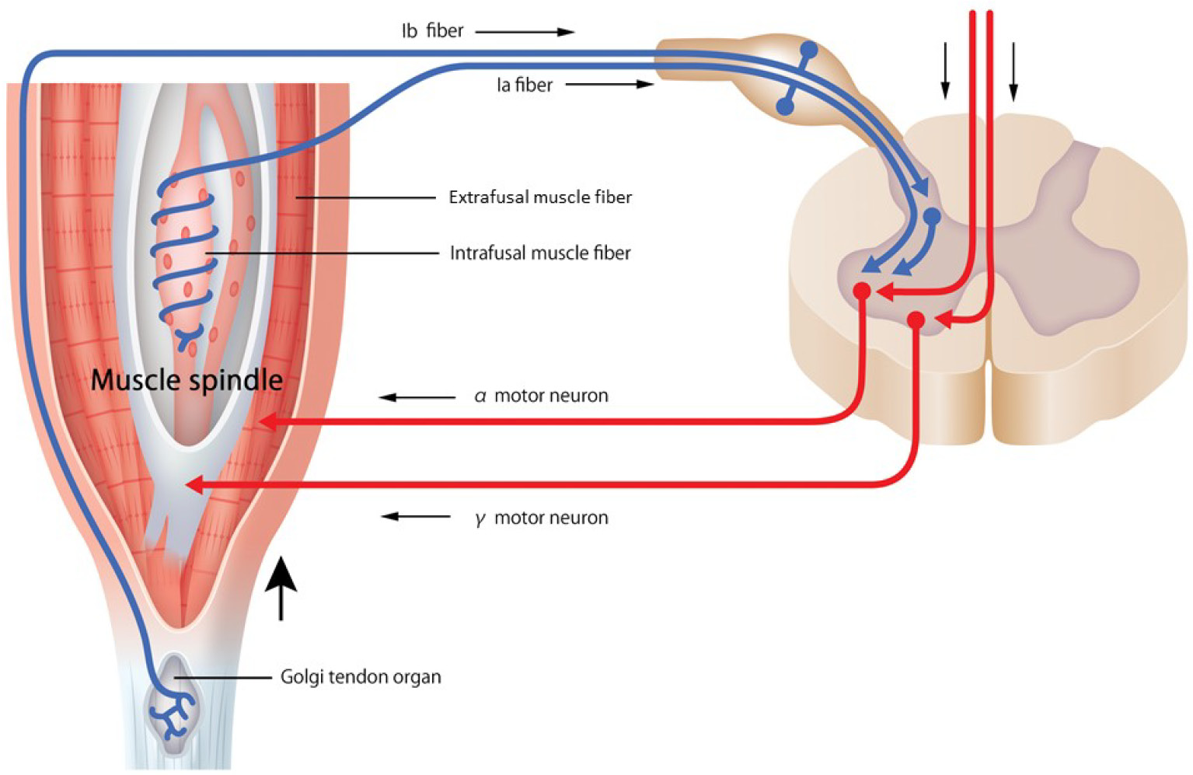
Proprioception and sensory feedback
Fundamentals of neurobiology – Systems neuroscience
Controlled movement relies on sensory feedback, particularly proprioception (the sense of body position in space and movement)¹
Sensory information from muscles, tendons, and joints is constantly fed back to the CNS, allowing the motor system to adjust movements in real time for precision, balance and coordination¹
Proprioceptors provide information to the brain regarding body positioning and movement:¹
  Muscle spindles (fibrous capsules within the muscles) measure muscle stretch (length)
  Golgi tendon organs (located between the outer muscle fibres and their points of attachment at the bones) measure muscle tension
Proprioception and sensory feedback²
This work is from Sakai et al. Spine Surg Relat Res 2022, licensed under CC BY-NC-ND. Published by Spine Surgery and Related Research on behalf of The Japanese Society for Spine Surgery and Related Research. The work cannot be changed in any way or used commercially without permission from the journal. https://www.jstage.jst.go.jp/article/ssrr/6/5/6_2021-0269/_article
CNS=central nervous system
1. Hedges. Spinal motor control and proprioception. In: Introduction to Neuroscience. Available at: https://openbooks.lib.msu.edu/introneuroscience1/;
2. Sakai et al. Spine Surg Relat Res 2022;6(5):422‒432
Notes:
For additional information about the integration of input from the sensory and motor systems for successful motor control, please see slide 20 and its slide notes.
References:
Hedges V. Spinal motor control and proprioception. In: Introduction to Neuroscience. Available at: https://openbooks.lib.msu.edu/introneuroscience1/. Accessed September 2025.
Sakai Y, Watanabe T, Wakao N, et al. Proprioception and geriatric low back pain. Spine Surg Relat Res 2022; 6 (5): 422‒432.

Slide 31
Associational systems

Slide 32
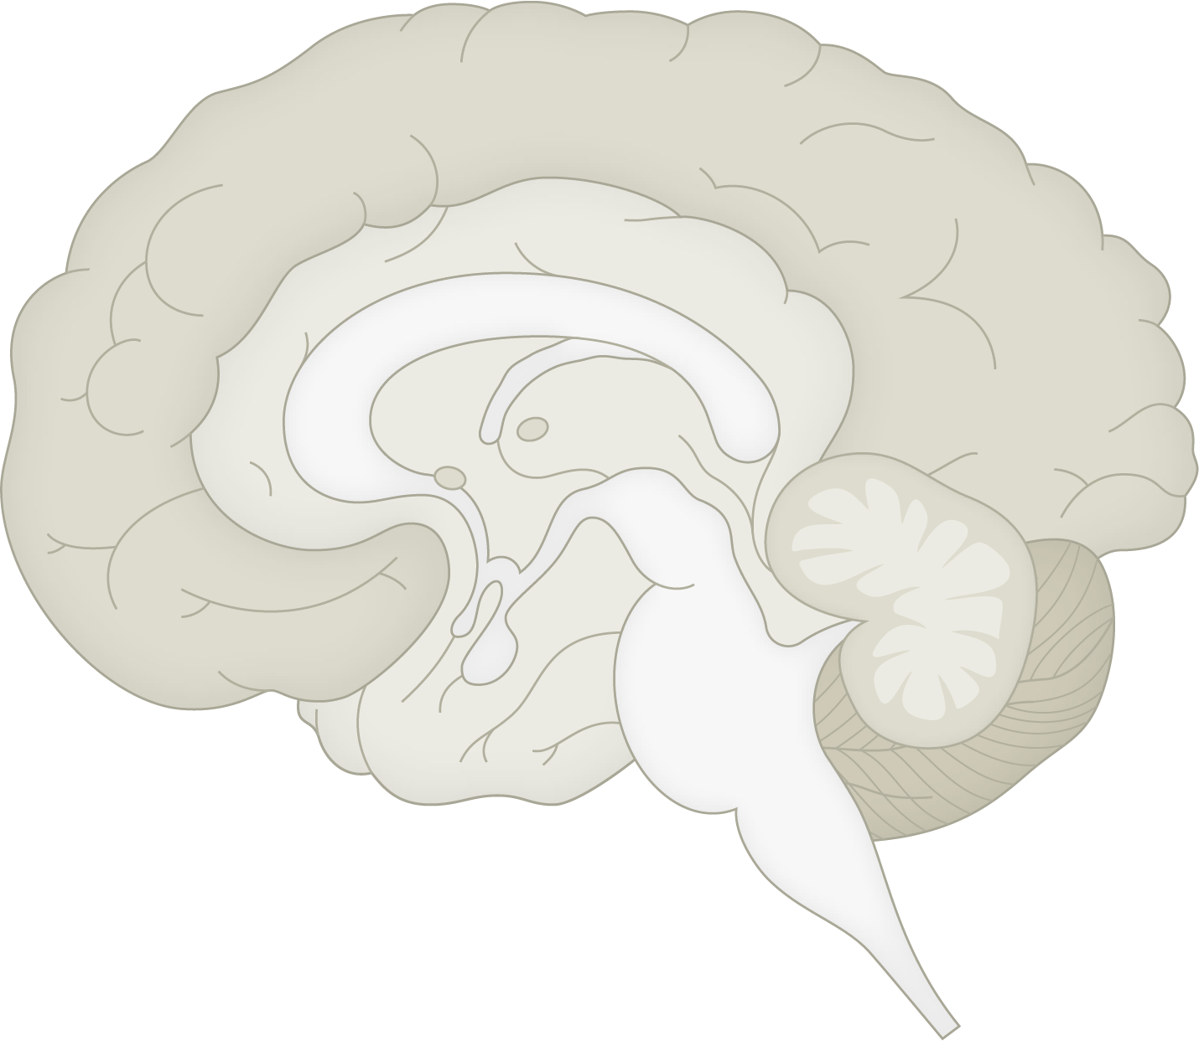
The limbic system
Fundamentals of neurobiology – Systems neuroscience
Structures of the limbic system⁷
There is no single, universally agreed and distinct definition of the limbic system;¹ it is a complex set of connected structures in the brain that plays a key role in:^{2,3}
  Regulating emotional responses
  Forming and processing emotional memories
  Learning, attention, decision making
  Certain aspects of behaviour, e.g., motivation
  Regulation of autonomic and neuroendocrine functions
The limbic system influences behaviour tied to survival, such as feeding, reproduction, and responses to threats³⁻⁵
Disruption of the limbic system may play a role in disorders like anxiety, depression, and post-traumatic stress disorder, due to altered emotional responses^{2,6}
Cingulate gyrus
Fornix
Hypothalamus
Thalamus
Septum
Olfactory bulb
Amygdala
Mammillary body
Hippocampus
This work is from ‘Neuroanatomical abnormalities in chronic tinnitus in the human brain’ by Adjamian et al., used under CC-BY. This work is licensed under Creative Commons license
CC-BY-SA by The Lundbeck Foundation.
1. Rolls. Cortex 2015;62:119–157; 2. Song. Biomed Pharmacother 2023;162:114647;
3. Jones et al. Neurogastroenterol Motil 2006;18(2):91‒103; 4. Stover et al. J Intern Med 2023;294(5):582‒604; 5. Yang et al. Cell Mol Life Sci 2018;75(12):2197‒2210;
6. Liberati & Perrotta. Ibrain 2024;10(1):46‒58; 7. Adjamian et al. Neurosci Biobehav Rev 2014;45:119‒133
Notes:
References:
Rolls ET. Limbic systems for emotion and for memory, but no single limbic system. Cortex 2015; 62: 119–157.
Song J. Amygdala activity and amygdala-hippocampus connectivity: Metabolic diseases, dementia, and neuropsychiatric issues. Biomed Pharmacother 2023; 162: 114647.
Jones MP, Dilley JB, Drossman D, Crowell MD. Brain–gut connections in functional GI disorders: anatomic and physiologic relationships. Neurogastroenterol Motil 2006; 18 (2): 91‒103.
Stover PJ, Field MS, Andermann ML, et al. Neurobiology of eating behavior, nutrition, and health. J Intern Med 2023; 294 (5): 582‒604.
Yang L, Comninos WS, Dhillo WS. Intrinsic links among, sex, emotion, and reproduction. Cell Mol Life Sci 2018; 75 (12): 2197‒2210.
Liberati AS, Perrotta G. Neuroanatomical and functional correlates in post-traumatic stress disorder: A narrative review. Ibrain 2024; 10 (1): 46‒58.
Adjamian P, Hall DA, Palmer AR, et al. Neuroanatomical abnormalities in chronic tinnitus in the human brain. Neurosci Biobehav Rev 2014; 45: 119‒133.

Slide 33
The limbic system: key structures and their roles
Fundamentals of neurobiology – Systems neuroscience
Region | Associated with
Amygdala | Processing emotions¹ Emotional memory¹ Threat recognition/fear^{1,2} Fight-or-flight response³
Hippocampus | Forming long-term memories¹ Spatial memory^{1,4}
Thalamus | Sensory information transfer⁵ Regulation of consciousness and alertness⁵
Hypothalamus | Homeostasis – hunger/satiety, thirst, temperature, circadian rhythms⁶
Cingulate gyrus | Emotion formation⁴ Pain⁷ Learning, memory^{4,8} Error detection⁷
Basal ganglia | Movement control⁹ Reward and cognition⁹
Fornix | Communication between the hippocampus and other parts of the limbic system⁴
1. Song. Biomed Pharmacother 2023;162:114647; 2. Jones et al. Neurogastroenterol Motil 2006;18(2):91‒103; 3. Šimić et al. Biomolecules 2021;11(6):823;
4. Torrico & Abdijadid. Neuroanatomy, limbic system. StatPearls [internet]. July 2023; 5. Torrico & Munakomi. Neuroanatomy, thalamus. StatPearls [internet]. July 2023;
6. Goel et al. Ann Neurosci 2025;32(2):128‒142; 7. Posner et al. Cogn Affect Behav Neurosci 2007;7(4):391‒395; 8. Augustine et al. Neuroscience, 7th edition. 2023;
9. Young et al. Basal ganglia. StatPearls [internet]. July 2023
Notes:
References:
Song J. Amygdala activity and amygdala-hippocampus connectivity: Metabolic diseases, dementia, and neuropsychiatric issues. Biomed Pharmacother 2023; 162: 114647.
Jones MP, Dilley JB, Drossman D, Crowell MD. Brain–gut connections in functional GI disorders: anatomic and physiologic relationships. Neurogastroenterol Motil 2006; 18 (2): 91‒103.
Šimić G, Tkalcic M, Vukic V, et al. Understanding emotions: Origins and roles of the amygdala. Biomolecules 2021; 11 (6): 823.
Torrico TJ, Abdijadid S. Neuroanatomy, limbic system. StatPearls [internet]. July 2023. Accessed September 2025.
Torrico TJ, Munakomi S. Neuroanatomy, thalamus. StatPearls [internet]. July 2023. Accessed September 2025.
Goel M, Mittal A, Jain VR, et al. Integrative functions of the hypothalamus: Linking cognition, emotion and physiology for well-being and adaptability. Ann Neurosci 2025; 32 (2): 128‒142.
Posner MI, Rothbart MK, Sheese BE, Tang Y. The anterior cingulate gyrus and the mechanism of self-regulation. Cogn Affect Behav Neurosci 2007; 7 (4): 391‒395.
Augustine GJ, Groh JM, Huettel SA, et al. Neuroscience, 7th edition. Oxford University Press Academic US; 2023.
Young CB, Reddy V, Sonne J. Neuroanatomy, basal ganglia. StatPearls [internet]. July 2023. Accessed September 2025.

Slide 34
Summary

Slide 35
Summary
Fundamentals of neurobiology – Systems neuroscience
The systems of the brain include the sensory systems, the motor systems, and associational systems
The sensory systems transduce external stimuli, such as touch, light, or sound, into electrical signals, which subsequently travel through specialized sensory pathways to specific brain regions responsible for sensory perception and cognition
The motor system is responsible for the control and execution of voluntary and involuntary movements
Associational systems are a network of brain regions that integrate and process information from different sensory and motor areas with past experiences to enable complex thought, underpinning higher cognitive functions such as memory, learning, perception and decision-making

