Slide 1
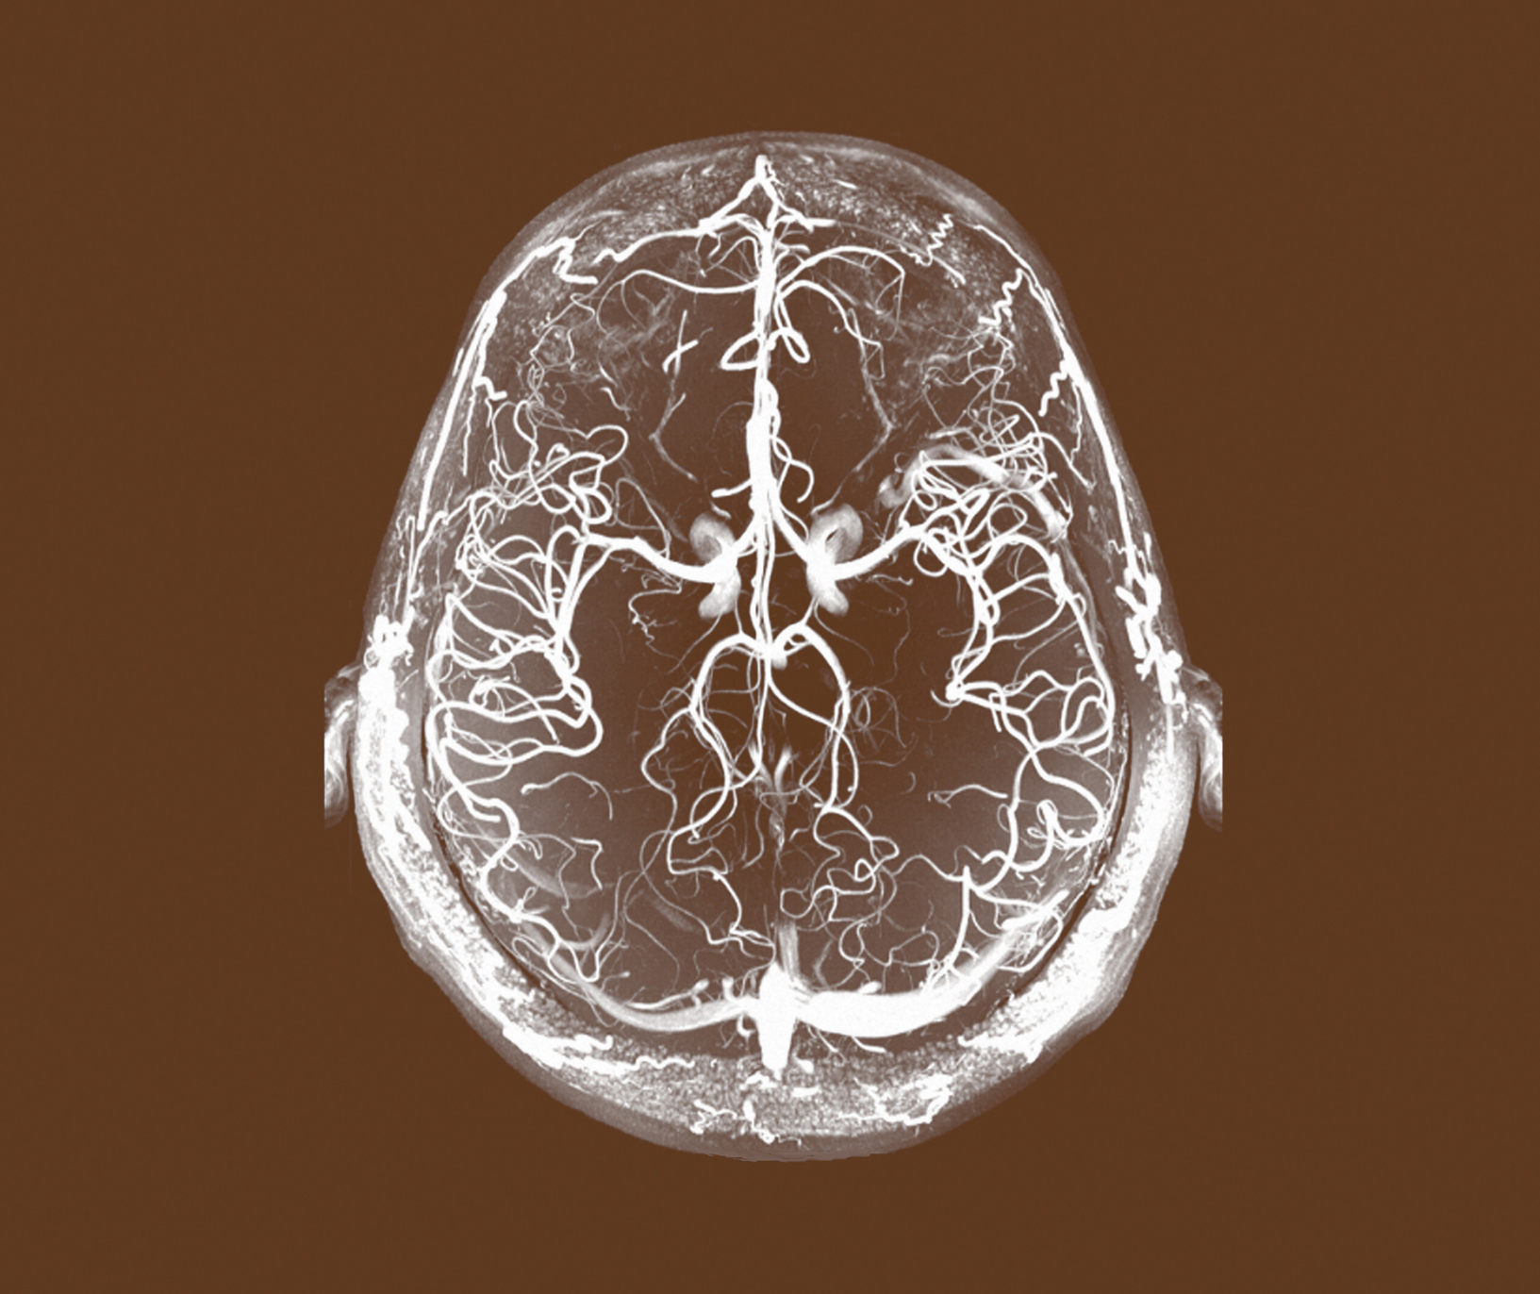
Major Depressive Disorder (MDD)
Definitions and Diagnosis

Slide 2
Definitions
Major Depressive Disorder (MDD)

Slide 3
Depression
Major Depressive Disorder (MDD)
Depression is a broad and heterogeneous diagnosis. ^{1,2,3,4}
Commonly used diagnostic manuals include the World Health Organization’s ICD-10 classification system² or the American Psychiatric Association’s DSM-IV³ and DSM-5 system⁴.
To diagnose depression symptoms should be present for at least 2 weeks and each symptom should be present at sufficient severity for most of every day. ^{1,2,3,4}
Severity of the disorder is determined by both the number and severity of symptoms, as well as the degree of functional impairment. ^{1,2,3,4}
Depression often has a remitting and relapsing course, and symptoms may persist between episodes. ^{1,2,3,4}
Where possible, the key goal of an intervention should be complete relief of symptoms (remission), which is associated with better functioning and a lower likelihood of relapse. ^{1,2,3,4}
NICE CG90. Depression in adults: recognition and management. 2009. Update April 2016 Available at: https://www.nice.org.uk/guidance/cg90 Accessed April 2016
WHO. ICD-10 Classification .1993. Available from: http://www.who.int/classifications/icd/en/GRNBOOK.pdf. Accessed April 2016
American Psychiatric Association. Diagnostic and statistical manual of mental disorders: DSM-IV. 4th edition: American Psychiatric Association. 1994:866
American Psychiatric Association. Diagnostic and statistical manual of mental disorders 5th edition: American Psychiatric Association. 2013
Notes:
This slide shows core definitions for depression based on World Health Organization’s ICD-10 classification system or the American Psychiatric Association’s DSM-IV and DSM-5 system

Slide 4
Depression
Major Depressive Disorder (MDD)
Major depressive disorder is characterized by discrete episodes of at least 2 weeks’ duration (although most episodes last considerably longer) involving clear-cut changes in affect, cognition, and neurovegetative functions and inter-episode remissions.¹
The common feature of the disorder is the presence of sad, empty, or irritable mood, accompanied by somatic and cognitive changes that significantly affect the individual’s capacity to function.¹
A diagnosis based on a single episode is possible, although the disorder is a recurrent one in the majority of cases.¹
Careful consideration is given to the delineation of normal sadness and grief from a major depressive episode.¹
American Psychiatric Association. Diagnostic and statistical manual of mental disorders 5th edition: American Psychiatric Association. 2013

Slide 5




Depression is a clinically heterogeneous disorder
Major Depressive Disorder (MDD)
Sadness
Attention and concentration
Anxiety
EMOTIONAL¹
COGNITIVE¹⁻⁴
Irritability
Short- and long-term memory
Lack of enjoyment
Judgment
Suicidal ideation
Decision-making
Hopelessness
Inappropriate guilt
Mental sharpness
Thinking speed
Fatigue
Headaches
Eating/weight changes
PHYSICAL¹
Stomach problems
Insomnia/hypersomnia
Pain
Sexual dysfunction
Psychomotor agitation
American Psychiatric Association. Diagnostic and Statistical Manual of Mental Health Disorders. 5th ed. Washington, DC: American Psychiatric Association; 2013
Marazziti D et al. Eur J Pharmacol 2010;626(1):83–86
Hammar A, Ardal G. Front Hum Neurosci 2009;3:26. doi: 10.3389/neuro.09.026.2009
Fehnel SE et al. CNS Spectr 2013;21:43–52.
Notes:
References
American Psychiatric Association. Diagnostic and Statistical Manual of Mental Health Disorders. 5th ed. Washington, DC: American Psychiatric Association; 2013
Jaeger J et al. Psychiatry Res 2006;145:39–48
World Health Organization Depression Fact Sheet N369. http://www.who.int/mediacentre/factsheets/fs369/en/#. Accessed August 2015
Hammar A, Ardal G. Front Hum Neurosci 2009;3:26. doi: 10.3389/neuro.09.026.2009

Slide 6
Cognitive symptoms of depression have a negative impact on many aspects of the patient’s life^{1,2}
Major Depressive Disorder (MDD)
Cognitive dysfunction and general functioning are linked and both have an impact on clinical outcomes in depression
Find it difficult to maintain performance
Work/school life
Family/personal life
Social life
Experience household and financial strain
Loss of focus
Loss of productivity
Struggle with a variety of attention-related tasks
Unable to participate fully in family life
Exhibit social irritability
Have problems meeting expectations from society
Find it difficult to participate in social life
McIntyre RS et al. Depress Anxiety 2013;30(6):515–527; 2. Hammar A, Ardal G. Front Hum Neurosci 2009;3:26. doi: 10.3389/neuro.09.026.2009.
Notes:
References
McIntyre RS et al. Depress Anxiety 2013;30(6):515–527
Hammar A, Ardal G. Front Hum Neurosci 2009;3:26. doi: 10.3389/neuro.09.026.2009

Slide 7
MDD symptoms – American Psychiatric Association
Major Depressive Disorder (MDD)
APA depressive symptoms for diagnostic purposes
Depressed mood | Patients may describe their mood as depressed, sad, hopeless, discouraged, or ‘down in the dumps’.¹ Alternatively, the patient may describe having no feelings at all, or feeling anxious¹ The lowered mood varies little from day to day, and is unresponsive to circumstances^{1,2}
Loss of interest or pleasure | Loss of interest or pleasure (known as ‘anhedonia’) in all, or almost all, activities, is nearly always present^{1,2} Individuals may report feeling less interest in hobbies, ‘not caring anymore’, or not finding enjoyment in activities previously considered pleasurable¹ Some patients may experience a significant reduction in levels of sexual interest or desire (i.e., decreased libido)^{1,2}
Psychomotor agitation/retardation | ‘Psychomotor agitation’ describes the inability to sit still; pacing or hand-wringing; or pulling/rubbing of skin, clothing, or other objects^{1,2} ‘Psychomotor retardation’ describes slowed speech, thinking, and body movements; increased pauses before answering; or speech that is decreased in volume, inflection, amount, or variety of content, or muteness^{1,2}
Worthlessness/guilt | Self-esteem and self-confidence are almost always reduced; feelings of worthlessness or excessive or inappropriate guilt (which may be delusional) may be present^{1,2} Individuals often misinterpret neutral or trivial day-to-day events as evidence of personal defects¹
Cognitive dysfunction | Many individuals report an impaired ability to think, concentrate, remember things, or make even minor decisions^{1,2} Patients engaged in cognitively-demanding pursuits are often unable to function¹
Fatigue | Decreased energy, tiredness, and fatigue are common^{1,2} Even the smallest tasks seem to require substantial effort, and result in marked tiredness^{1,2}
Thoughts of death/ suicide | Recurrent thoughts of death, suicidal ideation, or suicide attempts, are common¹ The severity of suicidal thoughts ranges from a passive wish to not awaken in the morning or a belief that others would be better off if the individual were dead, to transient but recurrent thoughts of committing suicide, to a specific suicide plan¹
Weight/appetite change | Patients may experience either a reduction or an increase in appetite, which can present as significant weight loss (without dieting) or weight gain¹ Some patients report that they have to force themselves to eat; others report a craving for specific foods (e.g., sweets or other carbohydrates)¹
Sleep disturbance | Sleep is usually disturbed, and may take the form of either difficulty sleeping (insomnia), or sleeping excessively (hypersomnia)^{1,2}
At least one of these is required
APA. 2013; 2. WHO. 2010
Notes:
The American Psychiatric Association (APA) describes nine depressive symptoms for diagnostic purposes.¹
Depressed mood
Patients may describe their mood as depressed, sad, hopeless, discouraged, or ‘down in the dumps’.¹ Alternatively, the patient may describe having no feelings at all, or feeling anxious.¹
The lowered mood varies little from day to day, and is unresponsive to circumstances.^{1,2}
Many individuals will report or show increased irritability, e.g., persistent annoyance, hostility, or a tendency to respond to events with outwardly expressed anger, ranging from argumentativeness to rage.^{1,3}
At least one of ‘depressed mood’ or ‘loss of interest or pleasure’ is required for a diagnosis of MDD, according to APA criteria (see section on Diagnosis of MDD).¹
Loss of interest or pleasure
Loss of interest or pleasure (known as ‘anhedonia’) in all, or almost all, activities, is nearly always present.^{1,2}
Individuals may report feeling less interest in hobbies, ‘not caring anymore’, or not finding enjoyment in activities that were previously considered pleasurable.¹
Family members, rather than the patient, may be the ones who notice social withdrawal or neglect of pleasurable activities.¹
Some patients may experience a significant reduction in levels of sexual interest or desire (i.e., decreased libido).^{1,2}
At least one of ‘depressed mood’ or ‘loss of interest or pleasure’ is required for a diagnosis of MDD, according to APA criteria (see section on Diagnosis of MDD).¹
Psychomotor agitation/retardation
‘Psychomotor agitation’ describes the inability to sit still; pacing or hand-wringing; or pulling/rubbing of skin, clothing, or other objects.^{1,2}
‘Psychomotor retardation’ describes slowed speech, thinking, and body movements; increased pauses before answering; or speech that is decreased in volume, inflection, amount, or variety of content, or muteness.^{1,2}
Worthlessness/guilt
Self-esteem and self-confidence are almost always reduced; feelings of worthlessness or excessive or inappropriate guilt (which may be delusional) may be present.^{1,2}
The sense of worthlessness or guilt may include unrealistic negative evaluations of one’s worth, or guilty preoccupations or ruminations over minor past failings.¹
Individuals often misinterpret neutral or trivial day-to-day events as evidence of personal defects.¹
Cognitive dysfunction
Many individuals report an impaired ability to think, concentrate, remember things, or make even minor decisions.^{1,2}
Patients engaged in cognitively-demanding pursuits are often unable to function.¹
Fatigue
Decreased energy, tiredness, and fatigue are common.^{1,2}
Even the smallest tasks seem to require substantial effort, and result in marked tiredness.^{1,2}
Patients may complain that, for example, washing and dressing in the morning are exhausting and take twice as long as usual.¹
Thoughts of death/suicide
Recurrent thoughts of death, suicidal ideation, or suicide attempts, are common.¹
The severity of suicidal thoughts ranges from a passive wish to not awaken in the morning or a belief that others would be better off if the individual were dead, to transient but recurrent thoughts of committing suicide, to a specific suicide plan.¹
Weight/appetite change
Patients may experience either a reduction or an increase in appetite, which can present as significant weight loss (without dieting) or weight gain.¹
Some patients report that they have to force themselves to eat; others report a craving for specific foods (e.g., sweets or other carbohydrates).¹
Sleep disturbance
Sleep is usually disturbed, and may take the form of either difficulty sleeping (insomnia), or sleeping excessively (hypersomnia).^{1,2}
‘Initial insomnia’ is having difficulty falling asleep, ‘middle insomnia’ is waking up during the night and then having difficulty returning to sleep, and ‘terminal insomnia’ is waking too early and being unable to return to sleep.¹
Hypersomnia may take the form of prolonged sleep at night, or increased daytime sleep.¹
References:
1. American Psychiatric Association. Diagnostic and Statistical Manual of Mental Disorders. Fifth Edition (DSM-5™). © American Psychiatric Association, 2013.
2. World Health Organization (WHO). International Statistical Classification of Diseases and Related Health Problems 10th Revision (ICD-10) Version for 2010. http://apps.who.int/classifications/icd10/browse/2010/en. Accessed 12th March 2014.
3. Judd LL, Schettler PJ, Coryell W, et al. Overt irritability/anger in unipolar major depressive episodes: past and current characteristics and implications for long-term course. JAMA Psychiatry 2013; 70 (11): 1171–1180.

Slide 8
MDD symptoms – The Montgomery-Åsberg Depression Rating Scale
Major Depressive Disorder (MDD)
MADRS depressive symptoms
1 | Apparent sadness | Representing despondency, gloom and despair (more than just ordinary transient low spirits), reflected in speech, facial expression, and posture¹
2 | Reported sadness | Representing reports of depressed mood, regardless of whether it is reflected in appearance or not.¹ Includes low spirits, despondency or the feeling of being beyond help and without hope¹
3 | Inner tension | Representing feelings of ill-defined discomfort, edginess, inner turmoil, mental tension mounting to either panic, dread or anguish¹
4 | Reduced sleep | Representing the experience of reduced duration or depth of sleep compared to the subject’s own normal pattern when well¹
5 | Reduced appetite | Representing the feeling of a loss of appetite compared with when well¹
6 | Concentration difficulties | Representing difficulties in collecting one’s thoughts mounting to incapacitating lack of concentration¹
7 | Lassitude | Representing a difficulty getting started or slowness initiating and performing everyday activities¹ Some elements also correspond to psychomotor retardation in the APA system²
8 | Inability to feel | Representing the subjective experience of reduced interest in the surroundings, or activities that normally give pleasure¹ The ability to react with adequate emotion to circumstances or people is reduced¹
9 | Pessimistic thoughts | Representing thoughts of guilt, inferiority, self-reproach, sinfulness, remorse and ruin¹
10 | Suicidal thoughts | Representing the feeling that life is not worth living, that a natural death would be welcome, suicidal thoughts, and preparations for suicide¹
Montgomery & Asberg. 1979
APA. 2013
Bech et al. 2002
MADRS core symptoms highlighted in bold³
Notes:
The Montgomery–Åsberg Depression Rating Scale (MADRS), which was designed to be sensitive to the effects of antidepressants, includes ten depressive symptoms, six of which are described as ‘core symptoms’.^{1,2}
MADRS item 1. Apparent sadness
Representing despondency, gloom and despair (more than just ordinary transient low spirits), reflected in speech, facial expression, and posture.¹
This item is a core symptom of the MADRS.²
MADRS item 2. Reported sadness
Representing reports of depressed mood, regardless of whether it is reflected in appearance or not.¹ Includes low spirits, despondency or the feeling of being beyond help and without hope.¹
This item is a core symptom of the MADRS.²
MADRS item 3. Inner tension
Representing feelings of ill-defined discomfort, edginess, inner turmoil, mental tension mounting to either panic, dread or anguish.¹
This item is a core symptom of the MADRS.²
MADRS item 4. Reduced sleep
Representing the experience of reduced duration or depth of sleep compared to the subject’s own normal pattern when well.¹
MADRS item 5. Reduced appetite
Representing the feeling of a loss of appetite compared with when well.¹
MADRS item 6. Concentration difficulties
Representing difficulties in collecting one’s thoughts mounting to incapacitating lack of concentration.¹
MADRS item 7. Lassitude
Representing a difficulty getting started or slowness initiating and performing everyday activities.¹
Some elements also correspond to psychomotor retardation in the APA system.³
This item is a core symptom of the MADRS.²
MADRS item 8. Inability to feel
Representing the subjective experience of reduced interest in the surroundings, or activities that normally give pleasure.¹ The ability to react with adequate emotion to circumstances or people is reduced.¹
This item is a core symptom of the MADRS.²
MADRS item 9. Pessimistic thoughts
Representing thoughts of guilt, inferiority, self-reproach, sinfulness, remorse and ruin.¹
This item is a core symptom of the MADRS.²
MADRS item 10. Suicidal thoughts
Representing the feeling that life is not worth living, that a natural death would be welcome, suicidal thoughts, and preparations for suicide.¹
References:
1. Montgomery SA, Asberg M. A new depression scale designed to be sensitive to change. Br J Psychiatry 1979; 134: 382–389.
2. Bech P, Tanghøj P, Andersen HF, Overø K. Citalopram dose-response revisited using an alternative psychometric approach to evaluate clinical effects of four fixed citalopram doses compared to placebo in patients with major depression. Psychopharmacology (Berl) 2002; 163 (1): 20–25.
3. American Psychiatric Association. Diagnostic and Statistical Manual of Mental Disorders. Fifth Edition (DSM-5™). © American Psychiatric Association, 2013.

Slide 9
The course of MDD¹
Major Depressive Disorder (MDD)
The course of MDD¹
Continuation phase:^{2,3}
A relapse in the vulnerable period immediately following remission should be avoided
Any unresolved symptoms should be eliminated
Suicide should be prevented
Patient’s level of psychosocial and occupational functioning should be restored – at least to levels seen prior to the current episode and, if possible, to levels seen prior to the onset of MDD
Remission
Recovery
No depression
Response
Symptoms
Progression
to disorder
Severity
Syndrome
Relapse
Recurrence
Treatment phases:
Acute
Continuation
Maintenance
Maintenance phase:³
A new episode of depression (recurrence) should be prevented
Suicide should be prevented
Full and lasting functional recovery should be aimed
Acute phase:^{2,3}
Remission (removal of symptoms, such that the criteria for a major depressive episode are no longer met) should be aimed
Suicide should be prevented
Improvement in functioning and quality of life should be aimed
MDD=major depressive disorder
Kupfer. J Clin Psychiatry 1991;52(Suppl 5):28–34;
APA. Practice Guideline for the Treatment of Patients with Major Depressive Disorder. 3rd Edition. 2010;
Bauer et al. World J Biol Psychiatry 2013;14(5):334–385
Notes:
The optimal outcome for a patient with major depressive disorder (MDD) is a full recovery from the major depressive episode and to never become depressed again.¹ Treatment of MDD is divided into three phases, corresponding to different stages of the illness.² Each of these phases has a different treatment goal.²
Acute treatment phase
‘Acute phase treatment’ of MDD occurs during a major depressive episode; it runs from the initiation of treatment until remission is achieved.^{3,4} The goals of acute phase treatment are to achieve remission (removal of symptoms, such that the criteria for a major depressive episode are no longer met), and an improvement in functioning and quality of life.^{3,5} Remission is a clinically-meaningful endpoint: patients who achieve remission are less likely to relapse than those who do not achieve remission.^{6,7} Response, i.e., a 50% improvement from baseline in a depression rating scale score, is an intermediate treatment goal; it is used to evaluate whether or not a treatment is benefiting the patient.³
Continuation treatment phase
‘Continuation phase treatment’ of MDD follows on from acute phase treatment, i.e., it starts when remission is achieved.^{3,4} The goals of continuation phase treatment are to prevent a relapse (a return of symptoms sufficient to meet the criteria for a major depressive episode) in the vulnerable period immediately following remission, to eliminate any unresolved symptoms, and to restore the patient’s level of psychosocial and occupational functioning – at least to levels seen prior to the current episode and, if possible, to levels seen prior to the onset of MDD.^{3,5} Continuation phase treatment continues until recovery is achieved (the end of a major depressive episode).³ The moment of recovery is difficult to identify in clinical practice.³
Maintenance treatment phase
‘Maintenance phase treatment’ of MDD follows on from continuation phase treatment, provided the patient did not experience a relapse.^{3,4} The goals of maintenance phase treatment are to prevent a new episode of depression (recurrence), to prevent suicide, and to enable full and lasting functional recovery.³ Typically, maintenance treatment is indicated in patients with chronic/recurrent MDD (i.e., those susceptible to recurrence).⁵
References:
1. Nierenberg AA, DeCecco LM. Definitions of antidepressant treatment response, remission, nonresponse, partial response, and other relevant outcomes: a focus on treatment-resistant depression. J Clin Psychiatry 2001; 62 (Suppl 16): 5–9.
2. Sadock BJ, Sadock VA, Ruiz P (eds). Kaplan & Sadock’s Comprehensive Textbook of Psychiatry. 9th Edition. Vol 1–2. © Lippincott Williams & Wilkins, 2009.
3. Bauer M, Pfennig A, Severus E, et al.; World Federation of Societies of Biological Psychiatry (WFSBP) Task Force on Unipolar Depressive Disorders. WFSBP guidelines for biological treatment of unipolar depressive disorders, part 1: update 2013 on the acute and continuation treatment of unipolar depressive disorders. World J Biol Psychiatry 2013; 14 (5): 334–385.
4. Kupfer DJ. Long-term treatment of depression. J Clin Psychiatry 1991; 52 (Suppl 5): 28–34.
5. American Psychiatric Association. Practice Guideline for the Treatment of Patients with Major Depressive Disorder. 3rd Edition. © American Psychiatric Association, 2010. http://psychiatryonline.org/guidelines.aspx. Accessed November 2017.
6. Nelson JC, Pikalov A, Berman RM. Augmentation treatment in major depressive disorder: focus on aripiprazole. Neuropsychiatr Dis Treat 2008; 4 (5): 937–948.
7. Rush AJ, Trivedi MH, Wisniewski SR, et al. Acute and longer-term outcomes in depressed outpatients requiring one or several treatment steps: a STAR*D report. Am J Psychiatry 2006; 163 (11): 1905–1917.

Slide 10
MDD is a complex, often recurrent and remitting disorder¹
Major Depressive Disorder (MDD)
Following an initial depressive episode:
50%
recover with no further episodes²
35%
experience recurrent MDD²
15%
experience unremitting MDD²
Kupfer DJ. J Clin Psychiatry 1991;52(suppl):28–34. 2. Eaton WW et al. Arch Gen Psychiatry 2008;65:513–520
Notes:
Previous slide illustrates the typical course of illness for patients with depression; either receiving only acute-phase treatment or receiving longer-term treatment designed to prevent relapse. It also highlights that long-term treatment of depression with antidepressants benefits many patients by (1) reducing the likelihood of relapse or recurrence and (2) increasing the amount of time spent asymptomatic between episodes.
Discontinuing antidepressant treatment in the acute phase before full symptomatic remission drastically increases the likelihood of relapse of the original episode, and discontinuing treatment during the continuation phase after symptomatic remission likewise increases the risk of relapse.
Discontinuing treatment during the maintenance phase, which begins after full recovery, increases the risk of developing a new depressive episode (i.e., recurrence).
Ref: Kupfer DJ. J Clin Psychiatry 1991;52(suppl):28–34.

Slide 11
Depression – signs and symptoms
Major Depressive Disorder (MDD)
Signs
Symptoms
Refers to the subjective complaints a patient describes (such as sadness)¹
Refers to objective phenomena observed by the physician (such as crying)¹
The DSM-IV, DSM-5 and ICD-10 criteria for major depression are used to diagnose patients with depression, and cover all the major signs and symptoms.
Shivani, et al. Alcohol Research & Health. 2002;26:90-8
Notes:
The slide aims at giving a simple definition for the terms signs and symptoms. It also highlights that the criteria used in the diagnostic manuals cover all major signs and symptoms of depression

Slide 12
Definitions of epidemiological terms
Major Depressive Disorder (MDD)
Prevalence
  The number of persons with disease, in a given population, at a designated time
    • Point prevalence
    Total number of persons with disease at a specified point in time, in a given population
    • Period prevalence
    Total number of persons with disease at any time during the specified period, in a given population
    • Annual or 12 month prevalence
    Total number of persons with disease during 12 month period, in a given population
    • Lifetime prevalence
    Total number of persons with disease for at least part of their life, in a given population
Incidence
  The number of new persons with disease over a specified period of time, in a given population
Last JM. A dictionary of epidemiology. New York: Oxford University Press, 2000.
Notes:
The slide explains the difference between prevelance and incidence as key epidemiological terms. While prevalence is the number of persons with disease, in a given population, at a designated time, the incidence looks into the number of new persons with disease over a specified period of time, in a given population.

Slide 13
Definitions of burden of disease and key epidemiological terms
Major Depressive Disorder (MDD)
Burden of disease (BoD)¹
  Measure of suffering caused by disease, which integrates mortality and morbidity
  Measurements include QALYs and/or DALYs
Quality adjusted life years (QALYs)¹
  Summary outcome measure of population health that uses life-years gained, integrating both quantity and quality of life
Years of life lost (YLLs)²
  Years of life lost due to premature mortality.
Years lived with disability (YLDs)²
  Years of life lived with any short-term or long-term health loss.
Disability adjusted life years (DALYs)²
  The sum of years lost due to premature death (YLLs) and years lived with disability (YLDs). DALYs are also defined as years of healthy life lost.
Healthy life expectancy, or health-adjusted life expectancy (HALE)²
  The number of years that a person at a given age can expect to live in good health, taking into account mortality and disability
Last JM. A dictionary of epidemiology. New York: Oxford University Press, 2000;
http://www.healthdata.org/sites/default/files/files/policy_report/2013/GBD_GeneratingEvidence/IHME_GBD_GeneratingEvidence_FullReport.pdf Accessed April 2014.
Notes:
This slide gives definitions for key epidemiological terms used in studies to quantify the burden of a disease. Term defined are the Burden of disease (BoD), Quality adjusted life years (QALYs), Years of life lost (YLLs), Years lived with disability (YLDs), Disability adjusted life years (DALYs), and Healthy life expectancy, or health-adjusted life expectancy (HALE)

Slide 14
Definitions of Clinical Course and Treatment Outcomes
Major Depressive Disorder (MDD)
Remission: is to be ‘normal’, i.e., to be free of symptoms often defined as a score below a predetermined cut off on a symptom severity scale, such as HAM-D17 or MADRS. However, with this definition unresolved symptoms still appear to be present.
100
Response
Response: ≥50% decrease from baseline depression scales to trial endpoint
Partial response: Most frequently defined as <50% but ≥25% decrease from baseline depression scale scores
Theoretical decrease in
depression scale (%)
50
Inadequate Response
Inadequate response: Inadequate response includes no response to treatment as well as partial response
25
Non-
Response
Non-response: Sometimes described as failing to achieve a minimal partial response, e.g., <25% decrease from baseline score (HAM-D17). Alternative definitions include failing to achieve a response (<50% decrease from baseline) and failing to achieve remission.
0
Note:. The graph is an illustration of common used criteria for defining response categories and is not based on real study numbers.
Also, here are no standard definitions for response and non-response in the literature.
Nierenberg & DeCecco. J Clin Psychiatry 2001; 62 (suppl 16): 5–9
Frank et al. Arch Gen Psychiatry 1991; 48 (9): 851–855
Notes:
Source (slide): 2. Nierenberg et al. J Clin Psychiatry 2003; 64 (suppl 15): 13–17; page 13 (‘Remission, relapse, recurrence’ section); Riso et al. J Affect Disord 1997; 43 (2): 131–142; 5. Nierenberg & DeCecco. J Clin Psychiatry 2001; 62 (suppl 16): 5–9; page 8; 6. Frank et al. Arch Gen Psychiatry 1991; 48 (9): 851–855; page 853.
References:
Frank E, Prien RF, Jarrett RB, et al. Conceptualization and rationale for consensus definitions of terms in major depressive disorder. Remission, recovery, relapse, and recurrence. Arch Gen Psychiatry 1991; 48 (9): 851–855.
Keller MB. Long-term treatment of recurrent and chronic depression. J Clin Psychiatry 2001; 62 Suppl 24: 3–5.
Lavori PW, Keller MB, Mueller TI, et al. Recurrence after recovery in unipolar MDD: an observational follow-up study of clinical predictors and somatic treatment as a mediating factor. Int J Methods Psychiatr Res 1994; 4 (4): 211–229.
Nierenberg AA, DeCecco LM. Definitions of antidepressant treatment response, remission, nonresponse, partial response, and other relevant outcomes: a focus on treatment-resistant depression. J Clin Psychiatry 2001; 62 Suppl 16: 5–9.
Nierenberg AA, Petersen TJ, Alpert JE. Prevention of relapse and recurrence in depression: the role of long-term pharmacotherapy and psychotherapy. J Clin Psychiatry 2003; 64 Suppl 15: 13–17.
Riso LP, Thase ME, Howland RH, et al. A prospective test of criteria for response, remission, relapse, recovery, and recurrence in depressed patients treated with cognitive behavior therapy. J Affect Disord 1997; 43 (2): 131–142.

Slide 15
Definitions of Clinical Course and Treatment Outcomes
Major Depressive Disorder (MDD)
Relapse: An episode of major depressive disorder that occurs within 6 months after either response or remission;^{2,3} theoretically, a return of the original episode4^{,5}
The course of MDD¹
Remission
Recovery
No depression
Response
Symptoms
Progression
to disorder
Severity
Syndrome
Recurrence: Depressive episode that occurs after 6 months following response or remission; ^{2,3} theoretically, a new episode^{4,5}
Relapse
Recurrence
Treatment phases:
Acute
Continuation
Maintenance
MDD=major depressive disorder
Kupfer. J Clin Psychiatry 1991;52(Suppl 5):28–34
Nierenberg et al. J Clin Psychiatry 2003; 64 (suppl 15): 13–17
Riso et al. J Affect Disord 1997; 43 (2): 131–142
Nierenberg & DeCecco. J Clin Psychiatry 2001; 62 (suppl 16): 5–9
Frank et al. Arch Gen Psychiatry 1991; 48 (9): 851–855
Notes:
MDD is a chronic disorder, most frequently characterised by relapses and recurrences.^{(Nierenberg et al., 2003)} Relapse can be defined as an episode of MDD that occurs within 6 months of response or remission;(Nierenberg et al., 2003; Riso et al., 1997) theoretically, relapse signifies the return of a major depressive episode, rather than a new episode.(Nierenberg & DeCecco, 2001; Frank et al., 1991) Recurrence can be defined as a depressive episode that occurs after 6 months following response or remission;(Nierenberg et al., 2003; Riso et al., 1997) theoretically, recurrence signifies the start of a new major depressive episode.(Nierenberg & DeCecco, 2001; Frank et al., 1991) Naturalistic studies have found that most patients will eventually experience either relapse or recurrence if followed for a long enough period without sustained treatment.(Nierenberg et al., 2003; Lavori et al., 1994) Following an acute depressive episode, almost 90% of patients could be expected to become depressed again in the next 15 years.(Nierenberg et al., 2003; Keller, 2001)
Sources: Frank E, Prien RF, Jarrett RB, et al. Conceptualization and rationale for consensus definitions of terms in major depressive disorder. Remission, recovery, relapse, and recurrence. Arch Gen Psychiatry 1991; 48 (9): 851–855.
Keller MB. Long-term treatment of recurrent and chronic depression. J Clin Psychiatry 2001; 62 Suppl 24: 3–5.
Lavori PW, Keller MB, Mueller TI, et al. Recurrence after recovery in unipolar MDD: an observational follow-up study of clinical predictors and somatic treatment as a mediating factor. Int J Methods Psychiatr Res 1994; 4 (4): 211–229.
Nierenberg AA, DeCecco LM. Definitions of antidepressant treatment response, remission, nonresponse, partial response, and other relevant outcomes: a focus on treatment-resistant depression. J Clin Psychiatry 2001; 62 Suppl 16: 5–9.
Nierenberg AA, Petersen TJ, Alpert JE. Prevention of relapse and recurrence in depression: the role of long-term pharmacotherapy and psychotherapy. J Clin Psychiatry 2003; 64 Suppl 15: 13–17.
Riso LP, Thase ME, Howland RH, et al. A prospective test of criteria for response, remission, relapse, recovery, and recurrence in depressed patients treated with cognitive behavior therapy. J Affect Disord 1997; 43 (2): 131–142

Slide 16
Diagnosis, Signs and Symptoms
Major Depressive Disorder (MDD)

Slide 17
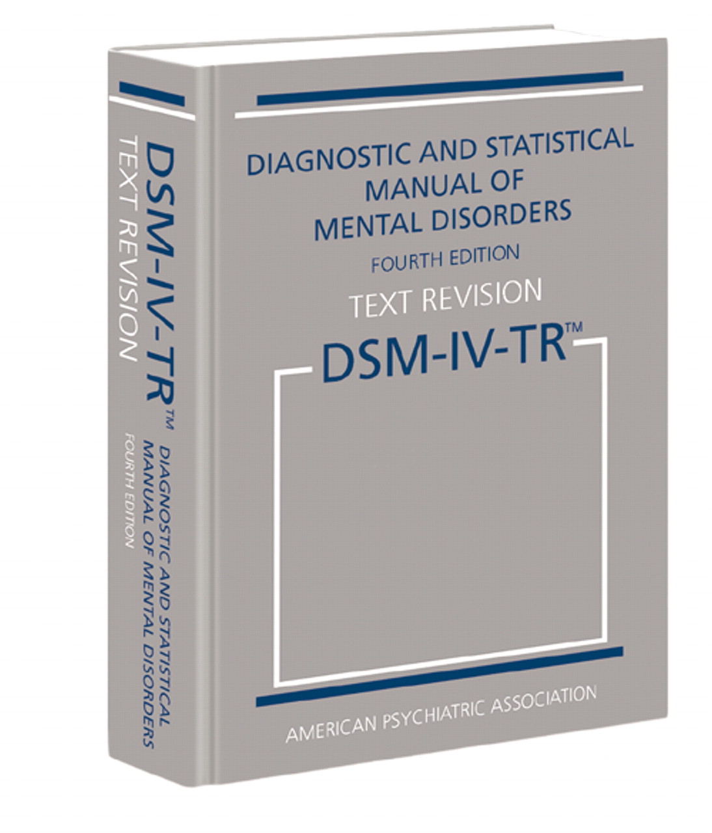
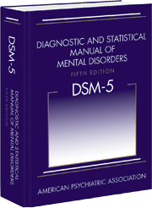
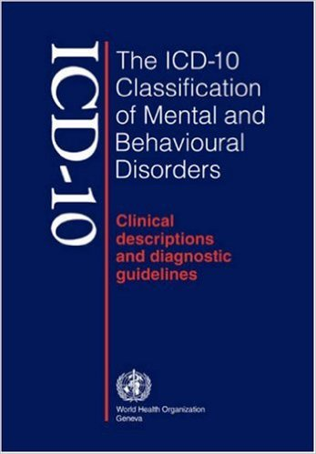
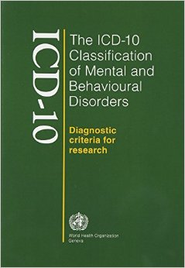
Signs and Symptoms of depression – Diagnostic criteria
Major Depressive Disorder (MDD)
Signs and Symptoms | DSM-IV | DSM-5 | ICD-10
Depressed mood | √ | √ | √
Anhedonia | √ | √ | √
Significant weight change | √ | √ | √
Sleep problems | √ | √ | √
Psychomotor problems | √ | √ | √
Fatigue | √ | √ | √
Feeling worthless / inappropriately guilty | √ | √ | √
Cognitive problems | √ | √ | √
Thoughts of death | √ | √ | √
Self-confidence, self-esteem problems |  |  | √
DSM-IV & DSM-5 Diagnostic and Statistical Manual of Mental Disorders^{1,2}
WHO. ICD-10 Classification of Mental and Behavioral Disorders 1993³
American Psychiatric Association. Diagnostic and statistical manual of mental disorders: DSM-IV. 4th edition: American Psychiatric Association. 1994:866
American Psychiatric Association. Diagnostic and statistical manual of mental disorders 5th edition: American Psychiatric Association. 2013
WHO. ICD-10 Classification .1993. Available from: http://www.who.int/classifications/icd/en/GRNBOOK.pdf. Accessed April 2016;
Notes:
This slide gives the signs and symptoms listed in the major diagnostic manuals, DSM-IV, DSM-5 and ICD10 used to describe the diagnostic critera. The silde highlights the high level of agreement between the manuals. Low self-esteem or self-confidence is listed as a seperate criteria in the ICD-10, which is not the case in the DSM-IV or -5. However, low self-esteem is often taken together with feelings of worthlessness and inappropriate guilt and represents as such not necessarely a criteria in itself, which would not be recognised using DSMIV or-5 manuals.

Slide 18

Depression is a clinically heterogeneous disorder
Major Depressive Disorder (MDD)
Sadness¹
Anxiety^{1,2}
Irritability¹
Lack of enjoyment^{1,2}
Suicidal ideation¹
Hopelessness¹
Guilt¹
Difficulties with:
Attention and concentration^{1,3,4}
Short- and long-term memory^{2, 3,4}
Decision making^{1,2}
Planning and organisation^{2,3}
Mental flexibility
Word-finding³
Thinking speed^{1, 3}
Emotional
Cognitive
Fatigue¹⁻³
Eating changes¹
Insomnia¹
Sexual dysfunction^{1,6}
Headaches^{1,5}
Stomach problems^{1,5}
Chest pain⁵
Physical
American Psychiatric Association. Diagnostic and Statistical Manual of Mental Disorders, Fifth Edition. Arlington, VA: APA; 2013.
World Federation for Mental Health. Depression: a global crisis. 10 October 2012. Available at http://www.who.intt
Fehnel et al. CNS spectrums 2013 (1-10)
Hammar et al. Front in Hum Neurosci 3 (2009)
Bair M. Archives of internal medicine 163.20 (2003): 2433-2445
Clayton A. Effects of Psychiatric Illness and Medication on Sexual Function http://www.medscape.org/viewarticle/482059_3; accessed 29 September 2014
Notes:
This slide expands the signs and symptoms used to define diagnostic criteria, to highlight the heterogeneity of the disease. It also highlights that the disease affects all aspects of every day life. Real life functional impairments affect social, occupational, family and daily activities, of which the listed signs and symptoms are part of. Signs and symptoms are grouped by emotional, cognitive and physical categories.

Slide 19
Depression – Levels of Severity¹
Major Depressive Disorder (MDD)
Sub-threshold Depressive Symptoms*
Fewer than 5 symptoms of depression¹
Mild Depression²
Few, if any, symptoms in excess of those required to make the diagnosis are present, the intensity of the symptoms is distressing but manageable, and the symptoms result in minor impairment in social or occupational functioning.
MADRS score range: 7 - 19
Moderate Depression²
The number of symptoms, intensity of symptoms, and/or functional impairment are between those specified for “mild” and “severe.”
MADRS score range: 20 - 34
Severe/Major Depression²
The number of symptoms is substantially in excess of that required to make the diagnosis, the intensity of the symptoms is seriously distressing and unmanageable, and the symptoms markedly interfere with social and occupational functioning.
MADRS score range: 35 - 60
*Fall below the criteria for major depression, and are defined as at least one key symptom of depression but with insufficient other symptoms and/or functional impairment to meet the criteria for full diagnosis. However, they are by guidelines recognized as being distressing and disabling if persistent.
MADRS = Montgomery Åsberg Depression Rating Scale
NICE CG90. Depression in adults: recognition and management. 2009. Update April 2016 Available at: https://www.nice.org.uk/guidance/cg90 Accessed April 2016
American Psychiatric Association. Diagnostic and statistical manual of mental disorders: DSM-5 2013.
Notes:
Various levels of depression exist including mild, moderate and severe. The table shows the DSM-IV definitions of depression. A comprehensive assessment of depression should not rely simply on a symptom count, but should take into account the degree of functional impairment and/or disability.
Note: NICE defines the depression severities based on DSM-IV. ICD-10 is similar but the threshold for mild depression is lower at 4 symptoms.
Source:
NICE CG90. Depression in adults: recognition and management. 2009. Update April 2016 Available at: https://www.nice.org.uk/guidance/cg90 Accessed April 2016;
American Psychiatric Association. Diagnostic and statistical manual of mental disorders: DSM-5 2013.

Slide 20
Depression in Diagnostic Manuals
Major Depressive Disorder (MDD)
DSM-IV, Diagnostic and Statistical Manual of Mental Disorders, 4th Edition¹
WHO. ICD-10 Classification of Mental and Behavioral Disorders 1993²
DSM-5, Diagnostic and Statistical Manual of Mental Disorders, 5th Edition³
American Psychiatric Association. Diagnostic and statistical manual of mental disorders: DSM-IV. 4th edition: American Psychiatric Association. 1994:866
WHO. ICD-10 Classification .1993. Available from: http://www.who.int/classifications/icd/en/GRNBOOK.pdf. Accessed April 2016
American Psychiatric Association. Diagnostic and statistical manual of mental disorders 5th edition: American Psychiatric Association. 2013
Notes:
Major manuals used for the diagnosis of depression:
American Psychiatric Association. Diagnostic and statistical manual of mental disorders: DSM-IV. 4th edition: American Psychiatric Association. 1994:866;
WHO. ICD-10 Classification .1993. Available from: http://www.who.int/classifications/icd/en/GRNBOOK.pdf. Accessed April 2016;
American Psychiatric Association. Diagnostic and statistical manual of mental disorders 5th edition: American Psychiatric Association. 2013

Slide 21
Depression – DSM-5: Updates from DSM-IV¹
Major Depressive Disorder (MDD)
The bereavement exclusion has now been removed.^{1,2}
  The new edition characterizes bereavement as a severe psychological stressor that can incite a major depressive episode
Dysthymia is now under the category of ‘persistent depressive disorder’, which includes both chronic major depressive disorder and the previous dysthymic disorder.¹
  An inability to find scientifically meaningful differences between these two conditions led to their combination
The coexistence within a major depressive episode of at least three manic symptoms (insufficient to satisfy criteria for a manic episode) is now acknowledged by the specifier “with mixed features”.^{1,4}
  The presence of mixed features in an episode of major depressive disorder increases the likelihood that the illness exists in a bipolar spectrum; however, if the individual has never met criteria for a manic or hypomanic episode, the diagnosis of major depressive disorder is retained
American Psychiatric Association (APA). Diagnostic and statistical manual of mental disorders 5th edition: APA. 2013
APA_DSM-5-Depression-Bereavement-Exclusion, Availability see notes
APA_DSM-5-Mixed-Features-Specifier.pdf Availability see notes
Notes:
Highlights of Changes from DSM-IV-TR to DSM-5. American Psychiatric Association 2013. Available from: http://www.psychiatry.org/dsm5 Accessed April 2016
While bereavement may precipitate major depression in people who are especially vulnerable (i.e. they have already suffered a significant loss or have other mental disorders), when grief and depression coexist, the grief is more severe and prolonged than grief without major depression. Despite some overlap between grief and MDD, they are different in important ways, and therefore they should be distinguished separately to enable people to benefit from the most appropriate treatment.
American Psychiatric Association, Changes in the new edition: Depression Bereavement Exclusion,
Source: American Psychiatric Association_DSM-5-Depression-Bereavement-Exclusion: https://www.psychiatry.org/File%20Library/Psychiatrists/Practice/DSM/APA_DSM-5-Depression-Bereavement-Exclusion.pdf, last assessed April 2016
A more chronic form of depression, persistent depressive disorder (dysthymia), can be diagnosed when the mood disturbance continues for at least 2 years in adults or 1 year in children. This diagnosis, new in DSM-5, includes both the DSM-IV diagnostic categories of chronic major depression and dysthymia.
Source:(1) American Psychiatric Association (APA). Diagnostic and statistical manual of mental disorders 5th edition: APA. 2013
In DSM-IV, a diagnosis of mixed episode required an individual to simultaneously meet all criteria for an episode of major depression and an episode of mania. During its review of the latest research, the DSM-5 Mood Disorders Work Group recognized that individuals rarely meet full criteria for both episode types at the same time. In order to be diagnosed with the new specifier in the case of major depression, the new DSM-5 specifier will require the presence of at least three manic/hypomanic symptoms that don’t overlap with symptoms of major depression. In the case of mania or hypomania, the specifier will require the presence of at least three symptoms of depression in concert with the episode of mania/hypomania.
Source: American Psychiatric Association_DSM-5-Mixed-Features-Specifier, Changes in the new edition: Mixed features. Available: https://www.psychiatry.org/File%20Library/Psychiatrists/Practice/DSM/APA_DSM-5-Mixed-Features-Specifier.pdf, last assessed April 2016

Slide 22
Depression – the Diagnostic and Statistical Manual (DSM-IV) criteria for major depression¹
Major Depressive Disorder (MDD)
At least five of the following symptoms have been present during the same 2-week period and represent a change from previous functioning: at least one of the symptoms is either 1) depressed mood or 2) loss of interest or pleasure
A
1
Depressed mood for most of the day,
based on self-report or observation of others
or
2
Marked reduction or loss of interest or pleasure
in nearly all activities for most of the day
3
Significant non-dieting weight loss or weight gain
(>5% change in body weight)
B
4
+
Insomnia or hypersomnia
5
Major Depression
Psychomotor agitation or retardation
(observable by others)
C
Any 5
+
6
Fatigue / loss of energy
Feeling of worthlessness or excessive /
inappropriate guilt
D
7
+
8
Diminished cognitive function
(reduced ability to think or concentrate)
E
9
Recurrent thoughts of death and/or suicide,
Suicide planning, or a suicide attempt
See next slide for criteria B – E
American Psychiatric Association. Diagnostic and statistical manual of mental disorders: DSM-IV. 4th edition: American Psychiatric Association. 1994:866
Notes:
The Diagnostic and Statistical Manual (DSM) of Mental Disorders is published by the American Psychiatric Association and provides standard criteria for the classification of mental disorders. It is now in its fifth edition, DSM-5, which was published in 2013.
1. Diagnostic and statistical manual of mental disorders 4th edition. American Psychiatric Association 1994

Slide 23
Depression – the Diagnostic and Statistical Manual (DSM-IV) criteria for major depression¹
Major Depressive Disorder (MDD)
B
Symptoms do not meet criteria for a mixed episode
C
Symptoms cause clinically significant distress or impairment in social, occupational, or other important areas of functioning
D
Symptoms are not due to the direct physiological effects of a substance (e.g. a medication) or a general medical condition (e.g. hypothyroidism)
E
Symptoms are not accounted for by bereavement and persist for longer than two months, or are characterized by marked functional impairment, morbid preoccupation with worthlessness, suicidal ideation, psychotic symptoms, or psychomotor retardation
American Psychiatric Association. Diagnostic and statistical manual of mental disorders: DSM-IV. 4th edition: American Psychiatric Association. 1994:866
Notes:
D - A diagnosis cannot be reached if the patient has a substance abuse disorder.
The Diagnostic and Statistical Manual (DSM) of Mental Disorders is published by the American Psychiatric Association and provides standard criteria for the classification of mental disorders. It is now in its fifth edition, DSM-V, which was published in 2013. The next three slides summarize the changes.
1. Diagnostic and statistical manual of mental disorders 4th edition. American Psychiatric Association 1994

Slide 24
Depression – the Diagnostic and Statistical Manual (DSM-5) criteria for major depression¹
Major Depressive Disorder (MDD)
At least five of the following symptoms have been present during the same 2-week period and represent a change from previous functioning: at least one of the symptoms is either 1) depressed mood or 2) loss of interest or pleasure
A
1
Depressed mood for most of the day,
based on self-report or observation of others
or
2
Marked reduction or loss of interest or pleasure
in nearly all activities for most of the day
3
Significant non-dieting weight loss or weight gain
(>5% change in body weight)
4
Major Depression
Insomnia or hypersomnia
B
Any 5
+
5
Psychomotor agitation or retardation
(observable by others)
6
C
Fatigue / loss of energy
Feeling of worthlessness or excessive /
inappropriate guilt
7
8
Diminished cognitive function
(reduced ability to think or concentrate)
9
Recurrent thoughts of death and/or suicide,
Suicide planning, or a suicide attempt
American Psychiatric Association. Diagnostic and statistical manual of mental disorders 5th edition: American Psychiatric Association. 2013
Notes:
The Diagnostic and Statistical Manual (DSM) of Mental Disorders is published by the American Psychiatric Association and provides standard criteria for the classification of mental disorders. It is now in its fifth edition, DSM-5, which was published in 2013.
Slide represent diagnostic criteria for a major depressive episode according to the DSM-5. Note that Criteria A-C represent a major depressive episode
Criteria A Five (or more) of the following symptoms have been present during the same 2-week period and represent a change from previous functioning: at least one of the symptoms is either (1) depressed mood or (2) loss of interest or pleasure.
Note: Do not include symptoms that are clearly attributable to another medical condition.
Criteria B: (next slide)
Criteria C: (next slide)
Note: Responses to a significant loss (e.g., bereavement, financial ruin, losses from a natural disaster, a serious medical illness or disability) may include the feelings of intense sadness, rumination about the loss, insomnia, poor appetite, and weight loss noted in Criterion A, which may resemble a depressive episode. Although such symptoms may be understandable or considered appropriate to the loss, the presence of a major depressive episode in addition to the normal response to a significant loss should also be carefully considered. This decision inevitably requires the exercise of clinical judgment based on the individual’s history and the cultural norms for the expression of distress in the context of loss.
Criteria D. The occurrence of the major depressive episode is not better explained by schizoaffective disorder, schizophrenia, schizophreniform disorder, delusional disorder, or other specified and unspecified schizophrenia spectrum and other psychotic disorders.
Criteria E. There has never been a manic episode or a hypomanie episode. Note: This exclusion does not apply if all of the manic-like or hypomanic-like episodes are substance-induced or are attributable to the physiological effects of another medical
condition.
Source: Diagnostic and statistical manual of mental disorders 5th edition. American Psychiatric Association 2013

Slide 25
Depression – the Diagnostic and Statistical Manual (DSM-5) criteria for major depression¹
Major Depressive Disorder (MDD)
B
Symptoms cause clinically significant distress or impairment in social, occupational or other important areas of functioning
C
Symptoms are not due to the direct physiological effects of a substance (e.g. a medication) or another medical condition (e.g. hypothyroidism)
American Psychiatric Association. Diagnostic and statistical manual of mental disorders 5th edition: American Psychiatric Association. 2013
Notes:
The Diagnostic and Statistical Manual (DSM) of Mental Disorders is published by the American Psychiatric Association and provides standard criteria for the classification of mental disorders. It is now in its fifth edition, DSM-5, which was published in 2013.
Slide represent diagnostic criteria for a major depressive episode according to the DSM-5. Note that Criteria A-C represent a major depressive episode
Criteria A (previous slide)
Criteria B: The symptoms cause clinically significant distress or impairment in social, occupational, or other important areas of functioning.
Criteria C: The episode is not attributable to the physiological effects of a substance or to another medical condition.
Note: Responses to a significant loss (e.g., bereavement, financial ruin, losses from a natural disaster, a serious medical illness or disability) may include the feelings of intense sadness, rumination about the loss, insomnia, poor appetite, and weight loss noted in Criterion A, which may resemble a depressive episode. Although such symptoms may be understandable or considered appropriate to the loss, the presence of a major depressive episode in addition to the normal response to a significant loss should also be carefully considered. This decision inevitably requires the exercise of clinical judgment based on the individual’s history and the cultural norms for the expression of distress in the context of loss.
Criteria D. The occurrence of the major depressive episode is not better explained by schizoaffective disorder, schizophrenia, schizophreniform disorder, delusional disorder, or other specified and unspecified schizophrenia spectrum and other psychotic disorders.
Criteria E. There has never been a manic episode or a hypomanie episode. Note: This exclusion does not apply if all of the manic-like or hypomanic-like episodes are substance-induced or are attributable to the physiological effects of another medical condition.
Source: Diagnostic and statistical manual of mental disorders 5th edition. American Psychiatric Association 2013

Slide 26
Depression – the Diagnostic and Statistical Manual (DSM-IV¹ & DSM-5²) Criteria for Major Depression
Major Depressive Disorder (MDD)
≥5 symptoms for 2-week:
Must change functioning
Must include 1 or 2
A
Any 5
DSM-IV all symptoms (B-E)
DSM-5 only the middle 2 symptoms (B & C)
B-E
DSM-IV & DSM-5 Diagnosis
1
Depressed mood
or
2
Anhedonia
Not mixed episode
B DSM-IV
Significant weight loss
+
3
Sleep problems
C DSM-IV
B DSM-5
Major Depression
4
Clinical distress or impaired functioning
+
Psychomotor problems
5
D DSM-IV
C DSM-5
Fatigue
Not due to a substance or other medical condition
6
DSM-IV and DSM-5
+
Feeling of worthlessness
or inappropriate guilt
7
Cognitive problems
Not bereavement
8
E DSM-IV
Thoughts of death
9
American Psychiatric Association. Diagnostic and statistical manual of mental disorders: DSM-IV. 4th edition: American Psychiatric Association. 1994:866
American Psychiatric Association. Diagnostic and statistical manual of mental disorders 5th edition: American Psychiatric Association. 2013
Notes:
The Diagnostic and Statistical Manual (DSM) of Mental Disorders is published by the American Psychiatric Association and provides standard criteria for the classification of mental disorders. This slide represents the diagnostic criteria for major depression in accordance with DSM-IV, as well as DSM-5.
Generally, for diagnosing MDD five (or more) of the A symptoms have been present during the same 2-week period and represent a change from previous functioning: at least one of the symptoms is either (1) depressed mood or (2) loss of interest or pleasure. Further, The symptoms have to cause clinically significant distress or impairment in social, occupational or other important areas of functioning (symptom C in DSM-IV and symptom B in DSM-5) and, the episode is not attributable to the physiological effects of a substance or to another medical condition (symptom D in DSM-IV and symptom C in DSM-5).
The DSM-5 excluded further criteria, which were present in DSM-IV, namely:
The bereavement exclusion has been removed. DSM-5 edition characterizes bereavement as a severe psychological stressor that can incite a major depressive episode
The coexistence within a major depressive episode of at least three manic symptoms (insufficient to satisfy criteria for a manic episode) is now acknowledged by the specifier “with mixed features”. The presence of mixed features in an episode of major depressive disorder increases the likelihood that the illness exists in a bipolar spectrum; however, if the individual has never met criteria for a manic or hypomanic episode, the diagnosis of major depressive disorder is retained
Another major difference, not present on this slide, is that “dysthymia” is now under the category of ‘persistent depressive disorder’, which includes both chronic major depressive disorder and the previous dysthymic disorder. An inability to find scientifically meaningful differences between these two conditions led to their combination.
1. Diagnostic and statistical manual of mental disorders 4th edition. American Psychiatric Association 1994
2. Diagnostic and statistical manual of mental disorders 5th edition. American Psychiatric Association 2013

Slide 27
Depression – the WHO ICD-10 classification of mental and behavioral disorders¹
Major Depressive Disorder (MDD)
Step 3
Differential diagnosis
Step 1 + 2
The ten symptoms define the degree of depression and management is based on the particular degree:
<4 = Not depressed
(fewer than four symptoms)
4 = Mild Depression (F32.0)
(four symptoms)
5/6 = Moderate Depression (F32.1) (five or six symptoms)
≥ 7 = Severe Depression (F32.2, F32.3)
(seven or more symptoms, with or
without psychotic symptoms)
Symptoms should be present for a month or more and every symptoms should be present for most of every day.*
Step 2
≥ 1
If any symptoms from step 1
are present, ask about associated symptoms:
Poor concentration
Low self-confidence
Guilt or self-blame
Pessimism towards the future
Suicidal thoughts or acts
Disturbed sleep
Poor or increased appetite
Step 1
At least one of the three,
most days, most of the time
for at least two weeks:
Persistent sadness or low mood, and/or
Loss of interests or pleasure
Fatique or low energy
WHO. ICD-10 Classification .1993. Available from: http://www.who.int/classifications/icd/en/GRNBOOK.pdf. Accessed April 2016 .
Notes:
Slide represent a depressive episode according to the WHO ICD10 Classification
Step 1: In typical depressive episodes of all three varieties described (mild (F32.0), moderate (F32.1), and severe (F32.2 and F32.3)), the individual usually suffers from depressed mood, loss of interest and enjoyment, and reduced energy leading to increased fatigability and diminished activity. Marked tiredness after only slight effort is common.
Step 2: Other common symptoms are listed in Step 2 (a-g):
(a) reduced concentration and attention;
(b) reduced self-esteem and self-confidence;
(c) ideas of guilt and unworthiness (even in a mild type of episode);
(d) bleak and pessimistic views of the future;
(e) ideas or acts of self-harm or suicide;
(f) disturbed sleep
(g) diminished appetite.
Step 3: The ICD10 differentiates diagnosis on the grades of severity, mild (F32.0), moderate (F32.1) and severe (F32.2 and F32.3) depressive episodes. These should be used only for a single (first) depressive episode. Further depressive episodes should be classified under one of the subdivisions of recurrent depressive disorder (F33.-). These grades of severity are specified to cover a wide range of clinical states that are encountered in different types of psychiatric practice. Individuals with mild depressive episodes are common in primary care and general medical settings, whereas psychiatric inpatient units deal largely with patients suffering from the severe grades.
Source: (1) WHO. ICD-10 Classification .1993. Available from: http://www.who.int/classifications/icd/en/GRNBOOK.pdf. Accessed April 2016

Slide 28



Depression can be evaluated from different perspectives
Major Depressive Disorder (MDD)
Depression
Patient
perspective^{1–3}
Physician
perspective^{1–3}
Clinical study
perspective³
Danner M, et al. Int J Technol Assess Health Care. 2011:27(4):369–75
Zimmerman M, et al. J Clin Psychiatry. 2012;73:790–95;
Zimmerman M, et al. J Affect Disord. 2012;142:77–81.
Notes:
This slide highlights the differences in assessing the depression status depending on the perspective. For example in treatment studies of depression, remission is typically defined narrowly, based on scores on symptom severity scales. Patients treated in clinical practice, however, define the concept of remission more broadly and consider functional status, coping ability, and life satisfaction as important indicators of remission status.
Source: Danner M, et al. Int J Technol Assess Health Care. 2011, Integrating patients’ views into health technology assessment: Analytic hierarchy process (AHP) as a method to elicit patient preferences:27(4):369–75;
(2) Zimmerman M, et al. Why do some depressed outpatients who are in remission according to the Hamilton Depression Rating Scale not consider themselves to be in remission? J Clin Psychiatry. 2012;73:790–95;
(3) Zimmerman M, et al. Symptom differences between depressed outpatients who are in remission according to the Hamilton Depression Rating Scale who do and don’t consider themselves to be in remission: J Affect Disord. 2012;142:77–81.

Slide 29
Common Screening Instruments for MDD
Major Depressive Disorder (MDD)
Clinician rated scales
Hamilton Depression Rating Scale (HAMD)¹
Montgomery and Åsberg Depression Rating Scale (MADRS)²
Children Depression Rating Scale -- Revised (CDRS-R)³
Self rated instruments
Beck Depression Inventory (BDI)⁴
Geriatric Depression Scale (GDS)⁵
Center for Epidemiologic Studies Depression Scale (CES-D)⁶
Patient Health Questionnaire (PHQ)⁷
General Behavior Inventory (GBI) 10-Item Depression Scale⁸
Hamilton M. J Neurol Neurosurg Psychiatry. 1960,23:56-62
Montgomery & Åsberg Brit J Psychiatry 1979; 134: 382-389
Poznanski et al. Pediatrics 1979; 164: 442-450
Beck et al Arch Gen Psychiatry. 1961 Jun. 4:561-71
Yesavage et al. J Psychiatr Res 1983; 17: 37-49
Radloff LS. Appl Psych Meas 1977; 1: 385–401
Williams et al. Gen Hosp Psychiatry. 2002 Jul-Aug. 24(4):225-37
Youngstrom et al. Jof Child & Adoles Psychopharm 2013; 23: 72-79.
See details for each scale on the following slides
Notes:
A 2002 literature review found that median sensitivity across 16 instruments, including the BDI, CES-D, SDS, and GDS, for major depression was 85%, ranging from 50-97%, while median specificity was 74%, ranging from 51-98%.^{[6]} The more common screening tools will be reviewed in this topic, including the following:

Slide 30
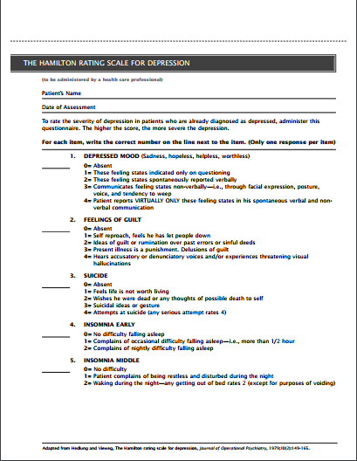
Hamilton Depression Rating Scale (HAMD)
Major Depressive Disorder (MDD)
Clinician-administered scale
The Hamilton Depression Rating Scale is the most widely used interview scale, developed in 1960 to measure severity of depression in an inpatient population.
In the original clinician-administered scale, the first 17 items are tallied for the total score, while items 18-21 are used to further qualify the depression.
Scores of 0-7 are considered normal, and scores greater than or equal to 20 indicate moderately severe depression. Each item either is scored on a 5-point scale, representing absent, mild, moderate, or severe symptoms, or on a 3-point scale, representing absent, slight or doubtful, and clearly present symptoms.
The HDRS contains a relatively large number of somatic symptoms and relatively few cognitive or affective symptoms.
It takes approximately 20 to 30 minutes to administer the HDRS.
Williams JW. Eur Arch Psychiatry Clin Neurosci. 2001. 251 (suppl 2):116
Hamilton M. J Neurol Neurosurg Psychiatry. 1960,23:56-62.
Notes:
The Hamilton Depression Rating Scale is the most widely used interview scale, developed in 1960 to measure severity of depression in an inpatient population. Since then, many versions have been adapted, including structured interview guides, self-report forms, and computerized versions. Widely used modified versions include:
Hamilton Depression Rating Scale and Beck-Rafaelson Melancholia Scale (HAM-DMES), 23 items measuring severity of depressive symptoms including melancholic symptoms³
Hamilton Depression Rating Scale (HAM-D24), 24 items measuring severity of depressive symptoms including helplessness, hopelessness and worthlessness⁴
In the original clinician-administered scale, the first 17 items are tallied for the total score, while items 18-21 are used to further qualify the depression. The scale takes 20-30 minutes to administer. Scores of 0-7 are considered normal, and scores greater than or equal to 20 indicate moderately severe depression. Each item either is scored on a 5-point scale, representing absent, mild, moderate, or severe symptoms, or on a 3-point scale, representing absent, slight or doubtful, and clearly present symptoms. The HDRS contains a relatively large number of somatic symptoms and relatively few cognitive or affective symptoms (Williams et al 2001, Hamilton 1960). The 21 items it assesses are as follows:
Depressed mood
Feelings of guilt
Thoughts of suicide
Insomnia
Work and activities
Psychomotor retardation
Psychomotor agitation
Psychic anxiety
Somatic anxiety
Gastrointestinal symptoms
General somatic symptoms
Genital symptoms
Hypochondriasis
Loss of insight
Loss of weight
Diurnal variation
Depersonalization and derealization
Paranoid symptoms
Obsessional and compulsive symptoms
Source: (1) Williams JW. Standardizing the Hamilton Depression Rating Scale: past, present and future. Eur Arch Psychiatry Clin Neurosci. 2001. 251 (suppl 2):116. (2) Hamilton M. A rating scale for depression. J Neurol Neurosurg Psychiatry. 1960 Feb. 23:56-62. (3) Bech et al. Mini-compendium of rating scales for states of anxiety, depression, mania, schizophrenia with corresponding DSM-III syndromes Act Psych Scand, 1986. 73 (suppl 326):22-28. (4) Miller et al. The modified Hamilton rating scale for depression: reliability and validity. Psych Res 1984,14:131-142

Slide 31
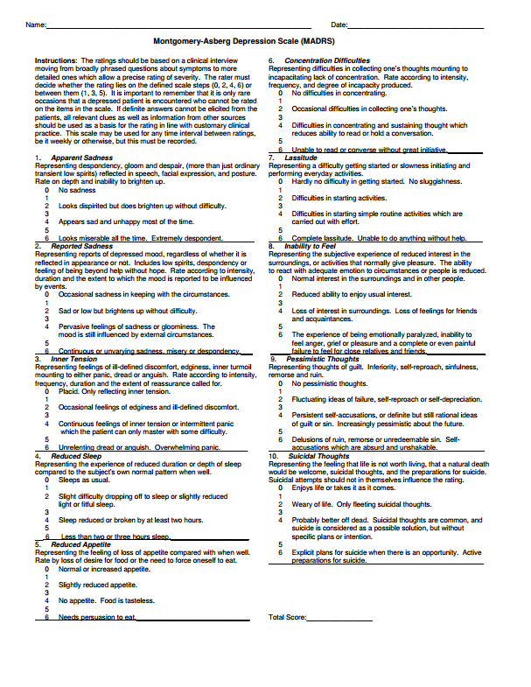
Montgomery and Åsberg Depression Rating Scale (MADRS)
Major Depressive Disorder (MDD)
Clinician-administered scale
The MADRS is a 10-item rating scale designed to assess the severity of the symptoms in depressive illness and to be sensitive to treatment effects.
Symptoms are rated on a 7-point scale from 0 (no symptom) to 6 (severe symptom). Definitions of severity are provided at two-point intervals. The total score of the ten items ranges from 0 to 60.
It takes approximately 15 to 20 minutes to administer and rate the MADRS
*Items sensitive to treatments available at the time of development of the MADRS (1979)
Montgomery & Åsberg Brit J Psychiatry 1979; 134: 382-389
Notes:
The MADRS is a ten-item rating scale designed to assess the severity of the symptoms in depressive illness and to be sensitive to treatment effects. Items in the scale assess apparent sadness, reported sadness, inner tension, reduced sleep, reduced appetite, concentration difficulties, lassitude, inability to feel, pessimistic thoughts and suicidal thoughts. Symptoms are rated on a 7-point scale from 0 (no symptom) to 6 (severe symptom). Definitions of severity are provided at two-point intervals. The total score of the ten items ranges from 0 to 60. An experienced clinician can use the MADRS after a training session. It takes approximately 15 to 20 minutes to administer and rate the MADRS.
Source: Montgomery SA, Åsberg M. A new depression scale designed to be sensitive to change. Brit J Psychiatry 1979; 134: 382-389

Slide 32
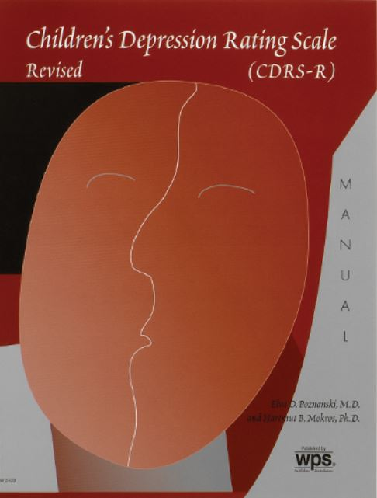
Children Depression Rating Scale - Revised (CDRS-R)
Major Depressive Disorder (MDD)
Clinician-rated scale
The CDRS-R is a clinician-rated scale to measure the severity of depression of children and adolescents.
The CDRS-R consists of 17 items: 14 items rate verbal observations, and three items rate nonverbal observations (tempo of language, hypoactivity, and nonverbal expression of depressed affect). Depression symptoms are rated on a 5-point scale from 1 to 5 for the verbal observations, and a 7-point scale from 1 to 7 for the nonverbal observations. The total score ranges from 17 (normal) to 113 (severe depression).
It takes approximately 20 to 30 minutes to administer and rate the CDRS-R.
Poznanski et al. Pediatrics 1979; 164: 442-450.
Notes:
The MADRS is a ten-item rating scale designed to assess the severity of the symptoms in depressive illness and to be sensitive to treatment effects. Items in the scale assess apparent sadness, reported sadness, inner tension, reduced sleep, reduced appetite, concentration difficulties, lassitude, inability to feel, pessimistic thoughts and suicidal thoughts. Symptoms are rated on a 7-point scale from 0 (no symptom) to 6 (severe symptom). Definitions of severity are provided at two-point intervals. The total score of the ten items ranges from 0 to 60. An experienced clinician can use the MADRS after a training session. It takes approximately 15 to 20 minutes to administer and rate the MADRS.
Source: Montgomery SA, Åsberg M. A new depression scale designed to be sensitive to change. Brit J Psychiatry 1979; 134: 382-389

Slide 33
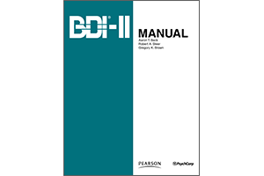
Beck Depression Inventory (BDI-II)
Major Depressive Disorder (MDD)
Patient self-rated scale
The BDI-II is a 21-item, patient self-rated scale designed to assess presence and severity of symptoms of depression in adolescents and adults.
Each of the 21 symptoms is rated on a 4-point scale from 0 (no symptom) to 3 (severe symptom). Two items include 7 response options to indicate an increase or decrease (appetite and sleep).
It takes approximately 5 to 10 minutes to complete the BDI-II.
Beck et al Manual for the Beck Depression Inventory-II. San Antonio, Tex: Psychological Corporation; 1996. (2) Beck et al Arch Gen Psychiatry. 1961 Jun. 4:561-71
Notes:
The Beck Depression Inventory (BDI) is the most widely used self-rating scale, developed in 1961 by Aaron Beck based on symptoms he observed to be common among depressed patients.
The BDI consists of 21 items of emotional, behavioral, and somatic symptoms that takes 5-10 minutes to administer. The items are scored from 0 to 3 and measure mood, pessimism, sense of failure, lack of satisfaction, guilty feelings, sense of punishment, self-hate, self-accusations, self-punitive wishes, crying spells, irritability, social withdrawal, indecisiveness, body image, work inhibition, sleep disturbance, fatigability, loss of appetite, weight loss, somatic preoccupation, and loss of libido.
Scores of 10-18 indicate mild depression, 19-29 indicate moderate depression, and greater than 30 indicate severe depression (Beck et al 1961). Other versions have been developed, including the Beck Depression Inventory II (BDI-II), a revision of the BDI in 1996 in response to the fourth edition of the DSM, and the Beck Depression Inventory for Primary Care (BDI-PC). The BDI-II is scored in the same manner as the BDI, but the cut-offs differ slightly. The BDI-PC is a screening 7-item scale for primary care outpatients, with a cut-off of 4 points for major depression. One study found a 97% sensitivity and 99% specificity rate for identifying patients with major depression (Steer et al 1999) (The BDI is copyright protected).
Sources: Beck et al An inventory for measuring depression.Arch Gen Psychiatry. 1961 Jun. 4:561-71
Steer RA, Cavalieri TA, Leonard DM, Beck AT. Use of the Beck Depression Inventory for Primary Care to screen for major depression disorders. Gen Hosp Psychiatry. 1999 Mar-Apr. 21(2):106-11.
Beck A, Steer R, Brown G. Manual for the Beck Depression Inventory-II. San Antonio, Tex: Psychological Corporation; 1996.

Slide 34
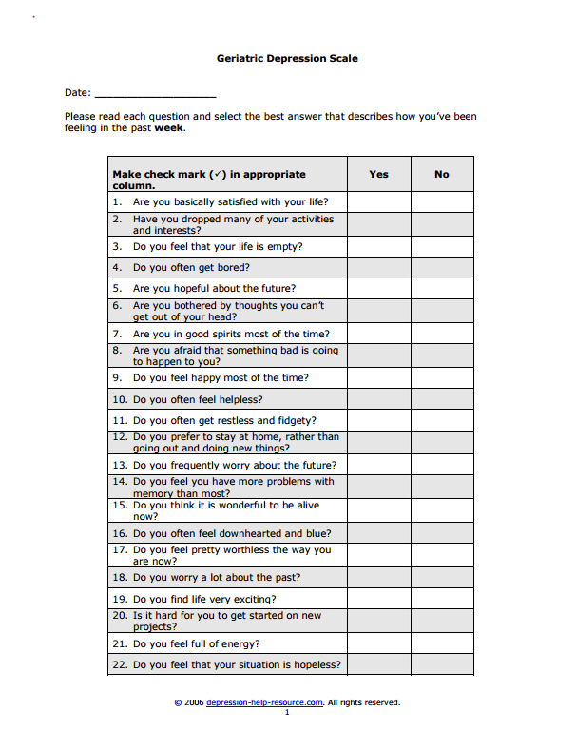
Geriatric Depression Scale (GDS)
Major Depressive Disorder (MDD)
Patient self-rated scale
The GDS is a patient-rated scale designed to screen for depression in elderly patients, and validated to measure severity of depressive symptoms.
The GDS consists of 30 items. Each item is assessed on a dichotomous scale: a “Yes” to a positive item scores 0, and a “Yes” to a negative item scores 1. The total score of the 30 items ranges from 0 (absent) to 30 (maximum severity).
It takes approximately 15 minutes to complete the GDS.
Yesavage et al. J Psychiatr Res 1983; 17: 37-49
Rinaldi et al. J Am Geriatr Soc. 2003 May. 51(5):694-8.
Notes:
The Geriatric Depression Scale (GDS) was specifically developed for use in geriatric populations, originally as a 30-item scale. It was modified a 15-item scale, which has been widely used. The GDS was later reduced to 5 items, so as to be better received by elderly patients. The questions elicit only “yes” or “no” responses, making comprehension easier compared with multiple-choice answers.
The 5-item scale has a sensitivity of 94%, specificity of 81%, and demonstrated a significant agreement in the clinical diagnosis of depression with the 15-item scale. The 5-item scale is scored by 1 point for a “no” answer on the first question or a “yes” answer for the remaining questions. A score of greater than or equal to 2 is a positive screen for depression (Rinaldi et al 2003, Yesavage et al 1983)
Source: Yesavage JA, Brink TL, Rose TL, Lum O, Huang V, Adey M, et al. Development and validation of a geriatric depression screening scale: a preliminary report. J Psychiatr Res 1983; 17: 37-49.
Rinaldi P, Mecocci P, Benedetti C, Ercolani S, Bregnocchi M, Menculini G. Validation of the five-item geriatric depression scale in elderly subjects in three different settings. J Am Geriatr Soc. 2003 May. 51(5):694-8.

Slide 35
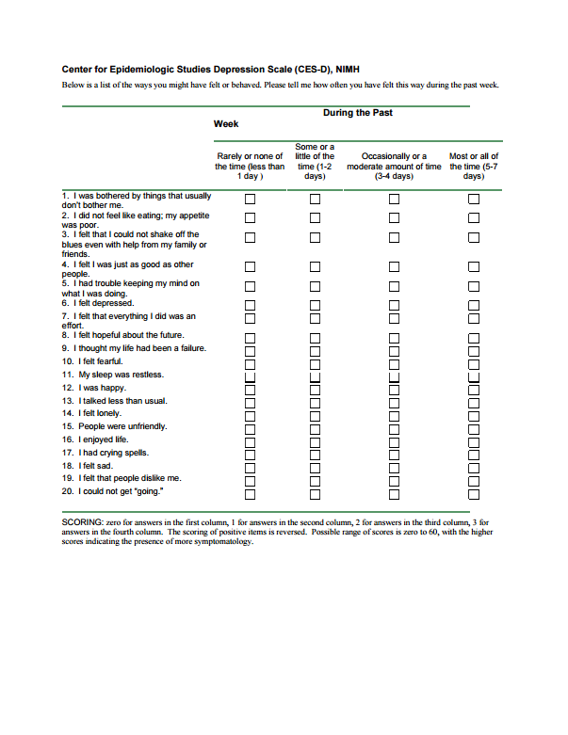
Center for Epidemiologic Studies Depression Scale (CES-D)
Major Depressive Disorder (MDD)
Patient self-rated scale
The Center for Epidemiologic Studies Depression (CES-D) scale was published in 1977 as a screening tool for depression in the general population.¹
The CES-D is often used in studies examining the well-being of participants in large-scale population surveys.
The self-administered screening scale consists of 20 items, 16 negatively worded and 4 positively worded. The instrument measures affective and somatic aspects of depression. Each question receives a score ranging from 0 to 3, and the possible range of scores is from 0 to 60, with higher scores indicating the presence of greater symptomatology.
The CES-D was revised to reflect current DSM-IV diagnostic criteria for depression, the CESD-R²
Radloff LS. Appl Psych Meas 1977; 1: 385–401
Van Dam & Earleywine. Psychiatry Res. 2011. 186(1):128-32.
Notes:
Sources: Radloff LS. The CES-D Scale: A self-report depression scale for research in the general population. Appl Psych Meas 1977; 1: 385–401, Van Dam NT, Earleywine M. Validation of the Center for Epidemiologic Studies Depression Scale--Revised (CESD-R): pragmatic depression assessment in the general population. Psychiatry Res. 2011. 186(1):128-32.

Slide 36
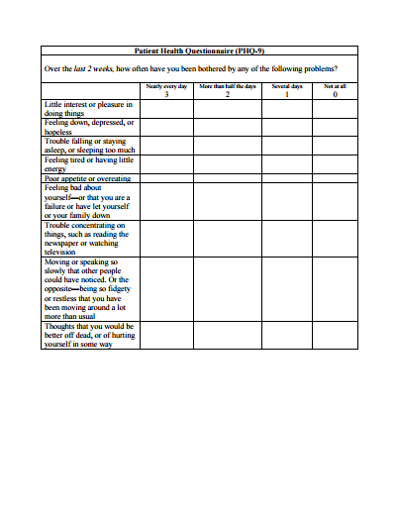
Patient Health Questionnaire (PHQ2 or PHQ9)
Major Depressive Disorder (MDD)
Patient self-rated tool
The Patient Health Questionnaire is a self-administered tool of 2 (PHQ2) or 9 (PHQ9) items. ^{1,2,3}
The PHQ-2 is a screening tool for depression that assesses the frequency of depressed mood and anhedonia over the past 2 weeks, scoring each as 0 ("not at all") to 3 ("nearly every day").¹
The PHQ 9 establishes the clinical diagnosis of depression and can additionally be used to track the severity of symptoms over time.^{2,3}
PHQ-9 scores of 5, 10, 15, and 20 are representative of mild, moderate, moderately severe, and severe depression^{2,3}
Kroenke et al. Med Care. 2003 Nov. 41(11):1284-92
Gilbody et al. J Gen Intern Med. 2007 Nov. 22(11):1596-602
Williams et al. Gen Hosp Psychiatry. 2002 Jul-Aug. 24(4):225-37.
Notes:
Source: Kroenke K, Spitzer RL, Williams JB. The Patient Health Questionnaire-2: validity of a two-item depression screener. Med Care. 2003 Nov. 41(11):1284-92.
Gilbody S, Richards D, Brealey S, Hewitt C. Screening for depression
Williams JW Jr, Pignone M, Ramirez G, Perez Stellato C. Identifying depression in primary care: a literature synthesis of case-finding instruments. Gen Hosp Psychiatry. 2002 Jul-Aug. 24(4):225-37.sion in medical settings with the Patient Health Questionnaire (PHQ): a diagnostic meta-analysis. J Gen Intern Med. 2007 Nov. 22(11):1596-602.

Slide 37
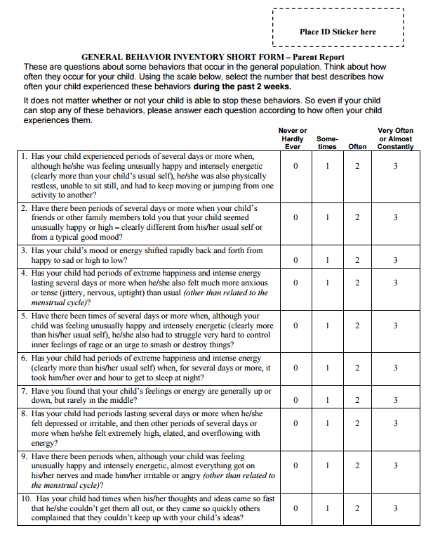
General Behavior Inventory 10-Item Depression Scale (GBI-10D)
Major Depressive Disorder (MDD)
Parent and patient self-rated scale
The GBI 10-item depression scale is a parent- and subject-rated scale designed to screen for depressive symptoms in children and adolescents.
The ten depression items are rated on a 4-point scale from 0 (never or hardly ever) to 3 (very often or almost constantly). The total score ranges from 0 to 30,with higher scores indicating greater pathology.
It takes approximately 5 minutes to complete the GBI 10-D
Youngstrom et al. Jof Child & Adoles Psychopharm 2013; 23: 72-79.
Notes:
Source: Youngstrom EA, Zhao J, Mankoski R., Forbes RA, Marcus RM, Carson W, et al. Clinical significance of treatment effects with aripiprazole versus placebo in a study of manic or mixed episodes associated with pediatric bipolar I disorder Journal of Child & Adolescent Psychopharmacology 2013; 23: 72-79.

Slide 38
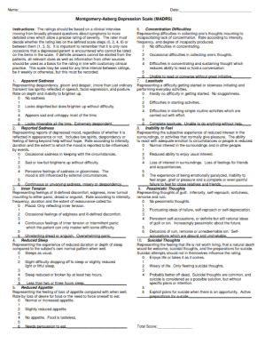
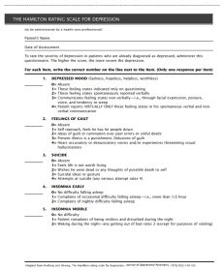
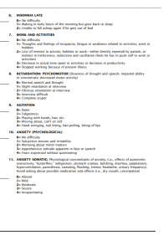
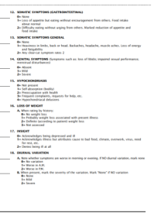
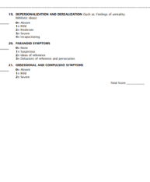
Depression rating scales measure symptom reduction in clinical trials, but are rarely used in clinical practice
Major Depressive Disorder (MDD)
Depressive and physical symptoms
Depressive, anxious, and somatic symptoms
Severity of depression of children and adolescents
MADRS⁴
HAMD⁵
CDRS-R⁶
CGI-S, Clinical Global Impression-Severity scale; HAM-D, Hamilton Depression Rating Scale; MADRS, Montgomery–Åsberg Depression Rating Scale;CDRS-R Children's Depression Rating Scale™, Revised
Furukawa TA. J Psychosom Res. 2010;68(6);581-589
Snaith P. Br J Psychiatry. 1993;163:293-298
Demyttenaere K, De Fruyt. Pscyhother Psychosom. 2003;72(2):61-70
Montgomery SA, et al. Br J Psychiatry. 1979;134:382-389
Hamilton M. J Neurol Neurosurg Psychiatry. 1960;23:56-62
Poznanski et al. Pediatrics 1979; 164: 442-450.
Notes:
This slide highlights that rating scales used for mood or specifically depression, are widely used in clinical trials. These scales are validated, meet general clinical and research purpose and have a proven reliability. However, there practical value, interpretability and feasibility in clinical practice is a matter of debate and has been questioned.
Sources: Furukawa TA. Assessment of mood: guides for clinicians.J Psychosom Res. 2010;68(6);581-589;
Snaith P. What do depression rating scales measure? Br J Psychiatry. 1993;163:293-298
Demyttenaere K, De Fruyt. Getting what you ask for: on the selectivity of depression rating scales. Pscyhother Psychosom. 2003;72(2):61-70

Slide 39
There are multiple ways to measure clinical outcomes in depression
Major Depressive Disorder (MDD)
In clinical practice, physicians and patients take a less empirical approach,
often with differing priorities^{1–6}
Physician
Patient
Remission^{4,5}
Avoidance of relapse⁴
Improvements in social function⁴
Response⁴
Reduction in cognitive symptoms⁴
Reduction in anxiety symptoms⁴
Key treatment priorities
Decrease in negative affect symptoms
Increase in positive affect symptoms⁵
Return to normal function⁴
Criteria for remission
Sanderson WC. Behav Modif. 2003;27(3):290-299
Barlow DH, et al. Behav Res Ther. 1999;37(Suppl 1):S147-S162
Herbert JD, Gaudiano BA. J Clin Psychol. 2005;61(7):893-908
Danner M, et al. Int J Technol Assess Health Care. 2011:27(4):369–75
Zimmerman M, et al. J Clin Psychiatry. 2012;73:790–95
Zimmerman M, et al. J Affect Disord. 2012;142:77–81
Notes:
This slide describes the difference in the outcome evaluation based on the perspective of either physicians or patients. In describing treatment outcome for depression, a distinction is made between response and remission. Treatment response is commonly defined as a 50% or greater improvement in scores on symptom measures such as the Hamilton Depression Rating Scale (HDRS), whereas remission is usually defined as a score below a predetermined cut-off score on the scale. Through the years, many cut-off scores have been used on the HDRS to define remission; however, since the publication of the recommendations of Frank and colleagues, a general consensus emerged to define remission on the 17-item HDRS as a score of 7 or less. Recognizing remission among patients who have responded to treatment is clinically important, because the presence of residual symptoms in treatment responders predicts an increased likelihood of relapse and greater psychosocial morbidity. In consideration of the clinical significance of residual symptoms, experts in the treatment of depression have suggested that achieving remission of symptoms should be viewed as the primary goal. Some patients who meet symptom-based definitions of remission nonetheless experience low levels of symptoms or functional impairment or deficits in coping ability, thereby warranting a modification in treatment. These findings raise caution in relying exclusively on symptom-based definitions of remission to guide treatment decision-making in clinical practice (Zimmermann et al 2012).
The AHP study included two AHP workshops, one with twelve patients and one with seven healthcare professionals. In these workshops, both patients and professionals rated their preferences with respect to the importance of different endpoints of antidepressant treatment by a pairwise comparison of individual endpoints. These comparisons were performed and evaluated by the AHP method and relative weights were generated for each endpoint. “Response” was rated the most important endpoint by the group of patients, followed by the endpoint “improvement of cognitive function.” The endpoint “remission” received the highest weighting within the group of professionals, followed by “avoidance of relapse.” The professionals rated “sexual dysfunction” lowest, as did the patients. In both workshop groups, there was good consistency in the results (CR<0.1). The set of the six most important patient-relevant outcome measures was the same for both groups. Three of these are related to efficacy: response, remission, and no relapse. Three are related to different aspects of quality of life: improvement of social functioning, improvement of cognitive function and reduction of anxiety.
Thus patients considered a return to normal level of functioning, coping with the daily stressors of life, and the presence of features of positive mental well-being such as self-confidence and optimism as equal if not more important indicators of remission as a resolution of depression symptoms.
Source: Danner M, et al. Int J Technol Assess Health Care. 2011, Integrating patients’ views into health technology assessment: Analytic hierarchy process (AHP) as a method to elicit patient preferences:27(4):369–75;
Zimmerman M, et al. Why do some depressed outpatients who are in remission according to the Hamilton Depression Rating Scale not consider themselves to be in remission? J Clin Psychiatry. 2012;73:790–95;
Zimmerman M, et al. Symptom differences between depressed outpatients who are in remission according to the Hamilton Depression Rating Scale who do and don’t consider themselves to be in remission: J Affect Disord. 2012;142:77–81.

Slide 40
Functional impairment in MDD
Major Depressive Disorder (MDD)
Functional impairment is defined as disruptions both globally and in specific areas
Patient-ranked factors to define ‘remission’
Positive mental health
(optimism, self-confidence)
Return to ‘normal’ self
Return to usual level of functioning
____
6. Absence of depressive symptoms
Work
Social life and leisure activities
Family life and home responsibilities
Interpersonal relationships
MDD=major depressive disorder
Sheehan DV. J Clin Psychiatry 2016;77:e908;Zimmerman M et al. Am J Psychiatry 2006;163:148-50
Notes:
Sheehan DV. Importance of Restoring Function in Patients With Major Depressive Disorder. J Clin Psychiatry. 2016 Jul;77(7):e908.3.

Slide 41
Patient-reported psychopathology is significant among those meeting clinical criteria for remission
Major Depressive Disorder (MDD)
17-item Hamilton Rating Scale for Depression (HAM-D17)
*
Quick Inventory of
Depressive Symptomatology (QUIDS)
*
Clinically Useful Anxiety Outcome Scale (CUXOS)
*
Clinically Useful Depression Outcome Scale (CUDOS)
*
Patient Global Rating
of Severity
*
Severity score
*p < 0.001
Patients with a HAM-D17 score ≤7, but who did not consider themselves to be in remission (n = 77), had significantly greater severity of symptoms and levels of anxiety than those who did consider themselves to be in remission (n = 63)¹
Zimmerman M et al. J Clin Psychiatry 2012;73:790–795
Notes:
This slide shows data demonstrating that patients who met the clinical criteria for remission and patients who did not consider themselves to be in remission had significantly greater severity of symptoms and levels of anxiety than those who did, demonstrating that the HAM-D17 definition of remission may not align with the patients’ view of well-being.¹
Remission: equivalent to ≤7 on the 17-item Hamilton Rating Scale for Depression [HAM-D17]
Study Background:
274 psychiatric outpatients diagnosed with DSM-IV major depressive disorder, who were in ongoing treatment, were interviewed
Patients were rated by the authors on the HAM-D17 and DSM-IV Global Assessment of Functioning (GAF) scale
Patient were assessed for depressive and anxious symptoms, psychosocial functioning, and quality of life
Patients completed seven self-report scales:
A demographic form, including a question regarding the patient's perception of whether they were currently in remission from depression
The Clinically Useful Depression Outcome Scale (CUDOS), a brief measure of depression severity that assesses the DSM-IV symptoms of major depressive disorder
The Quick Inventory of Depressive Symptomatology (QIDS), a reliable and valid measure of the DSM-IV symptom criteria of major depressive disorder
The Clinically Useful Anxiety Outcome Scale (CUXOS), general measure of psychic and somatic anxiety rather than a disorder-specific scale
The Patient Global Index of Severity of Depression (PGI)
The psychosocial functioning and quality of life subscales of the Diagnostic Inventory for Depression (DID), a self-report scale designed to assess the DSM-IV symptom inclusion criteria for a major depressive episode, assess psychosocial impairment due to depression, and evaluate subjective quality of life
The Remission from Depression Questionnaire (RDQ), consists of 41 items assessing multiple components of remission, such as positive mental health, symptom levels, and coping ability
References:
1. Zimmerman M et al. Symptom differences between depressed outpatients who are in remission according to the Hamilton Depression Rating Scale who do and don’t consider themselves to be in remission J Clin Psychiatry 2012;73:790–795

Slide 42
The definition of treatment success in depression has evolved
Major Depressive Disorder (MDD)
Nearly half of depressed patients who achieve ‘remission’ do not consider themselves to be in remission^{1,2}
Full functional recovery
Symptoms are essentially absent; patient returns to premorbid functional status
Current
Remission
Some symptoms may persist
Direct questioning combined with
a clinical impression assess
patient-specific functioning
and quality of life³
Response
Many symptoms remain
1990s
Commonly defined as
MADRS score ≤10,
or HAM-D17² score ≤7¹
1970s
Reduction of symptoms
(eg, ≥50% of MADRS or
HAM-D score)^{1,2}
Nierenberg AA & DeCecco LM. J Clin Psychiatry 2001;62(suppl 16):5–9
Hawley CJ et al. J Affect Disord 2002;72(2):177–184.
Saltiel PF & Silvershein DI. Depress Anxiety 2012;29(7):638–645
Notes:
This slide illustrates that the definition of treatment success has evolved since the 1970s, when a reduction in symptom severity was the top treatment priority. It is now accepted that treatment success requires more than symptomatic improvement, with full functional recovery the ultimate aim – a change that reflects the increasing importance of considering the patient perspective in treatment decisions.
References
Nierenberg AA & DeCecco LM. J Clin Psychiatry 2001;62(suppl 16):5–9
Hawley CJ et al. J Affect Disord 2002 Nov;72(2):177–184
Saltiel PF & Silvershein DI. Neuropsychiatric Disease and Treatment 2015:11 875–888

