Slide 1


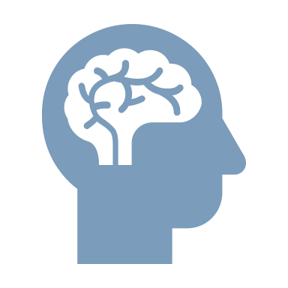
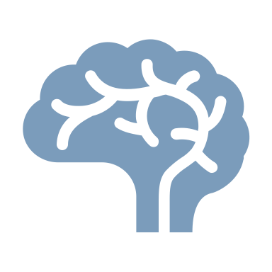
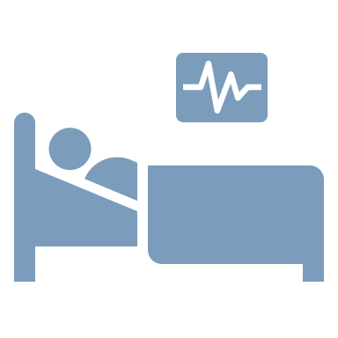
Delirium
Neurobehavioural consequences of stroke – Delirium
Delirium comes from the Latin delirare, meaning to deviate from a straight line^{1,2}
Delirium is a severe neuropsychiatric syndrome^{1,3}
It can be characterized as acute-onset deficits in attention and other aspects of cognition, typically lasting for a period of a few days^{1,3}
People with delirium often also experience altered arousal, ranging from reduced responsiveness at near-coma level, to hypervigilance and severe agitation¹
Delirium can also include psychosis; i.e., symptoms of delusions and hallucination¹
Delirium can be the result of many different medical causes, either secondary causes outside the brain (e.g., drug withdrawal, illness, or surgery), or from a primary cause within the brain, e.g., stroke¹
1. Wilson et al. Nat Rev Dis Primers 2020;6(1):90; 2. Adamis et al. Hist Psychiatry 2007;18:459–469; 3. APA. DSM-5-TR. 2022
Notes:
Delirium is a medical condition characterized by acute-onset deficits in attention and other aspects of cognition.¹ Various terms have been used in the past for this constellation of symptoms, e.g., ‘acute confusional state’, and ‘organic brain syndrome’.¹ This inconsistency of definition over the years has hindered research into delirium.¹
References:
Wilson JE, Mart MF, Cunningham C, et al. Delirium. Nat Rev Dis Primers 2020; 6 (1): 90.
Adamis D, Treloar A, Martin FC, Macdonald AJ. A brief review of the history of delirium as a mental disorder. Hist Psychiatry 2007; 18: 459–469.
American Psychiatric Association. Diagnostic and Statistical Manual of Mental Disorders – fifth edition text revision. American Psychiatric Association; 2022.

