Slide 1
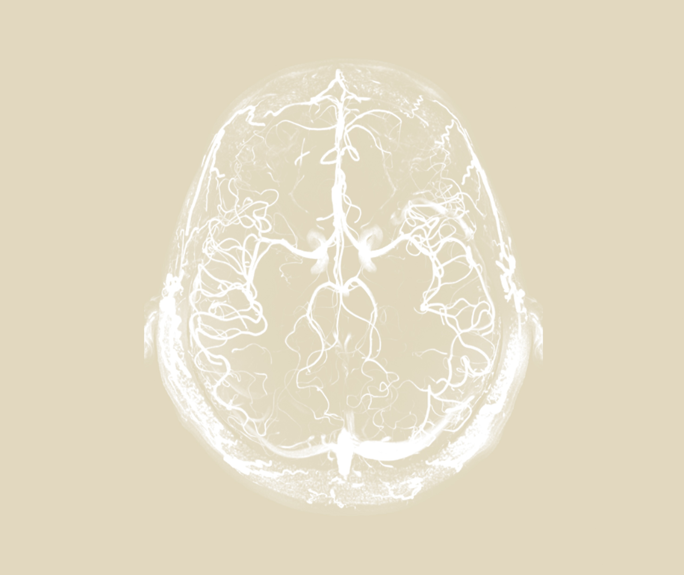
Neurobehavioural consequences of stroke
Delirium

Slide 2

Case presentation
Neurobehavioural consequences of stroke – Delirium
Mrs. A is an 88-year-old female patient who has been on the acute stroke unit for six days
She has a past medical history of mild cognitive impairment, visual impairment and alcohol excess
This admission was due to a major stroke, treated with tissue plasminogen activator. She was making good progress but now a change had been noted
She is drowsy during the day but awake and distressed at night. She is not engaging
in rehabilitation anymore and struggles to focus on tasks
She picks at the air as if hallucinating
During the doctor’s morning rounds she seems fine
This case study is a hypothetical patient case, based on Prof. Terry Quinn’s clinical experiences
Notes:
The slide details a case study of a patient who developed delirium after experiencing stroke.

Slide 3
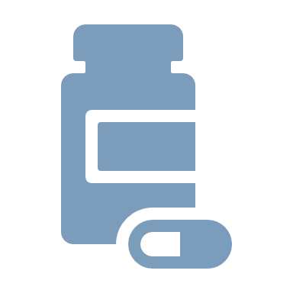



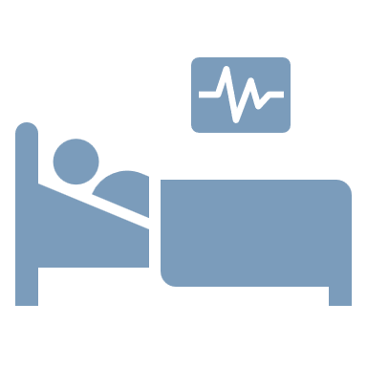
Delirium
Neurobehavioural consequences of stroke – Delirium
Delirium comes from the Latin delirare, meaning to deviate from a straight line^{1,2}
Delirium is a severe neuropsychiatric syndrome^{1,3}
It can be characterized as acute-onset deficits in attention and other aspects of cognition, typically lasting for a period of a few days^{1,3}
People with delirium often also experience altered arousal, ranging from reduced responsiveness at near-coma level, to hypervigilance and severe agitation¹
Delirium can also include psychosis; i.e., symptoms of delusions and hallucination¹
Delirium can be the result of many different medical causes, either secondary causes outside the brain (e.g., drug withdrawal, illness, or surgery), or from a primary cause within the brain, e.g., stroke¹
1. Wilson et al. Nat Rev Dis Primers 2020;6(1):90; 2. Adamis et al. Hist Psychiatry 2007;18:459–469; 3. APA. DSM-5-TR. 2022
Notes:
Delirium is a medical condition characterized by acute-onset deficits in attention and other aspects of cognition.¹ Various terms have been used in the past for this constellation of symptoms, e.g., ‘acute confusional state’, and ‘organic brain syndrome’.¹ This inconsistency of definition over the years has hindered research into delirium.¹
References:
Wilson JE, Mart MF, Cunningham C, et al. Delirium. Nat Rev Dis Primers 2020; 6 (1): 90.
Adamis D, Treloar A, Martin FC, Macdonald AJ. A brief review of the history of delirium as a mental disorder. Hist Psychiatry 2007; 18: 459–469.
American Psychiatric Association. Diagnostic and Statistical Manual of Mental Disorders – fifth edition text revision. American Psychiatric Association; 2022.

Slide 4
The history of delirium
Neurobehavioural consequences of stroke – Delirium
Quincy referred to mania or madness as “a Delirium without fever”, and stated “delirium is the dreams
of waking persons”
Hippocrates used about
16 different words to characterize the syndrome of delirium, including ‘phrenitis’
Procopius gives a description of delirium in his account of the plague in Constantinople
500 BC
~100
542
1592
1719
1900s
Celsus uses the words delirium and phrenitis in medical writings
‘Delirium’ in English was probably first coined by Cosin, in a book about insanity
A year later Philip Barrought described phrenesis as a ‘continual madness’ which was in most cases deadly
The influential psychiatrists of the age argued about definitions
of delirium and its terminology
Lipowski became a leading figure in delirium research, writing extensively about the subject
Adapted from: Adamis et al. Hist Psychiatry 2007;18:459–469
Notes:
As shown on the slide, the term delirium has been used inconsistently in its history stretching back several centuries.¹
Reference:
Adamis D, Treloar A, Martin FC, Macdonald AJ. A brief review of the history of delirium as a mental disorder. Hist Psychiatry 2007 Dec; 18 (72 Pt 4): 459–469.

Slide 5




Definitions
Neurobehavioural consequences of stroke – Delirium
Hypoactive delirium¹
43% of delirium cases in the PROPOLIS study²
Delirium with a hypoactive level of psychomotor activity that may be accompanied by:
  Sluggishness
  Lethargy that approaches stupor
Hyperactive delirium¹
16% of delirium cases in the PROPOLIS study²
Delirium with a hyperactive level of psychomotor activity that may be accompanied by:
  Mood lability
  Agitation
  Refusal to cooperate with
  medical care
Mixed delirium¹
36% of delirium cases in the PROPOLIS study²
Delirium accompanied by a normal level of psychomotor activity (even though attention and awareness are disturbed)
Delirium tremens^{1,3}
A form of psychotic delirium that can develop during alcohol withdrawal in people with
alcohol-use disorder
PROPOLIS=prospective observational Polish study on post-stroke delirium
1. APA. DSM-5-TR. 2022; 2. Droś et al. J Clin Med 2020;9(7):2165; 3. Grover & Ghosh. J Clin Exp Hepatol 2018;8(4):460–470
Notes:
Delirium is a neurocognitive disorder characterized by an acute disturbance in attention, which can be hypo- or hyper-active, or mixed.¹
References:
American Psychiatric Association. Diagnostic and Statistical Manual of Mental Disorders – fifth edition text revision. American Psychiatric Association; 2022.
Droś J, Kowalska K, Pasińska P, et al. Delirium post-stroke influence on post-stroke dementia (research study – part of the PROPOLIS Study). J Clin Med 2020; 9 (7): 2165.
Grover S, Ghosh A. Delirium tremens: assessment and management. J Clin Exp Hepatol 2018; 8 (4): 460–470.

Slide 6
Epidemiology and risk factors

Slide 7

Delirium and stroke
Neurobehavioural consequences of stroke – Delirium
Delirium is a complex syndrome, likely to be the result of multiple factors, including neuroinflammation, vascular dysfunction, altered metabolism, neurotransmitter imbalance, and altered neuronal network connectivity¹
Delirium is common as a result of stroke – one
meta-analysis estimated that 23% of people experience delirium with stroke²
Delirium after stroke is associated with poorer outcomes, including:³
  Longer hospital stay
  Risk of later institutionalization
  Mortality
Effect of delirium on inpatient stroke mortality³
From 6 studies, including 302 events of delirium
Odds ratio of death in those with delirium versus those without:
4.71 times greater
CI: 1.85–11.96
Effect of delirium on 12-month stroke mortality³
From 3 studies, including 124 events of delirium
Odds ratio of death in those with delirium versus those without:
4.91 times greater
CI: 3.18–7.60
CI=confidence interval
1. Wilson et al. Nat Rev Dis Primers 2020;6(1):90; 2. Shaw et al. Stroke 2019;50(11):3028–3036; 3. Shi et al. Stroke 2012;43(3):645–649
Notes:
Delirium is common in stroke, and is associated with poorer outcomes for the patient.^{2,3} However, the pathogenesis of delirium is poorly understood and thought to involve a multitude of interacting factors which increase the risk of a person experiencing delirium.¹
References:
Wilson JE, Mart MF, Cunningham C, et al. Delirium. Nat Rev Dis Primers 2020; 6 (1): 90.
Shaw RC, Walker G, Elliott E, Quinn TJ. Occurrence rate of delirium in acute stroke settings: systematic review and meta-analysis. Stroke 2019; 50 (11): 3028–3036.
Shi Q, Presutti R, Selchen D, Saposnik G. Delirium in acute stroke: a systematic review and meta-analysis. Stroke 2012; 43 (3): 645–649.

Slide 8
Occurrence of delirium in acute stroke
Neurobehavioural consequences of stroke – Delirium
Incidence of post-stroke delirium
In this sample of 141 people with stroke, the prevalence of delirium was 39%
Delirium occurred within 72 hours of stroke in the majority of cases
Majority of cases within 72 hours
Incidence of
post-stroke delirium
Point prevalence of post-stroke delirium
24
48
72
96
120
144
168
Time from stroke onset (hours)
Fleischmann et al. Stroke 2021;52(2):471–478
Notes:
This study followed 141 people after stroke and compared the usefulness of different methods for diagnosing delirium.¹ The results, as shown on the slide, show delirium is a common occurrence after stroke, and usually presents within the first 72 hours after stroke.¹ Although a smaller-scale study than was originally hoped, the results highlighted the importance of frequent screening for delirium.¹ The results also show the difficulties of detecting delirium, in part caused by the confounding effects of the potential focal neurological deficits of stroke.¹
Reference:
Fleischmann R, Warwas S, Andrasch T, et al. Course and recognition of poststroke delirium: a prospective noninferiority trial of delirium screening tools. Stroke 2021; 52 (2): 471–478.

Slide 9
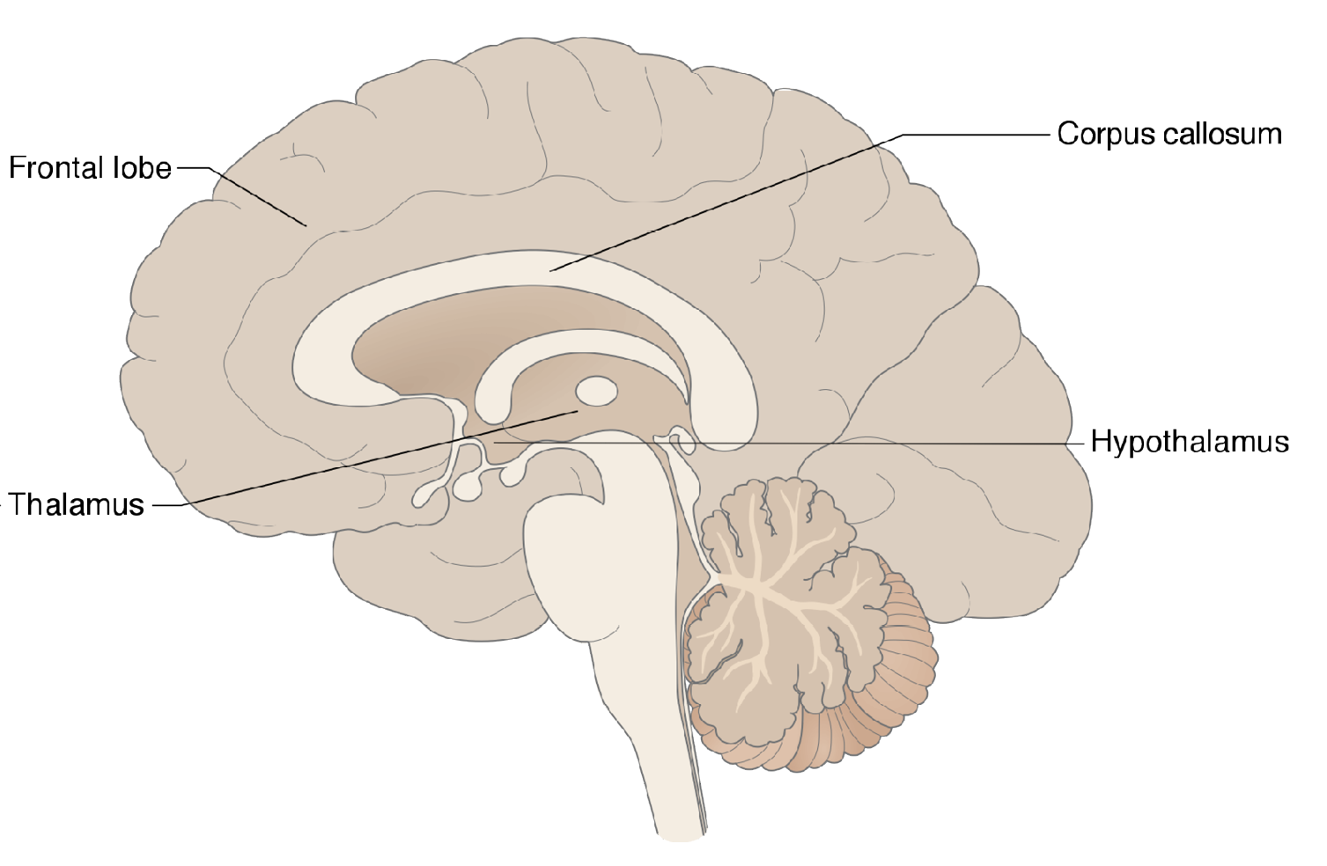
Pathology of delirium
Neurobehavioural consequences of stroke – Delirium
The pathology of delirium is complex
and multifaceted
Stroke can be a primary cause of delirium, but is also thought to combine with many other factors to increase the risk of delirium in people after stroke
Microglia
Astrocytes
Pre-existing neurodegenerative pathology
Release of chemokines and inflammatory chemicals
Neural injury and dysfunction
Pre-existing neurodegenerative pathology
Release of chemokines and phenotype switching
Increased immune infiltration
Corpus callosum
Frontal lobe
Vasculature
Endothelial and blood–brain barrier (BBB) dysfunction
Further endothelial and BBB damage
Metabolic insufficiency
Hypothalamus
Thalamus
Neural networks
Drugs
Pre-existing neurodegenerative pathology
Synaptic changes, impairments in
neural–vascular coupling
Reduced integration of neural networks
GABAergic sedatives
Anticholinergic medications
Antihistamine medications
Vulnerabilities Acute cellular changes Functional consequence
BBB=blood–brain barrier; GABA=gamma-aminobutyric acid
Wilson et al. Nat Rev Dis Primers 2020;6(1):90
Notes:
As outlined on the slide, there are many risk factors which can predispose a person to experiencing delirium.¹ Because there is such a complex network of predisposing and precipitating factors, it is often difficult to assign a specific cause of delirium in a patient.¹ There are many inter-connected networks within the mid-brain and brain stem that interact with the thalamus and the cortex to regulate arousal.¹ Some drugs have actions within these pathways of the brain, and are therefore thought to contribute to delirium, such as GABAergic sedatives, and anticholinergic and antihistamine drugs.¹
Reference:
Wilson JE, Mart MF, Cunningham C, et al. Delirium. Nat Rev Dis Primers 2020; 6 (1): 90.

Slide 10
Risk factors for post-stroke delirium
Neurobehavioural consequences of stroke – Delirium
Known risk factors for stroke include cognitive impairment, visual impairment, infection,
and dehydration¹⁻³
Risk factors for post-stroke delirium can be
separated into:⁴
  Prevalent risks that pre-date the stroke,
  e.g., cognitive impairment
  Incident risks that are caused by the stroke,
  e.g., dehydration
A model including patient age, stroke severity, and the presence of infection can be used to identify those at greatest risk of developing delirium⁵
A prospective observational study of 760 people after stroke analyzed risk factors for developing delirium, which included:⁶
  Atrial fibrillation
  A higher Rankin score (which measures the degree
  of neurologic disability)
  Hemianopia (loss of half of the visual field)
  A lower platelet-to-white blood cell count ratio
Another prospective cohort study of 527 patients with stroke found the following risk factors
for delirium:⁷
  Pre-existing cognitive decline
  Infection
1. Makin & Wardlaw. J Neurol Neurosurg Psychiatry 2014;85(4):357;
2. Inouye & Charpentier. JAMA 1996;275(11):852–857; 3. Wilson et al. Nat Rev Dis Primers 2020;6(1):90; 4. Shaw et al. Stroke 2019;50(11):3028–3036;
5. Oldenbeuving et al. J Neurol Neurosurg Psychiatry 2014;85(4):431–434; 6. Kotfis et al. Clin Interv Aging 2019;14:1771–1782; 7. Oldenbeuving et al. Neurology 2011;76(11):993–999
Notes:
Given the negative effects of delirium on the outcomes of stroke, predicting the risk of a person after stroke of developing delirium is a valuable clinical ambition.^{1,5} One such tool has been developed that included age, stroke severity and subtype, and the presence of infection as risks.⁵ These risks can be combined numerically to create a score, which the authors argue can be used easily in clinical practice to allow clinicians to evaluate an individual patient’s delirium risk.⁵
References:
Makin SD, Wardlaw J. Predicting delirium after a stroke. J Neurol Neurosurg Psychiatry 2014; 85 (4): 357.
Inouye SK, Charpentier PA. Precipitating factors for delirium in hospitalized elderly persons. Predictive model and interrelationship with baseline vulnerability. JAMA 1996; 275 (11): 852–857.
Wilson JE, Mart MF, Cunningham C, et al. Delirium. Nat Rev Dis Primers 2020; 6 (1): 90.
Shaw RC, Walker G, Elliott E, Quinn TJ. Occurrence rate of delirium in acute stroke settings: systematic review and meta-analysis. Stroke 2019; 50 (11): 3028–3036.
Oldenbeuving AW, de Kort PL, van Eck van der Sluijs JF, Kappelle LJ, Roks G. An early prediction of delirium in the acute phase after stroke. J Neurol Neurosurg Psychiatry 2014; 85 (4): 431–434.
Kotfis K, Bott-Olejnik M, Szylińska A, et al. Characteristics, risk factors and outcome of early-onset delirium in elderly patients with first ever acute ischemic stroke – a prospective observational cohort study. Clin Interv Aging 2019; 14: 1771–1782.
Oldenbeuving AW, de Kort PL, Jansen BP, et al. Delirium in the acute phase after stroke: incidence, risk factors, and outcome. Neurology 2011; 76 (11): 993–999.

Slide 11
Prognosis

Slide 12
Prognosis of delirium in stroke
Neurobehavioural consequences of stroke – Delirium
Delirium after stroke is associated with poorer outcomes, including: length of hospital stay, risk of later institutionalization, and mortality¹
The PROPOLIS study followed 682 people for 12 months after stroke, and measured the impact of delirium
on mortality²
Another study followed 103 patients for 3 months after stroke and measured the impact of delirium on mortality³
1.0
No delirium
1.0
No delirium
0.9
0.9
Delirium
0.8
0.8
Cumulative survival
Cumulative survival
0.7
0.7
Delirium
0.6
0.6
0.5
0.5
0
100
200
300
400
0
25
50
75
100
Days
Days
This work is adapted from ‘The long-term prognosis of patients with delirium in the acute phase of stroke: PRospective Observational POLIsh Study (PROPOLIS)' by Pasińska et al., used under CC-BY. This work is licensed under Creative Commons license CC-BY-SA by The Lundbeck Foundation.
This work is adapted from ‘Impact of delirium on the outcome of stroke: a prospective, observational, cohort study' by Rollo et al., used under CC-BY. This work is licensed under Creative Commons license CC-BY-SA by The Lundbeck Foundation.
PROPOLIS=prospective observational Polish study
1. Shi et al. Stroke 2012;43(3):645–649; 2. Pasińska et al. J Neurol 2019;266(11):2710–2717; 3. Rollo et al. J Neurol 2022;269(12):6467–6475
Notes:
Although common in people after stroke, the effect of delirium on clinical outcomes in the long term has been poorly studied.² To address this deficit, the PROPOLIS study (prospective observational Polish study) followed a large group of people (n=682) after stroke, and studied the effect of delirium on discharge destination, recurrence of stroke, cardiovascular events, functional status, nursing home admission, and death.² After correcting for several potential confounding factors (because delirium could be a proxy for severe illness), the rates of mortality – both at 3- and 12-months – were greater among people who had experienced delirium compared with those who had not, increasing the mortality rate by 2–3 times.²
References:
Shi Q, Presutti R, Selchen D, Saposnik G. Delirium in acute stroke: a systematic review and meta-analysis. Stroke 2012; 43 (3): 645–649.
Pasińska P, Wilk A, Kowalska K, et al. The long-term prognosis of patients with delirium in the acute phase of stroke: PRospective Observational POLIsh Study (PROPOLIS). J Neurol 2019; 266 (11): 2710–2717.
Rollo E, Brunetti V, Scala I, et al. Impact of delirium on the outcome of stroke: a prospective, observational, cohort study. J Neurol 2022; 269 (12): 6467–6475.

Slide 13




Post-stroke delirium and cognitive impairment and dementia
Neurobehavioural consequences of stroke – Delirium
The PROPOLIS study¹
Data from the PROPOLIS study (n=691) were used to compare rates of dementia in people who experienced post-stroke delirium versus those who did not
Delirium was an independent risk factor for dementia at 3-months:
  OR: 7.27
  (95% CI: 2.18, 24.21)
A 2-year prospective study²
Risk of developing dementia
at 2-years in patients who had delirium after stroke versus those without delirium:
  By CDR scale:
  OR: 4.7 (95% CI: 1.08, 20.42)
  By Rotterdam-CAMCOG:
  OR: 7.2 (95% CI: 1.88, 27.89)
The domains most affected in people with dementia after post-stroke delirium appeared to be:
  Memory
  Language
  Visual construction
  Executive functioning
50 people with stroke
22 with delirium
28 without delirium
2 years
The chance of developing dementia at
2-years for those with delirium was
5–7 times greater than those who did not experience delirium
CAMCOG=Cambridge Cognitive Examination; CDR=Clinical Dementia Rating Scale; CI=confidence interval; OR=odds ratio
1. Droś et al. J Clin Med 2020;9(7):2165; 2. van Rijsbergen et al. J Neurol Sci 2011;306(1–2):138–142
Notes:
People with delirium after stroke appear to be at a higher risk of developing dementia than people who do not experience delirium.^{1,2} However, delirium and dementia have a complex and interconnected relationship, making studies of the effect of post-stroke delirium on later dementia challenging to design.³ The results of the PROPOLIS study suggested that delirium was associated with dementia 3-months after stroke, but not later at 1 year, a result which might reflect the short-term nature of delirium.¹ More research is needed, with larger and longer-term studies, to understand the nature of the relationship between delirium and dementia after stroke.²
References:
Droś J, Kowalska K, Pasińska P, et al. Delirium post-stroke influence on post-stroke dementia (research study – part of the PROPOLIS Study). J Clin Med 2020; 9 (7): 2165.
van Rijsbergen MW, Oldenbeuving AW, Nieuwenhuis-Mark RE, et al. Delirium in acute stroke: a predictor of subsequent cognitive impairment? A two-year follow-up study. J Neurol Sci 2011; 306 (1–2): 138–142.
Fong TG, Inouye SK. The inter-relationship between delirium and dementia: the importance of delirium prevention. Nat Rev Neurol 2022; 18 (10): 579–596.

Slide 14


The relationship between delirium and dementia
Neurobehavioural consequences of stroke – Delirium
Delirium, cognitive impairment, and dementia appear to
be inter-connected in
older adults
New techniques are shining a light on how changes in cerebral blood flow, spectral power, and connectivity can be associated with delirium, some of which may be precipitated
by stroke
Resilience
No delirium
Healthy brain
Neuro-inflammation
Delirium
Dementia
Acceleration of AD pathology or neuronal injury
Brain with AD or neurodegenerative pathology
In the absence of resilience factors (e.g., cognitive reserve), or any prevention strategies, certain precipitating factors may lead to a patient
developing delirium
The neuroinflammation of delirium may accelerate a disease process already underway (e.g., AD), or it may cause neural injury through a different pathway
Baseline
Acute delirium phase
Chronic phase
AD=Alzheimer’s disease
Fong & Inouye. Nat Rev Neurol 2022;18(10):579–596
Notes:
Because delirium, cognitive impairment, and dementia appear to be inter-connected, strategies to prevent delirium may help reduce the risk of cognitive decline, or dementia, in older patients.¹ As shown on the slide, the multitude of factors involved present many opportunities for intervening in the hypothetical disease process that leads from delirium to dementia.¹
Reference:
Fong TG, Inouye SK. The inter-relationship between delirium and dementia: the importance of delirium prevention. Nat Rev Neurol 2022; 18 (10): 579–596.

Slide 15
Diagnosis and treatment

Slide 16

Diagnosis of delirium
Neurobehavioural consequences of stroke – Delirium
Delirium can be diagnosed using the DSM-5 criteria¹
Clinicians should be aware that people in hospital, or long-term care, may be at risk of delirium²
  Greater awareness and improved diagnosis of delirium aims to prevent the negative consequences that often accompany delirium, such as longer hospital stay or complications²
Patients with delirium should initially be assessed for triggers possibly underlying the delirium syndrome³
  Assessment can involve many different tests, including routine blood tests and less routine radiological scans³
There are many screening tools available that can help identify delirium in patients³
DSM-5 criteria for delirium¹
A disturbance in attention (i.e., reduced ability to direct, focus, sustain, and shift attention) and awareness (reduced orientation to the environment)
The disturbance develops over a short period of time (usually hours to a few days), represents a change from baseline attention and awareness, and tends to fluctuate in severity during the course of a day
An additional disturbance in cognition (e.g., memory deficit, disorientation, language, visuospatial ability, or perception)
The disturbances in Criteria A and C are not better explained by another pre-existing, established, or evolving neurocognitive disorder and do not occur in the context of a severely reduced level of arousal, such as coma
There is evidence from the history, physical examination, or laboratory findings that the disturbance is a direct physiological consequence of another medical condition, substance intoxication or withdrawal (i.e., due to a drug of abuse or to a medication), or exposure to a toxin, or is due
to multiple aetiologies
DSM-5=Diagnostic and Statistical Manual of Mental Disorders – fifth edition
1. APA. DSM-5-TR. 2022; 2. NICE. Clinical guideline CG103. January 2023;
3. Wilson et al. Nat Rev Dis Primers 2020;6(1):90
Notes:
Delirium is thought to be an unrecognized condition, often going undiagnosed in clinical settings.^{3.} This is partly due to a lack of training about the importance of diagnosing delirium, and lack of knowledge among healthcare professionals about the impact that delirium can have on patients.³
References:
American Psychiatric Association. Diagnostic and Statistical Manual of Mental Disorders – fifth edition text revision. American Psychiatric Association; 2022.
National Institute for Health and Care Excellence. Delirium: prevention, diagnosis and management in hospital and long-term care. Clinical guideline CG103. Updated January 2023. Available at: https://www.nice.org.uk/guidance/cg103. Accessed July 2023.
Wilson JE, Mart MF, Cunningham C, et al. Delirium. Nat Rev Dis Primers 2020; 6 (1): 90.

Slide 17
Screening tools used to assess delirium
Neurobehavioural consequences of stroke – Delirium
There are many different available tools for assessing delirium
The choice of screening tools is largely driven by the treatment setting, (e.g., different tools are applicable in general hospital settings compared with patients in intensive-care) but also by feasibility, copyright issues, and the training required
General hospital settings
CAM-based tools
(useful in general hospital, older patients, intensive-care patients, and people in nursing home and palliative care settings)
Intensive-care settings
4AT
4 items, scored differently:
1) Alertness
2) Abbreviated mental test – 4
3) Attention
4) Acute change or fluctuation
ICDSC
8 items, scored 1 (yes) or 0 (no):
Altered level of consciousness
Inattention
Disorientation
Hallucination, delusions
Agitation
Inappropriate speech
Sleep–wake disturbances
Symptom fluctuation
CAM
1) Acute-onset and fluctuating course in mental status
2) Inattention
3) Altered level of consciousness
4) Disorganized thinking
Delirium likely if score ≥4
Delirium likely if 1 and 2 are present plus 3 or 4
Delirium likely if score ≥4
4AT=The 4 A’s Test; CAM=Confusion Assessment Method; ICDSC=Intensive Care Delirium Screening Checklist
Wilson et al. Nat Rev Dis Primers 2020;6(1):90
Notes:
Many tools have been developed to assess and help diagnose delirium, some of which have been designed to screen for delirium when it is suspected, others are designed to monitor delirium once diagnosed, and others which are focused on categorizing the severity of delirium.¹
Reference:
Wilson JE, Mart MF, Cunningham C, et al. Delirium. Nat Rev Dis Primers 2020; 6 (1): 90.

Slide 18
The 4AT tool
Neurobehavioural consequences of stroke – Delirium
The 4AT instrument¹
1) Alertness
This includes patients who may be markedly drowsy (e.g., difficult to rouse and/or obviously sleepy during assessment) or agitated/hyperactive. Observe the patient. If asleep, attempt to wake with speech or gentle touch on shoulder. Ask the patient to state their name and address to assist rating
 | Normal (fully alert, but not agitated, throughout assessment) | 0
 | Mild sleepiness for <10 seconds after waking, then normal | 0
 | Clearly abnormal | 4
2) AMT-4
Age, date of birth, place (name of the hospital or building), current year
 | No mistakes | 0
 | 1 mistake | 1
 | >1 mistake/untestable | 2
3) Attention
Ask the patient: “Please tell me the months of the year in backwards order, starting at December.” To assist initial understanding, one prompt of “what is the month before December?” is permitted
 | Achieves 7 months or more correctly | 0
 | Starts but scores <7 months/refuses to start | 1
 | Untestable (cannot start because unwell, drowsy, inattentive) | 2
4) Acute change or fluctuating course
Evidence of significant change or fluctuation in: alertness, cognition, other mental function (e.g., paranoia, hallucinations) arising over the last 2 weeks and still evident in last 24 hours
 | No | 0
 | Yes | 4
The 4AT is a simple, widely-used tool to detect delirium¹
Free to use, the 4AT was designed to be completed within 2 minutes and used in the clinic¹
The 4AT has been validated in clinical use across 82,770 hospital admissions, where it has been used as part
of the usual care process²
  The scores on the 4AT test were correlated with 30-day mortality, and length of hospital stay²
A meta-analysis of 17 publications using the 4AT found that the 4AT test for delirium has good diagnostic accuracy, including in people with stroke:³
  Pooled sensitivity: 0.88 (95% CI: 0.80, 0.93)
  Pooled specificity: 0.88 (95% CI: 0.82, 0.92)
Total score ≥4: possible delirium with/without cognitive impairment
Total score 1–3: possible cognitive impairment
Total score 0: delirium or severe cognitive impairment unlikely
4AT=4 A’s test for delirium; AMT-4=Abbreviated Mental Test – 4 questions; CI=confidence interval
1. 4AT website. https://www.the4at.com. Accessed May 2023; 2. Anand et al. Age Ageing 2022;51(3):afac051; 3. Tieges et al. Age Ageing 2021;50(3):733–743
Notes:
The diagnostic accuracy of the 4AT has been assessed in many studies, 17 of which have been collectively analyzed in a systematic review and meta-analysis.³ The 17 studies varied; some studies included translated or modified versions of the original 4AT tool, and were in different patient settings.³ The studies reported a range of delirium prevalence ranging from 10.5–61.9%.³ Some of these validation studies were in acute stroke.³ In a pre-planned subgroup analysis, the sensitivity and specificity of the 4AT in patients with stroke (0.86 and 0.89, respectively) were similar to the values for the total population (0.88 and 0.88, as shown on the slide).³
References:
4AT website. Available at: https://www.the4at.com. Accessed May 2023.
Anand A, Cheng M, Ibitoye T, et al. Positive scores on the 4AT delirium assessment tool at hospital admission are linked to mortality, length of stay and home time: two-centre study of 82,770 emergency admissions. Age Ageing 2022; 51 (3): afac051.
Tieges Z, Maclullich AMJ, Anand A, et al. Diagnostic accuracy of the 4AT for delirium detection in older adults: systematic review and meta-analysis. Age Ageing 2021; 50 (3): 733–743.

Slide 19

NICE guidelines for preventing delirium
Neurobehavioural consequences of stroke – Delirium
People should be given a care package tailored to their needs, devised within 24 hours of admission if they are admitted to hospital¹
Multicomponent approaches to prevent delirium were found to reduce the incidence
of delirium by 43% compared with usual care in a large Cochrane review²
Address cognitive impairment or disorientation (e.g., use clear lighting, talk to the person to explain your clinical role)¹
Address dehydration or constipation (e.g., ensure adequate fluid intake)¹
Assess the patient for hypoxia and optimise oxygen saturation if necessary¹
Address any infection (e.g., treat infection, avoid unnecessary catheterisation)¹
Address mobility (e.g., encourage people to walk after surgery)¹
Address pain (e.g., review pain management, look for non-verbal signs of pain)¹
Address poor nutrition (e.g., ensure dentures fit)¹
Address sensory impairment (e.g., resolve ear wax, ensure hearing aids work)¹
Promote good sleep patterns (e.g., avoid medical procedures during sleeping hours, reduce noise during night time)¹
NICE=National Institute for Health and Care Excellence
1. NICE. Clinical guideline CG103. January 2023; 2. Burton et al. Cochrane Database Syst Rev 2021;7(7):CD013307
Notes:
Healthcare professionals should be aware that people in hospital or long-term care might be at risk of developing delirium, and should undertake a risk factor assessment for other delirium risks, including older age, cognitive impairment, and the presence of severe illness.¹ As outlined on the slide, a tailored multicomponent intervention package can be devised for the individual patient, to help prevent the occurrence of delirium.¹ Indeed, a Cochrane review concluded that multicomponent approaches to preventing delirium reduce the incidence of delirium by 43% compared with usual care – i.e., preventing two in five cases.²
References:
National Institute for Health and Care Excellence. Delirium: prevention, diagnosis and management in hospital and long-term care. Clinical guideline CG103. Updated January 2023. Available at: https://www.nice.org.uk/guidance/cg103. Accessed July 2023.
Burton JK, Craig LE, Yong SQ, et al. Non-pharmacological interventions for preventing delirium in hospitalised non-ICU patients. Cochrane Database Syst Rev 2021; 7 (7): CD013307.

Slide 20



Challenges and approaches to managing post-stroke delirium
– the views of healthcare professionals involved in the management of stroke
Neurobehavioural consequences of stroke – Delirium
1. Uncertainty around symptom recognition
3. Involving others in delivering care
“I would consider whether these are signs of early stages of dementia”
“I think confused is too broad a term and doesn’t identify the reasons for the behaviours”
“We have patients who have language, processing or visual difficulties due to the stroke however they are described as ‘confused’”
“I think it’s everyone’s responsibility but realistically the screening is done by nursing staff… as part of the admission process and it’s then ongoing”
“It may be good to involve her family in therapy to see if they can get her to engage”
“Could she be encouraged to join in any activities with other patients or perhaps her family could take her out for a short trip”
2. Information gathering
4. Delivering patient-focused care
“On admission, the 4AT screening for dementia/delirium should have been done, so you could track the changes”
“We use the 4AT screening tool for delirium and cognitive impairment. This should be carried out on all patients on admission… I think you need to be careful using this measure particularly if you do not have a clear idea of whether there was a degree of cognitive impairment prior to admission”
“Ensuring the patient has their hearing aid, glasses, mobility aid etc.
is crucial”
“I would like to see if she could be encouraged to eat and drink more if she was taken to a table to eat with others. Eating on your own by your bedside does not encourage an appetite or socialization”
“I would… offer reassurance and try make him feel safe and cared for in his surroundings”
4AT=4 A’s test for delirium
Carin-Levy et al. Qual Health Res 2021;31(1):137–147
Notes:
This study conducted online focus groups and interviews, using case vignettes, with 15 participants, including nurses, occupational therapists, speech and language therapists, and physiotherapists, all working in acute stroke services.¹ Four categories emerged from the results of the discussions, which are laid out on the slide.¹ The participants were clearly focused on person-centred care, however the analysis identified the challenges of early identification and then management of delirium in people after stroke.¹
References:
Carin-Levy G, Nicol K, van Wijck F, et al. Identifying and responding to delirium in acute stroke: clinical team members’ understandings. Qual Health Res 2021; 31 (1): 137–147.

Slide 21
Pharmacotherapies for delirium
Neurobehavioural consequences of stroke – Delirium
Several pharmacological approaches to delirium have been studied, including, benzodiazepines, AChEIs,
and antipsychotics¹⁻⁴
A Cochrane review found insufficient evidence (from 2 studies) for the effectiveness of benzodiazepines for treatment of delirium outside intensive-care settings¹
An open-label pilot study used an AChEI in 62 people who developed delirium out of 527 consecutive patients, and found delirium abated after an average of 6.7 days²
Although there is evidence from individual studies that the use of antipsychotics may be effective for delirium…³
…A Cochrane review found no evidence (from 9 studies) that the use of antipsychotics shortened length of hospital stay or improved HRQoL for patients with delirium⁴
Evidence for the use of antipsychotics for delirium³
First-generation antipsychotics (FGAs)
Case studies | Showing certain FGA can be well tolerated and efficacious in delirium
RCTs | Comparing different FGAs with each other and/or versus placebo One large-scale study showing haloperidol and olanzapine were both superior to placebo
Second-generation antipsychotics (SGAs)
Risperidone | Several small studies, open-label studies and case studies showing risperidone can be effective One large scale double-blind RCT, in which risperidone treatment was not superior to placebo
Olanzapine | Several small-scale open-label studies, showing olanzapine is well tolerated and equivalent to haloperidol
Quetiapine | Several small-scale open-label studies, showing quetiapine is well tolerated and equivalent to haloperidol
Aripiprazole | Several case reports suggest aripiprazole may be effective in treating delirium
AChEI=acetylcholinesterase inhibitor; HRQoL=health-related quality of life; RCT=randomized controlled trial
1. Li et al. Cochrane Database Syst Rev 2020;2(2):CD012670; 2. Oldenbeuving et al. BMC Neurol 2008;8:34;
3. Markowitz et al. Psychiatry (Edgmont) 2008;5(10):29–36; 4. Burry et al. Cochrane Database Syst Rev 2018;6(6):CD005594
Notes:
Evidence for the use of a variety of different pharmacotherapies for delirium is mixed, as reviewed on the slide.¹⁻⁴
References:
Li Y, Ma J, Jin Y, et al. Benzodiazepines for treatment of patients with delirium excluding those who are cared for in an intensive care unit. Cochrane Database Syst Rev 2020; 2 (2): CD012670.
Oldenbeuving AW, de Kort PL, Jansen BP, et al. A pilot study of rivastigmine in the treatment of delirium after stroke: a safe alternative. BMC Neurol 2008; 8: 34.
Markowitz JD, Narasimhan M. Delirium and antipsychotics: a systematic review of epidemiology and somatic treatment options. Psychiatry (Edgmont) 2008; 5 (10): 29–36.
Burry L, Mehta S, Perreault MM, et al. Antipsychotics for treatment of delirium in hospitalised non-ICU patients. Cochrane Database Syst Rev 2018; 6 (6): CD005594.

Slide 22
The future of treating post stroke delirium
Neurobehavioural consequences of stroke – Delirium
Principles of care established by ‘The Future Hospital Commission’ applied to improving delirium care delivered to patients
Fundamental standards of care must always be met
Patients have effective and timely access to care
Care is designed to facilitate self-care
and health promotion
Good communication with and about patients is the norm
Staff are supported to deliver safe, compassionate care, and are committed to improving quality
All patients have a care plan that reflects their individual clinical and support needs
Patients do not move wards unless it is necessary for their clinical care
Robust arrangements for the transfer of care are in place
Principles
of care
Delirium is
under recognized, preventing patients from receiving appropriate care
There is a notable lack of awareness of delirium among the public consciousness
Poor handover between staff prevents recognition of delirium
Negative attitudes and lack of ownership may worsen the patient's fear and anxiety
Delirium has many causes so targeted interventions must be tailored to individual patients
Changes in environment can disorient patients, and may contribute to delirium
Delirium is associated with an increased risk of incident dementia
Relevance
to delirium
Implementation of a validated screening tool
Patient information leaflets, teaching videos involving patients and carers, public lectures and awareness events
Interprofessional education regarding delirium and simulation training for patients with delirium
Patient and public involvement within interprofessional teaching interventions can drive attitudinal change
Relatives can play a vital role, facilitated by encouraging more open visiting
Those with or at high risk of delirium should be highlighted as inappropriate candidates for boarding
Robust communication between secondary
and primary care, including using the term ‘delirium’, helps highlight those who may need further follow up
Potential interventions
in delirium
Richardson et al. Future Hosp J 2016;3(3):178–181
Notes:
Despite delirium being a common occurrence in hospitals, it is under-recognized and under-diagnosed in clinical practice.¹ The Future Hospital Commission – set up in response to concerns about quality of care in UK hospitals – have established eleven principles of care.² These principles have been applied to form a blueprint for care of delirium in the future, as outlined on the slide.¹
References:
Richardson SJ, Fisher JM, Teodorczuk A. The Future Hospital: a blueprint for effective delirium care. Future Hosp J 2016; 3 (3): 178–181.
Royal College of Physicians. Future Hospital Commission. Available at: https://www.rcplondon.ac.uk/projects/outputs/future-hospital-commission. Accessed July 2023.

Slide 23
Summary

Slide 24



Summary
Neurobehavioural consequences of stroke – Delirium
Delirium is a severe neuropsychiatric condition, characterized as acute-onset deficits in attention and other aspects of cognition
Delirium is a common complication of stroke, and can manifest as hypoactive, hyperactive, or mixed delirium
Stroke can be a primary cause of delirium, but is also thought to interact with many other factors to increase the risk of delirium in people after stroke
Delirium after stroke is associated with poorer outcomes, including longer hospital stay, risk of later institutionalization, and mortality
Screening tools can help diagnose delirium
Delirium can be prevented with attention to patients at risk, and can be managed with a
care package tailored to their needs

Slide 25
Ultimately, implementing the recommendations from the Future Hospital Commission report will improve delirium care in hospital, as well as reducing the economic and health burden of this vulnerable, but often invisible group of patients
Richardson et al. Future Hosp J 2016;3(3):178–181
Notes:
Reference:
Richardson SJ, Fisher JM, Teodorczuk A. The Future Hospital: a blueprint for effective delirium care. Future Hosp J 2016; 3 (3): 178–181.

