Slide 1
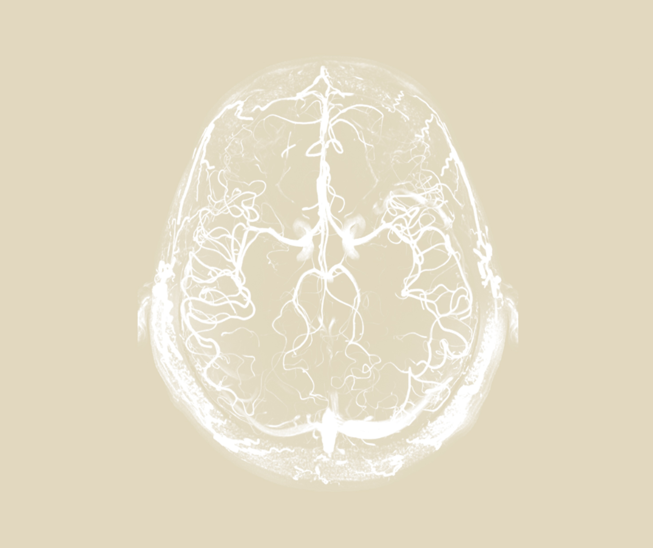

Neurobehavioural consequences of stroke
Epidemiology and global impact

