Slide 1


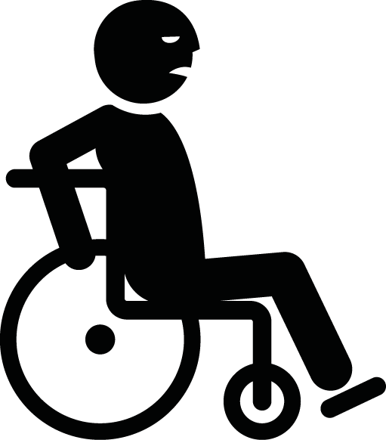
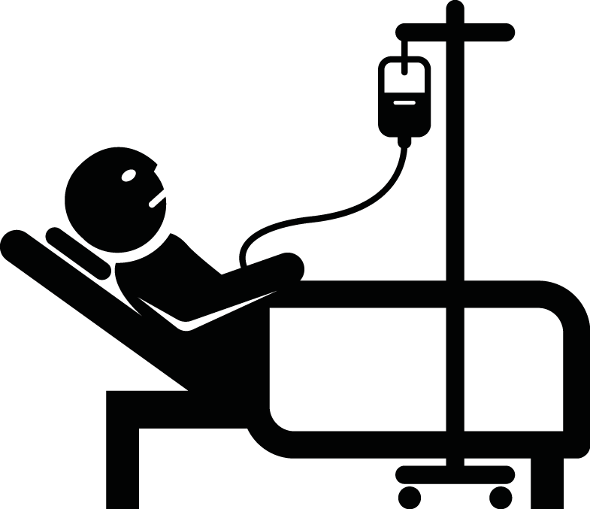

Disability weights associated with stroke
Neurobehavioural consequences of stroke – Epidemiology and global impact
The continuum of disability weights
Stroke with moderate long-term consequences and cognitive impairment:
0.316
Stroke with mild
long-term consequences:
0.019
Stroke with severe long-term consequences and cognitive impairment:
0.588
Perfect health: 0.000
Moderate low back pain:
0.054
Crohn’s disease:
0.231
After a
heart attack:
0.432
Severe
dementia:
0.449
Severe anxiety disorder:
0.523
Spinal cord
lesion:
0.589
Acute schizophrenia: 0.778
Patients with stroke can experience a high level of disability – similar to that experienced by patients with severe dementia, and patients following heart attack
Adapted from: Salomon et al. Lancet Glob Health 2015;3(11):e712–e723
Notes:
Health utility scores, examples of which are shown on the slide, can be generated using many different methods, including:²
The standard gamble: individuals are presented with a choice between a certain health state (e.g., the current state), or a gamble with one better (e.g., perfect health) and one worse (e.g., death). The odds are adjusted until the individual takes the gamble, e.g., a 10% chance of dying against a 90% chance of being cured back to perfect health.
Time trade-off methods: individuals are asked how many years of perfect health they would trade for their life expectancy in their current health state – what proportion of their life they would sacrifice to be cured of a certain condition.
A visual-analogue rating scale: individuals are asked to mark along a scale where a certain health state lies, e.g., between 100 for ‘the best health imaginable’, and 0 for ‘the worst health you can imagine’.
References:
Salomon JA, Haagsma JA, Davis A, et al. Disability weight for the Global Burden of Disease 2013 study. Lancet Glob Health 2015; 3 (11): e712–e723.
Phillips. Health Economics: An Introduction for Health Professionals. Blackwell, 2005.

