Slide 1
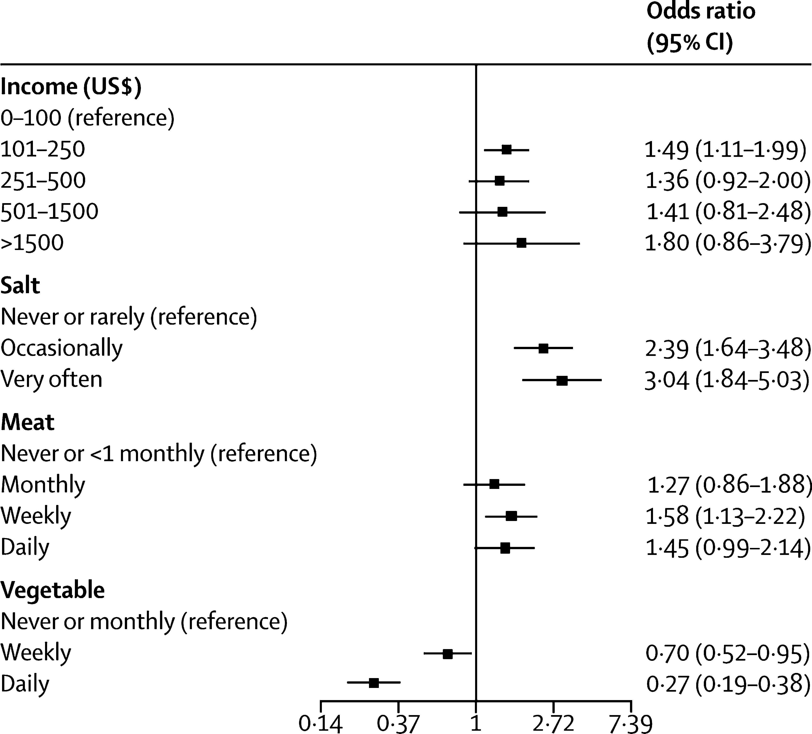
Stroke prevention in Africa
Neurobehavioural consequences of stroke – Overview of stroke
Dose–response relationships between risk factors
and incidence of stroke in Africa²
The increasing burden of stroke in Africa has led to a call for better strategies for prevention of stroke^{1,2}
As well as improving patients’ quality of life, prevention of stroke would reduce the financial cost of stroke in Africa¹
The SIREN study identified several stroke risk factors among an African population, including hypertension, dyslipidaemia, and various lifestyle factors²
Frequent vegetable consumptionª appears to be inversely proportional to the risk of hypertension in African people, and also shows a dose response protective effect against stroke^{2,3}
Efforts are underway to improve stroke risk factors in Africa, e.g., the ACHIEVE programme to address hypertension^{4,5}
This work is from Owolabi et al. Lancet Glob Health 2018, licensed under CC BY-NC-ND. Published by Elsevier Ltd. The work cannot be changed in any way or used commercially without permission from the journal. www.thelancet.com/journals/langlo/article/PIIS2214-109X(18)30002-0/fulltext
ª≥12 servings of vegetables per week
ACHIEVE=African Control of Hypertension through Innovative Epidemiology and a Vibrant Ecosystem;
CI=confidence interval; OR=odds ratio; SIREN=Stroke Investigative Research and Educational Network
1. Kalkonde et al. Stroke 2018;49(12):3092–3097; 2. Owolabi et al. Lancet Glob Health 2018;6(4):e436–e446; 3. Akpa et al. Eur J Prev Cardiol 2022;29(18):2359–2371;
4. Owolabi et al. J Hum Hypertens 2023; doi: 10.1038/s41371-023-00828-8; 5. Olowoyo et al. Lancet Glob Health 2024;12(2):e192–e193
Notes:
The Stroke Investigative Research and Educational Network (SIREN) study was a large multi-centre study over 15 sites in Nigeria and Ghana.² The study shown on the slide was part of the SIREN study, using data from 2,118 case–control pairs to test for associations between various risk factors and incidence of stroke.² Several risk factors were associated with stroke, both haemorrhagic and ischaemic stroke.² Interventions to address these risk factors are needed across Africa, to help prevent the incidence of stroke and reduce the burden on patients and healthcare systems.^{1,2}
References:
Kalkonde YV, Alladi S, Kaul S, Hachinski V. Stroke prevention strategies in the developing world. Stroke 2018; 49 (12): 3092–3097.
Owolabi MO, Sarfo F, Akinyemi R, et al.; SIREN Team; as part of H3Africa Consortium. Dominant modifiable risk factors for stroke in Ghana and Nigeria (SIREN): a case-control study. Lancet Glob Health 2018; 6 (4): e436–e446.
Akpa OM, Okekunle AP, Asowata OJ, et al. Frequent vegetable consumption is inversely associated with hypertension among indigenous Africans. Eur J Prev Cardiol 2022; 29 (18): 2359–2371.
Owolabi M, Olowoyo P, Mocumbi A, et al. African Control of Hypertension through Innovative Epidemiology and a Vibrant Ecosystem (ACHIEVE): novel strategies for accelerating hypertension control in Africa. J Hum Hypertens 2023; doi: 10.1038/s41371-023-00828-8.
Olowoyo P, Barango P, Moran A, et al.; ACHIEVE. Priorities to reduce the burden of hypertension in Africa through ACHIEVE. Lancet Glob Health 2024; 12 (2): e192–e193.

